Slide 1
Chapter 2 Lab: Installing Linux using VirtualBox
Sean Hughes-Durkin
ITMO/IT-O 456 Fall 2017
Information Technology & Management Programs
School of Applied Technology

Slide 2
Lab Objectives
Upon completion of this laboratory session students should be able to:
Install the current version of Fedora Desktop Linux
Use open-source virtualization software to run a virtual machine instance of Linux

Slide 3
Lab 2 Procedures
This lab may be performed on your own computer only if:
Your CPU supports VT-x
Have at least 8GB memory
At least 80GB free hard disk space
If you are unsure or do not meet these requirements, use the provided lab systems

Slide 4
Lab 2 Procedures
If using your own system, download the following:
VirtualBox
https://www.virtualbox.org/wiki/Downloads
Fedora 26
https://download.fedoraproject.org/pub/fedora/linux/releases/26/Workstation/x86_64/iso/Fedora-Workstation-Live-x86_64-26-1.5.iso

Slide 5
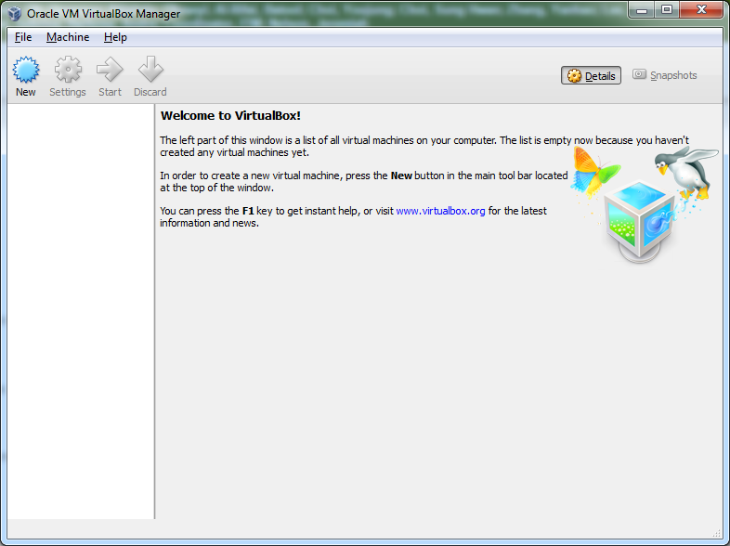
Lab 2 Procedures
Open Oracle VirtualBox
Click New

Slide 6
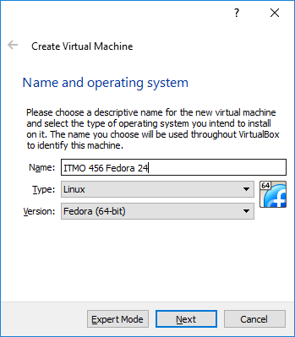
Lab 2 Procedures
Give the virtual machine a name
Select the type and version

Slide 7
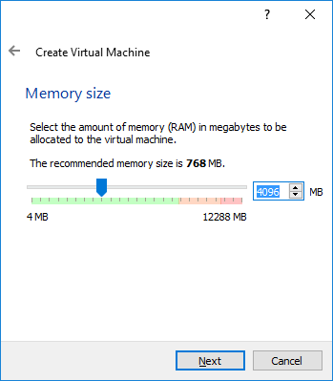
Lab 2 Procedures
Assign 4GB to the VM

Slide 8
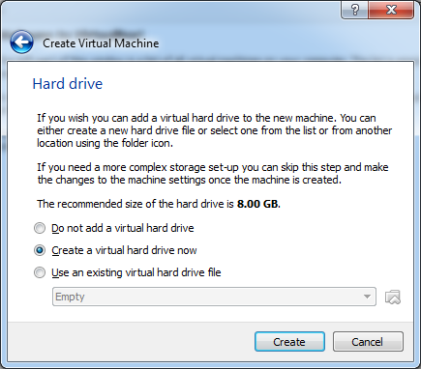
Lab 2 Procedures
Create the virtual hard drive

Slide 9
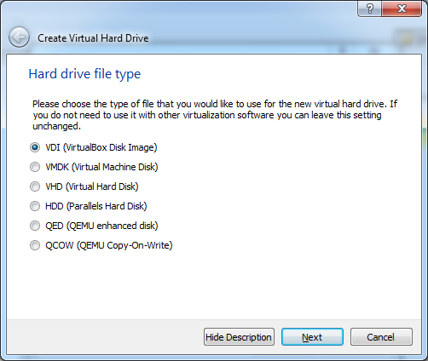
Lab 2 Procedures
Keep the default VDI

Slide 10
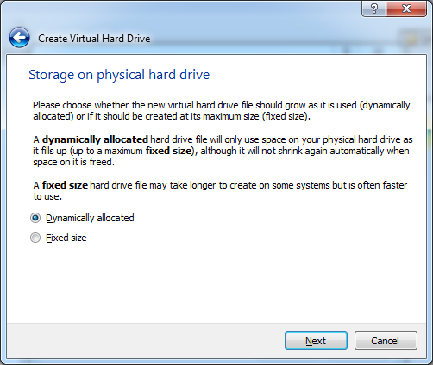
Lab 2 Procedures
Ensure dynamically allocated is selected

Slide 11
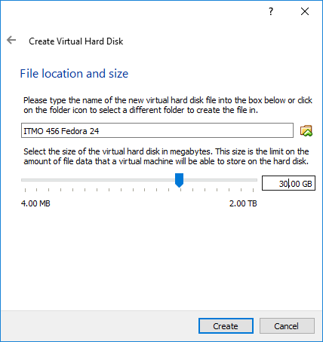
Lab 2 Procedures
Change from 8GB to 30GB for virtual drive

Slide 12
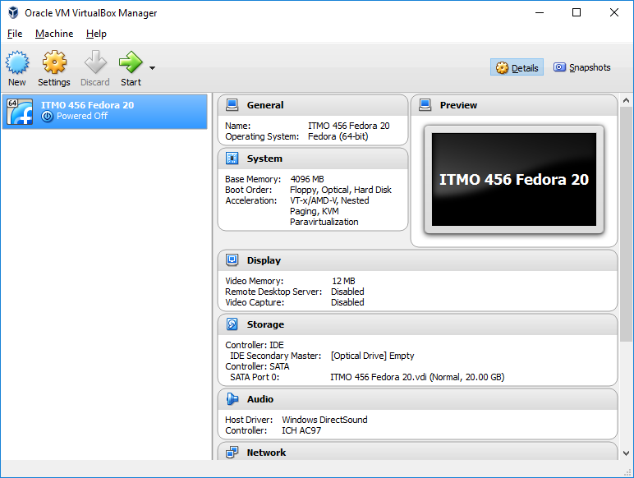
Lab 2 Procedures
Select settings

Slide 13
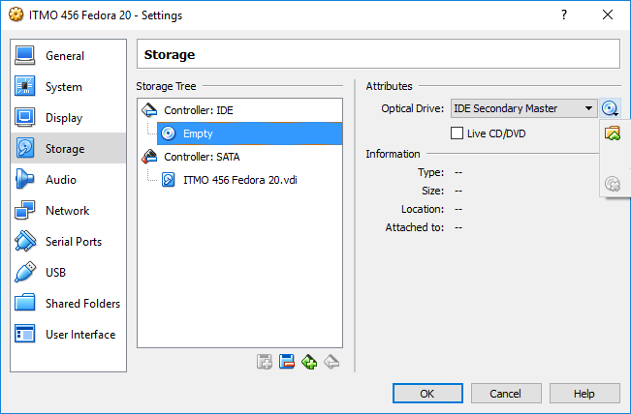

Lab 2 Procedures
Select storage and click on “empty” under Controller: IDE
Click the CD at the right and select “Chose Virtual Optical Disk File”
Remove ISO once Fedora is installed

Slide 14
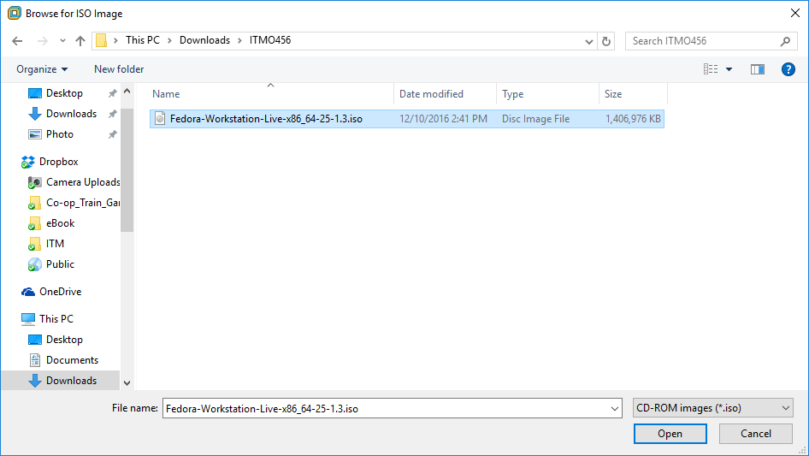
Lab 2 Procedures
Navigate to where you placed the Fedora 25 ISO

Slide 15
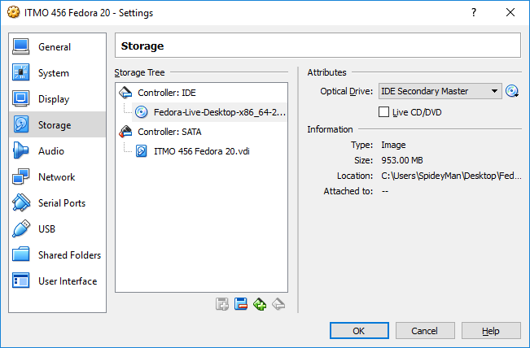
Lab 2 Procedures
ISO file mounted

Slide 16
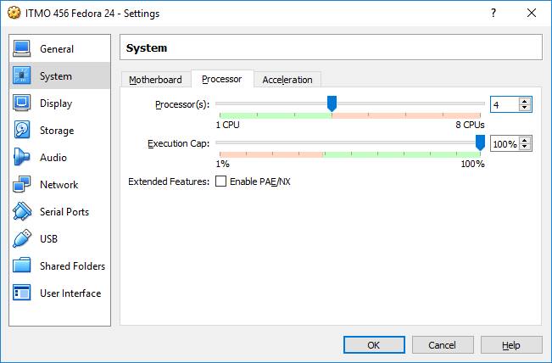
Lab 2 Procedures
Select System and select the processor tab and increase to 4 cores

Slide 17
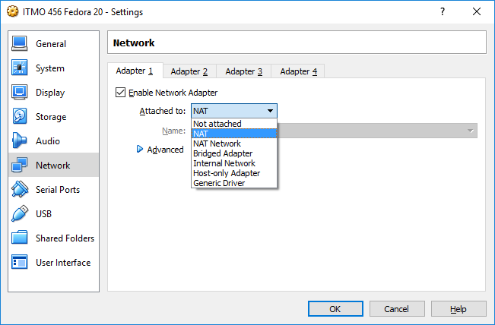
Lab 2 Procedures
How virtual networking works
Ensure NAT is selected

Slide 18
Lab 2 Procedures
The 2 types we are concerned with
NAT
Bridged
NAT
The easiest way to have your VM connect outbound
Uses VirtualBox networking engine
Virtual router
NAT mode does not allow inbound connections to the VM
Needed for later labs

Slide 19
Lab 2 Procedures
NAT Continued
VM will have different IP network than host OS
Not ideal for future labs
Bridged
Uses host NIC
VM will have same IP network as host OS
Allows inbound/outbound connections
Needed for later labs
You will want to use Bridged networking for your personal system or the lab systems
Personal systems will need to connect to the wired Ethernet for later labs

Slide 20
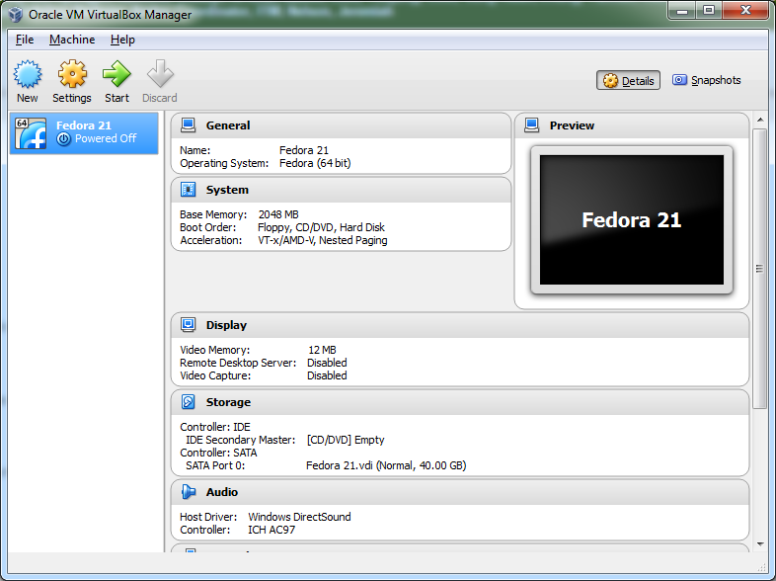
Lab 2 Procedures
To start the VM click start

Slide 21
Lab 2 Procedures
Continue on with the attached document file
For project 2-1, you can use the provided installation images in the lesson notes
Once Fedora 26 is installed, take a screenshot using the snipping tool in Windows or the built in “Take screenshot…” under View (see next slide)

Slide 22
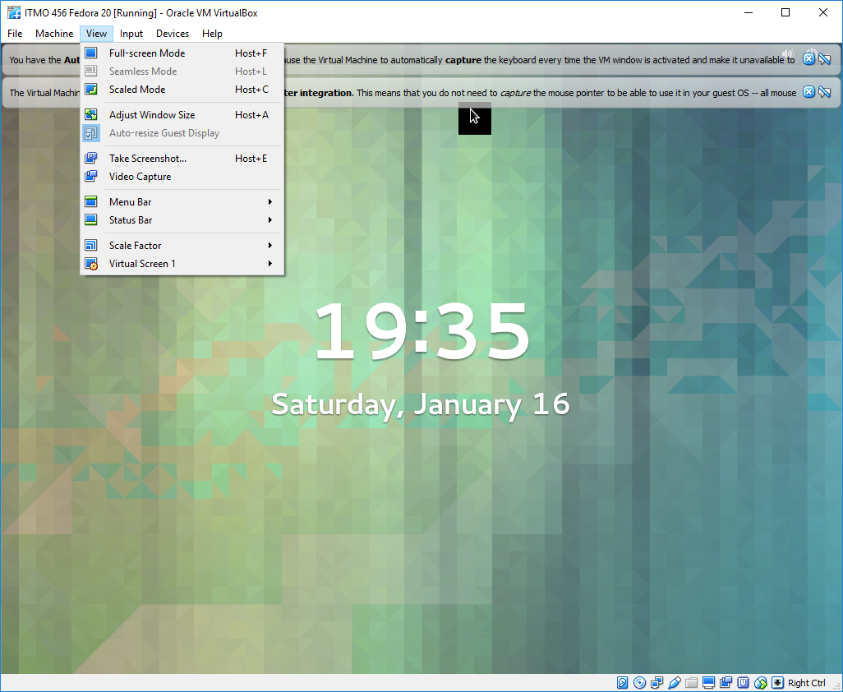
Lab 2 Procedures

Slide 23
Lab 2 Procedures
Screenshots are required for all labs
Try to get as many steps in each screenshot as possible
If you can fit the whole project in one screenshot, great. Some labs will need multiple screenshots.
Screenshots show me how you are progressing and if you are following Linux best practices
You can paste them in the provided document

Slide 24
Utilizing VM Snapshots
Snapshots are one of the reasons why we utilize virtualization software
Snapshots allow us to save a particular state of a virtual machine for later use
Good if you make a critical mistake and your system will not boot properly
You can restore snapshots
Requires “good” running state during snapshot creation
Use snapshots! (screenshots≠snapshots)

Slide 25
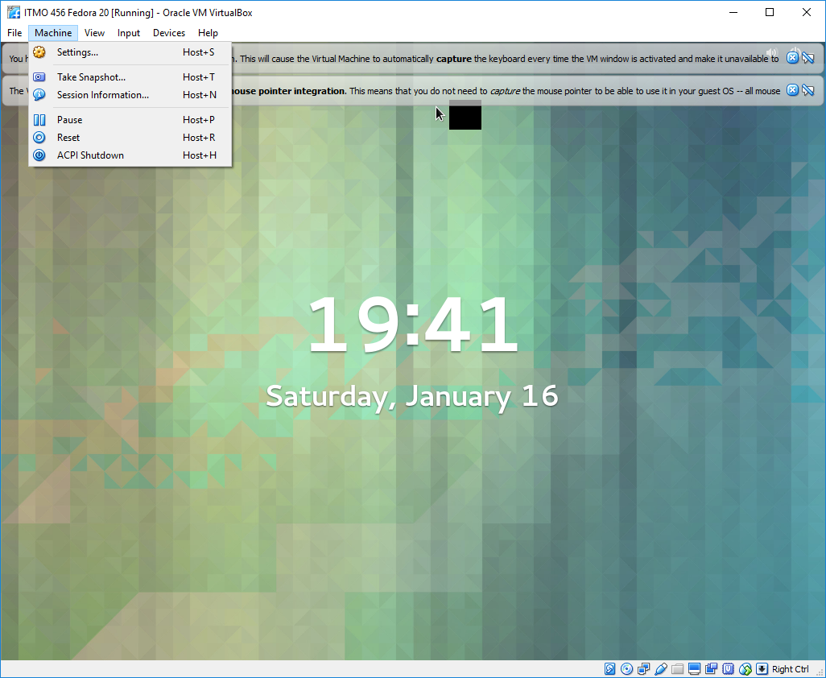
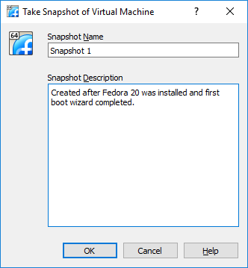
Utilizing Snapshots

Slide 26
Utilizing Snapshots
Show how to restore

Slide 27
The End…
Questions?

