Slide 1
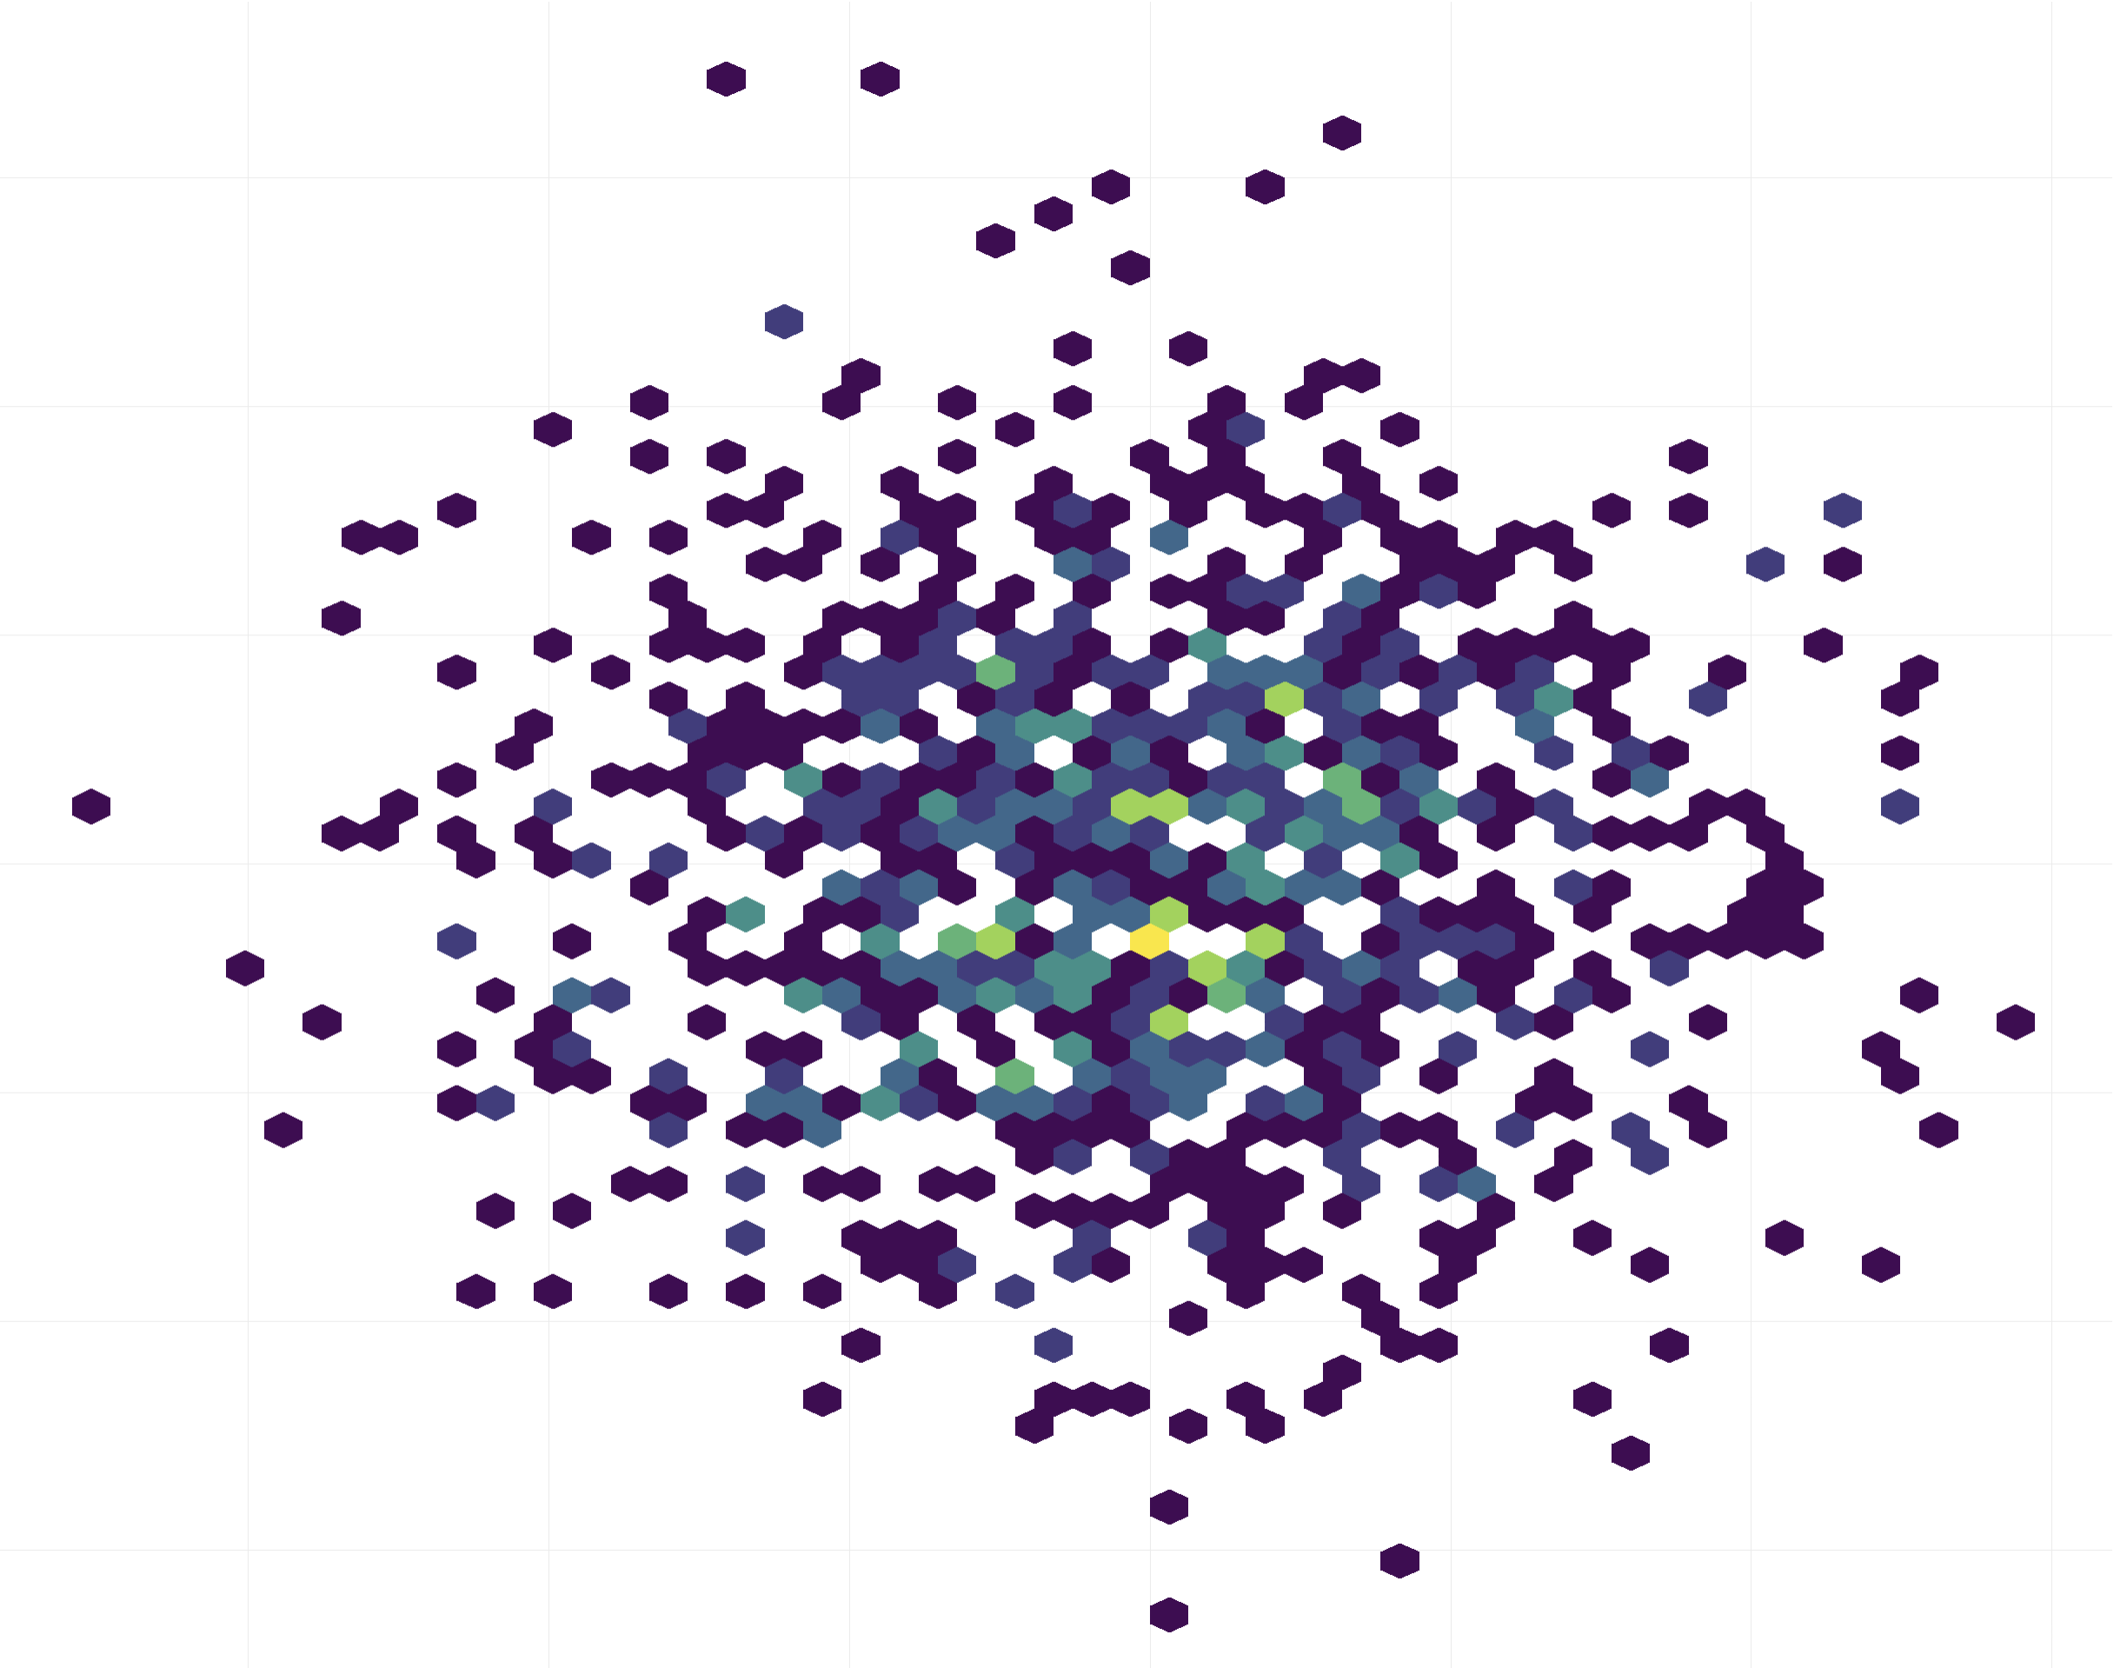
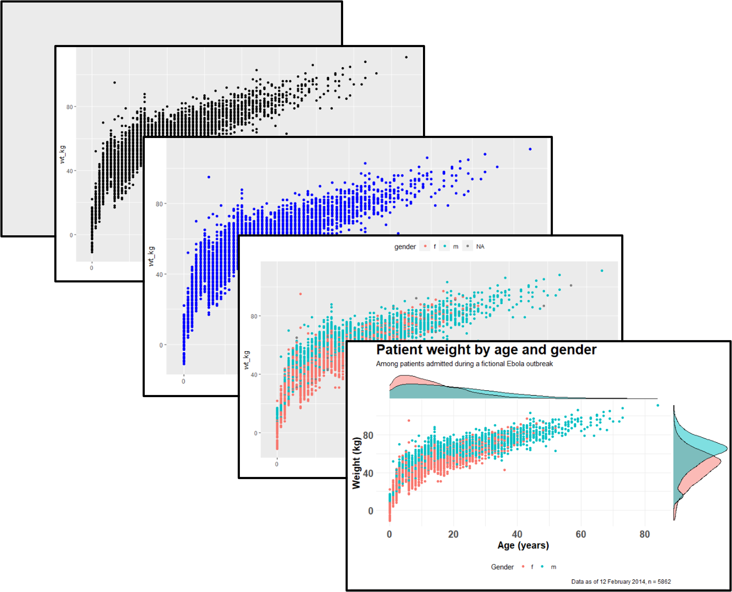

Plotting anything with ggplot2
Carlos Pulido & Gian Marco Franceschini (DBC)
20/03/2025

Slide 2
Introduction
Part of this workshop has been adapted from (Thomas Lin Pedersen) GitHub repository: https://github.com/thomasp85/ggplot2_workshop Link to youtube video: https://www.youtube.com/watch?v=h29g21z0a68 Plenty of examples here: http://www.sthda.com/english/wiki/be-awesome-in-ggplot2-a-practical-guide-to-be-highly-effective-r-software-and-data-visualization
It's dangerous to go alone! Take this (cheat sheet): https://rstudio.github.io/cheatsheets/data-visualization.pdf
The Grammar of Graphics
The ggplot2 API

Slide 3
Introduction
Libraries needed for this workshop:
library(ggplot2)
library(dplyr)
library(grid)
library(gridExtra)
library(tidyr)
library(reshape2)
library(patchwork)
Optional (for some examples):
library(ggrepel) library(ggraph) library(gt)
library(maps) library(igraph)
library(GGally) library(tidygraph)
library(treeio) library(chorddiag)
library(ggtree) library(RColorBrewer)
library(fmbs) library(wordcloud2)

Slide 4
The grammar of the graphics
Grammar of graphics

Slide 5
The grammar of the graphics
Bar chart
Pie chart
…
Line chart

Slide 6
The grammar of the graphics
Graphic
Pie chart
Line chart
Bar chart
…

Slide 7
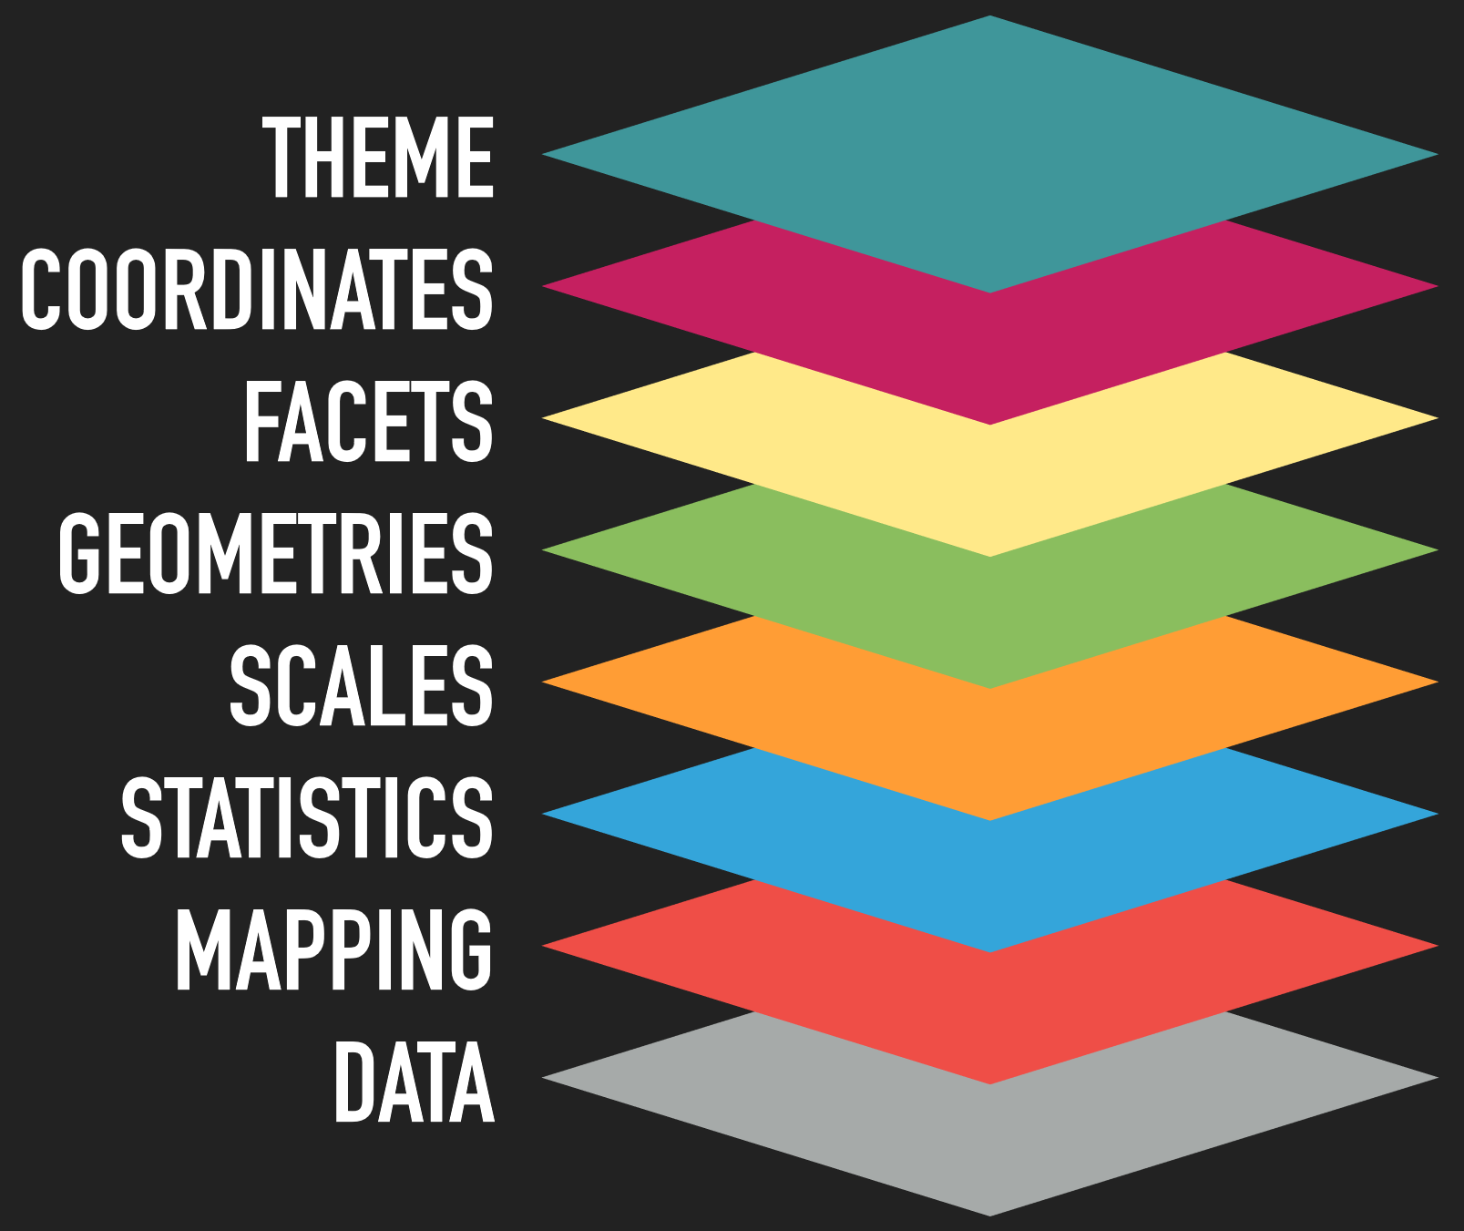
The grammar of the graphics
Grammar of Graphic

Slide 8
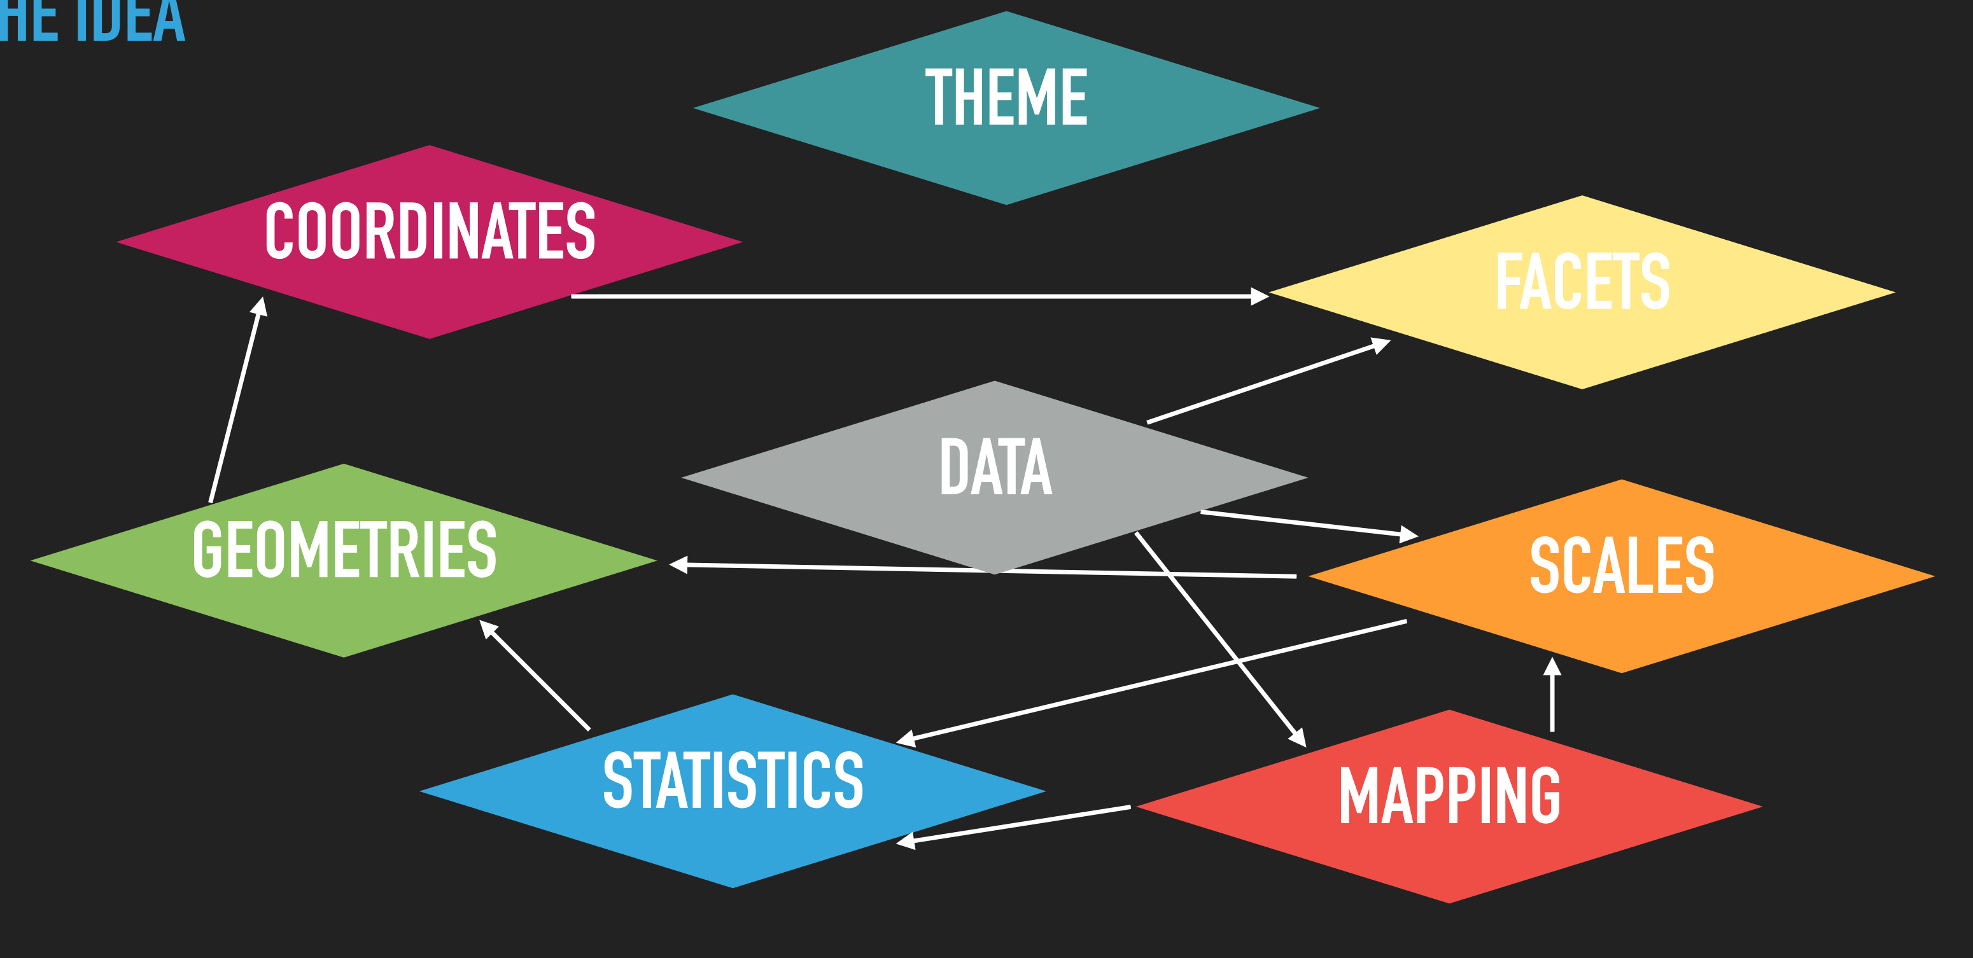
The grammar of the graphics
What ggplot2 understand:

Slide 9
The grammar of the graphics
What ggplot2 understand:
▸ Data is not just data
▸ Representation defines what can be done with it
▸ Grammar requires a tidy format (though it precedes the notion)

Slide 10
The grammar of the graphics
What ggplot2 understand:
▸ Allow generic datasets to be understood by the graphic system.
▸ Aesthetic mapping: Link variables in data to graphical properties in the geometry.
▸ Facet mapping: Link variables in the data to panels in the facet layout.

Slide 11
The grammar of the graphics
What ggplot2 understand:
▸ Even though data is tidy it may not represent the displayed values
▸ Transform input variables to displayed values:
• Count number of observations in each category for a bar chart
• Calculate summary statistics for a boxplot.
‣ Is implicit in many plot-types but can often be done prior to plotting

Slide 12
The grammar of the graphics
What ggplot2 understand:
▸ Most data does not directly represent graphical properties.
▸ A scale translate back and forth between variable ranges and property ranges
• Categories → Colour
• Numbers → Position
• …
▸ Imply a specific interpretation of values: discrete, continuous, etc.

Slide 13
The grammar of the graphics
What ggplot2 understand:
▸ How to interpret aesthetics as graphical representations
▸ Is a progression of positional aesthetics, a number of points, a line, a single polygon, or something else entirely different?
▸ To a high degree the determinator of your plot type

Slide 14
The grammar of the graphics
What ggplot2 understand:
▸ Define the number of panels with equal logic and split data among them…
▸ Small multiples
• Allows you to look at small subsets of your data in separate plots
▸ Panel layout may carry meaning

Slide 15
The grammar of the graphics
What ggplot2 understand:
▸ Positional aesthetics are special.
1. Variables are mapped, scaled, applied to a geometry
2. But in the end, the position values are interpreted by a coordinate system
‣ Defines the physical mapping of the aesthetics to the paper
‣ Vaguely similar to colour profile mapping for colour aesthetics (though you don’t have control over it)

Slide 16
The grammar of the graphics
What ggplot2 understand:
▸ None of the priors talked about the visual look of the plot.
▸ Theming spans every part of the graphic that is not linked to data

Slide 17
The grammar of the graphics
Tidying the data:
* We will use Iris dataset as showcase example
More on how to use tidy library here:
https://cran.r-project.org/web/packages/tidyr/vignettes/tidy-data.html
A dataset can be written in two different formats: wide and long. A wide format has values that do not repeat in the first column. A long format has values that do repeat in the first column.

Slide 18
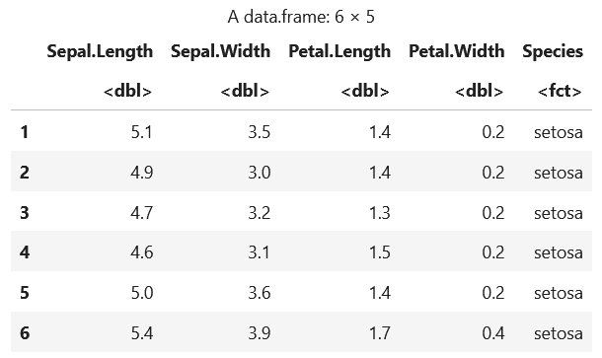
The grammar of the graphics
Tidying the data:
* We will use Iris dataset as showcase example
> head(iris)
150 entries for 3 different species (50 each).
Each entry contains measures for:
Sepal length
Sepal width
Petal length
Petal width

Slide 19
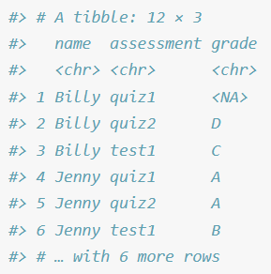
The grammar of the graphics
Tidying the data:
‘A dataset is a collection of values, usually either numbers (if quantitative) or strings (if qualitative). Values are organised in two ways. Every value belongs to a variable and an observation. A variable contains all values that measure the same underlying attribute (like height, temperature, duration) across units. An observation contains all values measured on the same unit (like a person, or a day, or a race) across attributes.’
Variable
This makes the values, variables, and observations more clear. The dataset contains 36 values representing three variables and 12 observations. The variables are:
name, with four possible values (Billy, Suzy, Lionel, and Jenny).
assessment, with three possible values (quiz1, quiz2, and test1).
grade, with five or six values depending on how you think of the missing value (A, B, C, D, F, NA).
Observation
Value

Slide 20
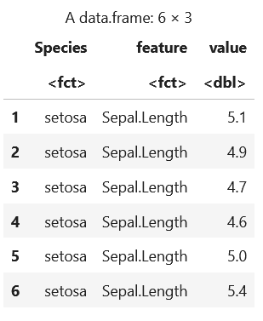
The grammar of the graphics
Tidying the data:
To transform from wide to long we have several options:
> library(tidyr)
> longIris <- gather(iris, feature, value, Sepal.Length:Petal.Width, factor_key=TRUE)
> head(longIris)
# The arguments to gather():
# - data: Data object
# - key: Name of new key column (made from names of data columns)
# - value: Name of new value column
# - ...: Names of source columns that contain values
# - factor_key: Treat the new key column as a factor (instead of character vector)
# To transform from long to wide you can use spread()

Slide 21
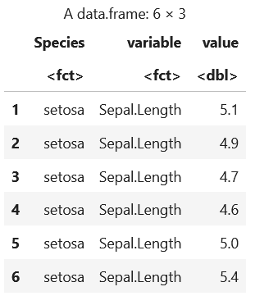
The grammar of the graphics
Tidying the data:
To transform from wide to long we have several options:
> library(reshape2)
> longIris <- melt(iris, id.vars=c("Species"), measure.vars=c("Sepal.Length", "Sepal.Width", "Petal.Length", "Petal.Width"), value.name="value")
> head(longIris)
# The arguments to gather():
# - id.vars: all the variables to keep but not split apart on
# - measures.vars: the source columns
# - value.name: name of the destination column that will identify the original column
that the measurement came from variable.name="variable"

Slide 22
The grammar of the graphics
But I just want to make a bar chart…
You

Slide 23
Mapping data
Mapping the data:
Allow generic datasets to be understood by the graphic system
> Aesthetic mapping: Link variables in data to graphical properties in the geometry.
> Facet mapping: Link variables in the data to panels in the facet layout

Slide 24
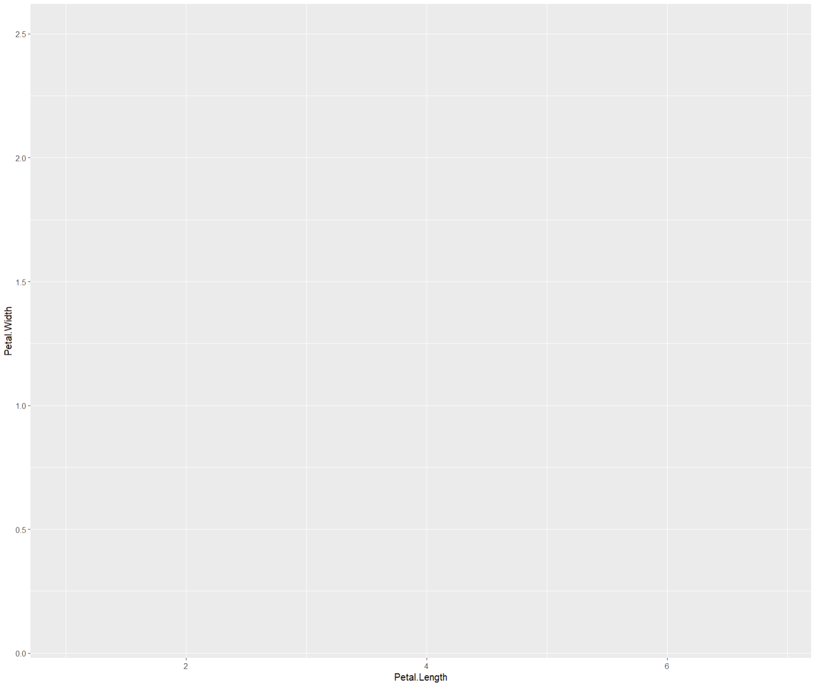
Mapping data: Aesthetic mapping
> library(ggplot2)
> ggplot(data = iris,
mapping = aes(x = Petal.Length,
y = Petal.Width))
# data: which dataset to plot
# mapping: which columns from data to use in:
* x: axis x in the plot
* y: axis y in the plot

Slide 25
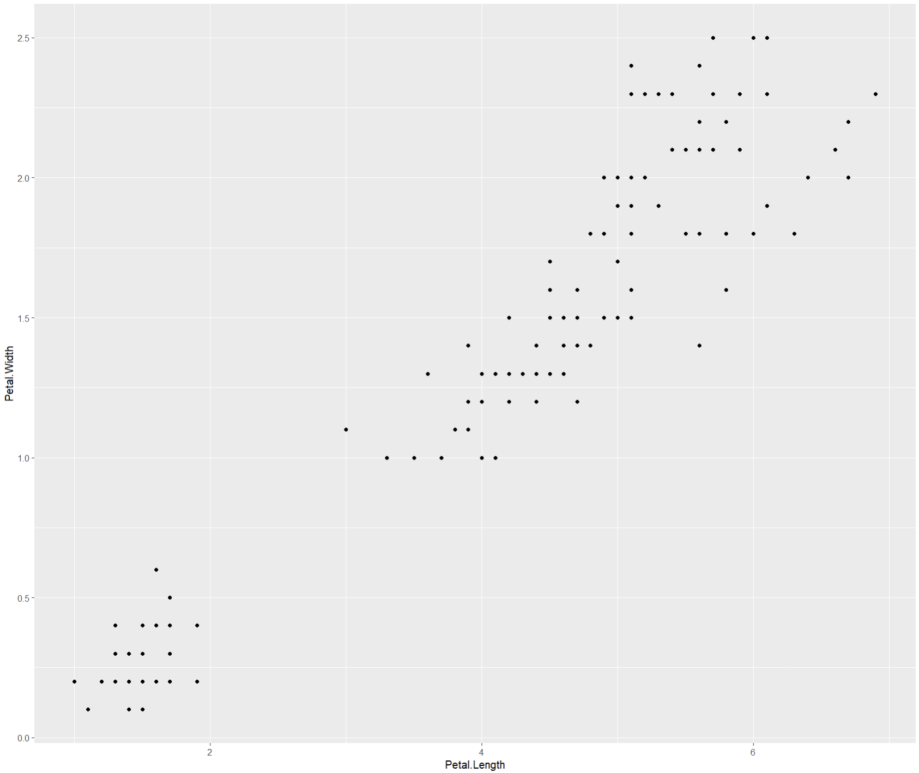
Mapping data: Aesthetic mapping
> ggplot(data = iris, mapping = aes(x = Petal.Length, y = Petal.Width)) +
geom_point()
# geom will tell ggplot how tro drow the data

Slide 26
Mapping data: Aesthetic mapping
> ggplot() +
geom_point(data = iris, mapping = aes(x = Petal.Length, y = Petal.Width))
# data can be mapped in each geom

Slide 27
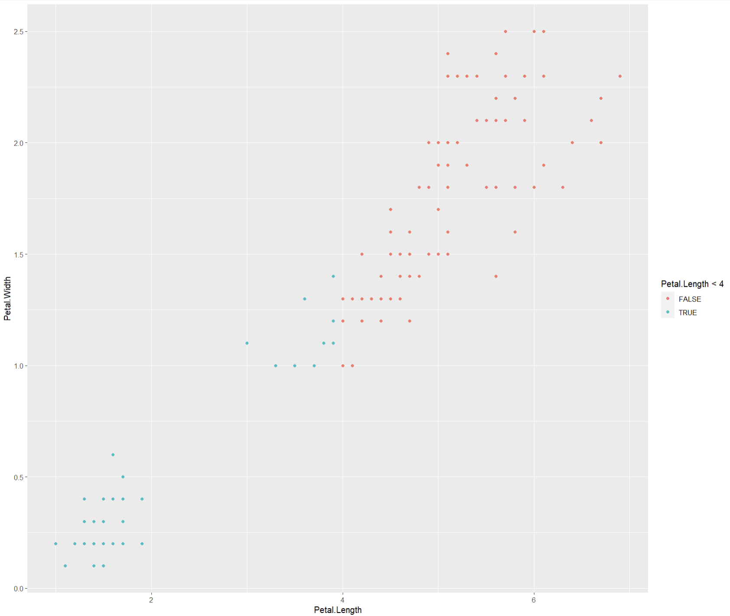
Mapping data: Aesthetic mapping
> ggplot() +
geom_point(data = iris, mapping = aes(x = Petal.Length, y = Petal.Width, color = Petal.Length < 4))
# data can be mapped to different aesthetics:
- color: map the data to a color
- size: …
- shape: …

Slide 28
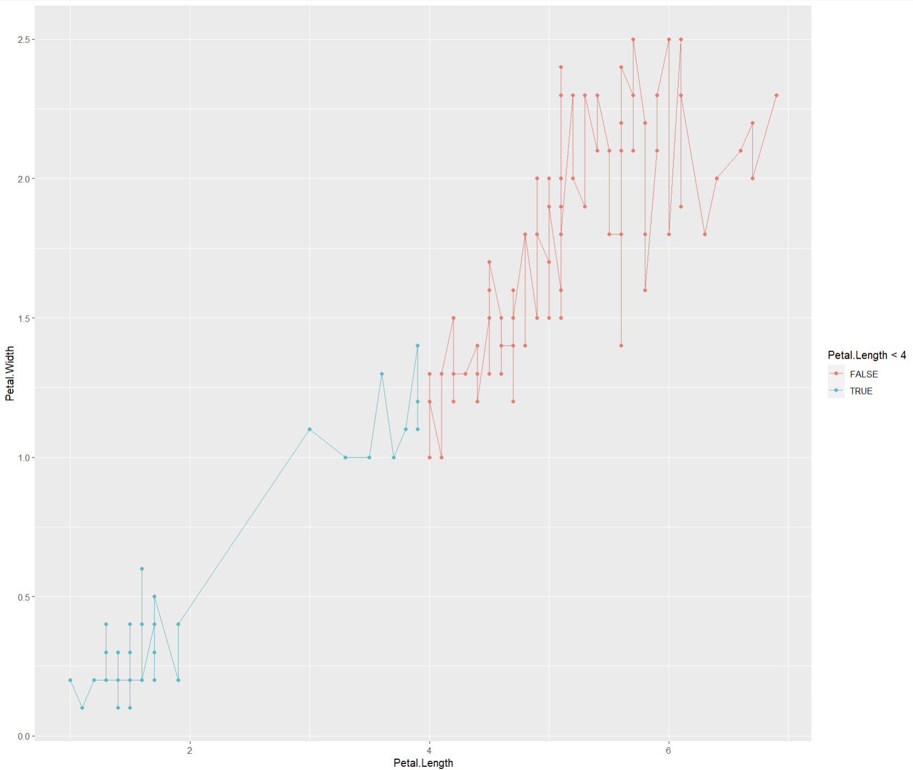
Mapping data: Aesthetic mapping
> ggplot(data = iris, mapping = aes(x = Petal.Length, y = Petal.Width, color = Petal.Length < 4)) +
geom_point() +
geom_line()
# multiple geoms can be plotted together
# mapping in ggplot function will be shared between geoms unless specified otherwise

Slide 29
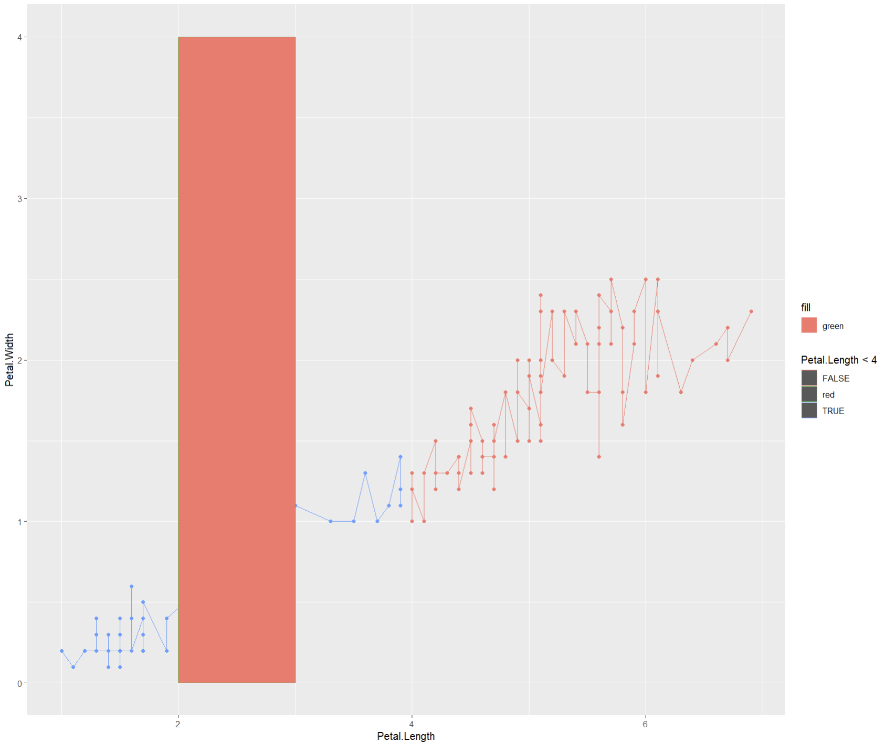
Mapping data: Aesthetic mapping
> ggplot(data = iris, mapping = aes(x = Petal.Length, y = Petal.Width, color = Petal.Length < 4)) +
geom_point() + geom_line() +
geom_rect(mapping = aes(xmin=2, xmax=3, ymin=0, ymax=4, color="red", fill="green"))
# Each geom corresponds to one layer
# Layers are plotted in order. Last layer on the code goes on top of the plot
# Notice that the mapped “fill” does not correspond with the fill in the plot

Slide 30
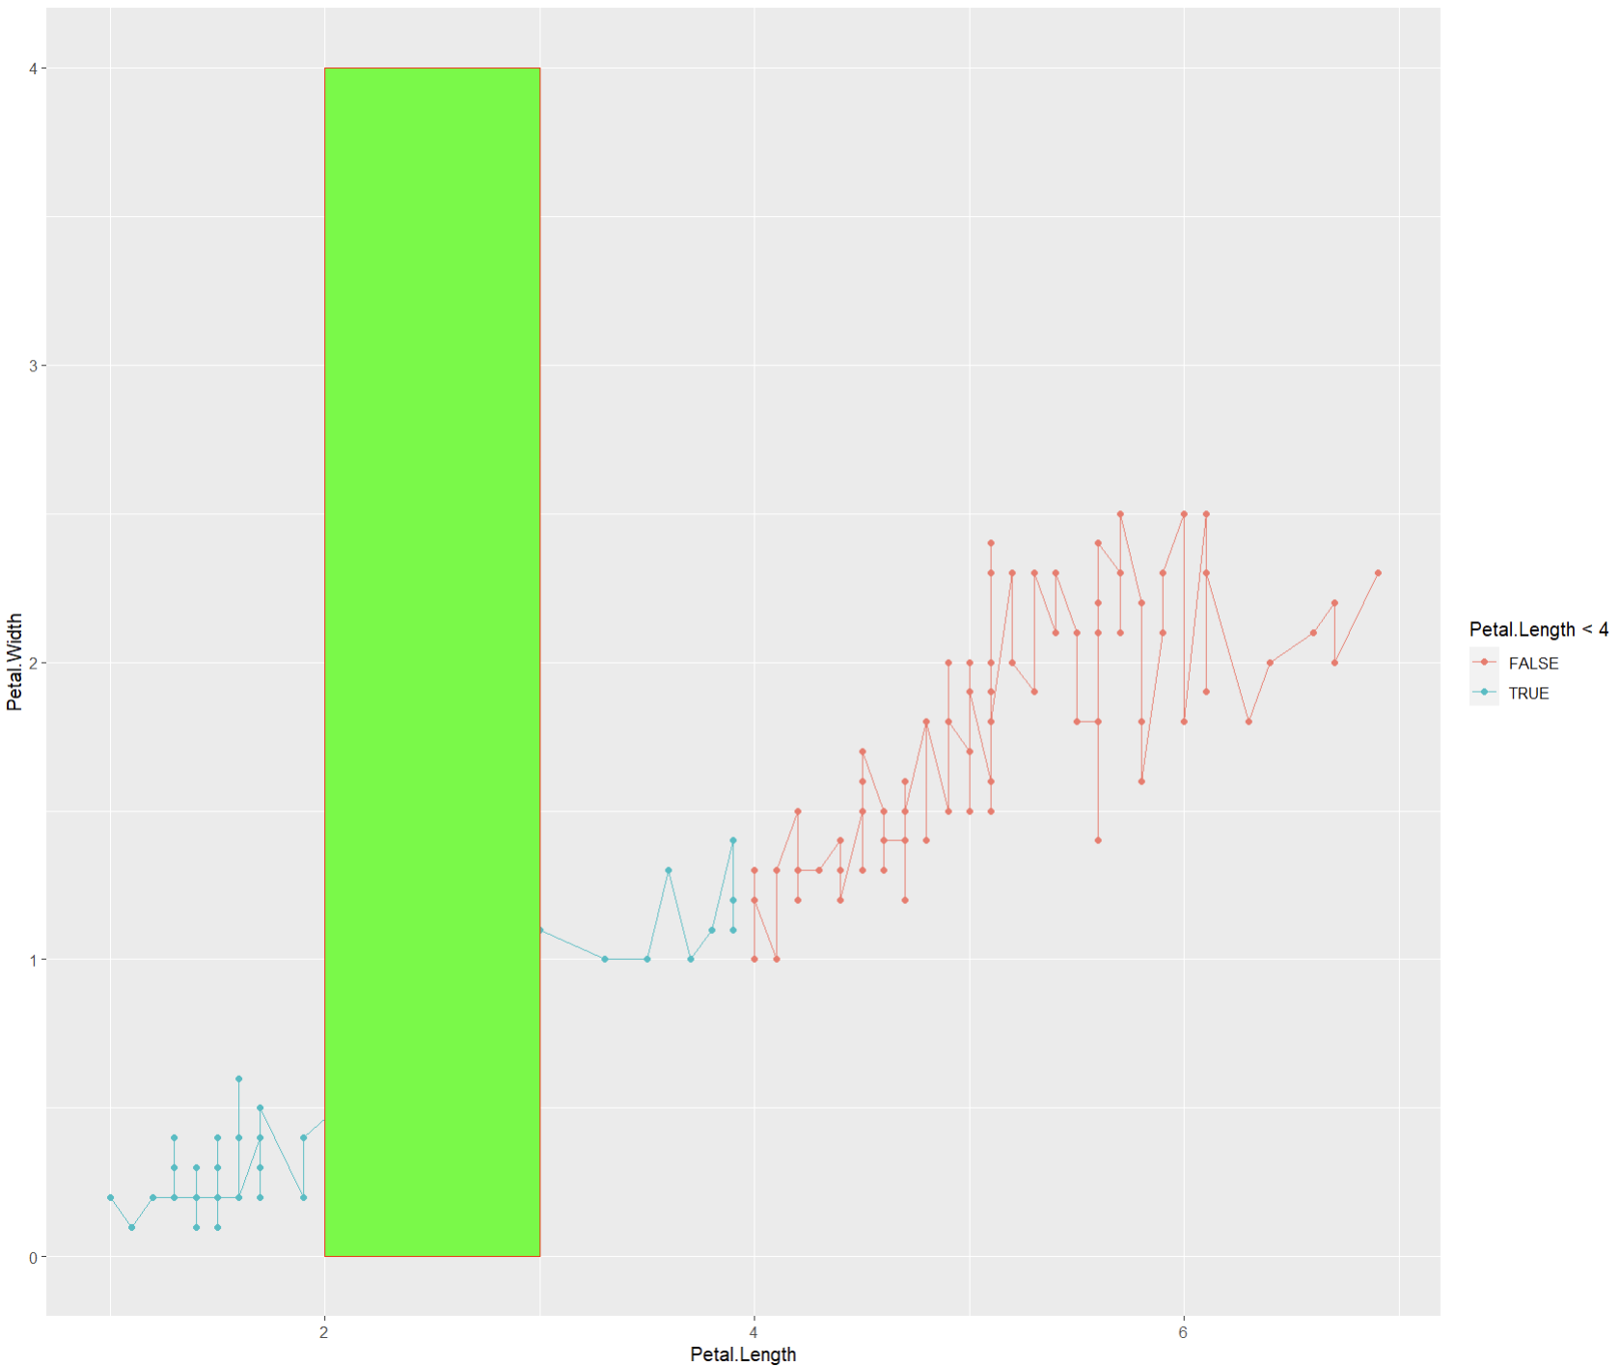
Mapping data: Aesthetic mapping
> ggplot(data = iris, mapping = aes(x = Petal.Length, y = Petal.Width, color = Petal.Length < 4)) +
geom_point() + geom_line() +
geom_rect(mapping = aes(xmin=2, xmax=3, ymin=0, ymax=4), color="red", fill="green")
# Difference between mapping and setting

Slide 31
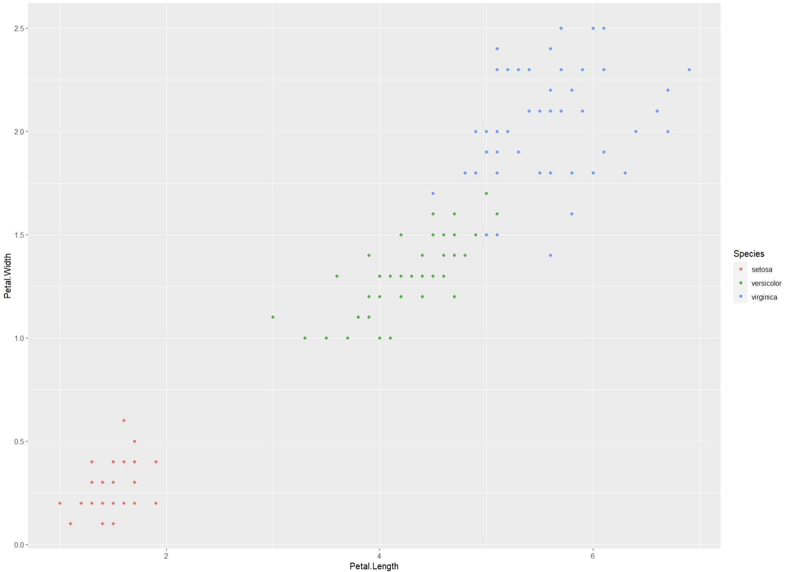
Mapping data: Aesthetic mapping
> ggplot(iris, aes(Petal.Length, Petal.Width, color=Species)) + geom_point()
# If not specify otherwise, default colors will be assigned each category (Species) in order

Slide 32
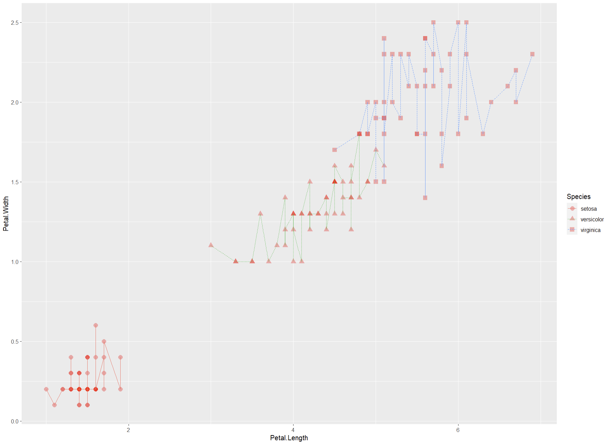
Mapping data: Aesthetic mapping
> ggplot(iris, aes(Petal.Length, Petal.Width, color=Species)) +
geom_point(aes(shape = Species), size = 3, alpha=0.3, color="red") +
geom_line(aes(linetype = Species), linewidth=0.5)
# New aesthetics can be maped/specified in the desired layer only

Slide 33
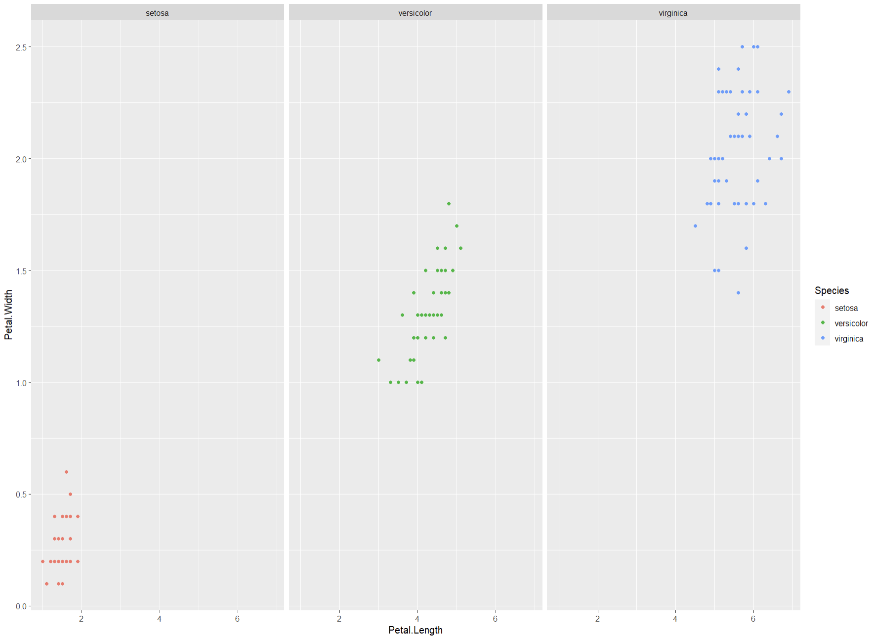
Mapping data: Facet mapping
> ggplot(iris, aes(Petal.Length, Petal.Width, color=Species)) +
geom_point() +
facet_wrap(~ Species)
# New aesthetics can be maped/specified in the desired layer only

Slide 34
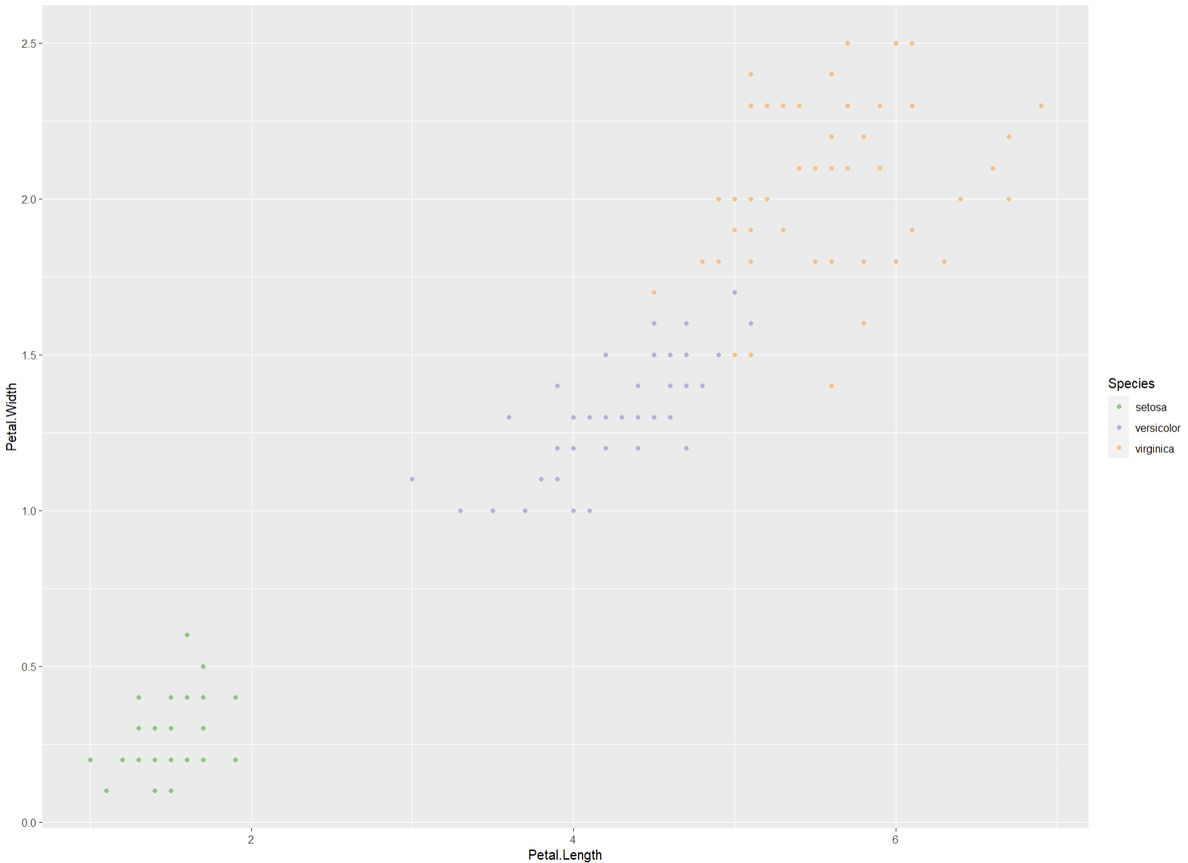
Scales
> ggplot(iris, aes(Petal.Length, Petal.Width, color=Species)) +
geom_point() +
scale_color_brewer(type="qual")
# based on the vector type of class, a discrete colour scale is picked
# scale can be applied to several aesthetics:
scale_color…
scale_fill…
scale_x…
# multiple scales to manipulate same aesthetics:
scale_color_brewer
scale_color_gradient
scale_color_manual

Slide 35
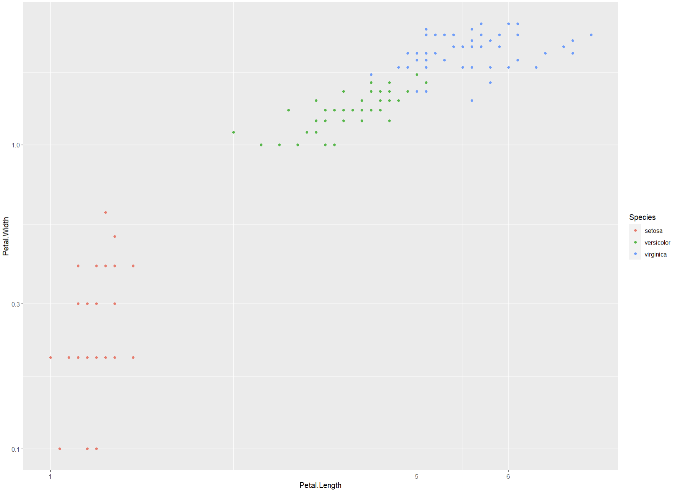
Scales
> ggplot(iris, aes(Petal.Length, Petal.Width, color=Species)) +
geom_point() +
scale_x_continuous(breaks = c(1,5,6)) +
scale_y_continuous(trans = 'log10')
# x and y are also controlled with scales

Slide 36
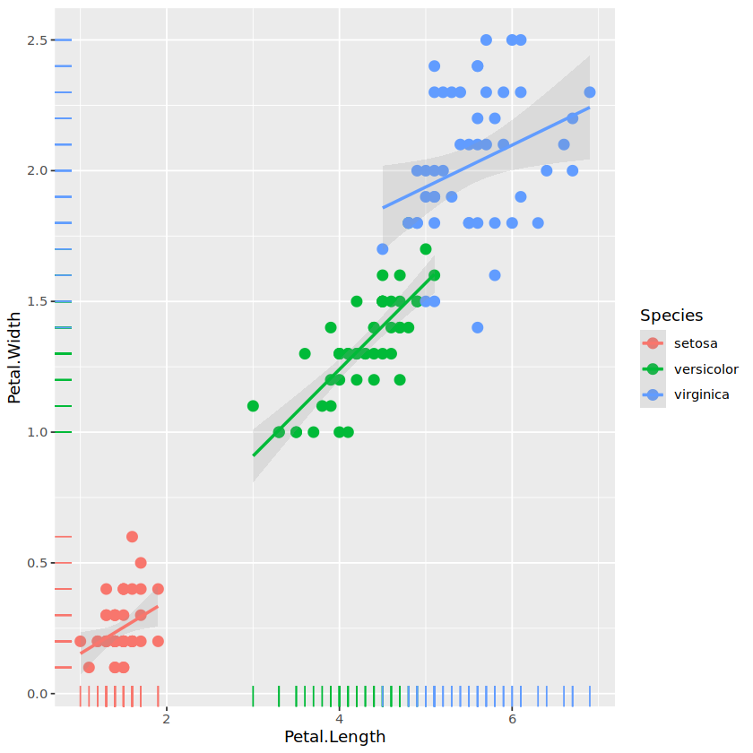
Geometries
> ggplot(iris, aes(Petal.Length, Petal.Width, color=Species)) +
geom_point(size=3) +
geom_smooth(method = "lm", formula = y ~ x, alpha=.2) + geom_rug()
# regression line geometry, also mapped to Species

Slide 37
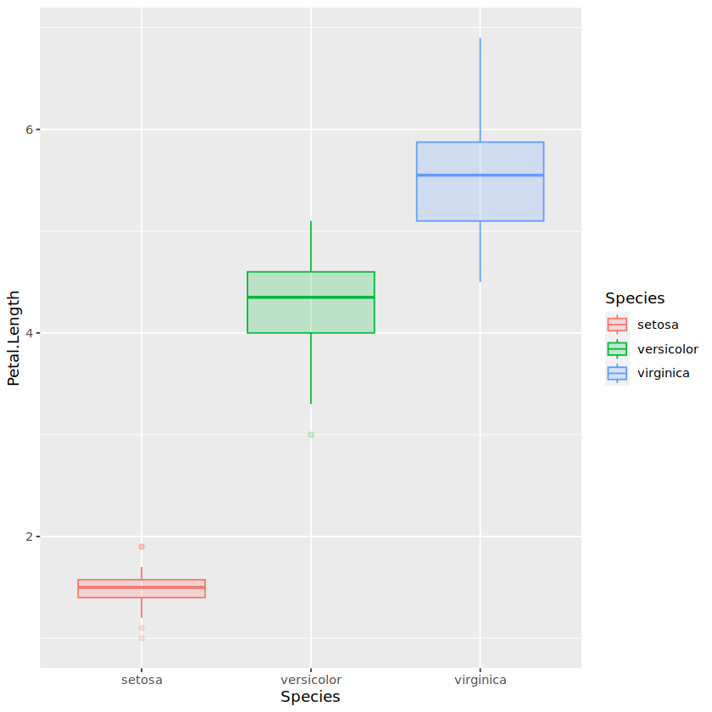
Geometries
> ggplot(iris, aes(Species, Petal.Length, color=Species, fill=Species)) +
geom_boxplot(alpha=.2)

Slide 38
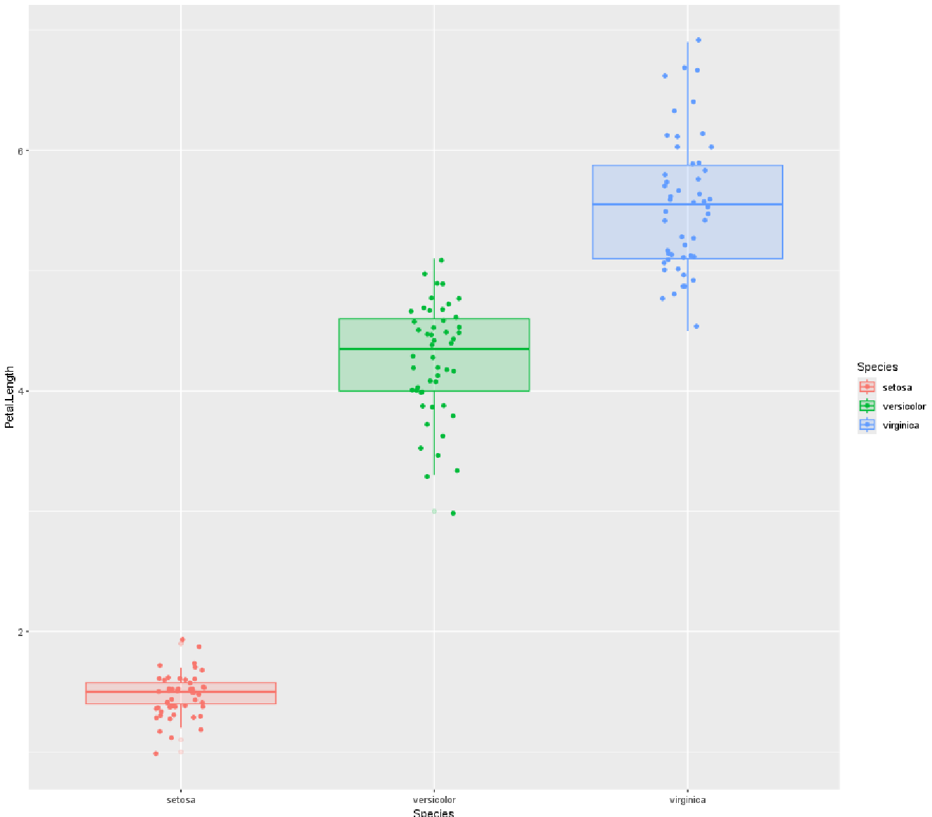
Geometries
> ggplot(iris, aes(Species, Petal.Length, color=Species, fill=Species)) +
geom_boxplot(alpha=.2) + geom_jitter(width=.1)

Slide 39
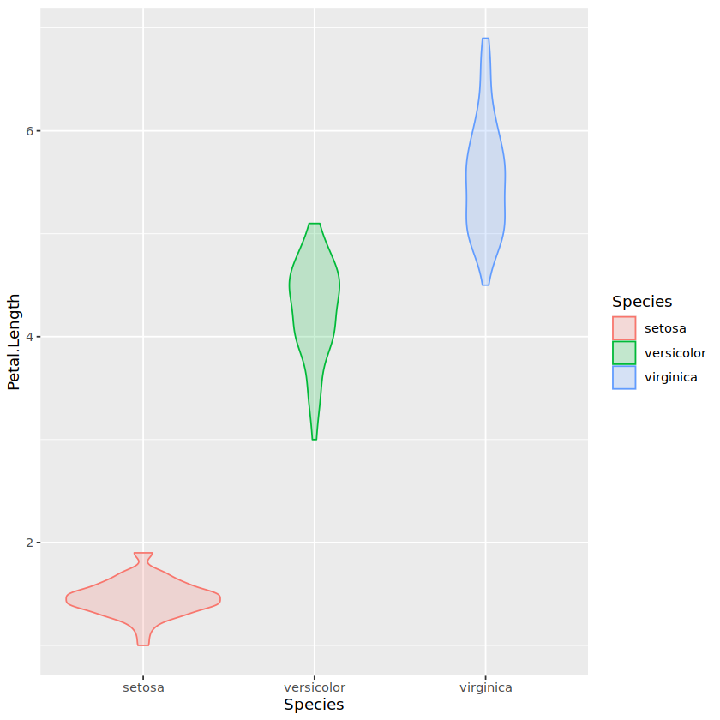
Geometries
> ggplot(iris, aes(Species, Petal.Length, color=Species, fill=Species)) +
geom_violin(alpha=.2)

Slide 40
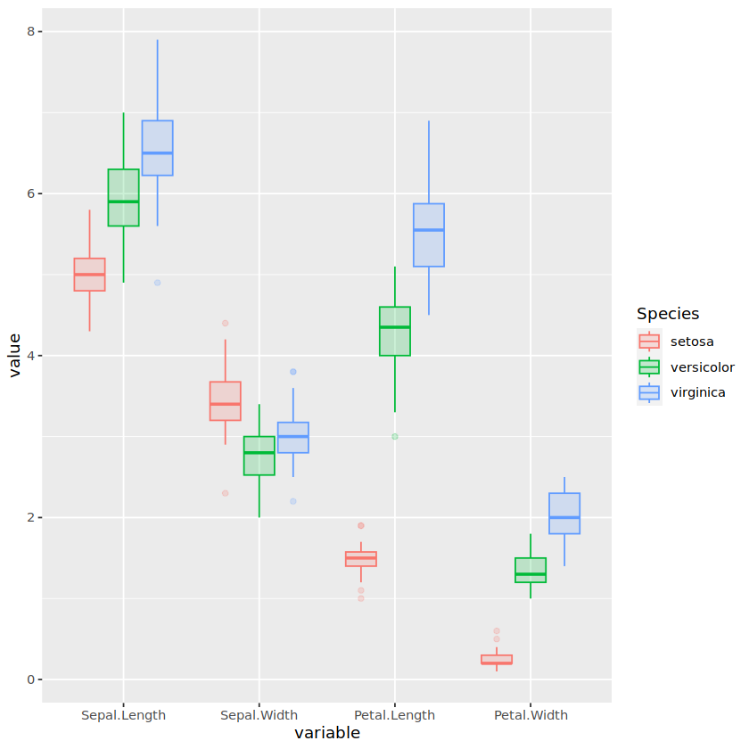
Geometries
> meltedIris <- melt(iris, id.vars=c("Species"))
> ggplot(meltedIris, aes(x=variable, y=value, color=Species, fill=Species)) +
geom_boxplot(alpha=.2)
# To map different categories into aesthetics we need to tidy the data

Slide 41
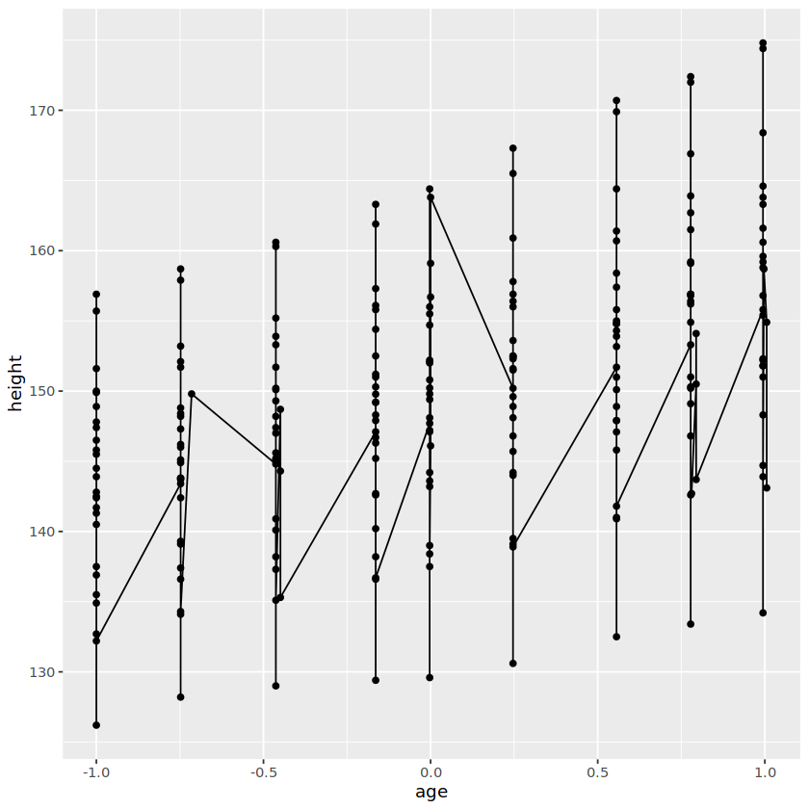
Geometries
> ggplot (nlme::Oxboys, aes(age, height)) +
geom_point() +
geom_line()
# Sequencial data can be grouped by mapping the data to the "group" aesthetic

Slide 42
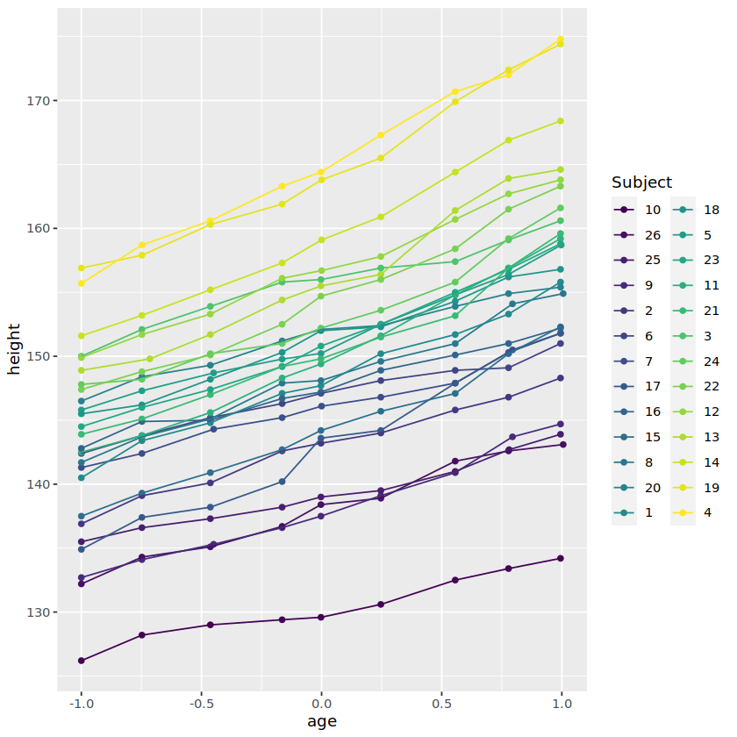
Geometries
> ggplot (nlme::Oxboys, aes(age, height, color=Subject, group = Subject)) +
geom_point() +
geom_line()
# Sequencial data can be grouped by mapping the data to the "group" aesthetic

Slide 43
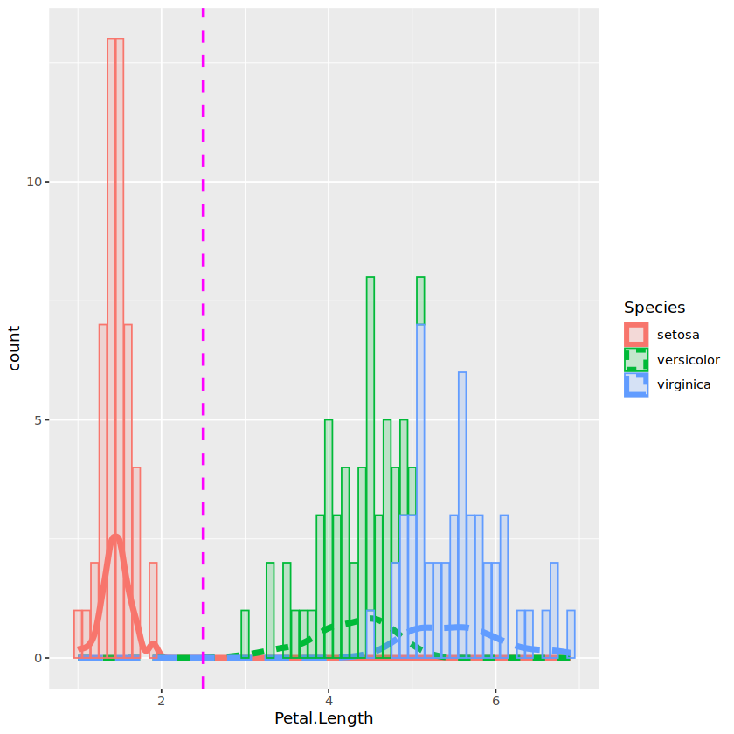
Geometries
> ggplot(iris, aes(Petal.Length, color=Species, fill=Species)) +
geom_density(aes(linetype = Species), alpha=0, linewidth=2) +
geom_bar(alpha=.2) + geom_vline(aes(xintercept=2.5), color="magenta", linetype="dashed", linewidth=1)
# Som distribution examples
# For some geometries statistics are computed by default.
# If not computed prior plotting, counts will be calculated by the statistics layer and used to plot the data. If counts are precoumputed use stat = 'identity’ in geom_bar

Slide 44
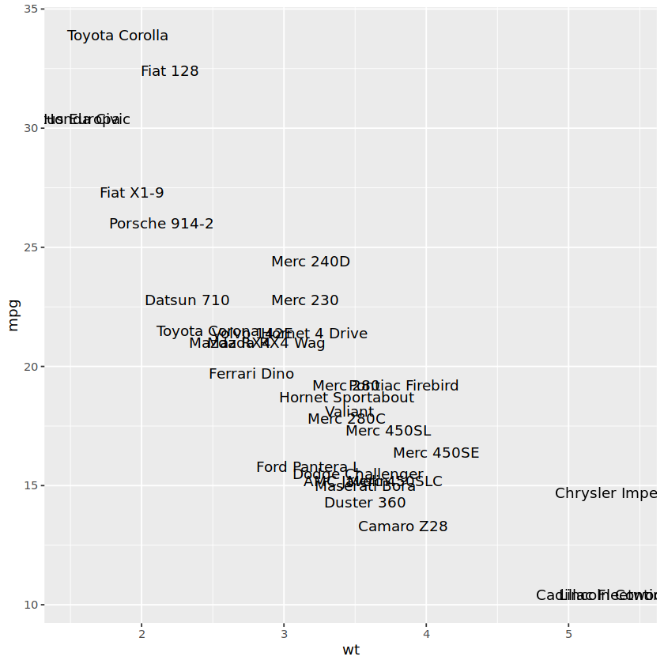
Geometries
Some geom examples
> ggplot(mtcars, aes(wt, mpg)) +
geom_text(aes(label = rownames(mtcars)))

Slide 45
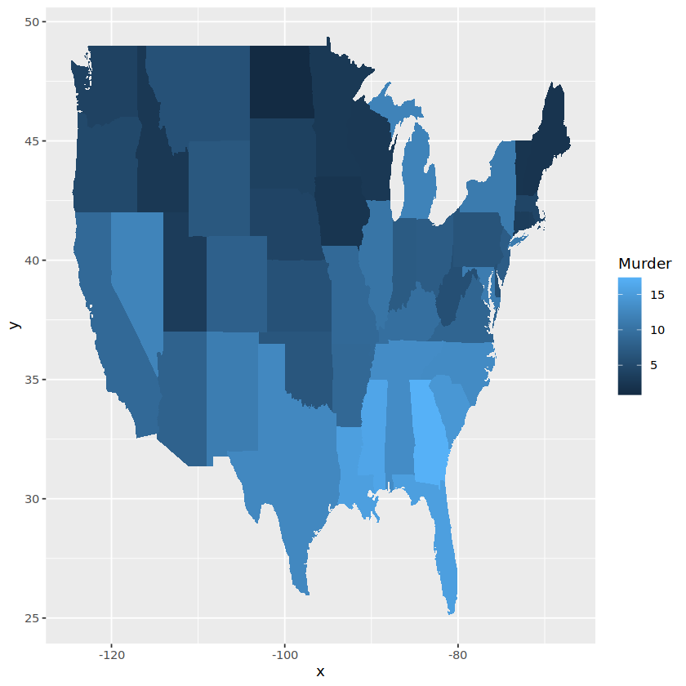
Geometries
Some geom examples
> crimes <- melt( data.frame(state = tolower(rownames(USArrests)), USArrests), id = 1)
> map_data <- map_data("state")
> ggplot(crimes, aes(map_id = state)) +
geom_map(aes(fill = Murder), map = map_data) +
expand_limits(x = map_data$long, y = map_data$lat)
# Maps

Slide 46
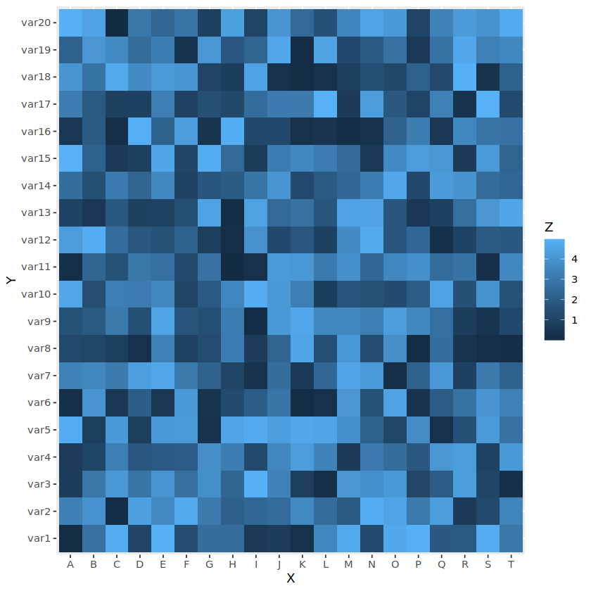
Geometries
Some geom examples
> x <- LETTERS[1:20]
> y <- paste0("var", seq(1,20))
> data <- expand.grid(X=x, Y=y)
> data$Z <- runif(400, 0, 5)
> ggplot(data, aes(X, Y, fill= Z)) +
geom_tile()
# Heatmaps

Slide 47
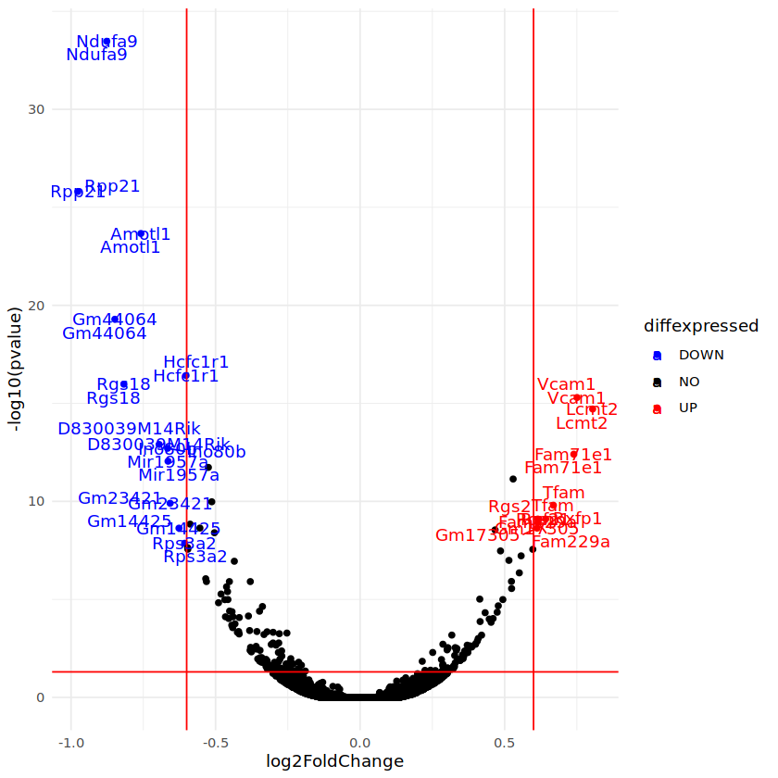
Geometries
Some geom examples
> Data <- …
> ggplot(data=de, aes(x=log2FoldChange, y=-log10(pvalue), col=diffexpressed, label=delabel)) +
geom_point()
# Volcano plots

Slide 48
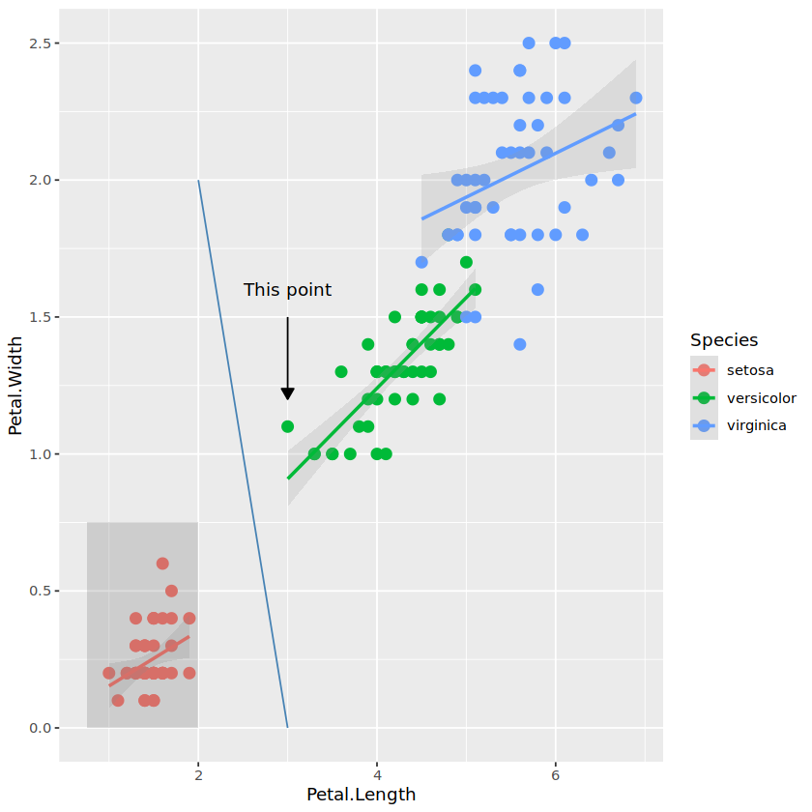
Geometries
Some geom examples
> p + annotate("rect", xmin = 0.75, xmax = 2, ymin = 0, ymax = 0.75, alpha = .2) +
annotate("segment", x = 2, xend = 3, y = 2, yend = 0, colour = "steelblue") +
annotate("segment", x = 3, y = 1.5, xend = 3, yend = 1.2, arrow = arrow(type = "closed", length = unit(0.02, "npc"))) +
annotate("text", x=3, y=1.6, label="This point")
# Annotations

Slide 49
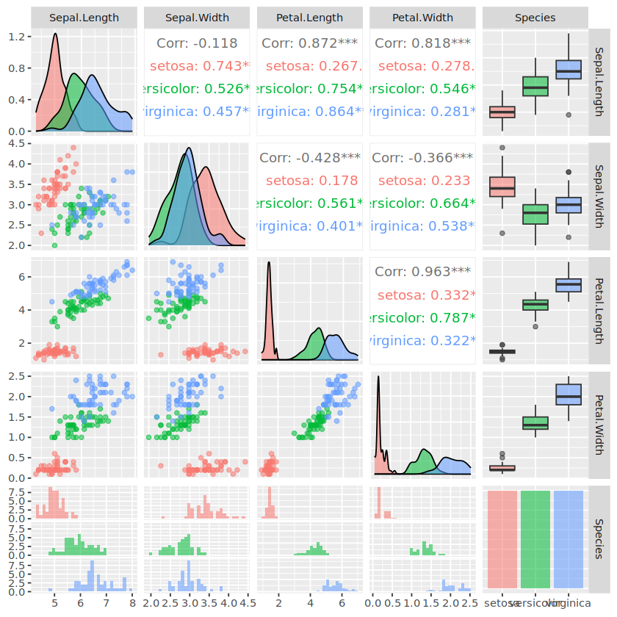
Facets
> # library(GGally)
> # ?ggpairs
ggpairs(iris, mapping = aes(color=Species, alpha=.5))
# Nice package for plot driven data exploration

Slide 50
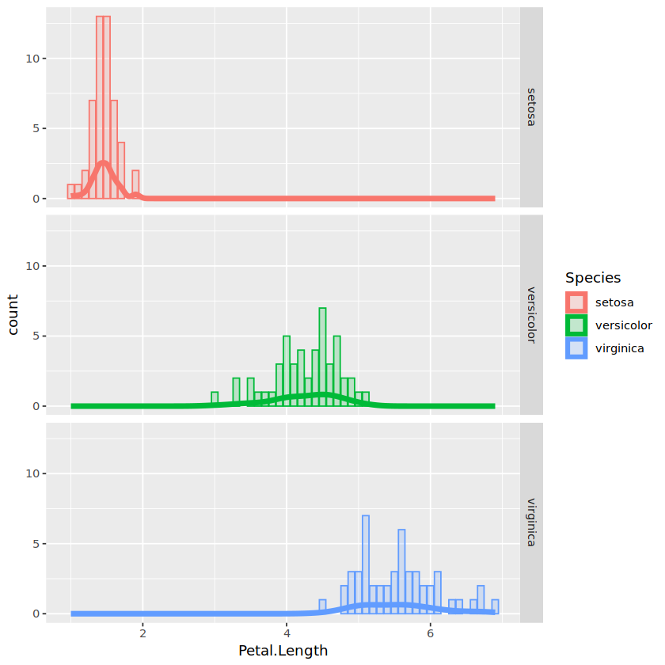
Facets
> ggplot(iris, aes(Petal.Length, color=Species, fill=Species)) +
geom_density(alpha=0, size=2) +
geom_bar(alpha=.2) +
facet_grid(Species ~ .)
# facet_grid( rows ~ columns )

Slide 51
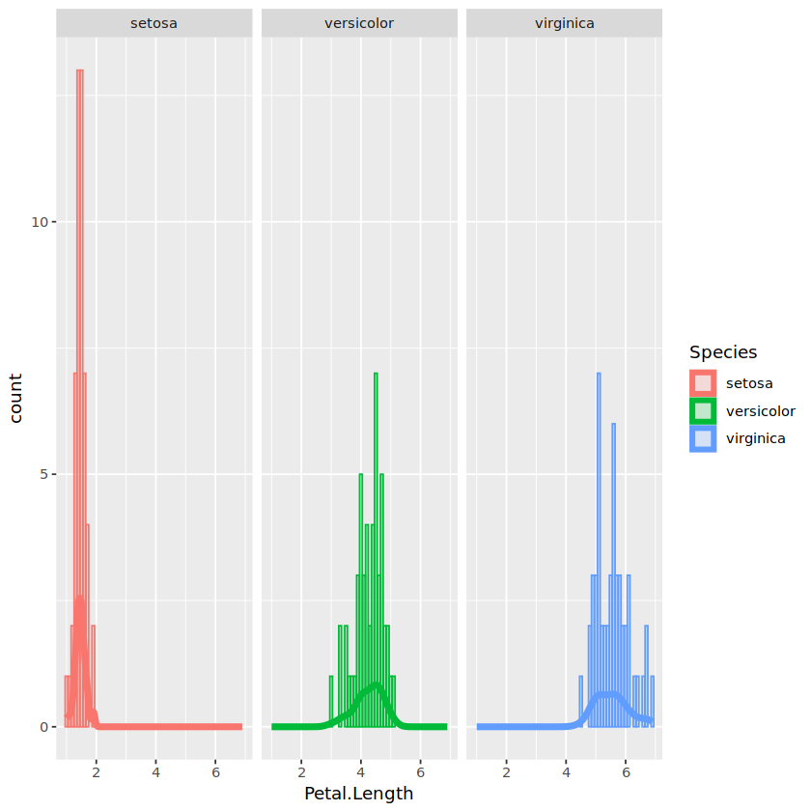
Facets
> ggplot(iris, aes(Petal.Length, color=Species, fill=Species)) +
geom_density(alpha=0, size=2) +
geom_bar(alpha=.2) +
facet_grid(Species ~ .)
# facet_grid( rows ~ columns )

Slide 52
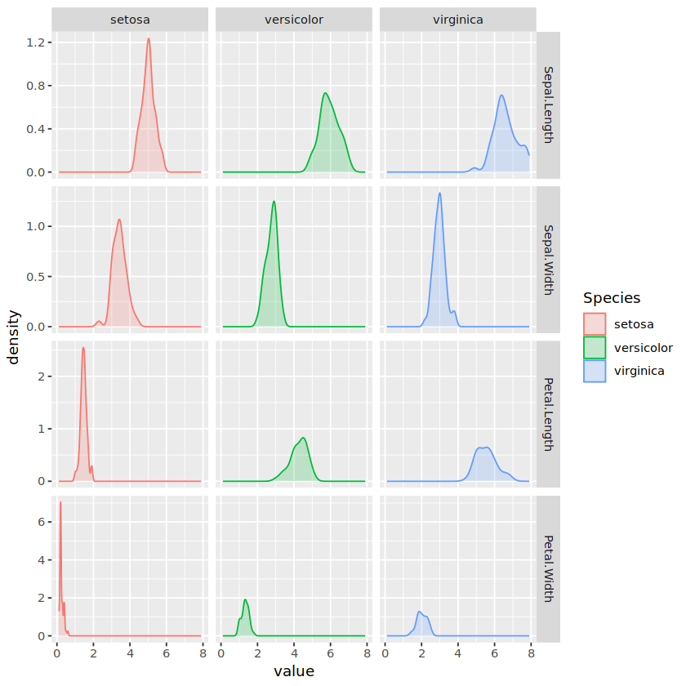
Facets
> ggplot(meltedIris, aes(value, color=Species, fill=Species)) +
geom_density(alpha=.2) +
facet_grid(variable ~ Species, scales = "free_y")
# facet_grid( rows ~ columns )

Slide 53
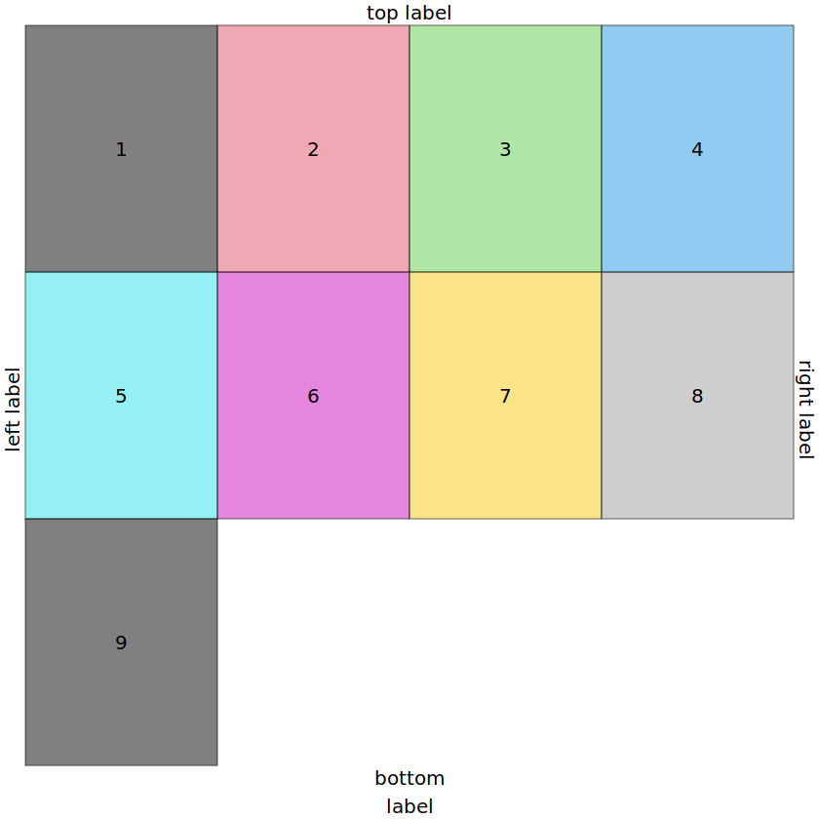
Facets
> gs <- lapply(1:9, function(ii) grobTree(rectGrob(gp=gpar(fill=ii, alpha=0.5)), textGrob(ii)))
> grid.arrange(grobs=gs, ncol=4, top="top label", bottom="bottom\nlabel", left="left label", right="right label")
# to add multiple graphics in the same plot we can use grid.arrange to create a grid and add one graphic in each cell of the grid.
# If layout is not described then graphics will be added to the grid sequentially according to the number of columns/rows specified.

Slide 54
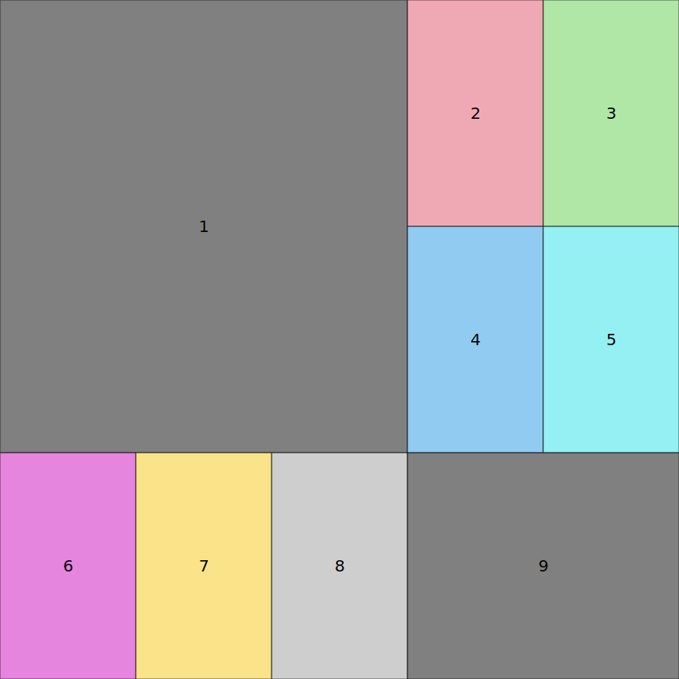
Facets
> lay <- rbind(c(1,1,1,2,3), c(1,1,1,4,5), c(6,7,8,9,9))
> grid.arrange(grobs = gs, layout_matrix = lay)
# to add multiple graphics in the same plot we can use grid.arrange to create a grid and add one graphic in each cell of the grid.
# If layout is not described then graphics will be added to the grid sequentially according to the number of columns/rows specified.

Slide 55
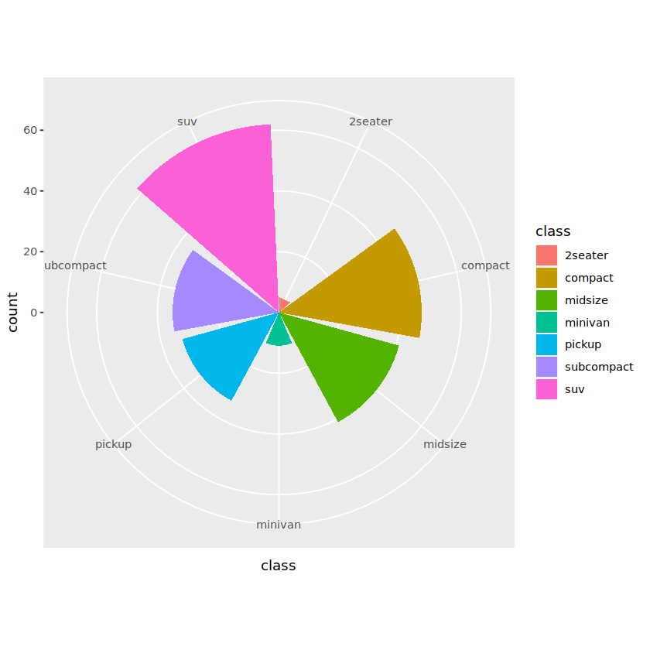
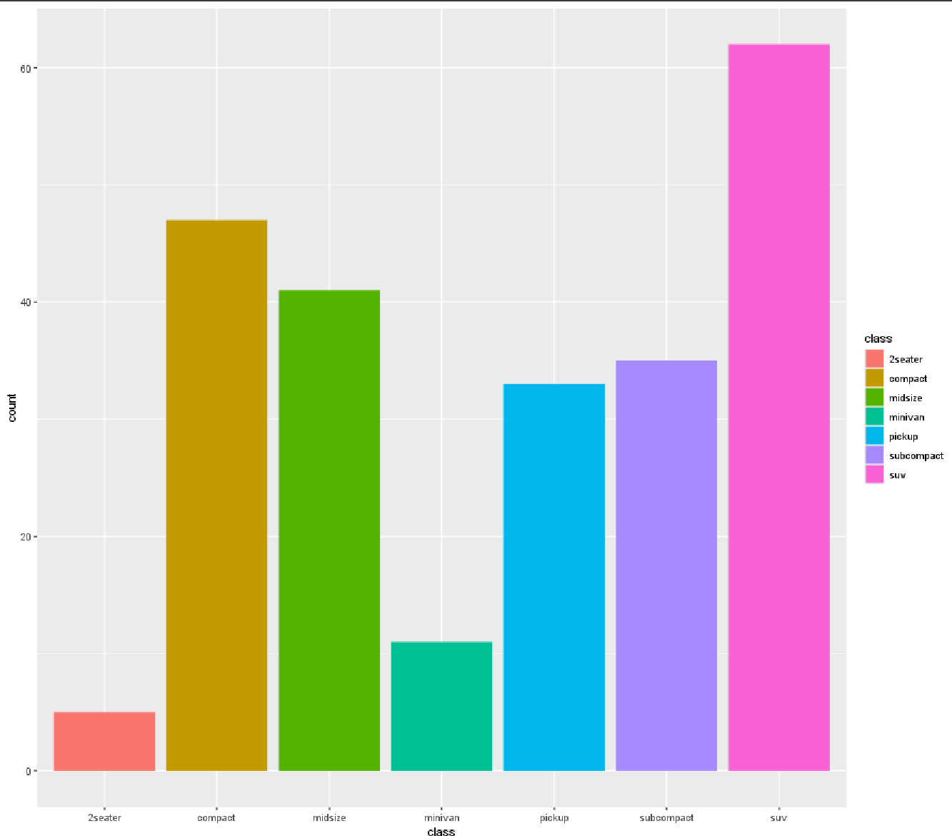
Coordinates
ggplot(mpg) +
geom_bar(aes(x = class, fill = class)) +
coord_polar()
> ggplot(mpg) +
geom_bar(aes(x = class, fill = class))
# Coordinates allows us to transform mappings. For example, a polar coordinate system interprets x and y as angles and radius

Slide 56
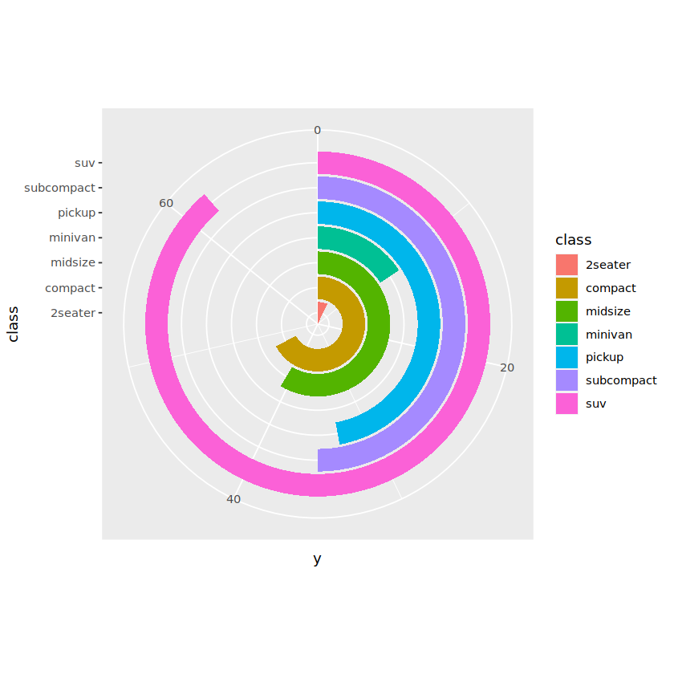
Coordinates
> ggplot(mpg) +
geom_bar(aes(x = class, fill = class)) +
coord_polar(theta = 'y') +
expand_limits(y = 70)
# Changing what is mapped to angle gives a very different plot

Slide 57
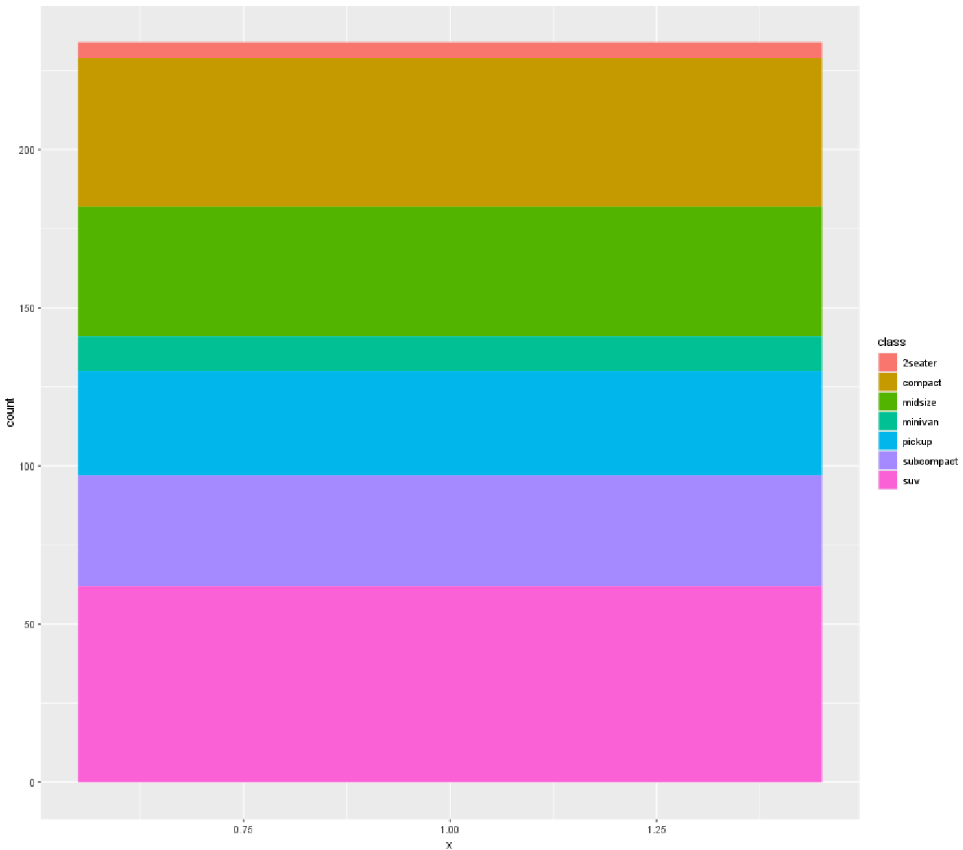
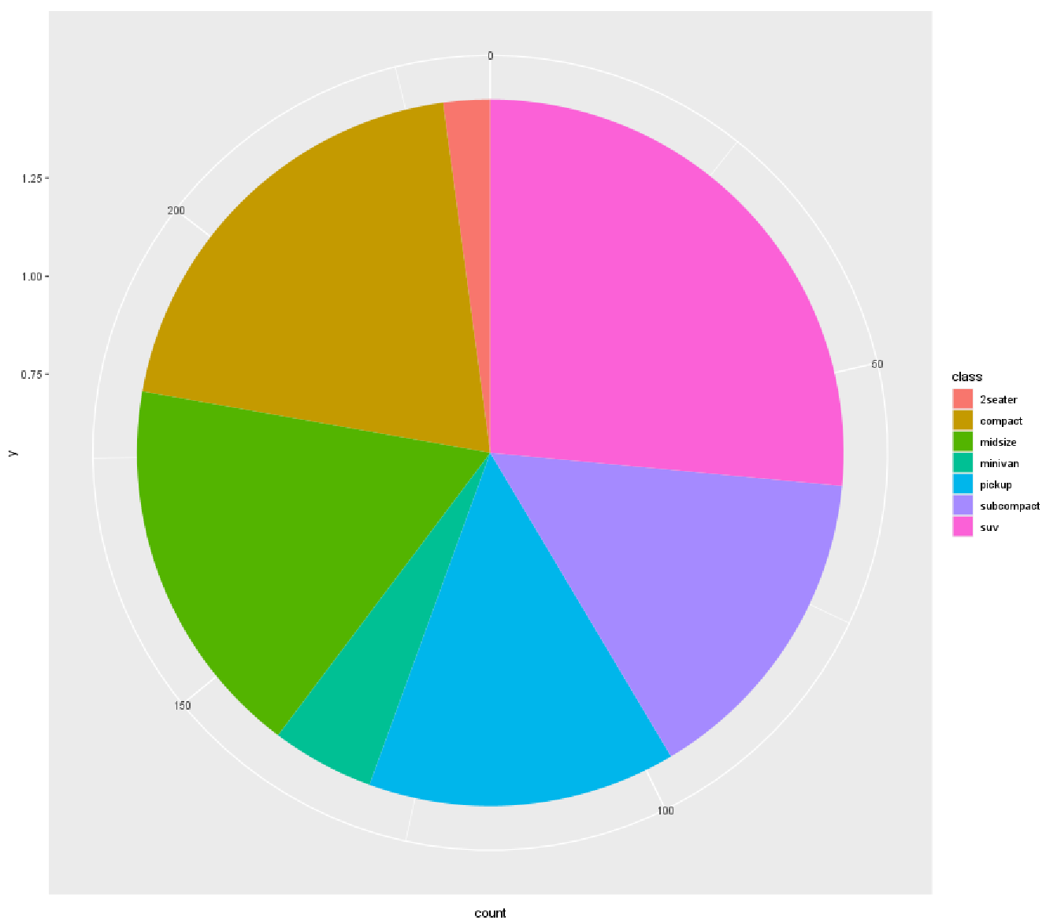
Coordinates
> ggplot(mpg, aes(x=1, fill=class, group=class)) +
geom_bar(stat="count“)
> ggplot(mpg, aes(y=1, fill=class)) +
geom_bar(stat="count") +
coord_polar('y')
# A Pie Chart is just a stacked bar plot with polar coordinates

Slide 58
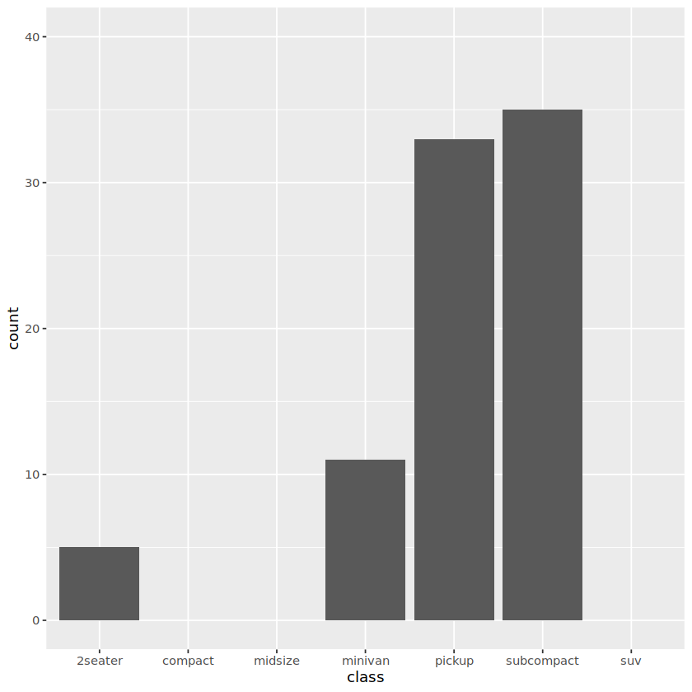
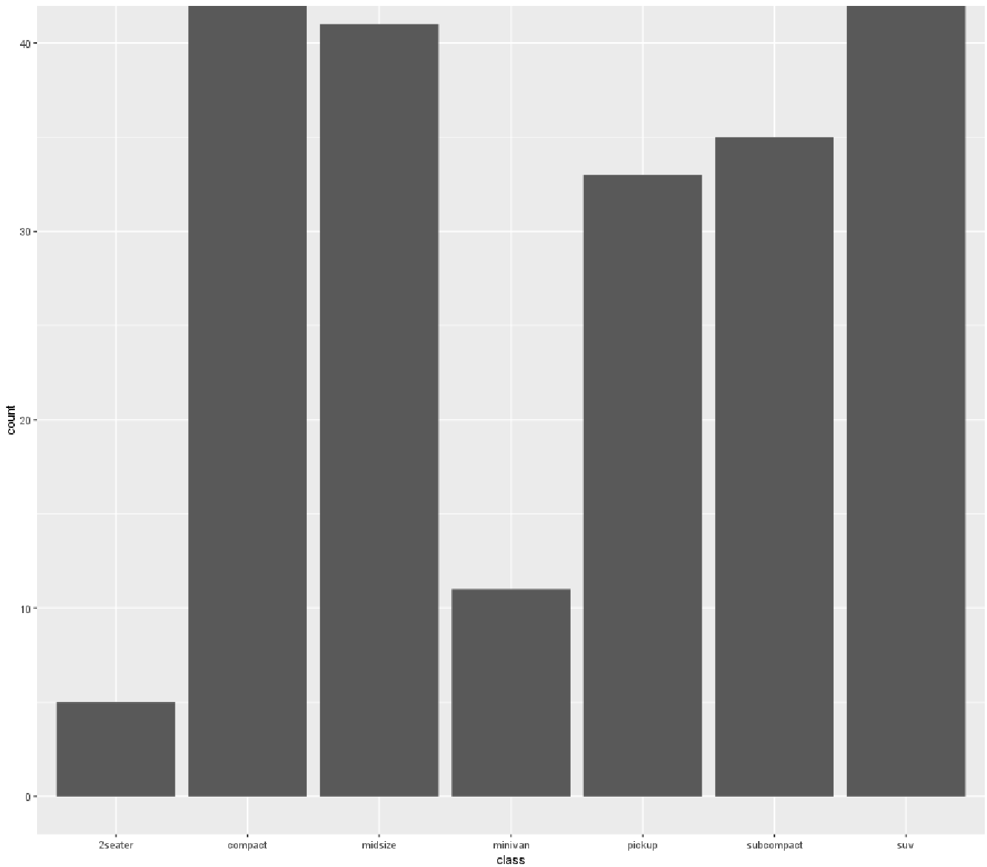
Coordinates
> ggplot(mpg) +
geom_bar(aes(x = class)) +
coord_cartesian(ylim=c(0, 40))
> ggplot(mpg) +
geom_bar(aes(x = class)) +
scale_y_continuous(limits = c(0, 40))
Warning message: “Removed 3 rows containing missing values (`geom_bar()`).”
#Zooming with coord_creates a proper zoom

Slide 59
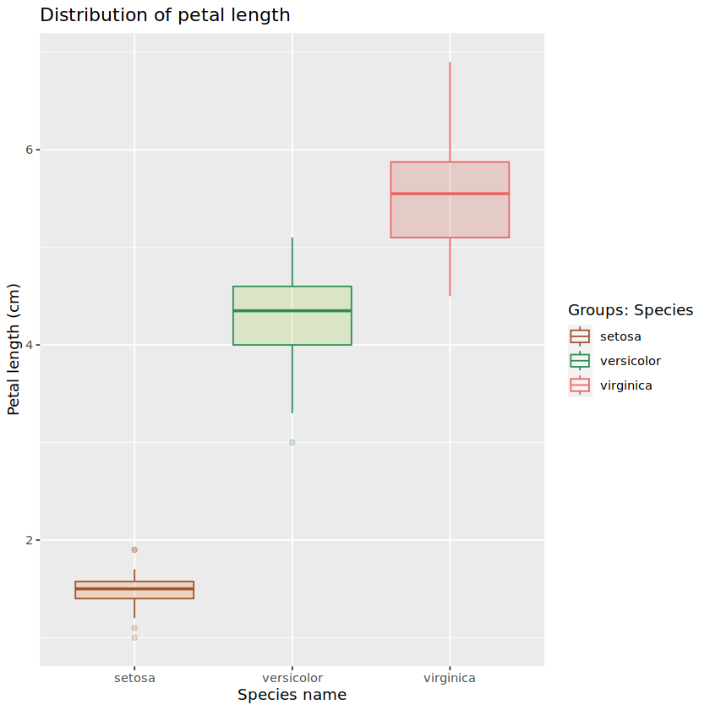
Theme
> p + labs(title="Distribution of petal length",
x="Species name", y="Petal length (cm)",
color="Groups: Species") +
theme( … )
# Any other aesthetic in the plot can be modify using theme

Slide 60
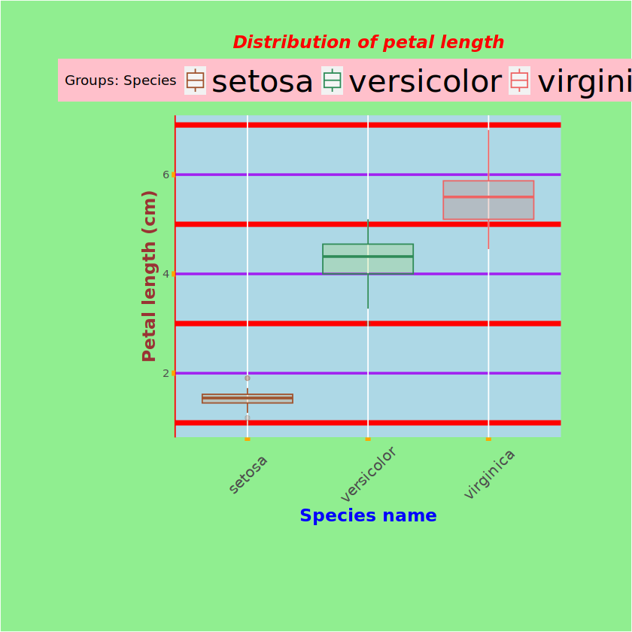
Theme
> p + labs(title="Distribution of petal length",
x="Species name", y="Petal length (cm)",
color="Groups: Species") +
theme( … )
# theme(plot.title = element_text(color="red", size=14, face="bold.italic", hjust = .5),
axis.title.x = element_text(color="blue", size=14, face="bold"),
axis.title.y = element_text(color="#993333", size=14, face="bold"),
axis.text.x = element_text(size= 12, angle = 45, vjust = .5),
axis.ticks = element_line(colour = "orange", linewidth = 2),
axis.line.y = element_line(colour = "red"),
panel.background = element_rect(fill = "lightblue"),
panel.grid.major.y = element_line(colour = "purple", linewidth=1),
panel.grid.minor.y = element_line(colour = "red", linewidth=2),
plot.margin = unit(1:4, "cm"),
plot.background = element_rect(fill = "lightgreen"),
legend.background = element_rect(fill="pink"),
legend.text.align = 1,
legend.position = "top",
legend.text = element_text(size=25))

Slide 61
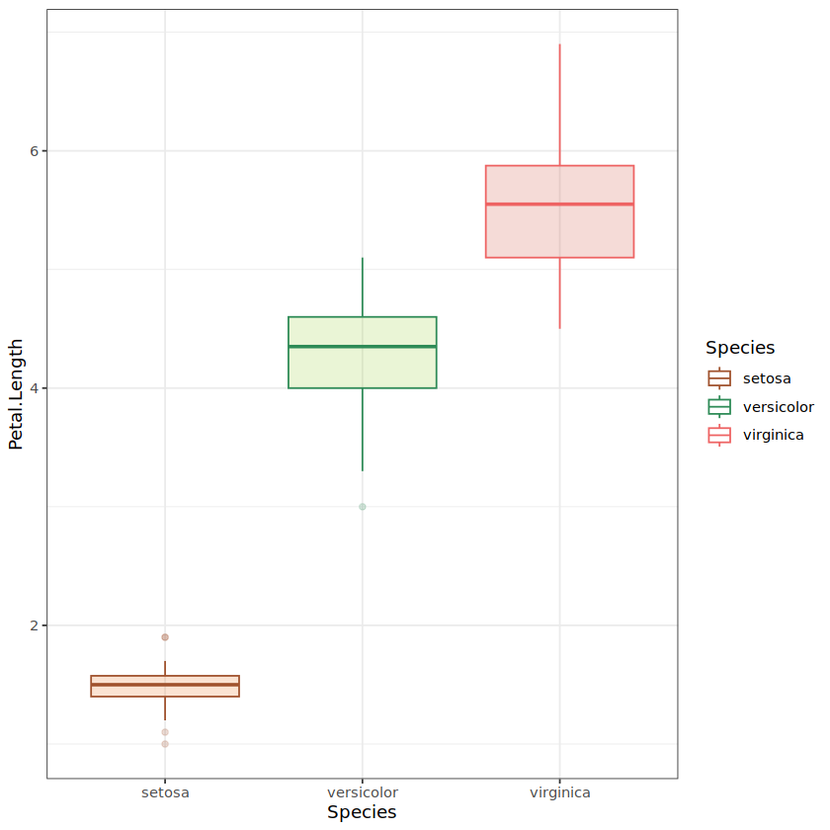
Theme
> p + theme_bw()
# There are some predefined themes ready to use
# p + theme_bw()
# p + theme_classic()
# p + theme_minimal()
# p + theme_dark()
# p + theme_linedraw()

