Slide 1
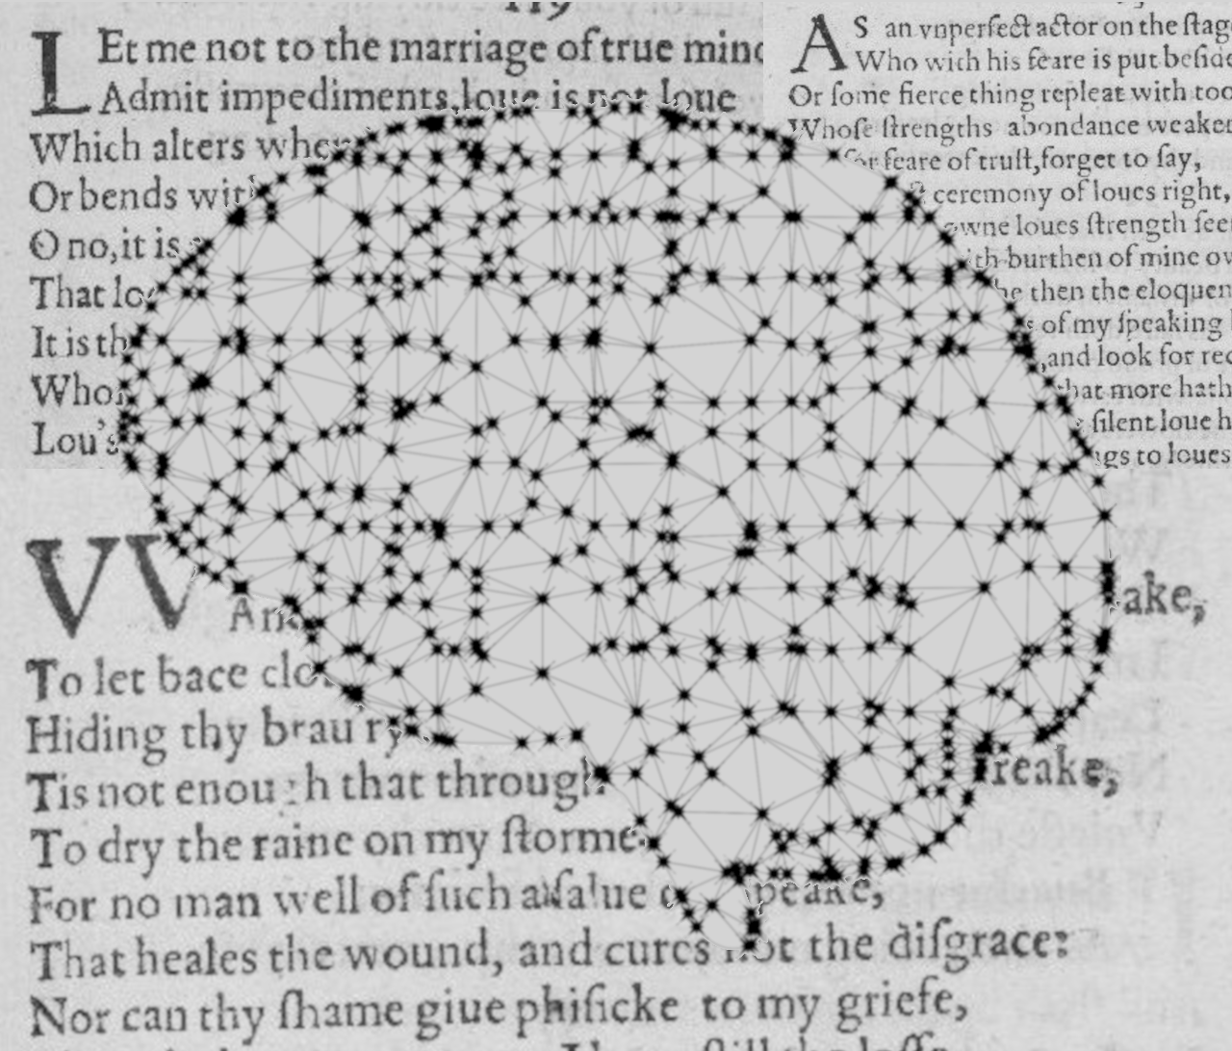
Author Classification in Poetry
Institut für Maschinelle Sprachverarbeitung
Katrin Schmidt & Carlotta Quensel
Team Lab NLP | SS2021 | 14-06-2021

Slide 2
Author classification
Goal
Stylometrics: what age, education, gender, social class has the author
Find specific values for one author
Author prediction: classification task with known classes
Which of 5 known authors has written this text
Our goal: find a method which works well with poetry
Style choices might reflect the medium more than the author
Special features (number of verses, meter, anaphora, …)
Choice of data is limited
Notes:
What is author classification?
What did we decide to do?
Data choice is limited -> our data

Slide 3
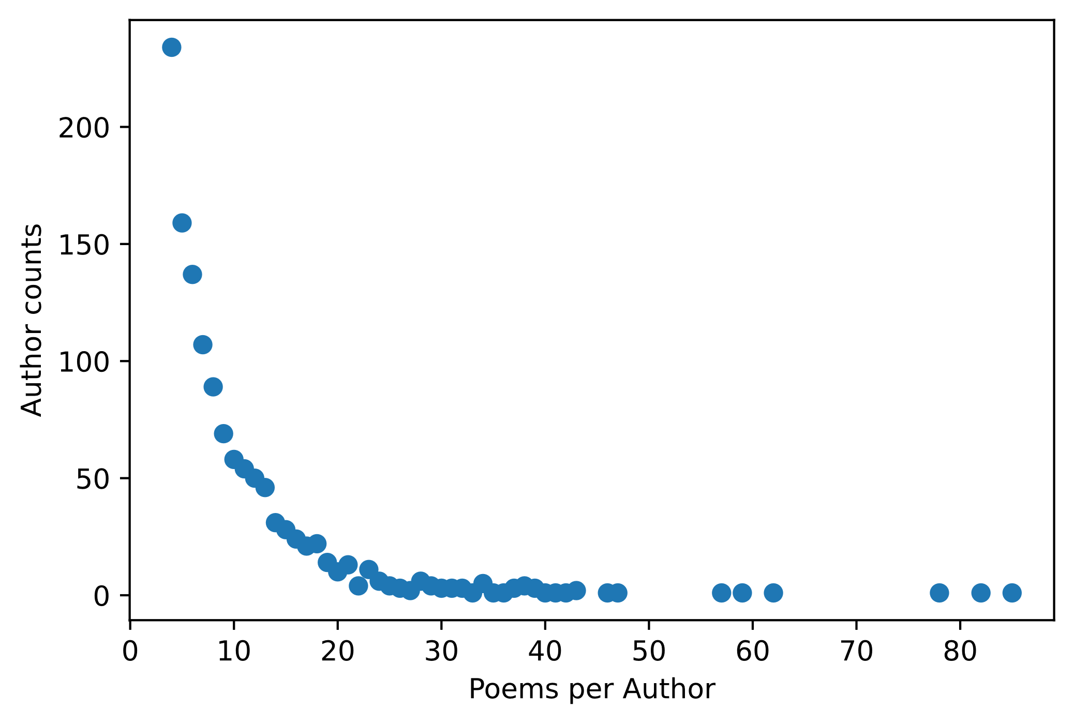
Author classification
Data
Poetry Foundation (founded in 2003)
3 309 authors
15 567 poems
We decided on the 30 most prolific authors
More datapoints per class
Lower computational effort
1 569 poems
Notes:
Show stats: sparse data for many classes (many authors only wrote one to ten poems)
Therefore we only use the most prolific authors

Slide 4
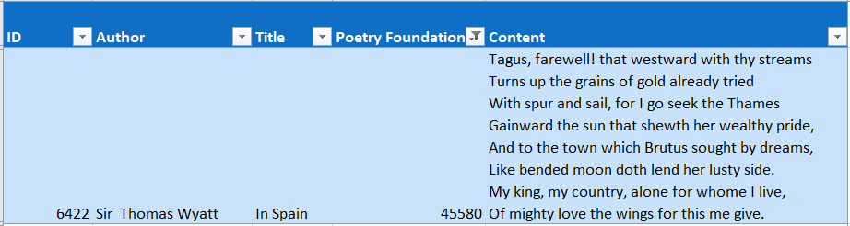
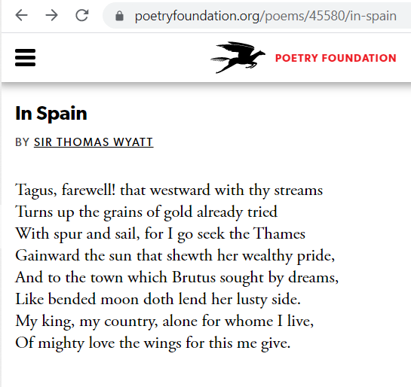
Author classification
Data
CSV from kaggle
Tokenization with NLTK
{'Sir Thomas Wyatt' : [[‘tagus', ',', 'farewell', '!', 'that', 'westward', ',', 'with', 'thy', 'streams', ',', ‘turns', 'up', 'the', 'grains', 'of', 'gold', 'already', 'tried', ',', ‘with', 'spur', 'and', 'sail', 'for', ‘i', 'go', 'seek', 'the', ‘thames', ',', ‘gainward', 'the', 'sun', 'that', 'show', "'", …]}
Bag-of-words vectors
((0,0,0,1,0,0,1,1,0,0,0,1,0,0,1, …), 'Sir Thomas Wyatt')
Notes:
Example for one poem or datapoint
We downloaded a premade csv table from kaggle.com
Each poem has an index, its title and its Poetry-Foundation-ID (unique index)
Saved each poem sorted by author
Final structure: each datapoint consists of a vector and a label

Slide 5

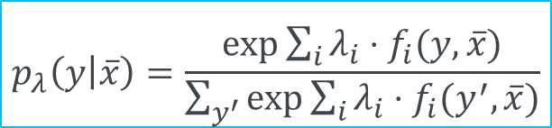
Approach
Baseline method
Maximum Entropy Classifier
Feature $f_{i}$: data properties paired with a label
e.g.: $f_{1}\left(y,\overline{x}\right)=\left\{\begin{aligned}1, \\ 0, \end{aligned}{y = \text{Shakespeare} ∧ \text{thou} ∈ \overline{x} \atop \text{otherwise}}\right.$
Weight $λ_{i}$ for each feature to represent the importance of the feature
Training by optimizing the weights (stochastic gradient ascent)
$$p_{λ}\left(y | \overline{x}\right)=\frac{\exp{\sum_{i}{λ_{i}⋅f_{i}(y,}}\overline{x})}{\sum_{y^{′}}{exp⁡\sum_{i}{λ_{i}⋅f_{i}(y^{′},\overline{x}})}}$$
Notes:
What is maximum entropy
This is the formula, each label has a probability
We compute the partial derivative with regard to each weight and optimize the weights iteratively

Slide 6
Approach
Our implementation
Features (PMI)
Initial weights
Accuracy with these weights
Iterative optimization
Classification

Slide 7

Approach
Our implementation
Features (PMI)
Initial weights
Accuracy
Iterative optimization
Classification
Pointwise mutual information
30 features per author
Randomized between -10 and 10
Count correct classifications with current weights
Update weights by adding the gradient
Choose label with highest $p_{λ}(y|\overline{x})$ for each label

Slide 8
Approach
Our implementation
Features
Initial weights
Accuracy
Optimization
Classification
Pointwise mutual information
30 features per author
Randomized between -10 and 10
Count correct classifications with current weights
Compute gradient
Update weights by adding the gradient
Compute $p_{λ}(y|\overline{x})$ for each label
Compute 𝑝_𝜆 (𝑦|𝑥 ̅) for each label
Choose label with highest probability

Slide 9
Results
How does the number of authors influence the classification?
Are bag-of-word features enough?
Experimental design:
30 authors
10-50 features per label (only bag-of-words)
Evaluation:
The classifier doesn’t learn yet
Features too uninformative
Always predicts the same class

Slide 10
Experimental design
Setup
How does the number of authors influence the classification?
30 authors vs. 10 authors
Are bag-of-word features enough?
30 features per label (bag-of-word)
Evaluation:
Precision, recall and F₁ for each label
Micro and macro average for all scores
Confusion matrix for further error analysis

Slide 11
Experimental design
Results
Features are equally important
Maximum entropy not right for bag-of-words
Different feature selection method
The most prolific author is also the most predicted

Slide 12
Results
How does the number of authors influence the classification?
Are bag-of-word features enough?
Experimental design:
39 authors (vs. 15 authors)
50 features per label (only bag-of-words)
F1 – overview
Confusion matrix (if time + interesting)

Slide 13
Next steps
Goal
Classifier that is especially good for poems
Approaches
Architecture (MaxEnt vs. NN vs. ...)
Features (stanzas/verses/rhymes/...)
Division
Kati experiments with NN
Carlotta searches for poetry-specific features

Slide 14
Katrin Schmidt
Carlotta Quensel
katrin.schmidt@ims.uni-stuttgart.de
carlotta.quensel@ims.uni-stuttgart.de
source1
source2
source3

