Slide 1
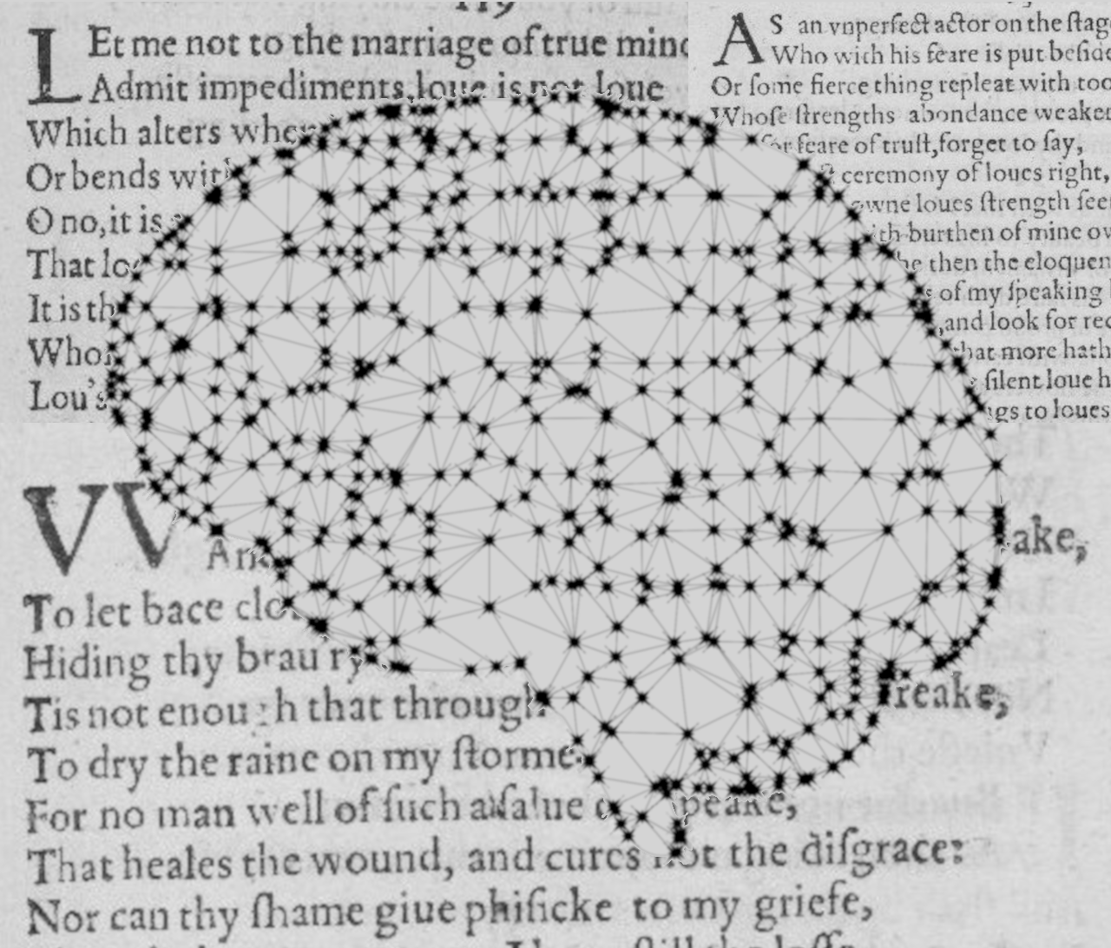
Author Classification in Poetry
Institut für Maschinelle Sprachverarbeitung
Katrin Schmidt & Carlotta Quensel
Team Lab NLP | SS2021 | 14-06-2021

Slide 2
Author classification
Goal
Stylometrics: what age, education, gender, social class has the author
Find specific values for one author
Author prediction: classification task with known classes
Which of 5 known authors has written this text
Our goal: find a method which works well with poetry
Style choices might reflect the medium more than the author
Special features (number of verses, meter, anaphora, …)
Choice of data is limited
Notes:
What is author classification?
What did we decide to do?
Data choice is limited -> our data

Slide 3
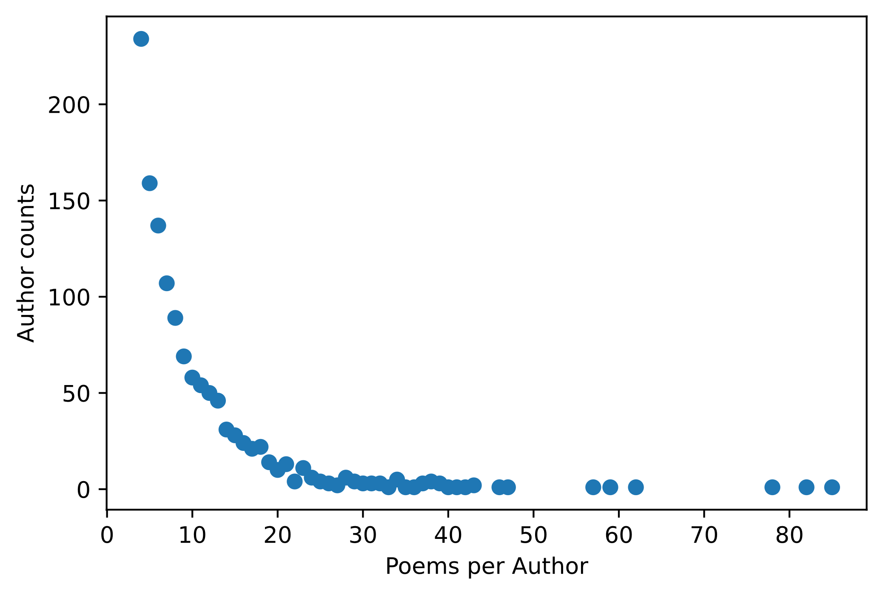
Author classification
Data
Poetry Foundation (founded in 2003)
3 309 authors
15 567 poems
We decided on the 30 most prolific authors
More datapoints per class
Lower computational effort
1 569 poems
Fig 1 – Poem distribution per author
Notes:
Show stats: sparse data for many classes (many authors only wrote one to ten poems)
Therefore we only use the most prolific authors

Slide 4
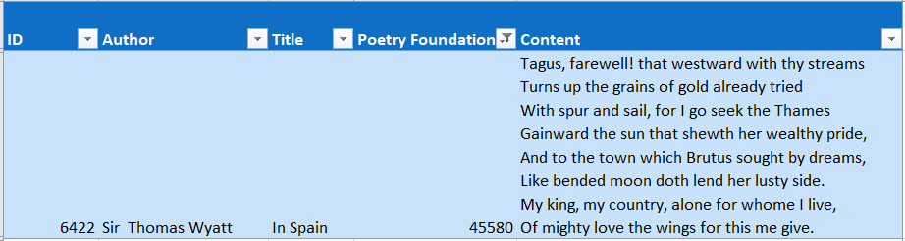
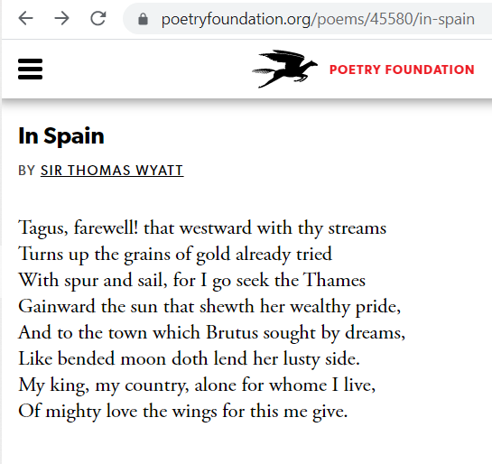
Author classification
Data
CSV from kaggle
Tokenization with NLTK
{'Sir Thomas Wyatt' : [[‘tagus', ',', 'farewell', '!', 'that', 'westward', ',', 'with', 'thy', 'streams', ',', ‘turns', 'up', 'the', 'grains', 'of', 'gold', 'already', 'tried', ',', ‘with', 'spur', 'and', 'sail', 'for', ‘i', 'go', 'seek', 'the', ‘thames', ',', ‘gainward', 'the', 'sun', 'that', 'show', "'", …]}
Bag-of-words vectors
((0,0,0,1,0,0,1,1,0,0,0,1,0,0,1, …), 'Sir Thomas Wyatt')
Notes:
Example for one poem or datapoint
We downloaded a premade csv table from kaggle.com
Each poem has an index, its title and its Poetry-Foundation-ID (unique index)
Saved each poem sorted by author
Final structure: each datapoint consists of a vector and a label

Slide 5

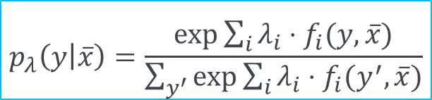
Approach
Baseline method
Maximum Entropy Classifier
Feature $f_{i}$: data properties paired with a label
e.g.: $f_{1}\left(y,\overline{x}\right)=\left\{\begin{aligned}1, \\ 0, \end{aligned}{y = \text{Shakespeare} ∧ \text{thou} ∈ \overline{x} \atop \text{otherwise}}\right.$
Weight $λ_{i}$ for each feature to represent the importance of the feature
Training by optimizing the weights
$$p_{λ}\left(y | \overline{x}\right)=\frac{\exp{\sum_{i}{λ_{i}⋅f_{i}(y,}}\overline{x})}{\sum_{y^{′}}{exp⁡\sum_{i}{λ_{i}⋅f_{i}(y^{′},\overline{x}})}}$$
Notes:
What is maximum entropy
This is the formula, each label has a probability
We compute the partial derivative with regard to each weight and optimize the weights iteratively

Slide 6

Approach
Baseline method
Features (PMI)
Initial weights
Accuracy
Iterative optimization
Classification
Pointwise mutual information
30 features per author
Randomized between -10 and 10
Count correct classifications with current weights
Update weights by adding the gradient
Choose label with highest $p_{λ}(y|\overline{x})$ for each label

Slide 7
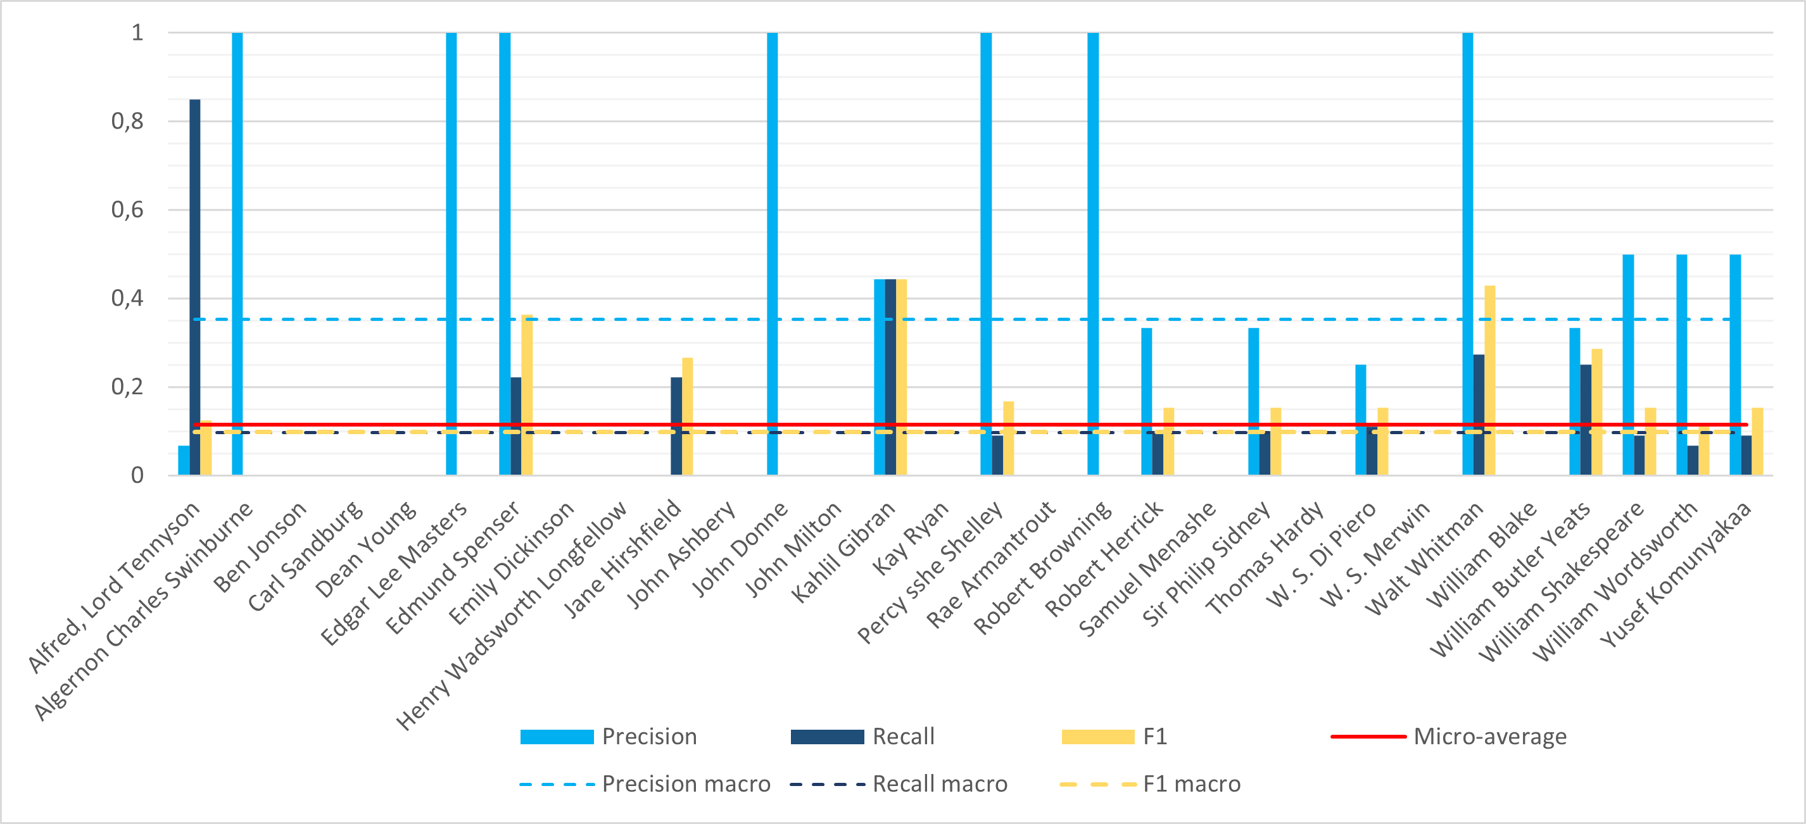
Evaluation
Quantitative
Accuracy much worse on the test data
test: 0.11
training: 0.49
Many authors never predicted
Fig 2 – Evaluation on test data (338 poems) for 30 authors, trained on 959 poems

Slide 8
Evaluation
Qualitative
Many authors never predicted
Bad features for this author
Data not evenly distributed
Features are equally important (random weights approximate each other)
Different model or feature selection
The alphabetically first author is chosen too often
Every author has the same probability
Choose most prolific author instead

Slide 9
Next steps
Research Question
Which features are inherent to poetry writers
Are there inter-dependencies between the features
Advanced method
Extending the features ⇨ until 07/05
Number of stanzas and verses ⇨ Katrin
Rhyming and rhyme schemes ⇨ Carlotta
Non-linear model for sparse features and interaction
Multi-layer NN ⇨ until 07/12
Notes:
We extend the features to literary devices
Because these features have less variation we will also look at non-linear classification

Slide 10
Katrin Schmidt
katrin.schmidt@ims.uni-stuttgart.de
Carlotta Quensel
carlotta.quensel@ims.uni-stuttgart.de

