Slide 1
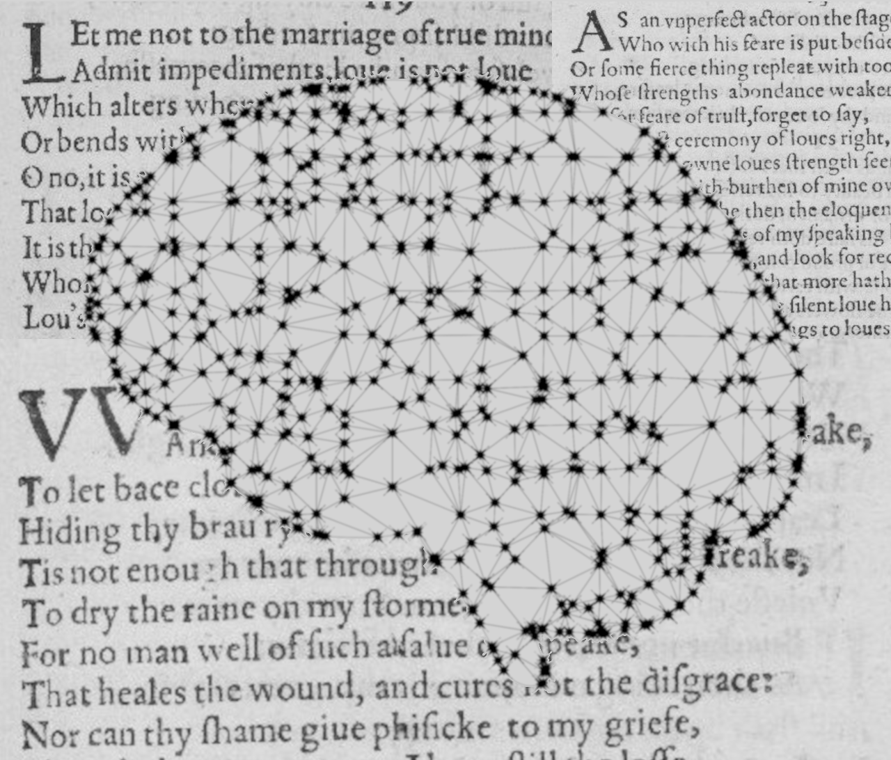
Author classification in poetry
Institut für Maschinelle Sprachverarbeitung
Katrin Schmidt & Carlotta Quensel
Team Lab NLP | SS2021 | 14-06-2021

Slide 2
our task
task description
data and preprocessing
baseline model
first evaluation
outlook: advanced method

Slide 3
Katrin Schmidt
Carlotta Quensel
katrin.schmidt@ims.uni-stuttgart.de
carlotta.quensel@ims.uni-stuttgart.de
source1
source2
source3

