Slide 1
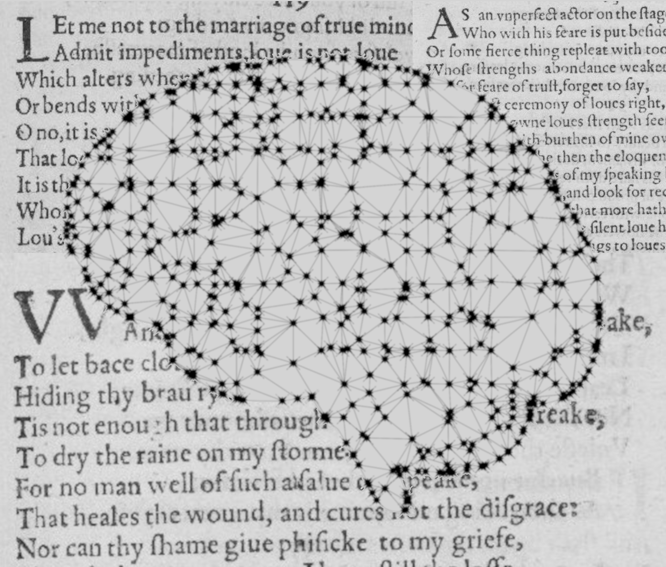
Author Classification in Poetry
Institut für Maschinelle Sprachverarbeitung
Katrin Schmidt & Carlotta Quensel
Team Lab NLP | SS2021 | 14-06-2021

Slide 2
Author classification
Goal
Stylometrics: what age, education, gender, social class has the author
Find specific values for one author
Author prediction: classification task with known classes
Which of 5 known authors has written this text
Our goal: find a method which works well with poetry
Style choices might reflect the medium more than the author
Special features (number of verses, meter, anaphora, …)
Choice of data is limited
Notes:
What is author classification?
What did we decide to do?
Data choice is limited -> our data

Slide 3
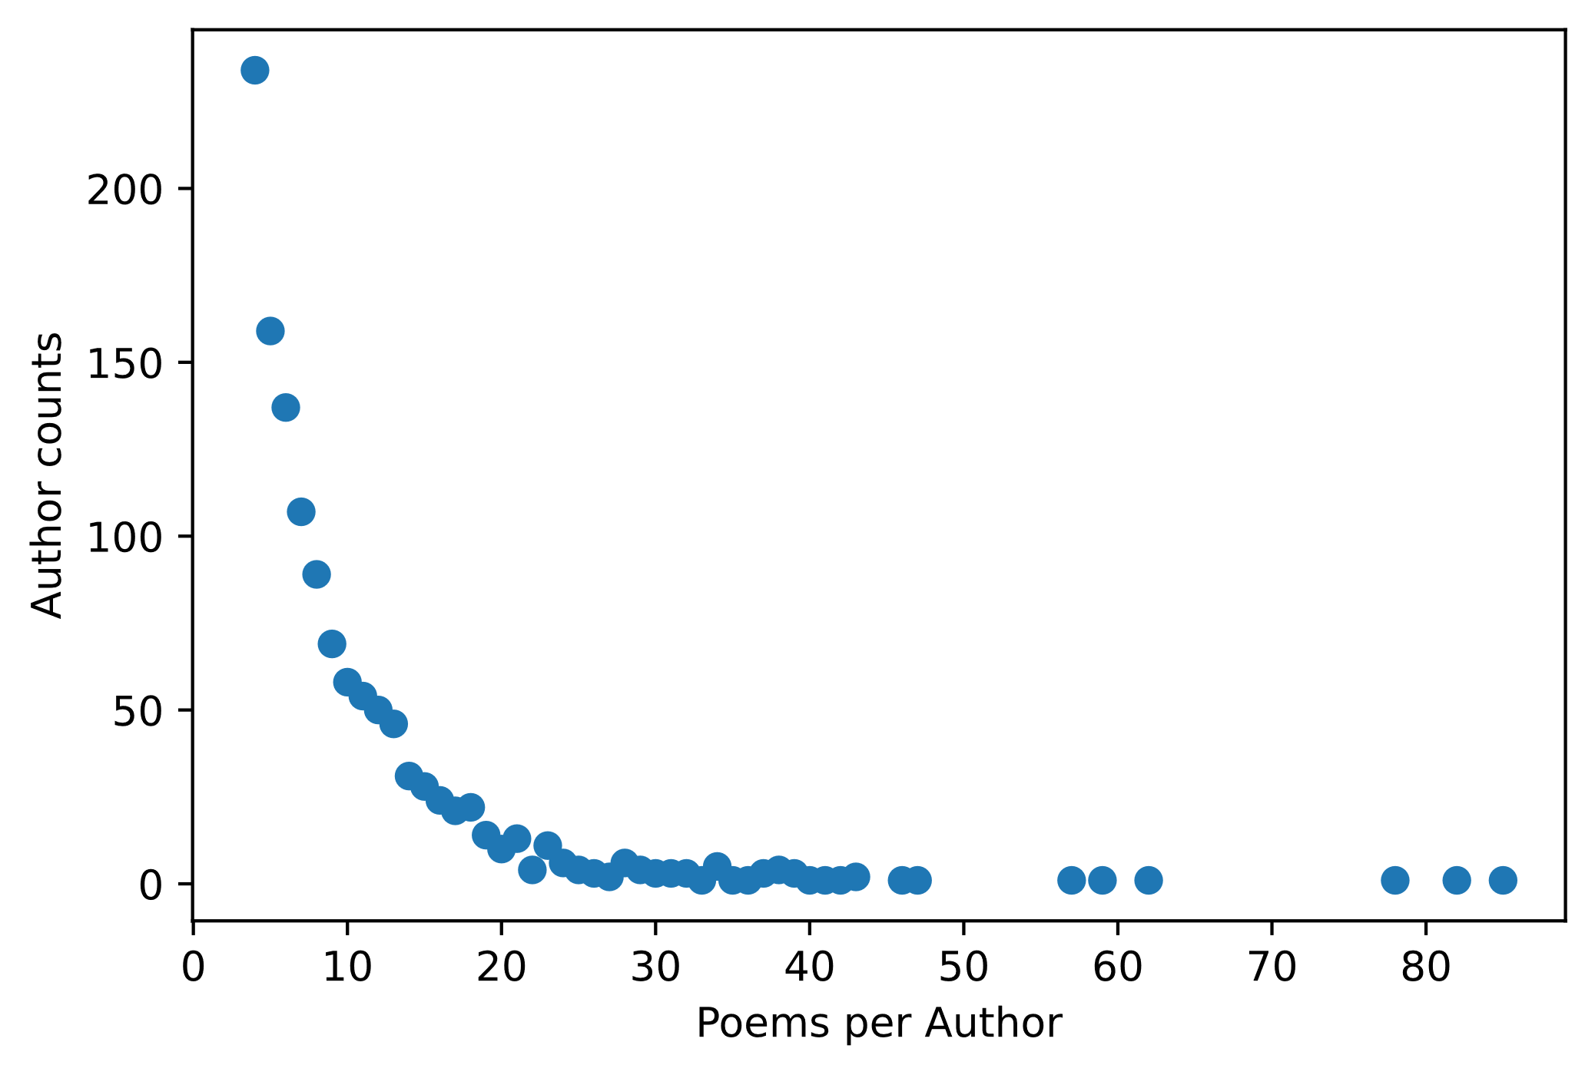
Author classification
Data
Poetry Foundation (founded in 2003)
3 309 authors
15 567 poems
We decided on the 30 most prolific authors
More datapoints per class
Lower computational effort
1 569 poems
Notes:
Show stats: sparse data for many classes (many authors only wrote one to ten poems)
Therefore we only use the most prolific authors

Slide 4
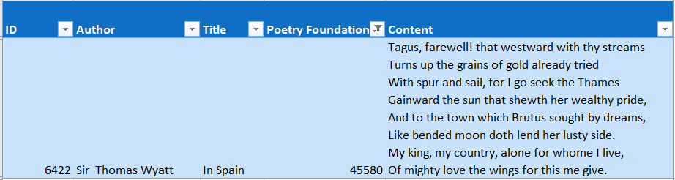
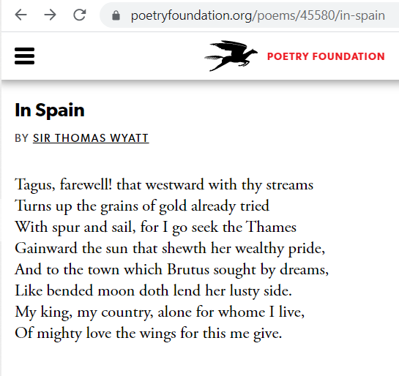
Author classification
Data
CSV from kaggle
Tokenization with NLTK
{'Sir Thomas Wyatt' : [['Tagus', ',', 'farewell', '!', 'that', 'westward', ',', 'with', 'thy', 'streams', ',', 'Turns', 'up', 'the', 'grains', 'of', 'gold', 'already', 'tried', ',', 'With', 'spur', 'and', 'sail', 'for', 'I', 'go', 'seek', 'the', 'Thames', ',', 'Gainward', 'the', 'sun', 'that', 'show', "'", …]}
Bag-of-words vectors
((0,0,0,1,0,0,1,1,0,0,0,1,0,0,1, …), 'Sir Thomas Wyatt')
Notes:
Example for one poem or datapoint
We downloaded a premade csv table from kaggle.com
Each poem has an index, its title and its Poetry-Foundation-ID (unique index)
Saved each poem sorted by author
Final structure: each datapoint consists of a vector and a label

Slide 5

Approach
Baseline method
Maximum Entropy Classifier
Features: data properties paired with a label
e.g.: $f_{1}\left(y,\overline{x}\right)=\left\{\begin{aligned}1, \\ 0, \end{aligned}{y = \text{Shakespeare} ∧ \text{thou} ∈ \overline{x} \atop \text{otherwise}}\right.$
Weight for each feature to represent the importance of the feature
Training by stochastic gradient descent
p$λ$(y | x) = $\frac{\exp{∑i λifi(y, x)}}{∑y^{′ }\exp{∑i λifi(y′,x)}}$ = $\frac{score of a class y}{sum of scores for all classes y′}$
Notes:
What is maximum entropy
This is the formula, each label has a probability
We compute the partial derivative with regard to each weight and optimize the weights iteratively

Slide 6
Approach
Our implementation
Features learned with PMI
Random weight for each feature
Accuracy with these weights
Iterative optimization
Classify

Slide 7
Results
How does the number of authors influence the classification?
Are bag-of-word features enough?
Experimental design:
30 authors
10-50 features per label (only bag-of-words)
Evaluation:
The classifier doesn’t learn yet
Features too uninformative
Always predicts the same class

Slide 8
Results
How does the number of authors influence the classification?
Are bag-of-word features enough?
Experimental design:
39 authors (vs. 15 authors)
50 features per label (only bag-of-words)
F1 – overview
Confusion matrix (if time + interesting)

Slide 9
Next steps
Goal
Classifier that is especially good for poems
Approaches
Architecture (MaxEnt vs. NN vs. ...)
Features (stanzas/verses/rhymes/...)
Division
Kati experiments with NN
Carlotta searches for poetry-specific features

Slide 10
Katrin Schmidt
Carlotta Quensel
katrin.schmidt@ims.uni-stuttgart.de
carlotta.quensel@ims.uni-stuttgart.de
source1
source2
source3

