Slide 1
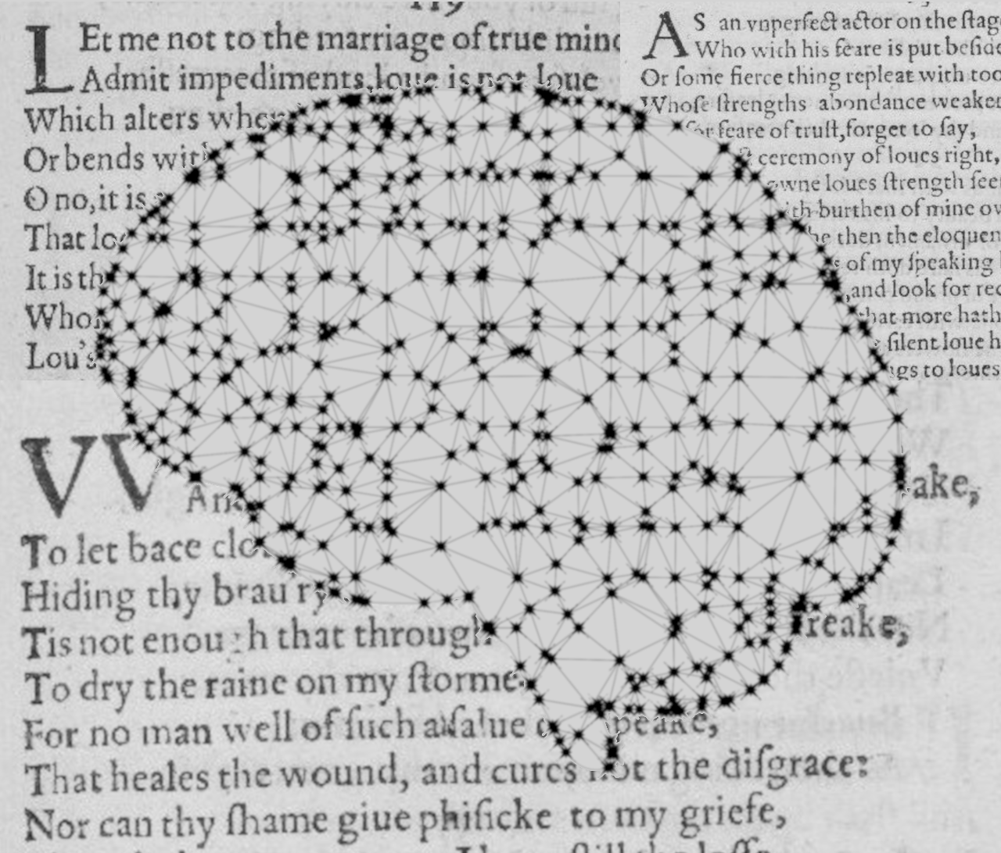
Author Classification of Poetry
Institut für Maschinelle Sprachverarbeitung
Katrin Schmidt & Carlotta Quensel
Team Lab NLP | SS2021 | 14-06-2021

Slide 2
Outline
Task description
Data and preprocessing
Baseline model
First evaluation
Outlook: advanced method

Slide 3
1. Task description
Goal: develop a classifier to identify the author given a document
Program should be able to read in a document and classify it by an author
based on training data
authors have been already seen (no zero shot learning)
How does the vocabulary of a poem determine its author?
representation of the data: word vectors

Slide 4
2. Data and preprocessing
Corpus sourced from “The Poetry Foundation” (founded in 2003), downloaded as finished dataset (csv file) from kaggle.com
Data statistics:
Total number: 3.309 authors - 15.567 poems
Number of authors with > 5 poems: 852 authors - 10.580 poems
We chose: 30 authors - 1297 poems (without "Anonymous”)
Why?
30 authors with the most frequent poems
30 authors = 30 labels, lower computational power than with 800 labels

Slide 5
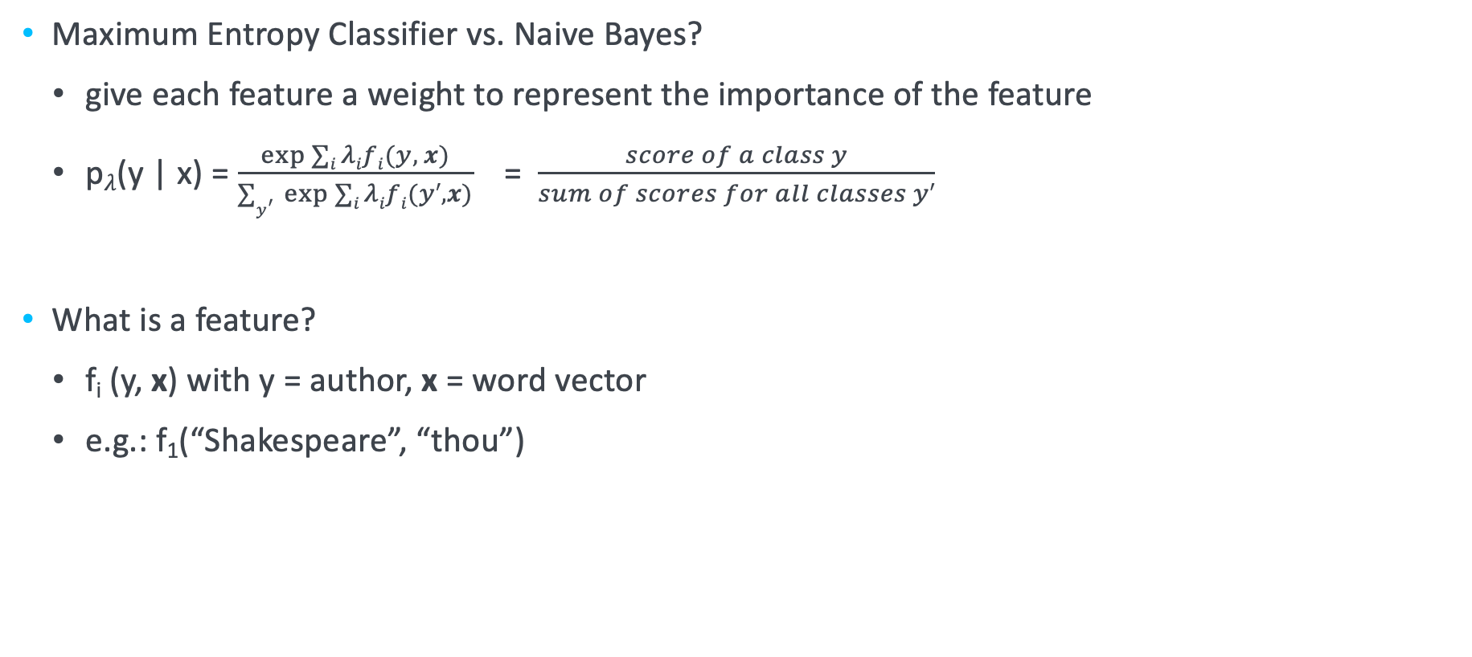
3. Baseline model
Maximum Entropy Classifier vs. Naive Bayes?
give each feature a weight to represent the importance of the feature
p$λ$(y | x) = $\frac{\exp{∑i λifi(y, x)}}{∑y^{′ }\exp{∑i λifi(y′,x)}}$ = $\frac{score of a class y}{sum of scores for all classes y′}$
What is a feature?
f_{i} (y, x) with y = author, x = word vector
e.g.: f₁(“Shakespeare”, “thou”)

Slide 6
3. Baseline model
Maximum Entropy Classifier
Start with least informative weights (choose them random)
Calculate accuracy of classification with these weights
Improve them through iterative optimization:
calculate the derivative of the function F (conditional log likelihood)
new_weight = old_weight - derivative
Find the best weight for each feature (by approaching good accuracy)

Slide 7
Katrin Schmidt
Carlotta Quensel
katrin.schmidt@ims.uni-stuttgart.de
carlotta.quensel@ims.uni-stuttgart.de
source1
source2
source3

