Slide 1
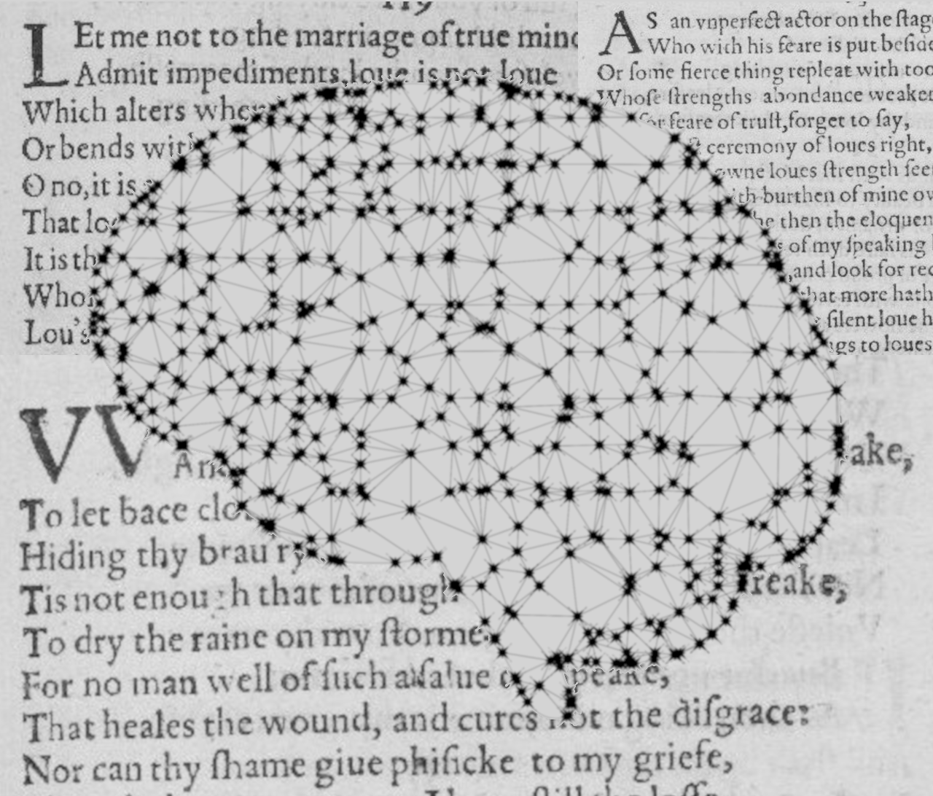
Author Classification in Poetry
Institut für Maschinelle Sprachverarbeitung
Katrin Schmidt & Carlotta Quensel
Team Lab NLP | SS2021 | 14-06-2021

Slide 2
Author classification
Goal
Stylometrics: what age, education, gender, social class has the author
Find specific values for one author
Author prediction: classification task with known classes
Which of my 5 authors has written this text
Our goal: find a method which works well with poetry
Style choices might reflect the medium more than the author
Special features (number of verses, meter, anaphora, …)
Choice of data is limited

Slide 3
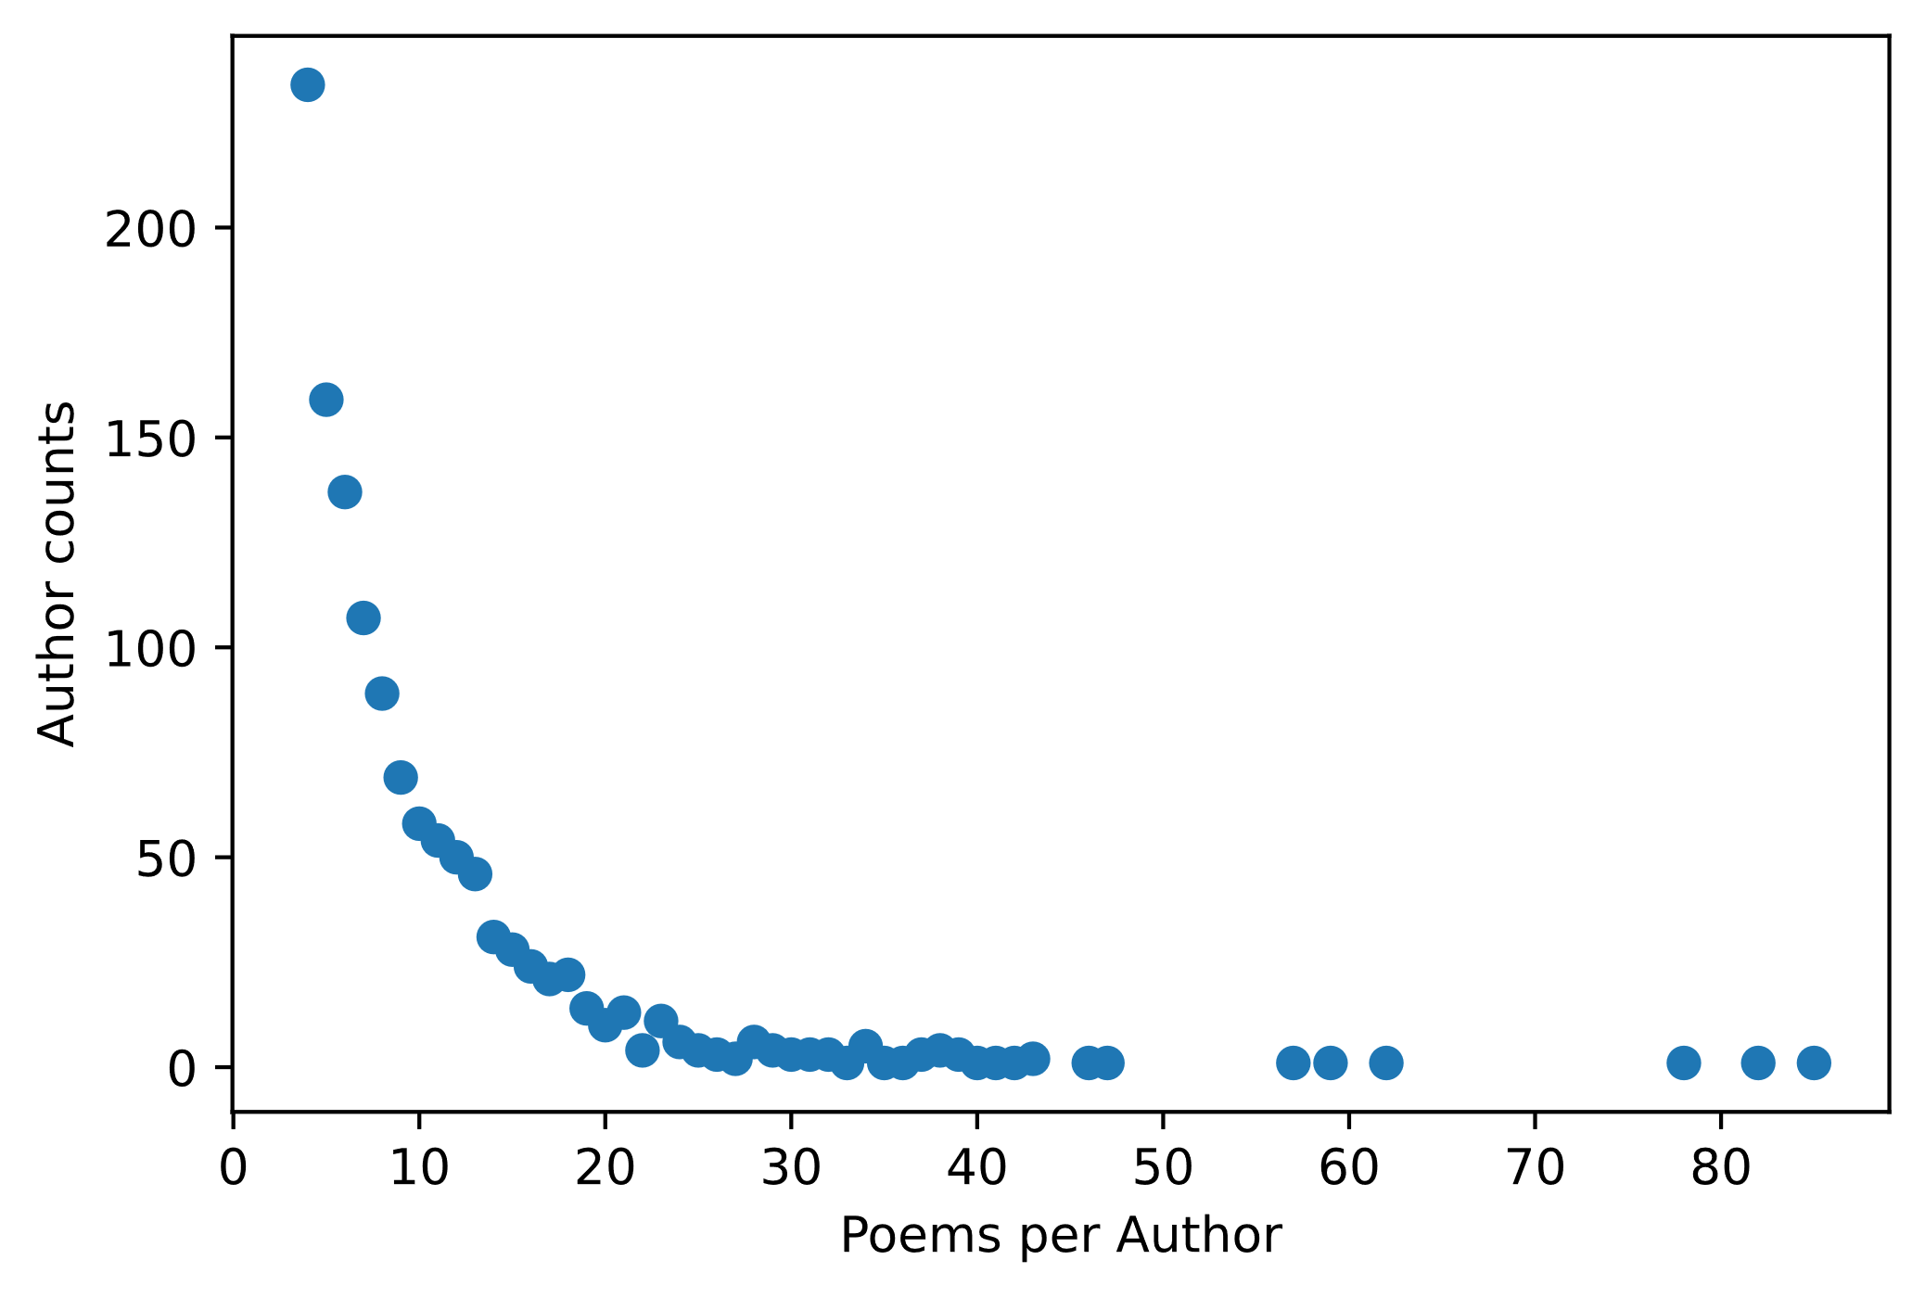
Author classification
Data
Poetry Foundation (founded in 2003)
3309 authors
15567 poems
We decided on the 30 most prolific authors
Prolific authors → more datapoints per class
Only 39 labels, lower computational effort
1569 poems

Slide 4
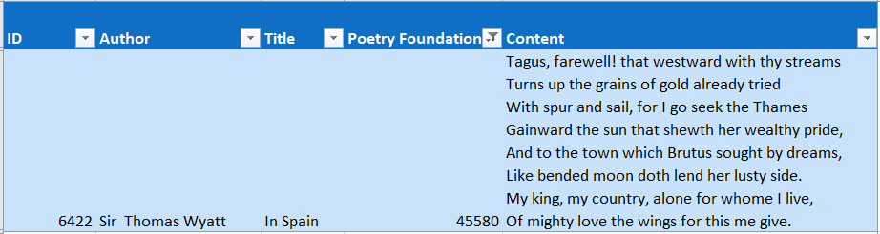
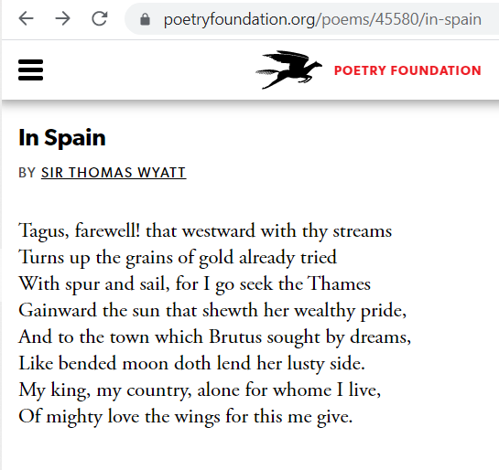
Author classification
Data
CSV from kaggle
Tokenization with NLTK
{'Sir Thomas Wyatt' : [['Tagus', ',', 'farewell', '!', 'that', 'westward', ',', 'with', 'thy', 'streams', ',', 'Turns', 'up', 'the', 'grains', 'of', 'gold', 'already', 'tried', ',', 'With', 'spur', 'and', 'sail', 'for', 'I', 'go', 'seek', 'the', 'Thames', ',', 'Gainward', 'the', 'sun', 'that', 'show', "'", …]}
Bag-of-words vectors
((0,0,0,1,0,0,1,1,0,0,0,1,0,0,1, …), 'Sir Thomas Wyatt')

Slide 5

Approach
Baseline method
Maximum Entropy Classifier
Features: data properties paired with a label
e.g.: $f_{1}\left(y,\overline{x}\right)=\left\{\begin{aligned}1, \\ 0, \end{aligned}{y = \text{Shakespeare} ∧ \text{thou} ∈ \overline{x} \atop \text{otherwise}}\right.$
Weight for each feature to represent the importance of the feature
Training by stochastic gradient descent
p$λ$(y | x) = $\frac{\exp{∑i λifi(y, x)}}{∑y^{′ }\exp{∑i λifi(y′,x)}}$ = $\frac{score of a class y}{sum of scores for all classes y′}$

Slide 6
Approach
Our implementation
50 features per label learned with PMI
Assign a random weight to each feature
Calculate the accuracy with these weights
Iterative optimization
Classify by choosing the label with the highest probability

Slide 7
Results
How does the number of authors influence the classification?
Are bag-of-word features enough?
Experimental design:
39 authors (vs. 15 authors)
50 features per label (only bag-of-words)
F1 – overview
Confusion matrix (if time + interesting)

Slide 8
Next steps
Goal
Classifier that is especially good for poems
Approaches
Architecture (MaxEnt vs. NN vs. ...)
Features (stanzas/verses/rhymes/...)
Division
Kati experiments with NN
Carlotta searches for poetry-specific features

Slide 9
Katrin Schmidt
Carlotta Quensel
katrin.schmidt@ims.uni-stuttgart.de
carlotta.quensel@ims.uni-stuttgart.de
source1
source2
source3

