Slide 1

Australian Energy Production
An insight, provided by Morgan & Carly.

Slide 2
Presenting Part I & II Of The Data Journey
Back end ETL, data sourcing & data cleaning.
Visualisations, dashboard and story telling.

Slide 3

Extract, Transform, Load

Slide 4
ETL: Data Sourcing & Cleaning
Government Data (www.energy.gov.au/data & the ABS)
Energy.gov data extracted through CSVs & ABS data extracted through web scraping.
PostgreSQL Database.
Loading through python in Pandas notebook.
See next page for more cleaning.

Slide 5
Cleaning Steps & Observations
Poorly uniformed data.
Poor use of excel to create usable CSV’s.
Adding columns for year of data & column for renewable/non-renewable indicator.
Use google API to find latitudes & longitudes for all energy plants.
Some “state” columns has acronyms and some had state names.
Numbers had commas and were saved as strings.
Did our own calculations to find energy production per capita.
States with no non-renewable plants showed NaN, so we changed that to show 0 for the maths.

Slide 6
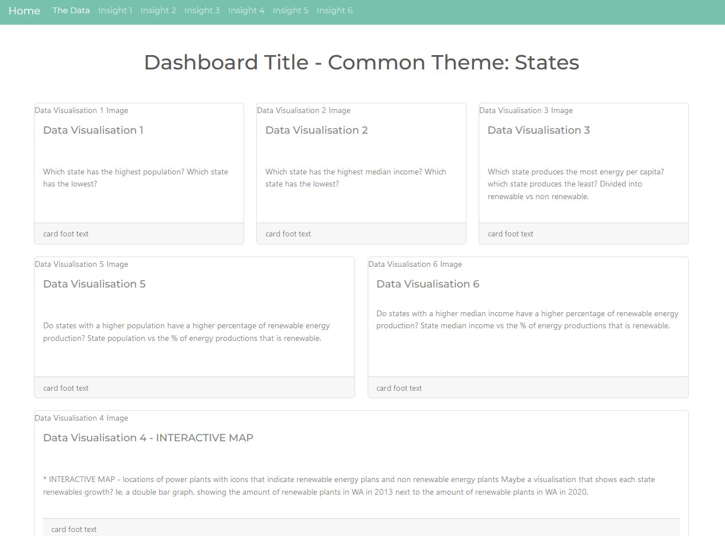
Dashboard & Data Story

Slide 7
Dashboard Development
Flask API
JS library Leaflet Awesome Markers
Jinja HTML
CSS Bootswatch Theme
JS Plotly Visualisations

Slide 8

Our Visualizations & Data Story
Let’s check out the dashboard, shall we?
*Link Here*

Slide 9
Thank you for coming to our Ted Talk.

Slide 10
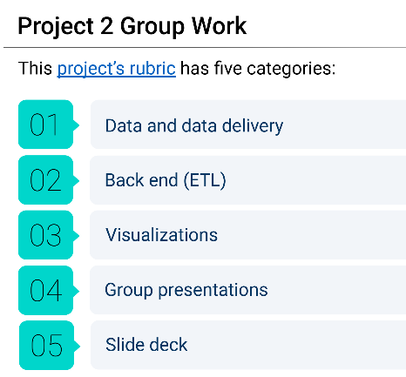
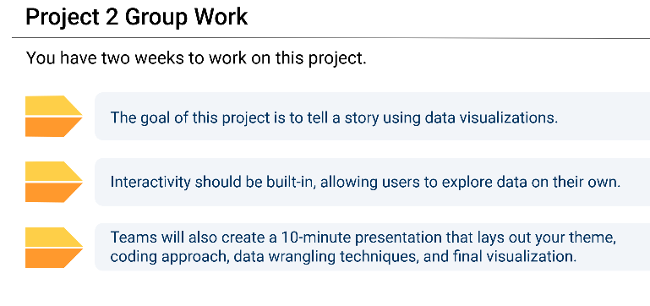

Slide 11
