Slide 1


Work Experience
October 2022

Slide 2
Contents
1 | Introductions
2 | Setup
3 | Project Introduction
4 | Timetable

Slide 3

Introductions

Slide 4
Who am I?
My name is Carly, and I’m a Software Developer at Softwire.
I’ll be running your work experience program this week, and will be the main person you interact with.
I studied Maths at university for 4 years. After my second year I did an internship at Softwire, and joined after I graduated. I’ve been working at Softwire for just over a year.
Since being at Softwire, I’ve worked on:
Creating an analytics dashboard and working on a new booking system for a charter aircraft company
The website for for displaying results for the World Cup for the BBC
Outside of work, I love keeping active and enjoy lots of sports – at uni I took part in rowing, and at the moment I’m enjoying swimming and trying to get better at running!

Slide 5
Who are you?
What is your name?
What year are you in at school and what subjects are you studying?
How much coding have you done (if any), and in what languages? It’s absolutely fine to have not done any!
Do you have any fun hobbies?

Slide 6

Setup

Slide 7
Required Software
You should all have laptops with the following installed:
VS Code
Node.js
Git
You will also need:
A GitHub account
You may also want:
Postman – we can leave this for later in the week though!

Slide 8
GitHub Repository
We will all be working on the same codebase, using Git and GitHub (I’ll be explaining how these work later this morning).
I’ll send the link to the repository this afternoon.
As well as the code, this repository contains:
A README file, which you can read by scrolling down on the link above. This README contains everything you’ll need to know, including:
Timetable
Useful links
Technical overview
How to run the website locally
How to contribute code
The slides for all of the presentations I’ll be giving this week in case you want to look back and remind yourself of anything

Slide 9

Project Introduction

Slide 10
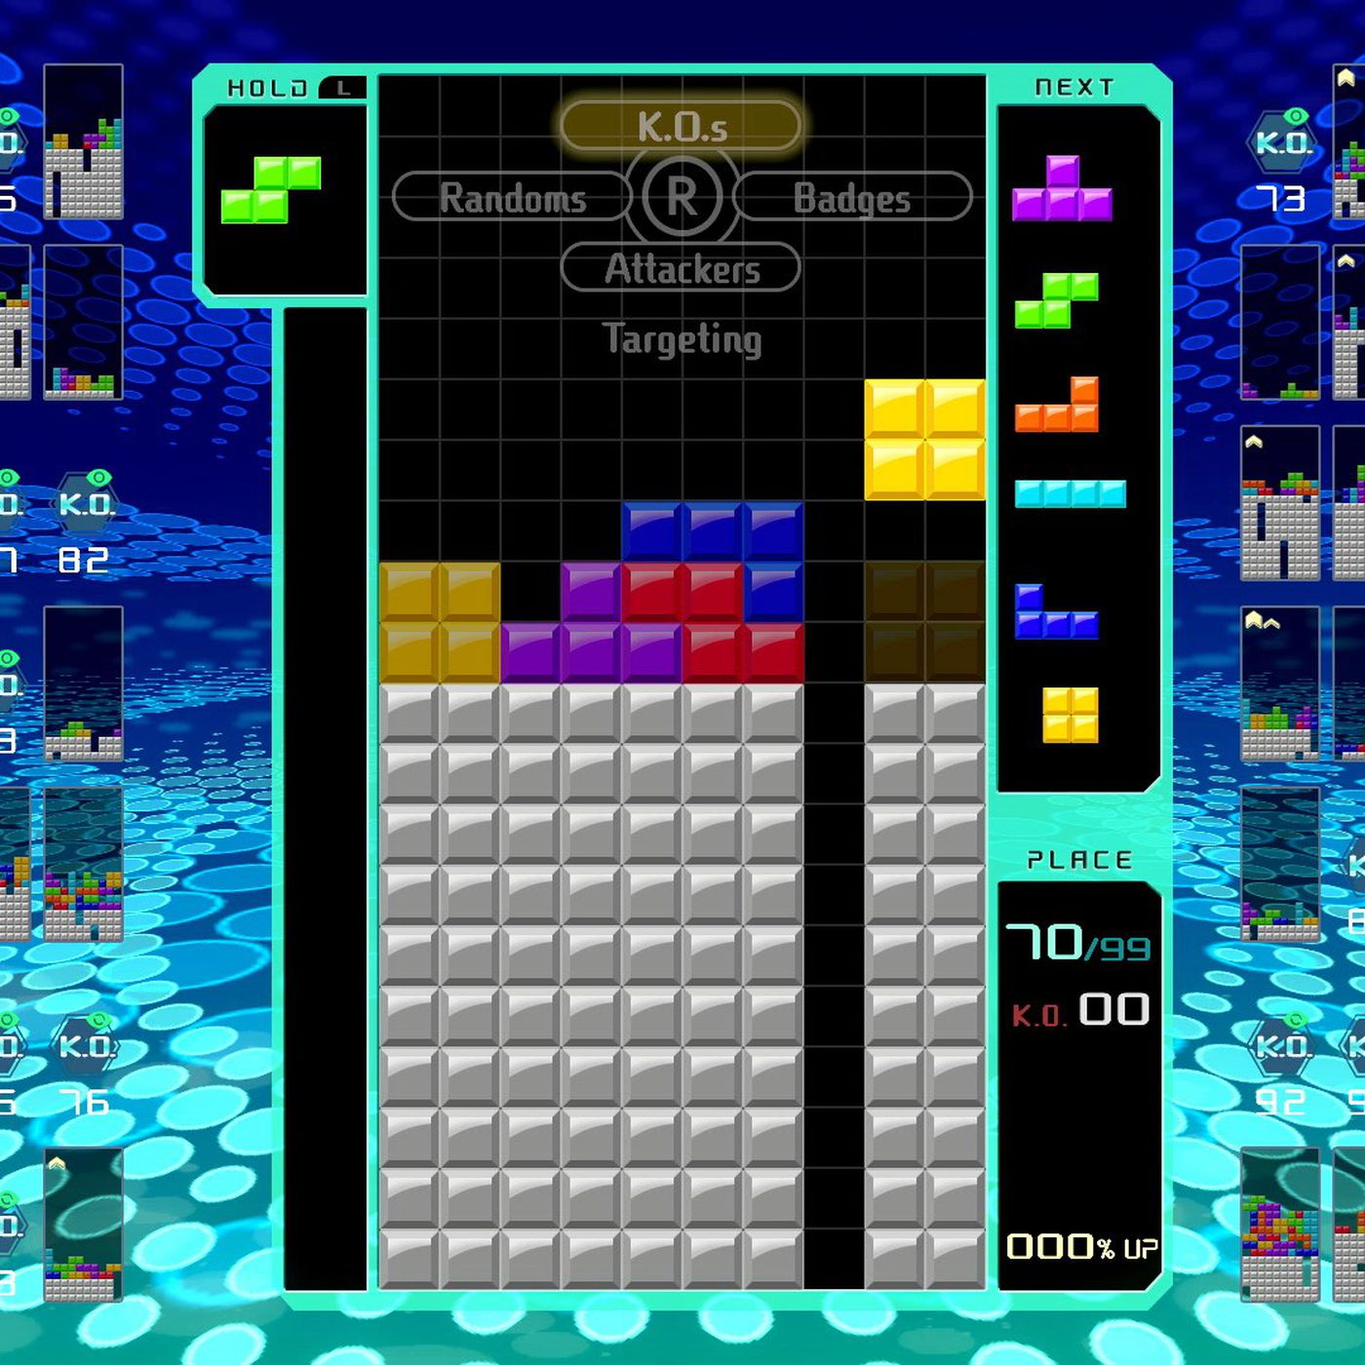
What are we going to build?
We will be building a Tetris website!
This website must:
Have a home screen from which a game of Tetris can be started
Have a playable Tetris game
Handle the end of the Tetris game sensibly
Also:
We’ll be able to come up with lots of our own features too!

Slide 11
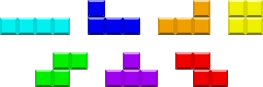
What is Tetris?
You can play Tetris here: https://tetris.com/play-tetris
Tetris is a 10x20 square grid, where different shaped pieces are added randomly to the top of the grid one-at-a-time and descend downwards until they hit another piece or the bottom of the grid.
The player can move the piece in play left or right, or rotate the piece into a different orientation.
In some versions of Tetris, the player can make the pieces drop faster with the down key.
In most version of Tetris, the pieces drop faster as the game progresses.

Slide 12
Let’s play some Tetris!
Let’s take 10 minutes to play some Tetris so that you can introduce yourself to, or remind yourself of, the gameplay.
You can play Tetris here: https://tetris.com/play-tetris

Slide 13
What technology are we going to use?
The project will have two parts:
The frontend code – this is where the static web pages and main gameplay will be. Most of the work will probably be in this area.
The backend code – this will run on a web server and can be used to store or modify data (for example, saving users’ scores).

Slide 14
What technology are we going to use?
Frontend:
The frontend code base will be written in HTML/CSS/JS.
HTML provides the basic structure of each page
CSS is used to control the formatting and layout of the HTML content
JavaScript is used to control the behaviour of different elements on the page
There will be a presentation tomorrow with more details about frontend development and there is more information in the README.
We will not be using any JavaScript framework or library or working with Typescript. These things are excellent, and very common on professional software projects, but by working with “vanilla” JavaScript you’ll be able to focus more closely on writing code and will get a better fundamental understanding of how a website works.

Slide 15
What technology are we going to use?
Backend:
The backend for the website is a Node.js/Express web application. The code for this application will also be written in JavaScript.
Node.js is a JavaScript runtime that allows JavaScript to run outside of a web browser. You don’t need to know too much about it, other than that it’s what we’re using! I am of course happy to discuss in more detail with those who are interested.
Express is a Node.js web application framework. It allows web applications to be built quickly, easily and robustly.
On Wednesday, I’ll be explaining the backend codebase in more detail. I expect we will all start by working on frontend code.

Slide 16
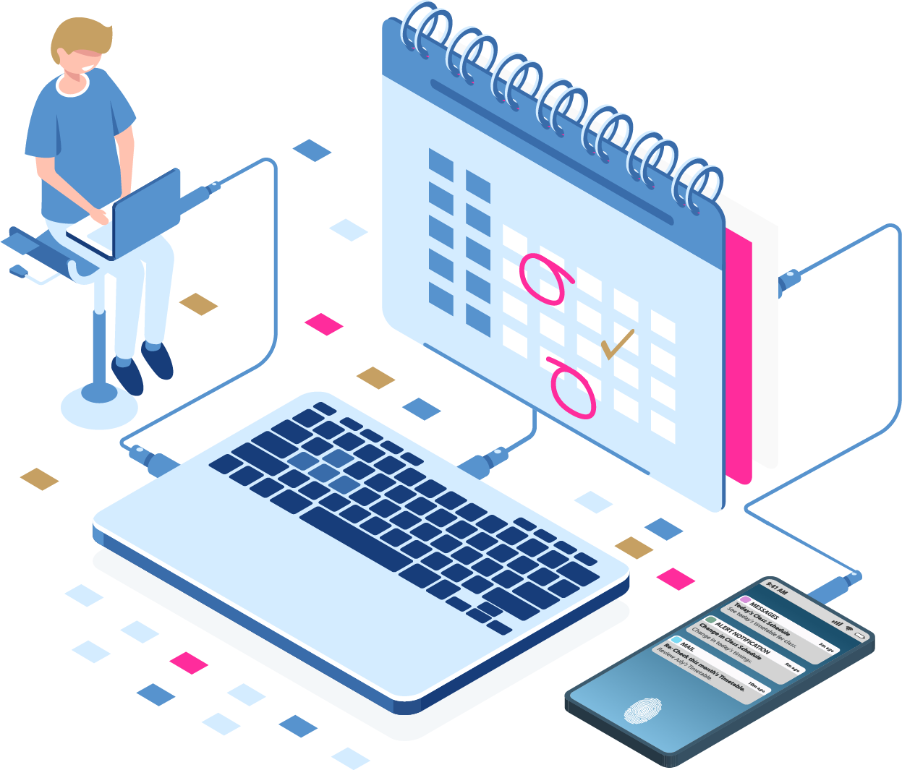
Timetable

Slide 17
An aside: Agile/Scrum/Sprints
“Scrum” is a project management technique that is commonly used on software projects. It is a subset of “Agile”.
There’s lots to it, but in summary:
Work is done in short “Sprints”
At the start of a sprint, the work to be done in the sprint is defined and goals are set
There is a dedicated “scrum master” who is responsible for keeping the team on track
During the sprint, there is a daily “standup” meeting to discuss how things are going and if there are any issues
During the sprint, people work on the various tasks and goals
At the end of the sprint, a retro meeting is held to review how the sprint went and discuss any ideas to be applied in future sprints
This week will be structured a bit like a sprint. We’ll start by defining goals for the week and features that we’d like our website to have. We’ll have a standup meeting at the start of every day and at the end of the week we’ll have a retro to see how things have gone and if we’ve met the goals we set out at the start of the week.

Slide 18
An aside: Pairing
Pair programming, or “Pairing”, is an Agile software development technique where two developers work together on a problem
Traditionally, this happens at the same computer screen, but in the era of remote working it also very commonly happens via video call and/or live share
There are two roles:
The “Driver”: writes the code and focuses closely with line-by-line detail
The “Navigator”: reviews each line of code as it is typed in, and tries to keep in mind the overall direction of the work beyond the current line of code
Advantages of this:
Developers bring different experience to the task and may assess it in different ways
Developers are forced to think in different ways by the two different roles
Knowledge sharing happens between the developers
Main disadvantage: it takes longer!

Slide 19
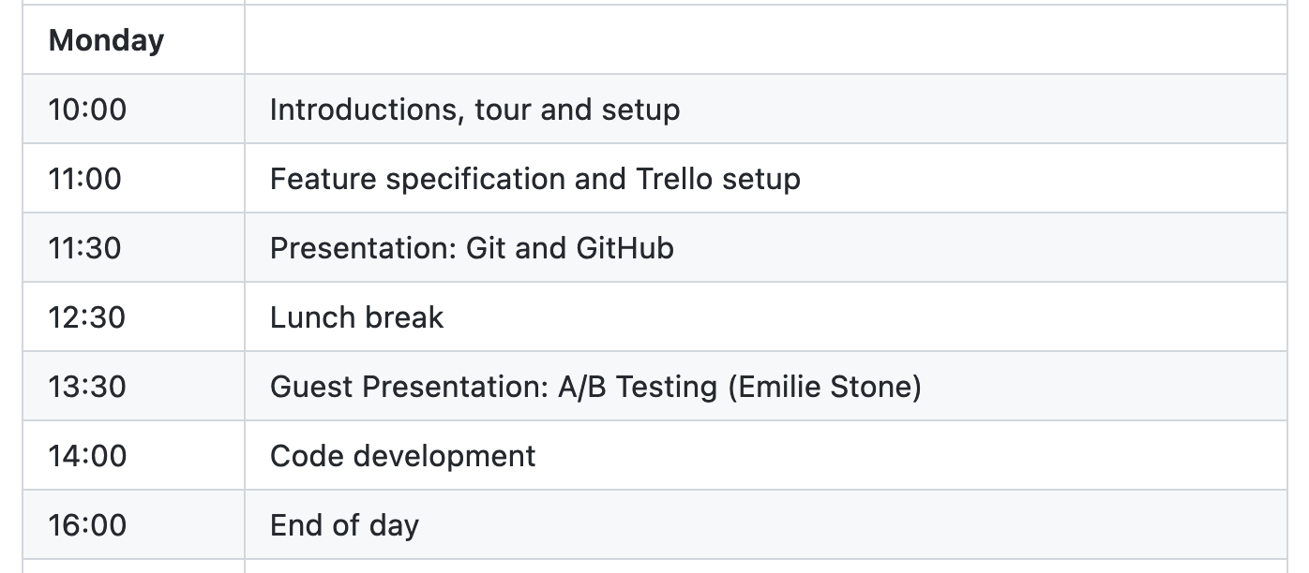
Timetable - Monday

Slide 20
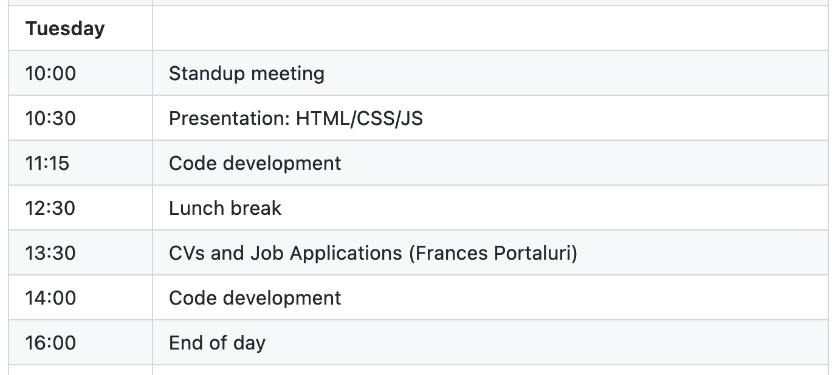
Timetable - Tuesday

Slide 21
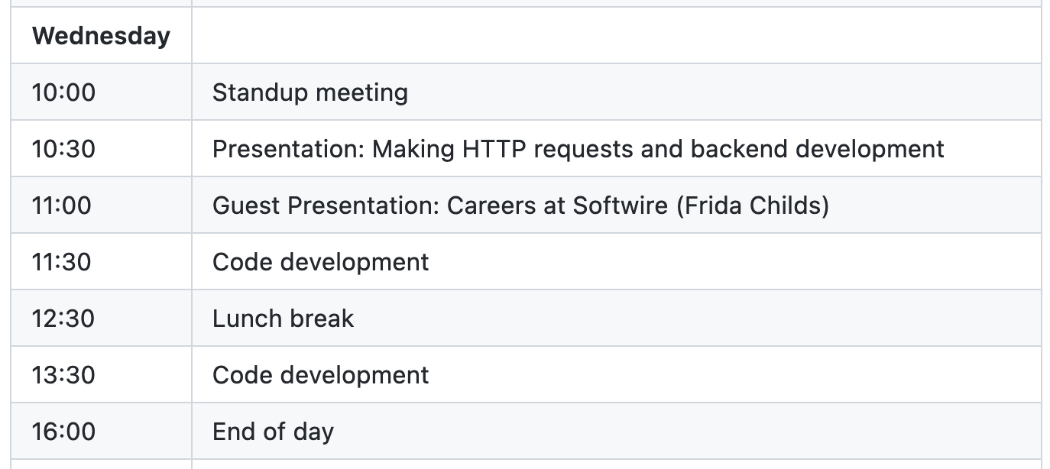
Timetable - Wednesday

Slide 22
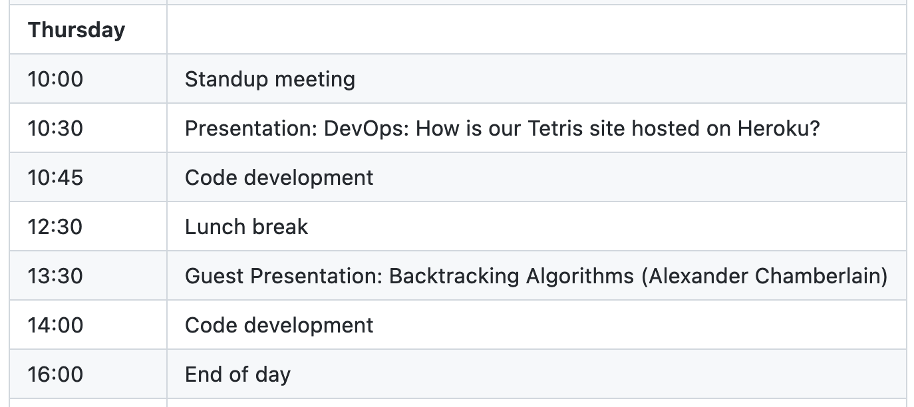
Timetable - Thursday

Slide 23
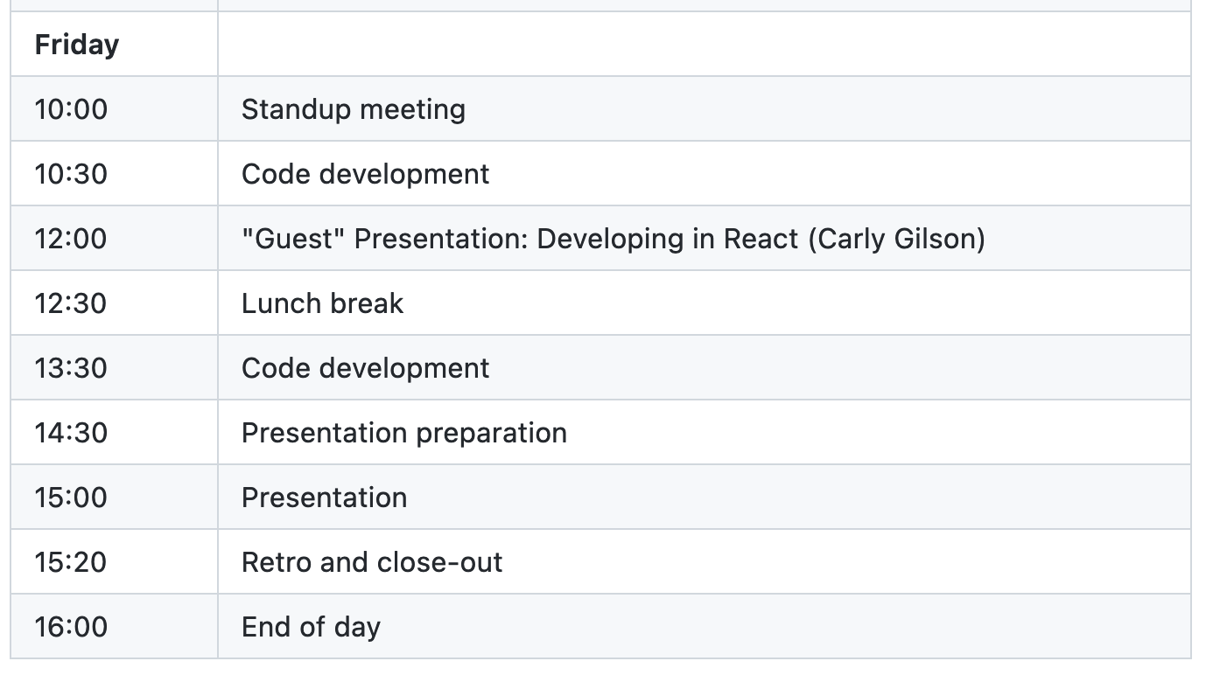
Timetable - Friday

Slide 24
Carly Gilson
Software Developer
carly.gilson@softwire.com
Suite 315, Highgate Studios
53-79 Highgate Road
London NW5 1TL
Copyright © Softwire 2021
All rights reserved

