Slide 1


HTML, CSS and JavaScript
February 2022

Slide 2
Contents
1 | What are HTML, CSS and JavaScript?
2 | How do HTML/CSS/JS fit together on our website?
3 | HTML: the basics
4 | CSS: the basics
5 | JavaScript: the basics
6 | Example

Slide 3
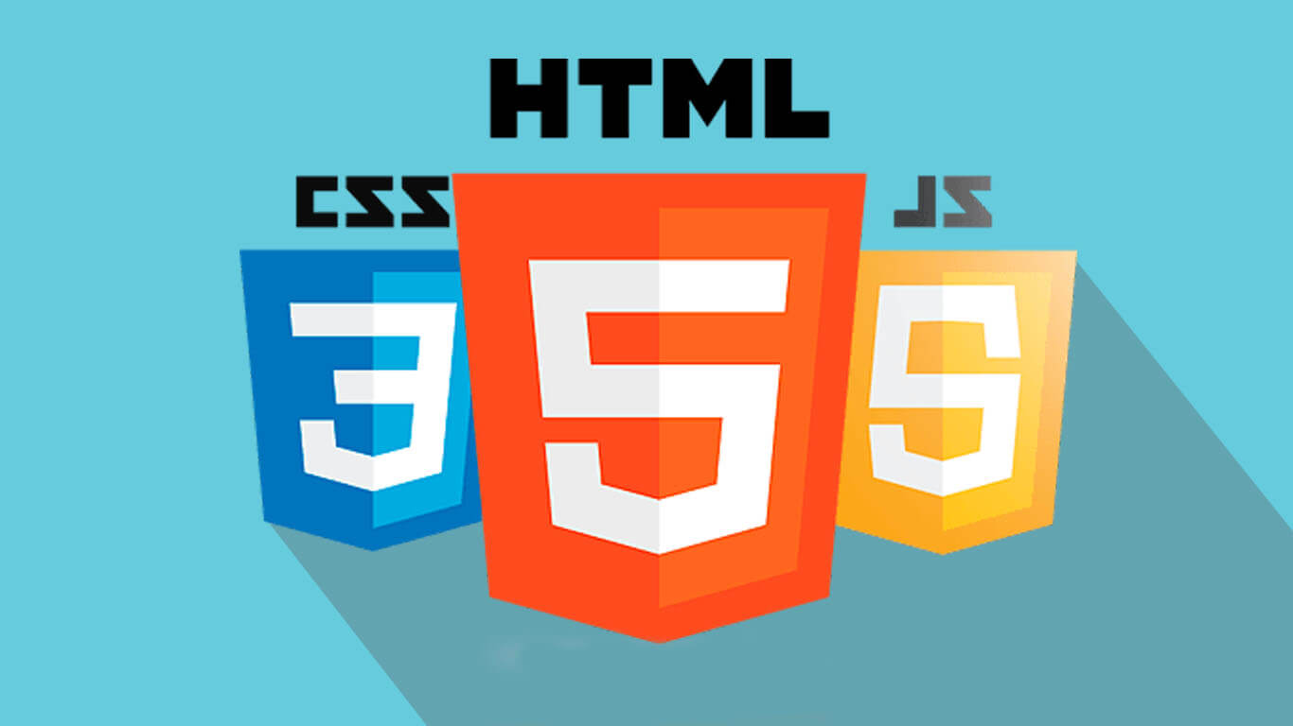
What are HTML,
CSS and
JavaScript?

Slide 4
What roles do HTML/CSS/JS fill in a web frontend?
HTML
Provides the basic structure of a website
Enhanced an modified by CSS and JavaScript
CSS
Used to control presentation, formatting and layout of elements on the page
JavaScript
Controls the behaviour of elements on the page
Allows a site to be interactive rather than just displaying static content

Slide 5
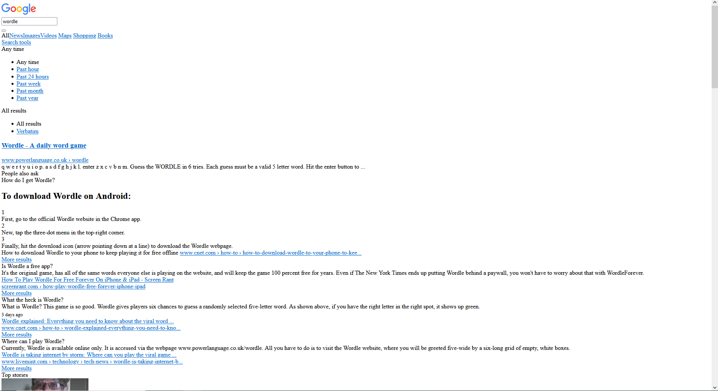
An example – Google with HTML only
The Google results page for “Wordle” with just HTML.
We have:
Text
Clickable links
Images
However:
This doesn’t look like Google should do!
There is no styling of the content
There is nothing dynamic on the page

Slide 6
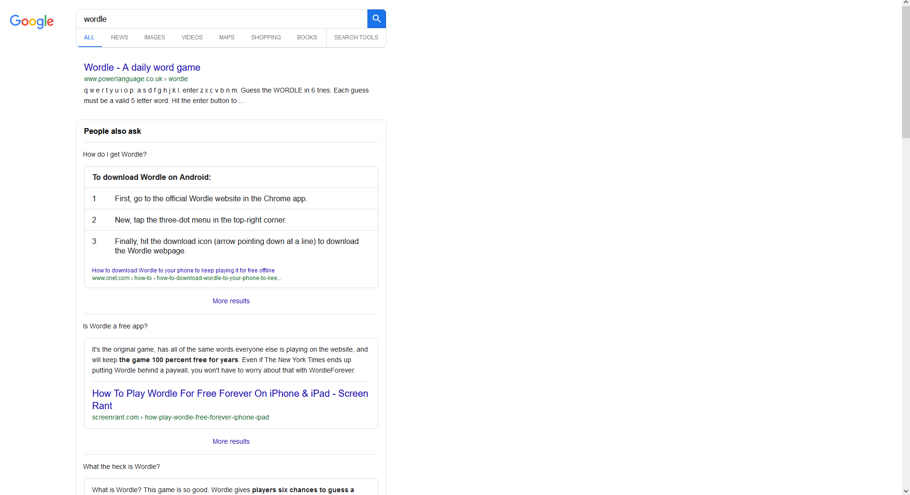
An example – Google with HTML and CSS
The Google results page for “Wordle” with HTML and CSS.
This looks a lot better!
The page now has lots of styling and looks more like the Google page we expect.
There’s still some things missing though!

Slide 7
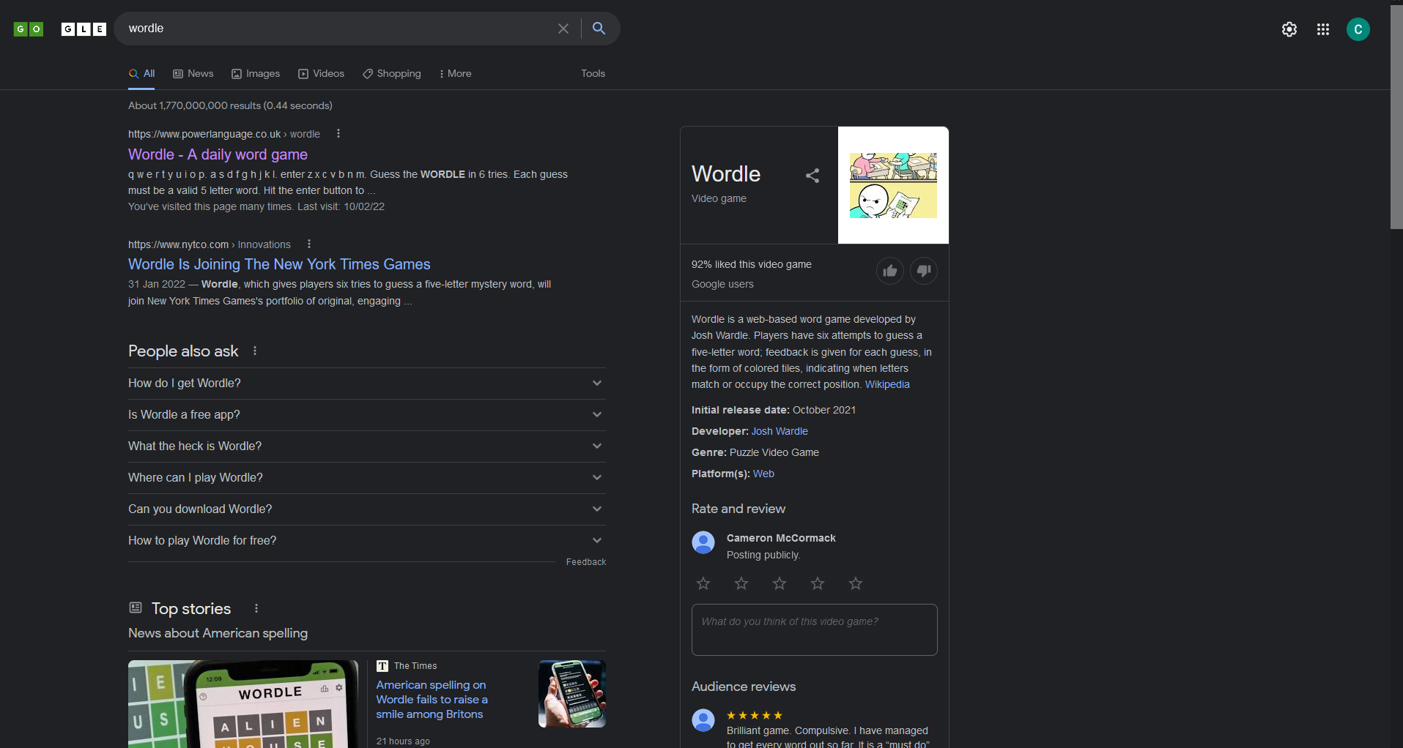
An example – Google with HTML/CSS/JS
The Google results page for “Wordle” with HTML, CSS and JS.
This is now the complete page.
All of the elements that need to run dynamic code to be shown are now present, including:
Animated Google doodle
Reviews section
Account settings
Dark mode preference detected
There is also lots more code running behind the scenes that the user doesn’t see (analytics, tracking, etc)

Slide 8

How do HTML/CSS
/JS fit together for
our website?

Slide 9
What will we use HTML/CSS/JS for? Example: the main Tetris game page.
HTML
CSS
Arranging the elements sensibly on the page
JavaScript
Making the blocks appear at the top of the grid
The general structure of the page
The game grid
Any text fields or images
Buttons
Defining any other components that we want
Colours
Fonts
Selecting what the next block will be
Controlling the movement of the blocks down the grid
Handling rotation of the blocks
Handling the blocks hitting another block or the bottom of the grid
Note: we can use a common CSS file across multiple HTML pages. For example, we can define a style named “back-button” in a single style.css file, and use it to style the back button in every HTML page
Note: it is possible to write CSS and JavaScript within the HTML file. However, it’s generally best practice to avoid this and keep them in their own files.

Slide 10

HTML: the basics

Slide 11
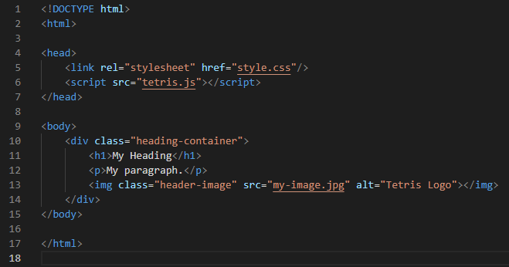
HTML Basics
Here, we are importing our CSS file
All HTML files need to declare their type at the top like this
Inside the head tag, we import other files that we need
Here, we are importing a JavaScript file
The HTML content is contained within this HTML tag
A div is an element used to divide up a page, and it can be styled with CSS. By setting the class as heading-container, we can define a style in style.css for this type of div
Inside the body tag, we define the elements we want to see on the screen
Every opening tag must also have a closing tag
We can nest elements in other elements to create a sensible structure
There are built-in HTML tags for headings, paragraphs, images and much more!

Slide 12

CSS: the basics

Slide 13
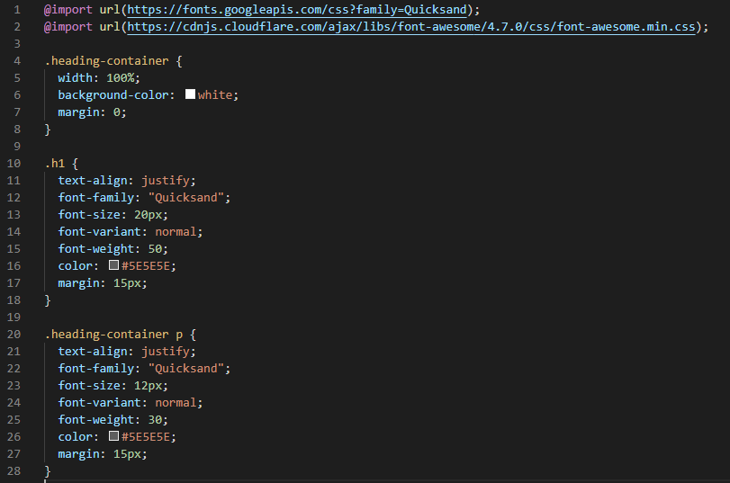
CSS Basics
We can import fonts and other styles from the internet here
This styles the heading-container that we defined in our HTML
There are lots of different properties that you can set for an element
By putting the h1 element here, this will style all h1-type HTML elements like this
By defining this p after the heading-container tag, this style will only affect p-type elements within a heading-container type div

Slide 14
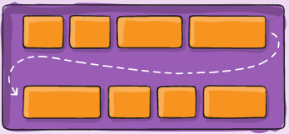
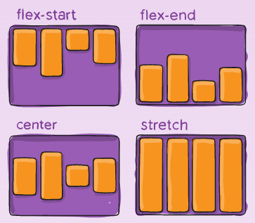
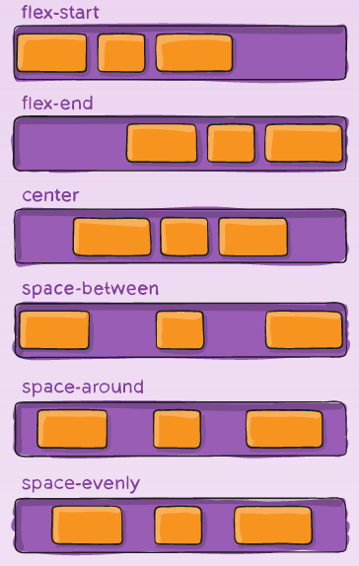
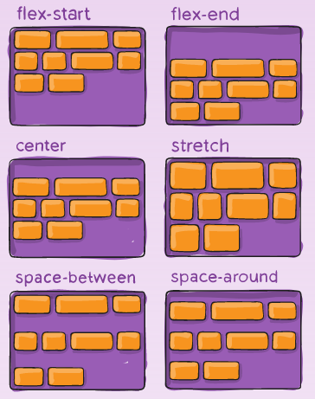
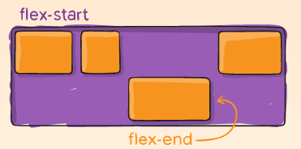
CSS Flexbox
A “Flexbox” is a very useful and powerful CSS tool that helps to lay out, align and distribute items within a container. It’s likely that using a flexbox for some parts of this website will make things much easier and more robust! It allows you to easily do things like this in CSS:
This website is a fantastic resource for using flexboxes: https://css-tricks.com/snippets/css/a-guide-to-flexbox/. It is also linked in the README of the GitHub repository.

Slide 15

JavaScript: the basics

Slide 16
JavaScript Basics - Intro
In this project, most of what you would traditional think of as “programming” will be done in JavaScript.
This includes:
All of the dynamic logic and control in the frontend codebase
The entire backend codebase
If you have written code in another language before, you will hopefully find the skills quite transferable to JavaScript! It has some quirks, but good coding practices generally apply across all languages.
In the next few slides I’ll describe some very fundamental concepts of writing JavaScript code which should hopefully be enough to get you going! As and when more complex use cases come up, we can deal with them.

Slide 17
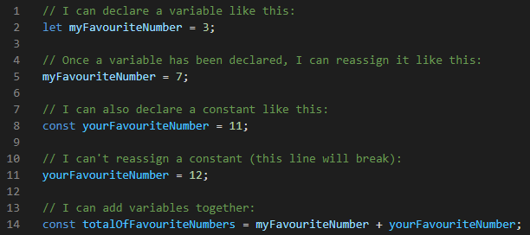
JavaScript Basics – Variables
In JavaScript, we can assign values to variables so that they can be reused later. This looks like this:

Slide 18
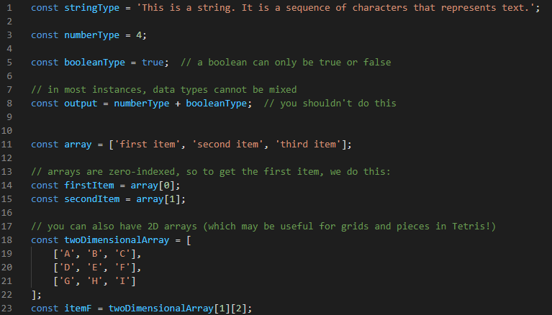
JavaScript Basics – Data Types
Variables don’t just have to be numbers though, there are a variety of types. Here are some examples:

Slide 19
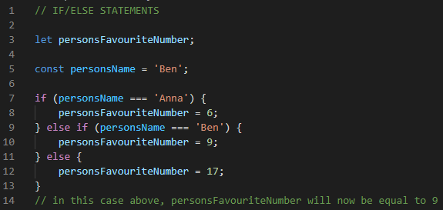
JavaScript Basics – Conditionals – If/Else If/Else
The following conditional operations may be useful for parts of the project:

Slide 20
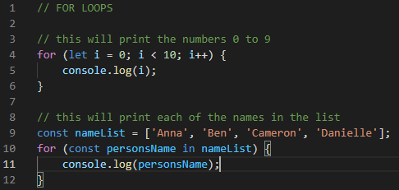
JavaScript Basics – Conditionals – For Loops
The following operations may be useful for parts of the project:

Slide 21
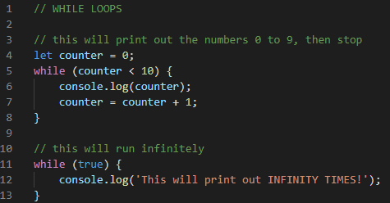
JavaScript Basics – Conditionals – While Loops
The following operations may be useful for parts of the project:

Slide 22
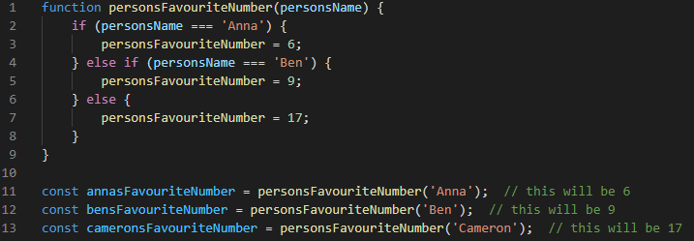
JavaScript Basics – Functions
We can also define functions so that basic operations can be reused:

Slide 23
Basics - Summary
The HTML/CSS/JavaScript I’ve shown you is only a very brief introduction. It’s a very big and complex topic!
I’ve included some useful links in the README for a bit more further reading should you need it.
As well as the links in the README, if you have any questions there are two excellent resources available to you:
Me! I’m here to help and will be moving between the breakout rooms regularly to help you out and answer any questions. Please ask me lots of stuff; I want to help you learn as much as possible.
Google! It’s not cheating to Google things if you’re looking for a quick answer. This is work experience, and professional software developers Google things all the time – there’s too much content to remember it all!

Slide 24

Demonstration

Slide 25
Demonstration
I will now demonstrate adding a quick feature to the website using HTML, CSS and Javascript.

Slide 26
Cameron McCormack
Software Developer
cameron.mccormack@softwire.com
Suite 110, Highgate Studios
53-79 Highgate Road
London NW5 1TL
Copyright © Softwire 2021
All rights reserved

