Slide 1


HTTP Requests and Backend Development
February 2022

Slide 2
Contents
1 | What are HTTP requests and why do we use them?
2 | How can we easily test an HTTP request?
3 | How can we send HTTP requests from the frontend code?
4 | How do we receive and enact HTTP requests in the backend?

Slide 3

What are HTTP
requests and why
do we use them?

Slide 4
What are HTTP requests?
HTTP stands for Hypertext Transfer Protocol. We use an HTTP request when we want to get or modify data on a server.
HTTP requests are a structure of requests made by a client to a server. There are several types of request; we’ll only need to worry about the following:
GET: this is used to get data from the server, in a read-only operation. (This is what a web browser uses to load a page, but is also used for many other calls to get data from a server).
POST: this is used to create, update or otherwise modify data on the server.
HTTP responses return data from the request. As well as containing the data, they also contain a response code to indicate what type of response it is. There are many response codes, we’ll only need to worry about the following:
200 OK: The request succeeded
400 Bad Request: The server could not understand the request due to bad syntax
404 Not Found: The server could not find the requested resource
500 Internal Server Error: The server has had an unexpected error
There are links to more details about request types and response codes in the README

Slide 5

How can we easily test an HTTP request?

Slide 6
How can we easily test an HTTP request?
Postman can be used – this is an API platform for using APIs.
I will now demonstrate using the Trello API to access our Trello board via Postman

Slide 7
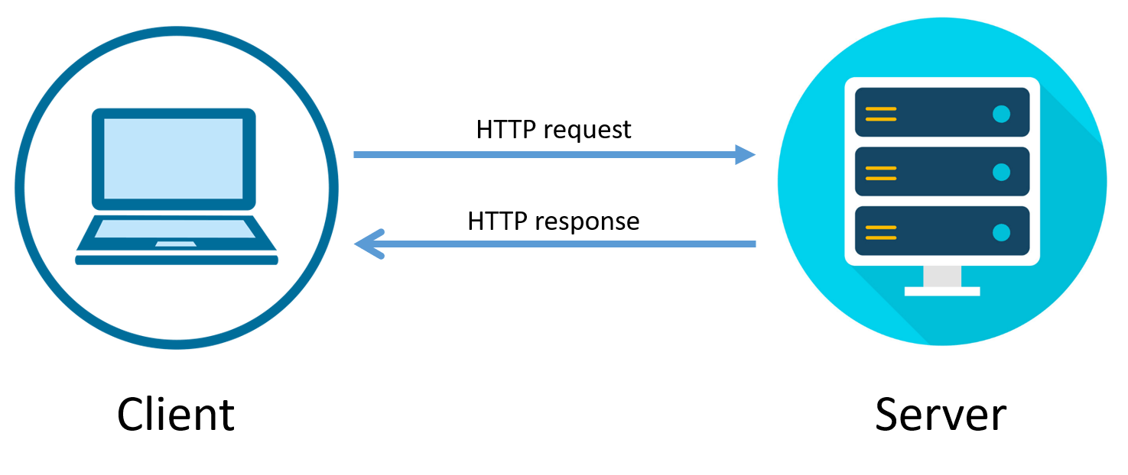
How can we send HTTP requests from the frontend code?

Slide 8
How can we send HTTP requests from the frontend code?
There is already a helper class implemented for this – ApiMessageSender.
This class is set up to be able to make GET and POST requests, with body parameters on the POST request.
HTTP requests will be handled as asynchronous operations, so need to be awaited.
I’ll now run through the code, and how to use this class.

Slide 9

How can we receive and enact HTTP requests in the backend?

Slide 10
How can we receive and enact HTTP requests in the backend?
Our backend code is a web application – a Node.js/Express app to be precise
We can define “endpoints” on this application. An endpoint is a point of entry to our backend app, it received a specific HTTP request method at a specific URL.
For each of these endpoints, we define a function in the backend code that is called when a client makes the request. This function will do some processing and then return a response to the client.
I’ll now run through an example endpoint in the backend codebase to explain how this process works end-to-end.

Slide 11
Cameron McCormack
Software Developer
cameron.mccormack@softwire.com
Suite 110, Highgate Studios
53-79 Highgate Road
London NW5 1TL
Copyright © Softwire 2021
All rights reserved

