Slide 1
Micro-Level Natural Interaction with Information Systems: An International Screenshots Comparison
ICA 2018 Information Systems
Yingdan Lu, Dan Muise, Jennifer Pan, Byron Reeves Department of Communication, Stanford University
Notes:
Good afternoon everyone. My name is Yingdan Lu and I am from Stanford University. It is a great honor for me to present the preliminary findings from the pilot study conducted by me and my collaborator Yu Xin from Oxford.

Slide 2
Introduction
Is human-smartphone interaction similar across highly varied contexts?
USA | Longest time and high maturity with mobile / internet media
MYANMAR | Recent transition and sudden widespread adoption of mobile / internet media
CHINA | Growing mobile / internet media under authoritarian control
Notes:
The reason for us to do this research is two-fold. Social movements in China has a sharp increase from 2003 to 2010, when China experienced an economic boom. Meanwhile, the Internet infrastructure also has a tremendous increase, which provide new opportunities for organizing social movements. However, previous studies also investigate that the development of social media facilitates more fragmented online political engagement and individualized collective actions. Among the possible influencing factors, political values is regarded as an internal constraint of netizens’ political behaviors. So in this paper, we focus on the inference between political ideology and the participation of online collective actions.

Slide 3
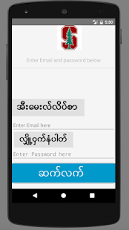
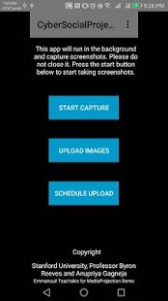
Method: longitudinal checks, is the screen on?
Using a novel android app, participants’ smartphone screens were tracked at five-second intervals.
We analyze the timestamps of screenshots to measure phone usage.
Sample adults from each country
Ages 22-30
One week of screenshot collection
App UI in Burmese, English and Chinese
Notes:
When studying political values and political ideology, the most frequent paradigm would be the left-right demarcation. The leftism is usually regarded as preferring state power and government lead, defending traditional culture and existing order, and affirming Mao’s legacy. The rightism goes opposite by supporting economic and individual freedom, social justice, postmodern values and denying Mao’s legacy.

Slide 4
Data
 | Both genders without outliers
Country | US | MM | CN
Sample size | 18 | 12 | 23
Average hours of phone usage | 24 | 16 | 36
Average # times turned on | 2415 | 1396 | 3583
Mean seconds b/w on and off | 41 | 45 | 40
Mean seconds b/w off and on | 151 | 534 | 141
Notes:
Differently, the latest paper from Pan and Xu uses a more inductive way, which argues that the demarcation of Chinese political ideology includes three dimensions. Xxx, xxx and xxx. Also, the analysis of latent factors show that the dimensions are highly correlated with each other.

Slide 5
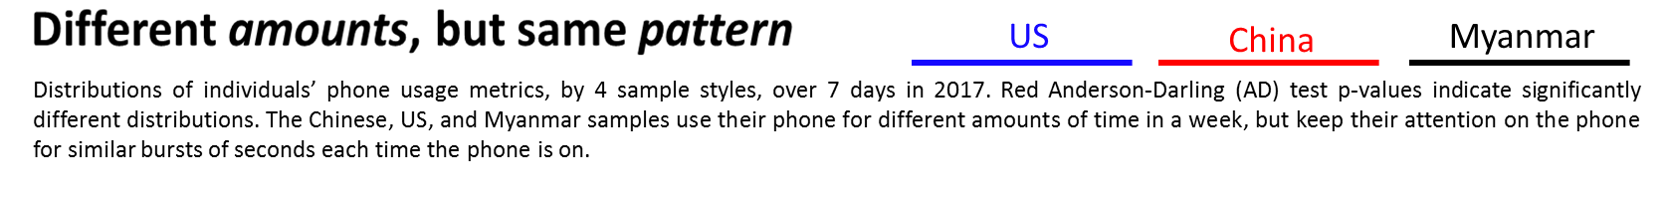
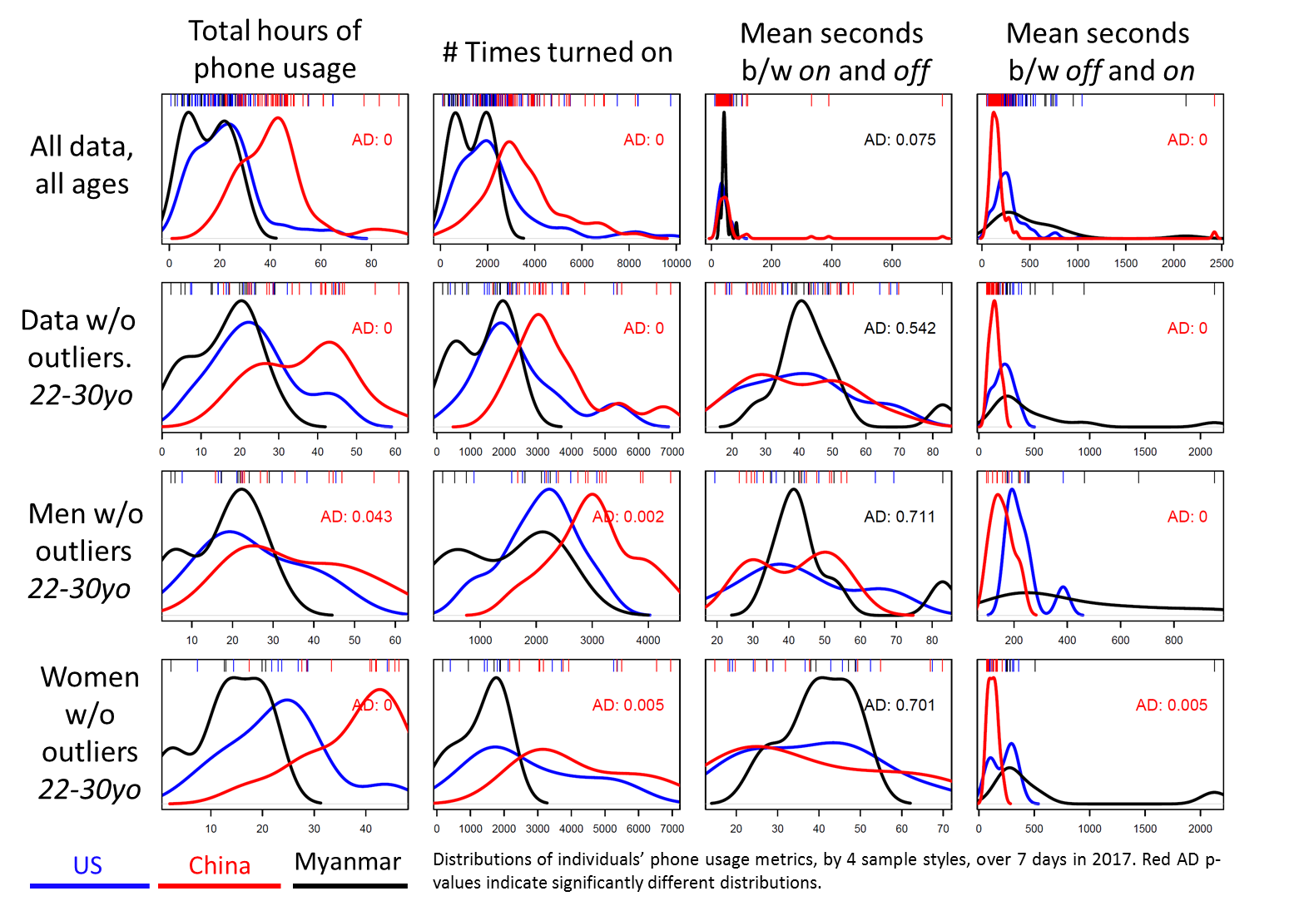
Results
Distributions of individuals’ phone usage metrics, by 4 sample styles, over 7 days in 2017.
Red Anderson-Darling (AD) test p-values indicate significantly different distributions.

Slide 6
Conclusion
Screen time China > US > Myanmar, heavier phone activity among participants in China. Mean session length Similar distributions of average time between phone-on and off. Basic implications Participants in China, US, and Myanmar use their phones for differing lengths of time overall, but keep their attention on the phone for similar time durations each time they turn the phone on. Substantive implications Suggests similarity in human-smartphone interaction in three highly varied contexts.

Slide 7
Thank you
Dan Muise dmuise@stanford.edu Yingdan Lu Yingdan@stanford.edu

