Slide 1
Carme.AI
Benjamin H. Volk
SummerRay A. Morrow
Thomas W. MacIntosh
Osama J. Minhas

Slide 2
Agenda
Project Team
Client Information
The Problem
Our Solution
Requirements
Design
CBA
Scope
Construction
Demo
Turnover/Results
Notes:
Thomas

Slide 3
The Team
Benjamin Volk
Project Manager
Thomas Macintosh
Front End Developer
SummerRay Morrow
Lead Developer
Osama Minhas
QR Engineer & AI Developer
Notes:
Thomas

Slide 4
Who is Carme?
The Company
Startup Status
Founded one year ago
Developed with help from RCOS
The Service
Big Data Development and Hosting
Currently in Alpha
Focus on streamlined workflow
Notes:
Thomas

Slide 5

Pain Points
The Problem
?
?
Backend Framework
Data hosting is difficult for the average user
Workflow is constrained to just command line
Strategic fit is very narrow
Notes:
Thomas

Slide 6
The Solution
User Interface
ETL
Backend Framework
Notes:
What we created was the two missing pieces to their backend with an emphasis on the average user. To do this, we created a dashboard based integration and an ETL layer to translate high level user input into the low lever console commands Carme already has
Thomas

Slide 7

Functional Requirements
Process
Scalability
People
Compliance
Notes:
Thomas

Slide 8



Non-Functional Requirements
Security
SSL and Encryption
Branding
Compliant branding solutions
Networking
Dynamic Load Balancing
Notes:
Thomas

Slide 9
Design & Process

Slide 10
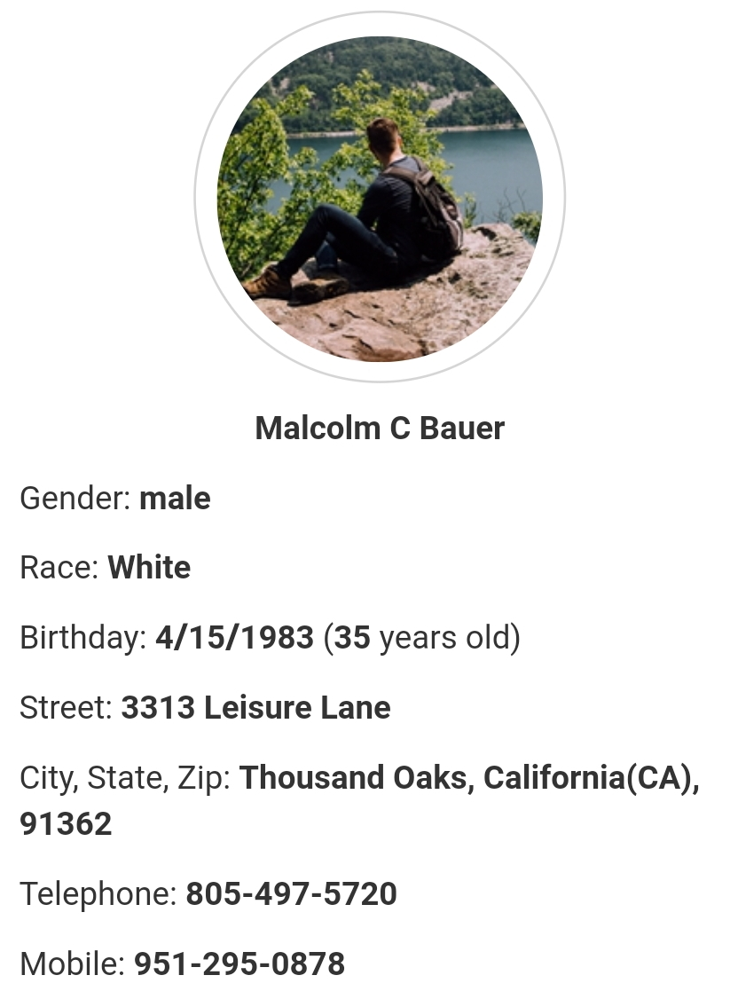
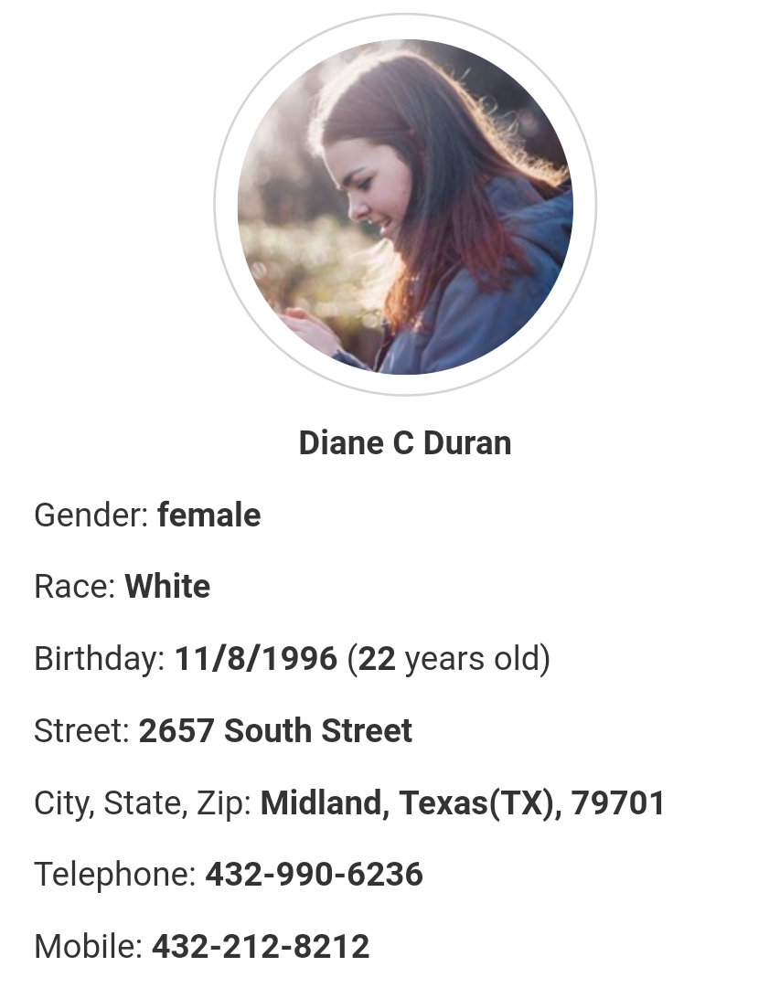
Design – Use Cases
Use of Empathy Maps
Personas used to determine how a certain type of user would use the system
Develop around the users!
Notes:
Ben

Slide 11
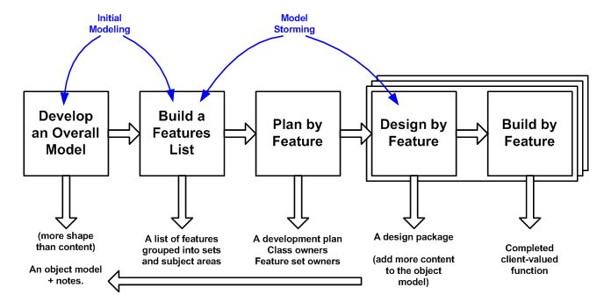
Methodology – Feature Driven Development
Notes:
Ben

Slide 12
Cost-Benefit Analysis
Costs
Group Meetings
Client Meetings
Benefits
New Customer Acquisition
Reduced Cycle Times
Hosting
Development
Testing
Brand Recognition
Government Compliance
Improved Data Storage/Use
Total Cost: $32,000
Total Benefits: $218,000
NPV
$143,000
IRR
232%
Risk Rate
16%
Notes:
Ben

Slide 13
Risk Considerations
Organizational
Continued Support
Technology
Integration Failures*
Resource
Implementation
Training
Compliance Failures
Back End Volatility
Future Development Stack
Timeline Overages
Notes:
Ben

Slide 14
Timeline
Startup
Analysis
Design
1 week
2 Weeks
Construction
1 Week
9 Weeks
Testing
2 Weeks
Closing
1 Week
Notes:
Ben

Slide 15
Project Scope & Construction

Slide 16
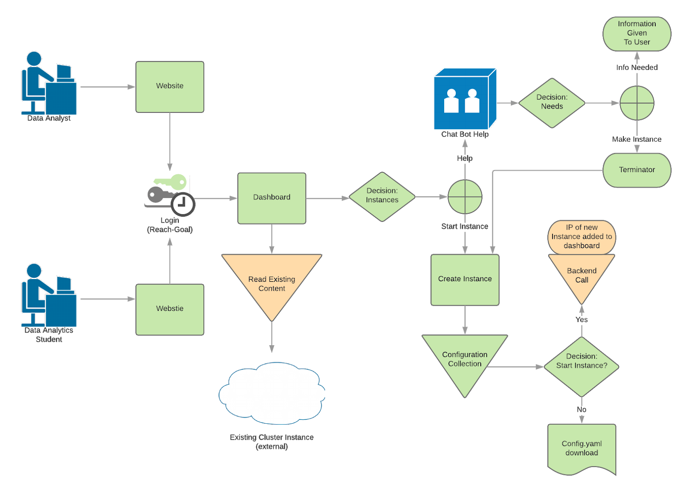
Data Flow & Scope
Green = In Scope
Orange = Reach Goals
Notes:
SR

Slide 17





Development Stack & Challenges
Notes:
SR

Slide 18
Demo & Completion

Slide 19
DEMO
https://carmeonline.azurewebsites.net/
Notes:
Osama

Slide 20

Post-Turnover
Code Turnover
Training
Github provided by the client
README
Project Manager Contact Details
Notes:
Osama
Code Turnover
All code created over the duration of this project is transitioned into it’s own Github repo provided to us by the client
Training
Along with the project, an Extensive Readme was generated to show the structure of the application as well as basic instructions of how to get the application up and running.
The Project Manager’s contact details have been included in this report should any specific questions arise.

Slide 21
Results
Scope
Impacts to Business
Full scope achieved
One stretch goal completed
3-4 months ahead in development
Closer to MVP Status
Notes:
Osama
Scope
Our full scope was achieved by the end of the project plus one additional reach goal
Impacts to Business
Though Carme is very early in it’s lifecycle, we believe that this user interface will provide the company a substantial jump in their progress towards MVP status

Slide 22
Lessons
What Worked
What Didn’t
Feature Based Methodology
Communication Channels
Workload Splitting
Client Communication
The Carme backend is still being developed, this made interfacing with it difficult at times
Risk Analysis needed more time
Scope Creep
Notes:
SR

Slide 23
Questions?

Slide 24
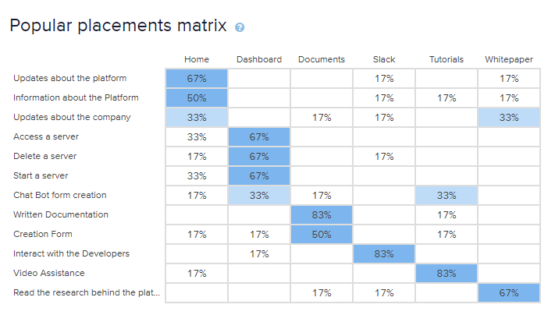
Appendix I: Usability Survey
7 People Surveyed
Majority of non-technical users were able to properly group categories which validates our navigation.

