Slide 1
Machine and Deep Learning
2022-2023, 2nd semester
Alzheimer’s disease onset recognition by handwriting

Slide 2
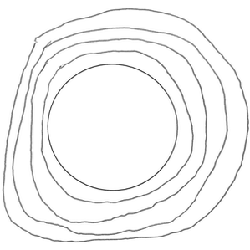
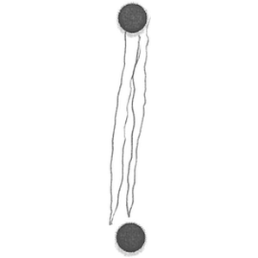
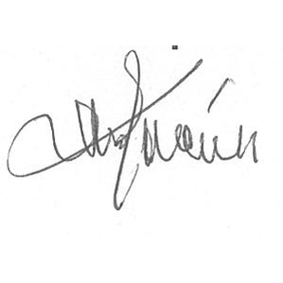
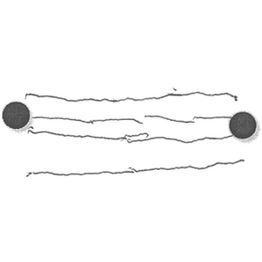
Motivations
In Alzheimer’s disease prediction systems, handwriting seems to be one of the first skills to be influenced by this disease.
The information considered is related to the dynamics of the handwriting process, directly derived from online handwriting samples.
These kinds of features, however, are not able to capture the alterations in the shape, size, and thickness of the handwritten traits, which may be produced by the alterations in motor control due to neurodegenerative disorders.

Slide 3
Materials
All used tasks are described in link, and in particular, we can use that where the participants were asked to:
write down their signature (Task 1),
to join 2 points with a horizontal line, continuously four times (Task 2),
to join 2 points with a vertical line, continuously four times (Task 3),
Retrace a circle of 6 cm in diameter continuously for times (Task 4),
write in cursive the bigram ”le” four times continuously (Task 9)
write the Italian word for sheet, ”foglio” (Task 10).
166 images of offline handwriting for each task:
88 PT (patients – positive class)
78 HC (healthy controls – negative class)

Slide 4
Feature Engine
The Features are extracted from X and Y coordinates acquired by a Wacom and using MovAlyzeR a software produced by neuroscript.
The features extracted from each stroke are then averaged to produce a single sample representing the patient.
Further features are then added to consider also personal information that can be helpful for the diagnosis

Slide 5
Performance evaluation
The performance measures suggested are
Accuracy
Fscore
Precision
Recall
You can use ICPR paper as a comparison for deep learning performance.

Slide 6
Constraints and hints to procede
Apply X fold validation with k >= 5
train your ML/DL models on the training set, evaluate performance on the test set
ML: test several models and find your own (possibly novel) method
...it is not okay to train/test only one model (e.g. SVM) because 'it just works'
DL: it is ok to implement and/or fine-tune an architecture found on the web..
...if it works on the first attempt, at least try something different, like different hyperparameters and slight modifications of the architecture
As the samples of the dataset are not a lot, you can pretrain your net using dataset like: Emnist, ImageNet or specific dbs (be carefull on the image size!)
Try to apply combiner methods that gather together results from different tasks

