Slide 1
Carmen Johana Calderón Chona
Intermediate Representations

Slide 2
Content
Taxonomic overview of IRS and their properties
IRS based on trees and graphs
Linear IRS
Naming
  Static single-assignment form (SSA)
Symbol tables – How the compiler builds, uses, and maintains them

Slide 3
INTERMEDIATE REPRESENTATION
Representation for all of the facts that a compiler derives about the program in the frontend
A compiler may have a single IR, or it may have a series of IRS that it uses as it transforms the code from source language into its target language

Slide 4
A taxonomy of intermediate representations
Compilers have used many kinds of IR
We will organize our discussion of IRS along three axes generally independent:
  Structural organization
  Level of abstraction
  Naming discipline

Slide 5
Structural categories
Graphical IRS:
  Encode the compiler’s knowledge in a graph. The algorithms are expressed in terms of graphical objects: nodes, edges, lists, or trees. The parse trees used to depict derivations in Chapter 3 are graphical IR.
Linear IRS:
  Resemble pseudo-code for some abstract machine. The algorithms iterate over simple, linear sequences of operations. The ILOC code used in this book is a form of linear IR.
Hybrid IRS:
  Combine elements of both graphical and linear IRS, in an attempt to capture their strengths and avoid their weaknesses. A common hybrid representation uses a low-level linear IR to represent blocks of straight-line code and a graph to represent the flow of control among those blocks.

Slide 6
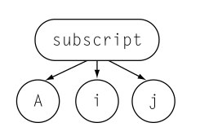
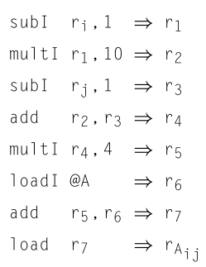
Structural categories
Linear IR
Graphical IR
The structural organization of an IR has a strong impact on how the compiler writer thinks about analysis, optimization, and code generation

Slide 7
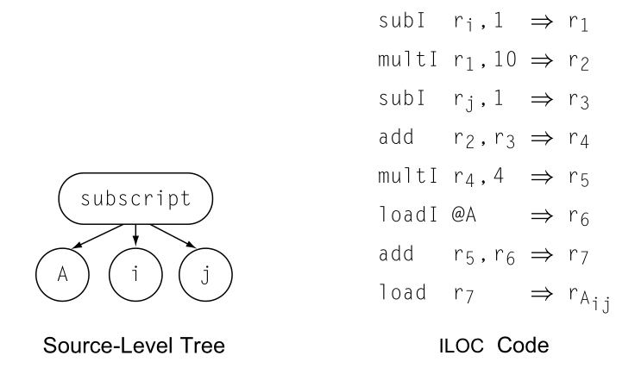
Level of abstraction at which the IR represents operations
Near-source representation: A single node might represent an array access or a procedure call
Low-level representation: Several IR operations must be combined to form a single target-machine operation

Slide 8
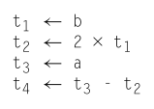
Name space used to represent values in the code
The choice of a naming scheme has a strong effect on how optimization can improve the code. For example, it has an impact on compile time, because it determines the sizes of many compile-time data structures.
Example: To evaluate a - 2 × b in a low-level ir, the compiler might generate a sequence of operations such as those shown in the margin. Here, the compiler has used four names, t1 through t4 . An equally valid scheme would replace the occurrences of t2 and t4 with t1 , which cuts the number of names in half.

Slide 9
Practical matter (1)
The data-space requirements of different IRS vary over a wide range. Since the compiler typically touches all of the space that it allocates, data space usually has a direct relationship to running time.
To make this discussion concrete, consider the IRS used in two different research systems that authors built at Rice University:

Slide 10
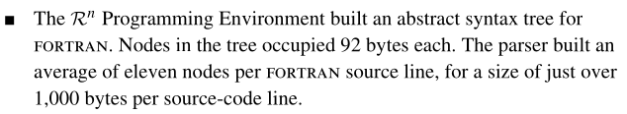
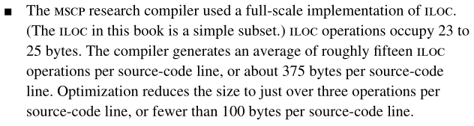
Practical matter (2)

Slide 11
Graphical IRS
IR as a graph
All the graphical IRS consist of nodes and edges. They differ in their level of abstraction, in the relationship between the graph and the underlying code, and in the structure of the graph.
Two of the most common types of graphical IRS are:
  Syntax-Related Trees
  Graphs

Slide 12
Syntax-Related Trees
We will discuss three types, each of which can be considered an improvement and/or modification of the previous one:
  Parse trees
  Abstract Syntax Tree
  Directed Acyclic Graph

Slide 13
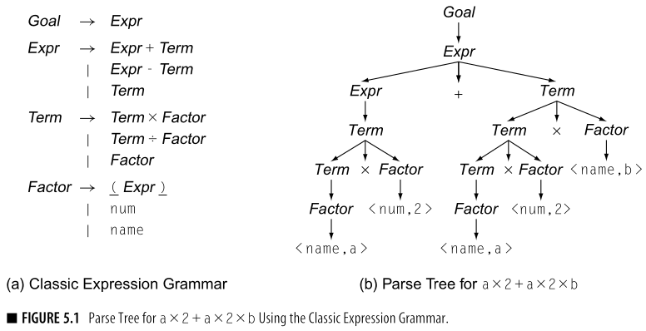
Syntax-Related Trees
Parse Trees
  It is not a source level representation
  They are the primary IR in parsing and in attribute-grammar systems

Slide 14
Syntax-Related Trees
Parse Trees
  Fundamental Problem: Reduce size
  Some proposed solutions:
    Techniques described in section 3.6.1
    To abstract away those nodes that serve no real purpose in the rest of the compiler. This approach leads to a simplified version of the parse tree called AST.

Slide 15
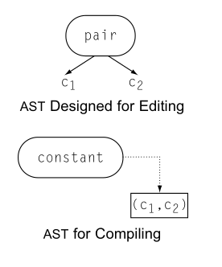
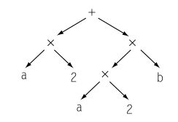
Syntax-Related Trees
Abstract Syntax Tree
  Contraction of the parse tree that omits most nodes for nonterminal symbols. Example: The S-expressions found in Lisp and Scheme implementations are, essentially, ASTs.
  Near source-level representation
  In source-to-source systems, including syntax-directed editors and automatic parallelization tools, often use an AST from which source code can easily be regenerated
  Representation choices affect usability.

Slide 16
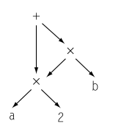
Syntax-Related Trees
Directed Acyclic Graphs
  AST contraction that avoids some redundancies by allowing nodes to have multiple parents and enabling the reuse of identical subtrees.
  For expressions without assignment, textually identical expressions must produce identical values.
  The DAG encodes an explicit hint for evaluating the expression.
  Advantages of using DAGs:
    They reduce the memory footprint
    They expose redundancies

Slide 17
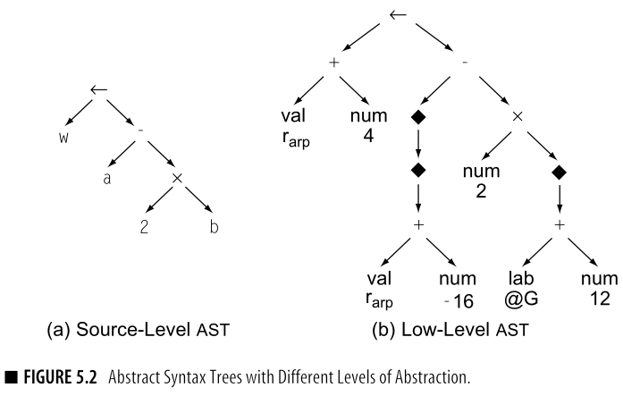
Syntax-Related Trees
Low-level trees
  It contains much of the detail needed to translate the statement into assembly code
  The level of abstraction matters because the compiler can, in general, only optimize details that are exposed in the IR

Slide 18
Graphs
While trees provide a natural representation for the grammatical structure of the source code discovered by parsing, their rigid structure makes them less useful for representing other properties of programs
To model these aspects of program behavior, compiler often use more general graphs as IRs

Slide 19
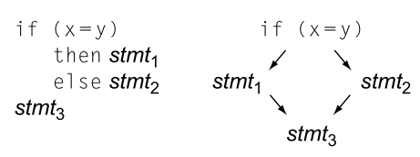
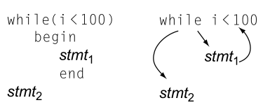
Graphs
Control-Flow Graph (CFG)
  Basic block: A maximal-length sequence of branch-free code. It begins with a labelled operation and ends with a branch, jump, or predicated operation.
  A CFG has a node for every basic block and an edge for each possible control transfer between blocks.
  Some authors recommend building CFGs in which each node represents a shorter segment of code than a basic block.
    Tradeoff: Time and space for analysis and optimization

Slide 20
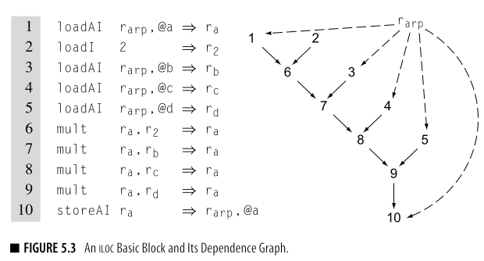
Graphs
Directed Acyclic Graphs
  Compilers typically use a CFG in conjunction with another IR. The CFG represents the relationships among blocks, while the operations inside a block are represented with another IR, such as an expression-level AST, a DAG, or one of the linear IRS.

Slide 21
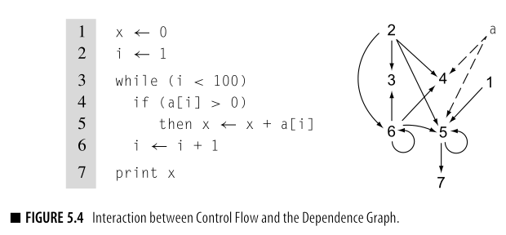
Graphs
Data-dependence graph
  A graph that models the flow of values from definitions to uses in a code fragment
  They are often used as a derivative IR - constructed from the definitive IR for a specific task, and then discarded. For example, they play a central role in:
    Instruction scheduling
    A variety of optimizations

Slide 22
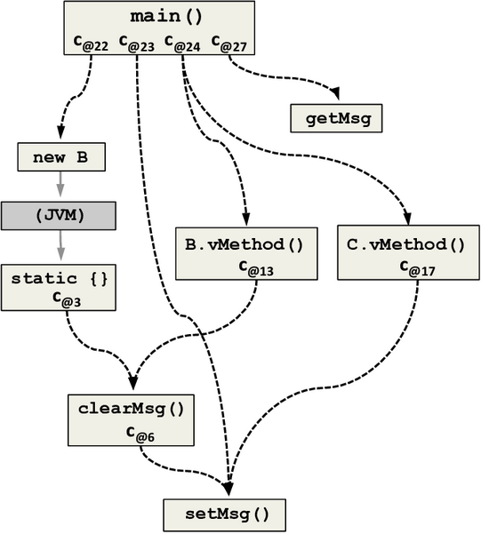
Graphs
Call Graph
  A graph that represents the calling relationships among the procedures in a program. The call graph has a node for each procedure and an edge for each call site.
    A call graph has a node for each procedure and an edge for each distinct procedure call site. Thus, the code calls q from three textually distinct sited in p; the call graph has three edges (p,q), one for each call site.

Slide 23
Linear IRs
It consists of a sequence of instructions that execute in their order of appearance (or in an order consistent with that order).
  Example: ILOC
Instructions may contain more than one operation; if so, those operations execute in parallel.
Several early compilers used linear IRS.
If a linear IR is used as the definitive representation in a compiler, it must include a mechanism to encode transfers of control among points in the program.

Slide 24
Linear IRs
Many kinds of linear IRS have been used in compilers.
  One-address codes
  Two-address codes
  Three-address codes

Slide 25
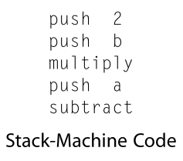
Linear IRs
Stack-machine code
  Compact, storage-efficient representation
  It is a form of one-address code that assumes the presence of a stack of operands
  The stack discipline creates a need for some new operations:
    Swap: Interchanges the top two elements of the stack
for a-2xb

Slide 26
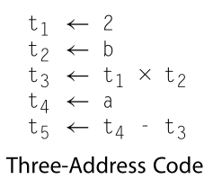
Linear IRs
Three-Address Code
  In three-address code most operations have the form i ← j op k, with an operator (op), two operands (j and k) and one result (i). Some operators, such as n immediate load and a jump, will need fewer arguments.
  Example: ILOC

Slide 27
Linear IRs
Advantages of three-address codes
  Reasonably compact
  Separate names for the operands and the target give the compiler freedom to control the reuse of names and values; three-address code has no destructive operations
  Since many modern processors implements three-address operations, a three-address code models their properties well

Slide 28
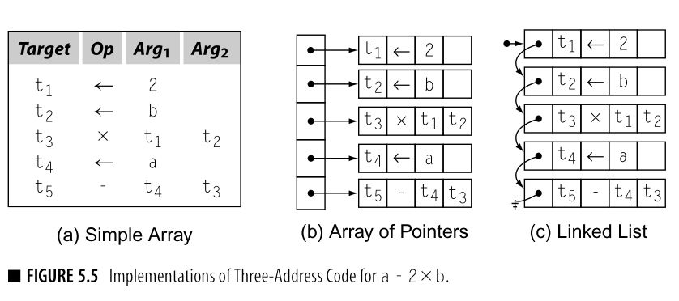
Representation of Linear Codes
The choices that a compiler writer makes affect the costs of various operations on IR code
The discussion will focus on three-address codes, but most of the points apply equally to stack-machine code (or any other linear form)

Slide 29
Building a Control-Flow Graph from a Linear Code
Compilers often must convert between different IRS, often different styles of IRS.
One routine conversion is to build a CFG from a linear IR such as ILOC
  Often, the compiler must build a CFG from a simple, linear IR that represents a procedure

Slide 30
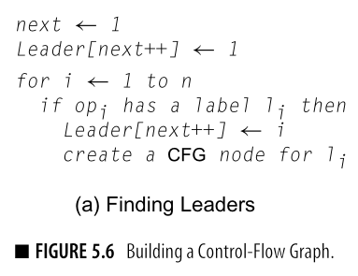
Building a Control-Flow Graph from a Linear Code
First step: The compiler must find the beginning and the end of each basic block in the linear IR.
  A leader will be the initial operation of a block.
  An operation is a leader if it is the first operation in the procedure, or if it has a label that is, potentially, the target of some branch.
A leader can be identified in a single pass over the IR

Slide 31
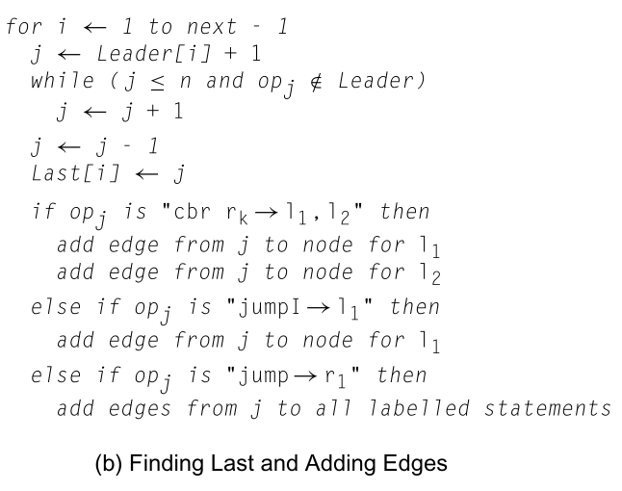
Building a Control-Flow Graph from a Linear Code
Second step: Find every block-ending operation.
  The algorithm assumes that every block ends with a branch or a jump and that branches specify labels for both outcome-a “branch taken” label and a “branch not taken” label

Slide 32
References
Engineering a compiler, Keith D. Cooper & Linda Torczon
Playlist: CSCI 485 (435) Intro to Compilers https://www.youtube.com/watch?v=AGd1YRKRNaM&list=PLVPTmCr8BDsvGN6rlVDeCo-v3xnxURHa9&index=44

