Slide 1
Answer: 6 in 10 Australian said they are. (Source: Michael Page studies- “Make 2022 the Year of Opportunities)
When COVID / lockdown happen, have you had thought of changing career? Are you planning to make a move in next 6 months
Impact of COVIID on Australian Employment

Slide 2
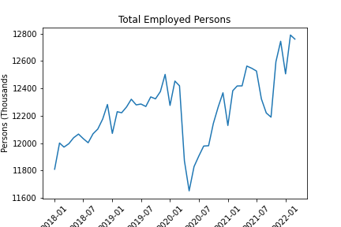
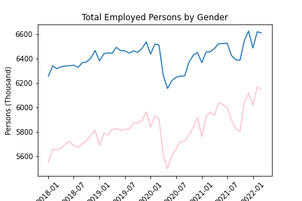
Employment evolution (pre/post COVID)
Lockdown Start 13 March 2020
766K people get into unemployment
356K men vs 410K women

Slide 3
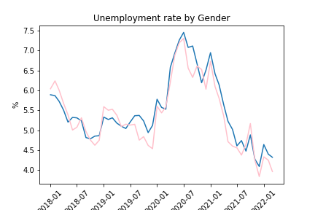

Unemployment rate
Current unemployment rate even lower than pre-COVID

Slide 4
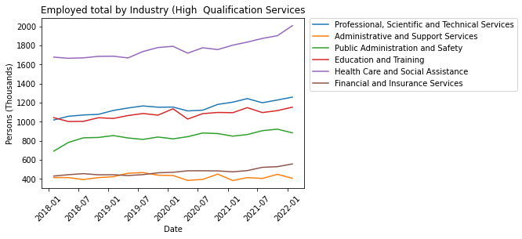

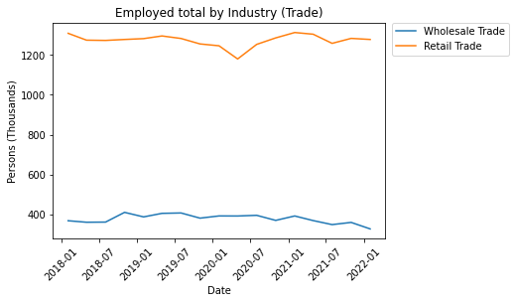

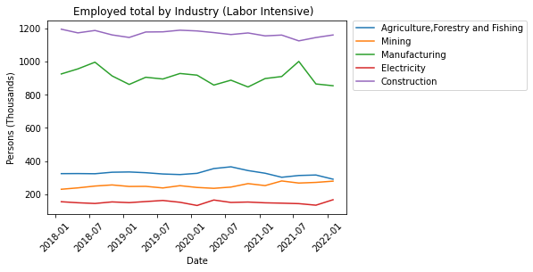
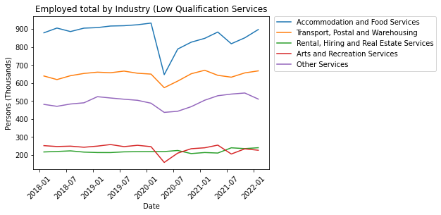
Evolution by Industry
Accommodation and arts services
High skilled jobs
Health care increase occupation

Slide 5
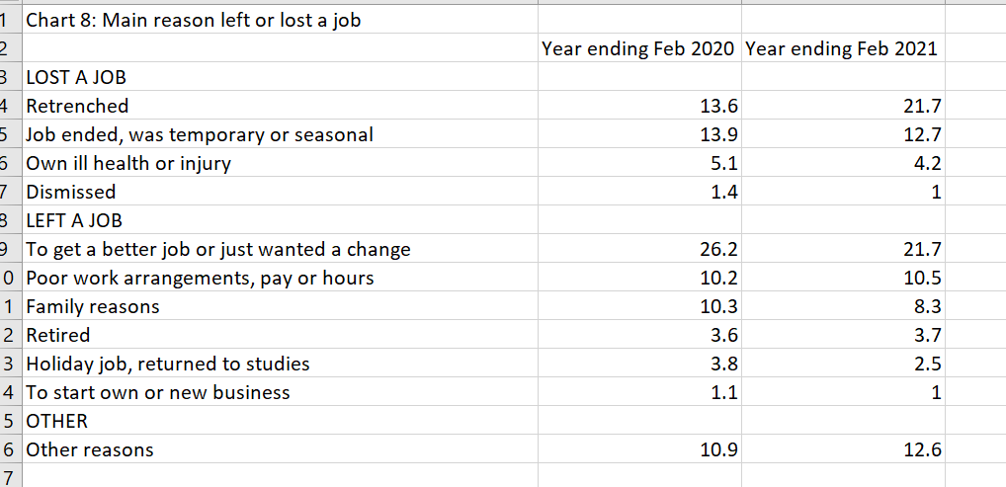
Pie chart here

Slide 6
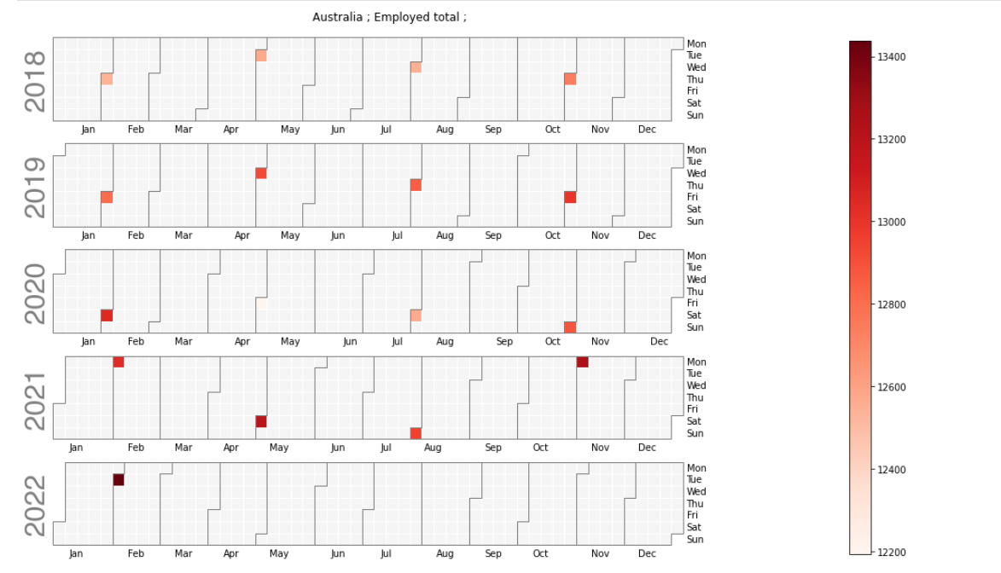
Australian Employed Total (Qtly)

Slide 7
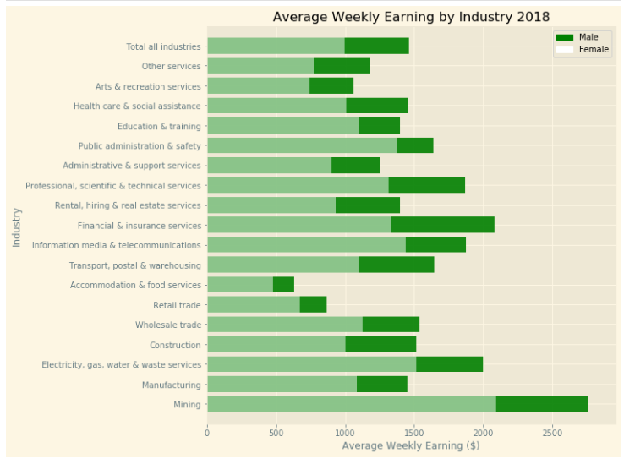
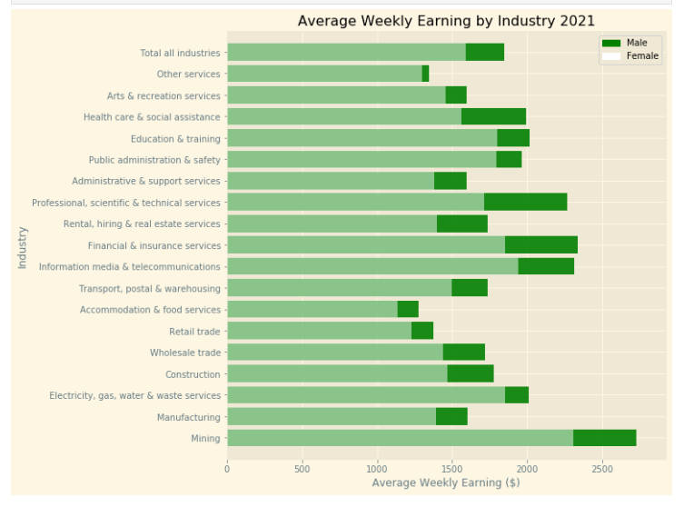
2018 vs 2021

Slide 8
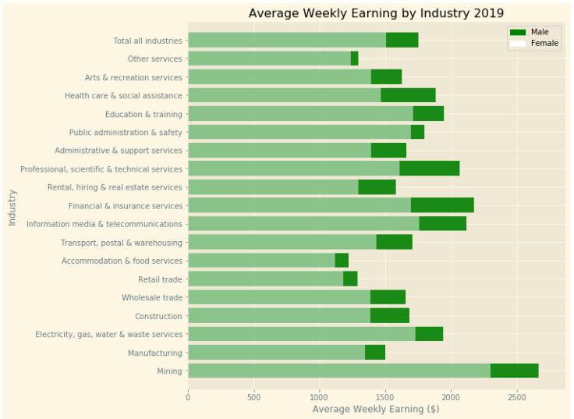
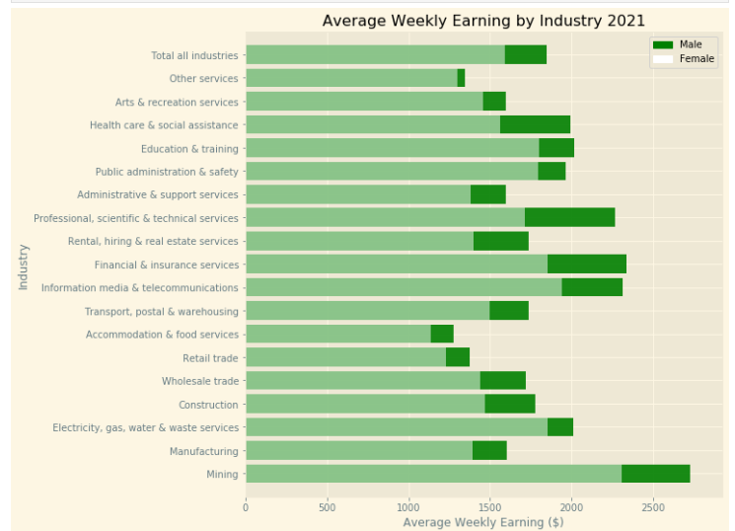
2019 vs 2021

Slide 9
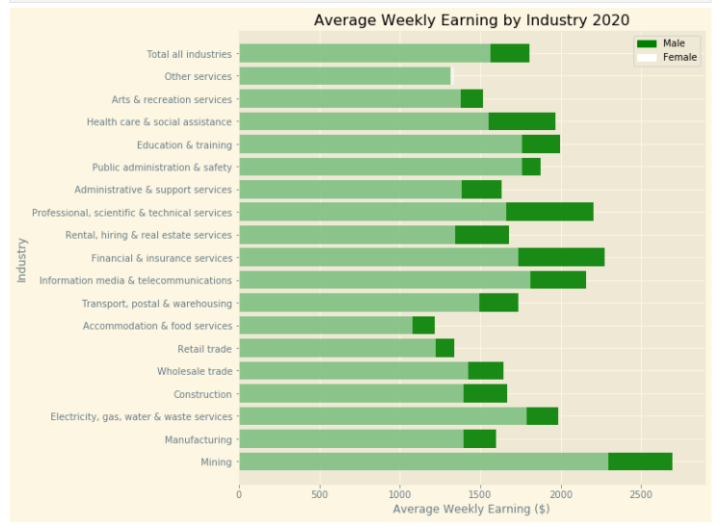
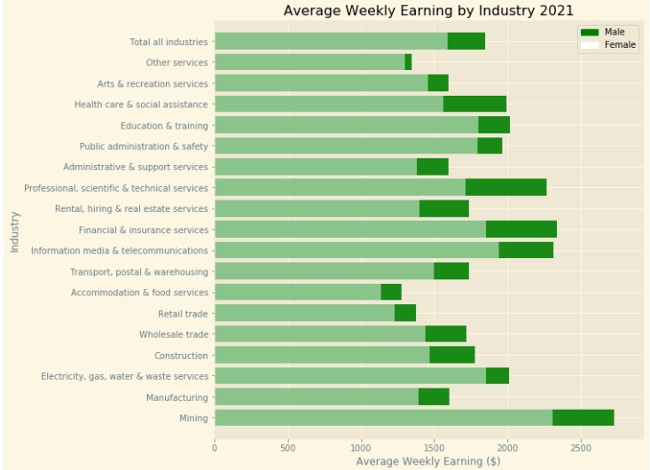
2020 vs 2021

Slide 10
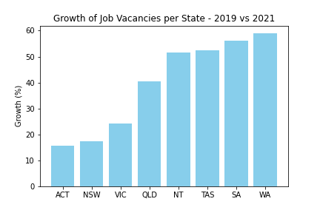
Job Vacancies by State
Data compiled by the National Skills Commission through job boards such as Seek, CareerOne and Australian JobSearch (https://labourmarketinsights.gov.au/our-research/internet-vacancy-index/#3)
Comparing the total vacancies between 2019 vs 2021, Western Australia had a growth of 59%.

Slide 11
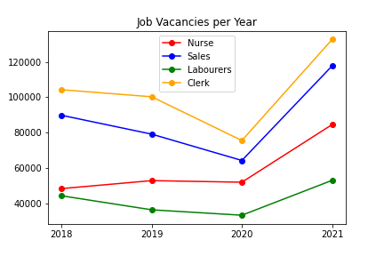
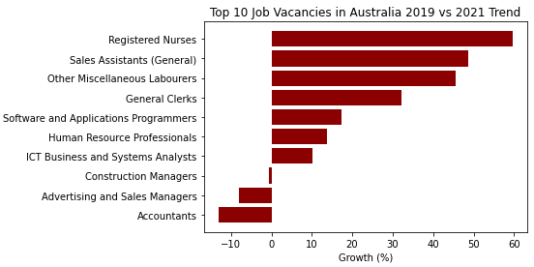
*****Insert info for the Top & bottom 5 industries – Avg wkly Earning

Slide 12
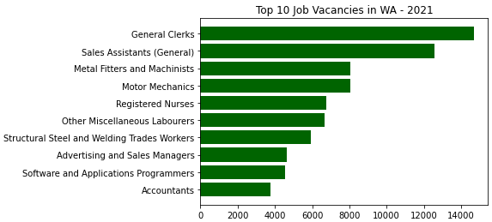
WA boarder policy

Slide 13
NSW / VIC boarder open date??
Employment / Unemployment post the boarder open

Slide 14
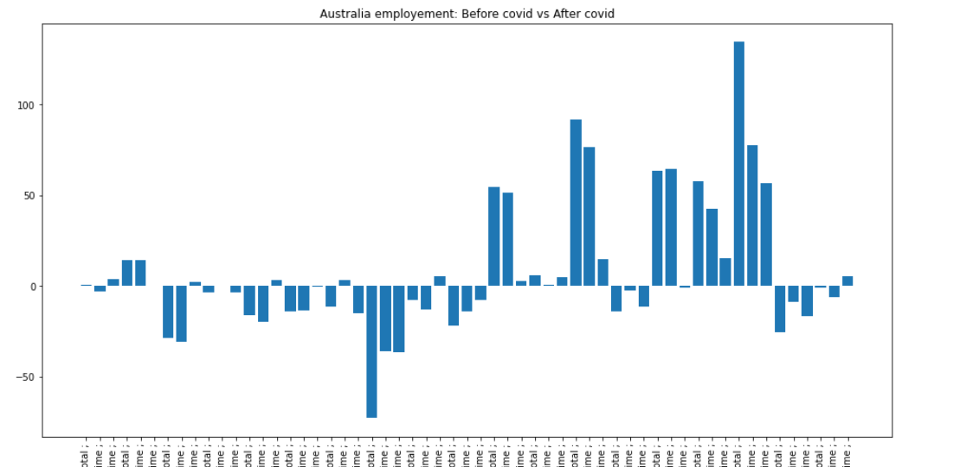
Australia (need to separate FT/PT, top5 and bo

Slide 15
WA data FT/ PT data

Slide 16
Conclusion
COVID have initially had negative impact to some industry but as we ride out of COVID peak, there are positive coming out from the COVID. Some industries are benefit from the restriction
Some industries are more susceptible to social distancing and restriction measures.
There are positive changes to some industry's average weekly earning
COVID also provide greater job vacancy / employment opportunity
Job vacancy for the highlighted industry has been upward trajectory and exceed pre- COVID level
Insight for job seeker??
How can we prepare for the next potential pandemic? Moving into industry where they are less suspectable to social restriction measure?

