Slide 1
Impact of COVIID on Australian Employment

Slide 2
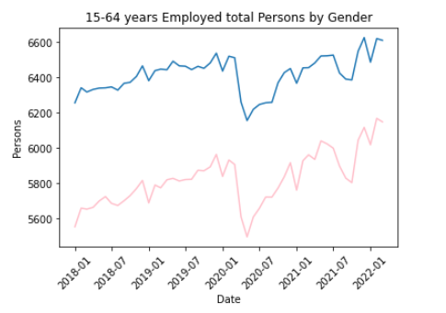
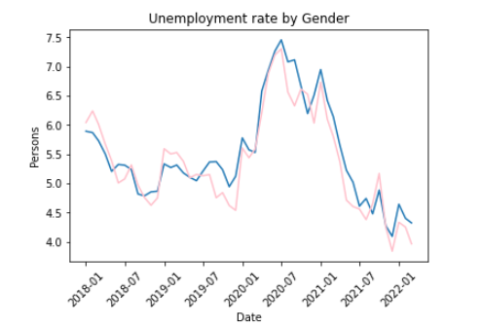
Employment vs Unemployment landscape
**Need to add more info:
First day of Lockdown in each state
Day for boarder closure?
When people line up outside Centrelink waiting for payment?

Slide 3
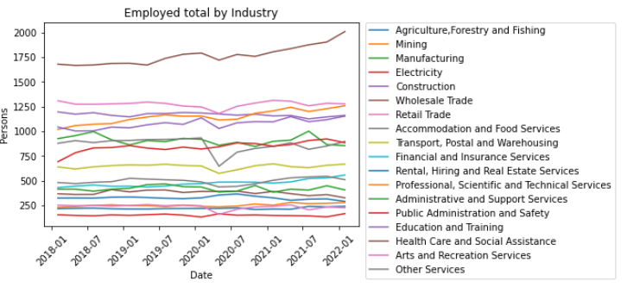
Employed by Industry ***Only include top 5 industries

Slide 4
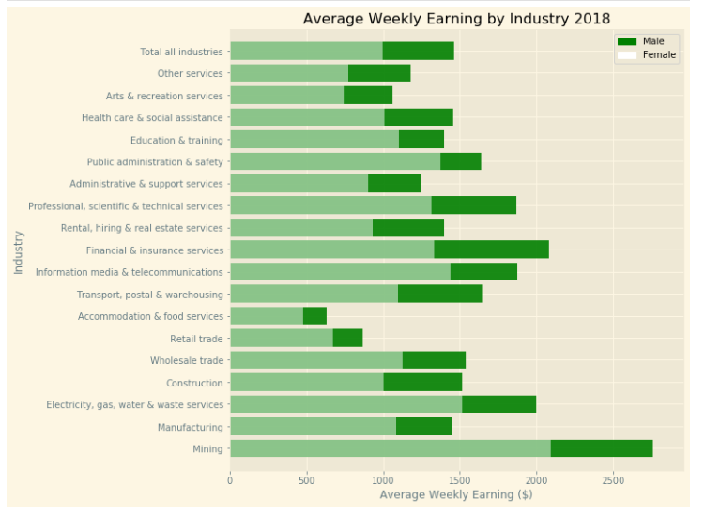
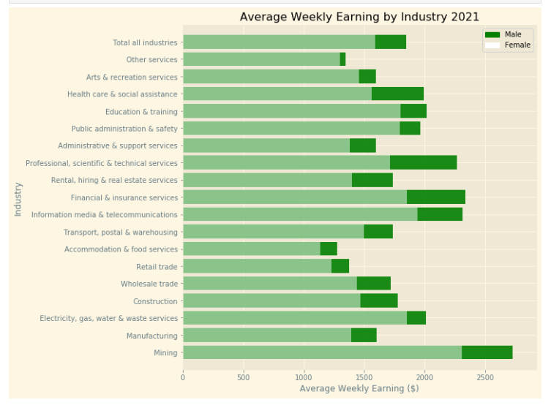
2018 vs 2021

Slide 5
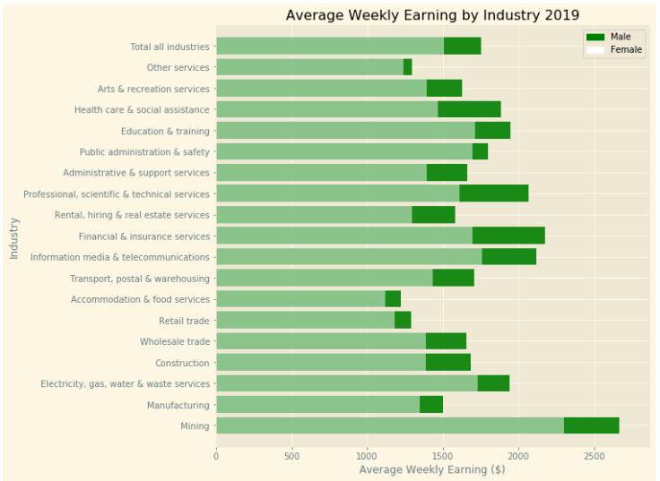
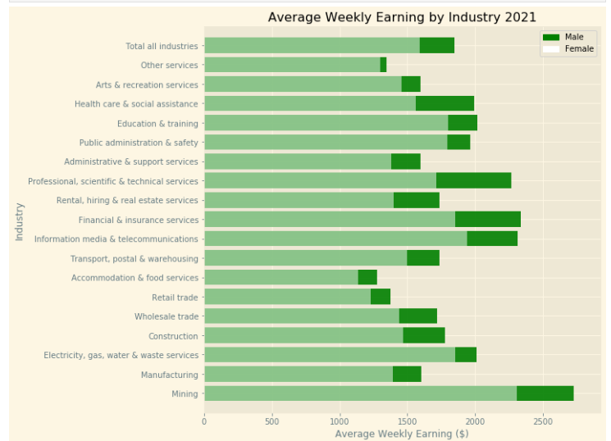
2019 vs 2021

Slide 6
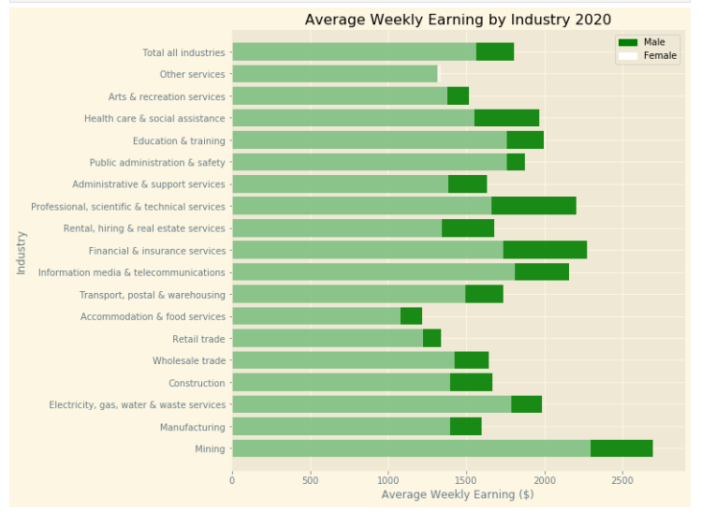
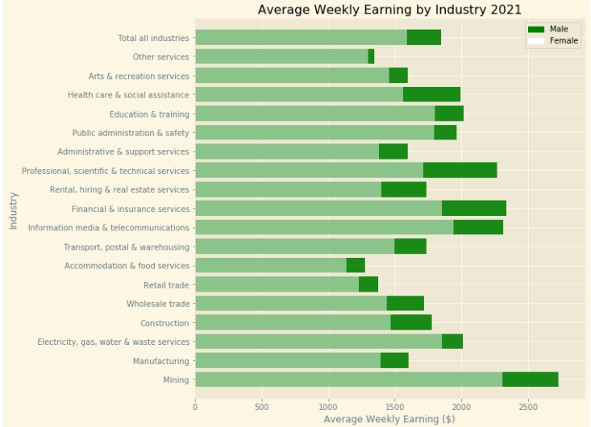
2020 vs 2021

Slide 7
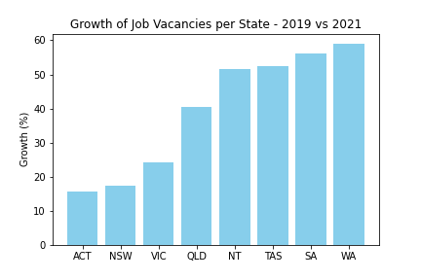
Job Vacancies by State
Data compiled by the National Skills Commission through job boards such as Seek, CareerOne and Australian JobSearch (https://labourmarketinsights.gov.au/our-research/internet-vacancy-index/#3)
Comparing the total vacancies between 2019 vs 2021, Western Australia had a growth of 59%.

Slide 8
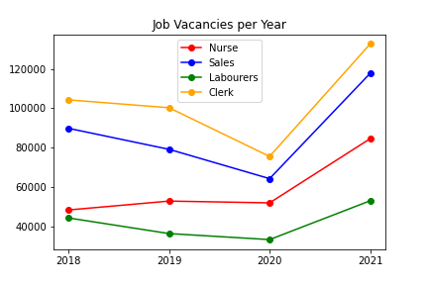
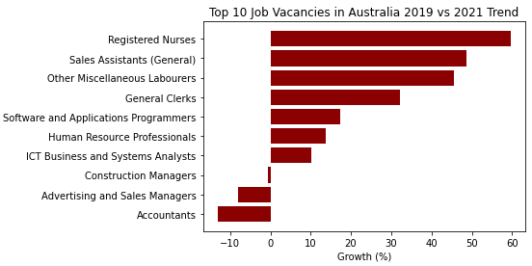
*****Insert info for the Top & bottom 5 industries – Avg wkly Earning

Slide 9
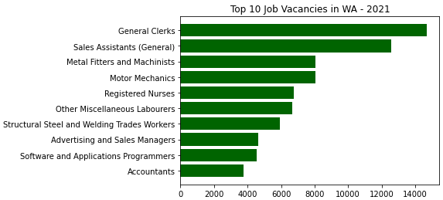
WA boarder policy

Slide 10
NSW / VIC boarder open date??
Employment / Unemployment post the boarder open

