Slide 1
When COVID / lockdown happen, have you had any thought of changing your career ?
Are you planning to move in the next six months?
Answer: 6 in 10 people in Australian are planning to….. (insert link, quote the source)
Impact of COVIID on Australian Employment

Slide 2
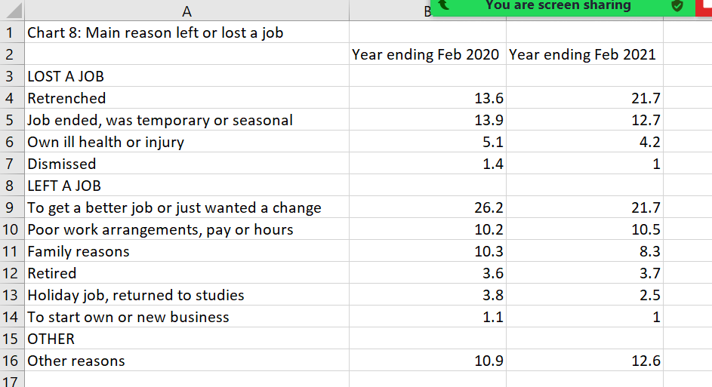
2021 (pie chart)

Slide 3
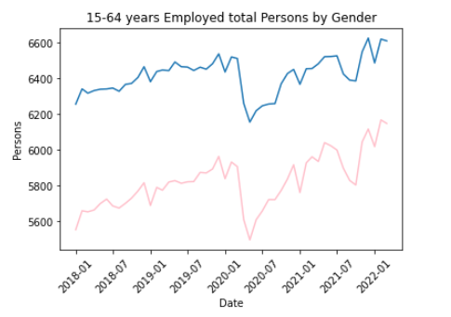
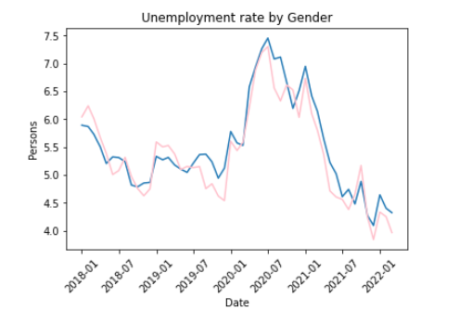
Employment vs Unemployment landscape
**Need to add more info:
First day of Lockdown in each state
Day for boarder closure?
When people line up outside Centrelink waiting for payment?

Slide 4
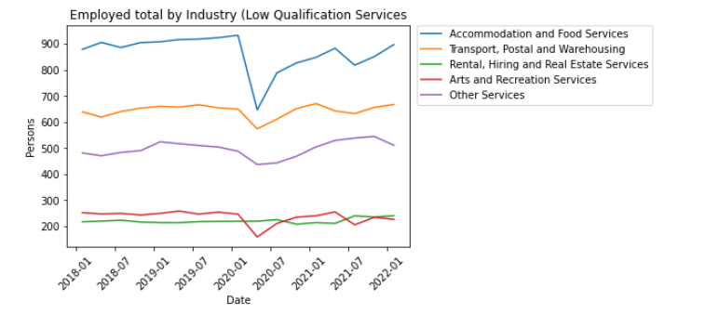
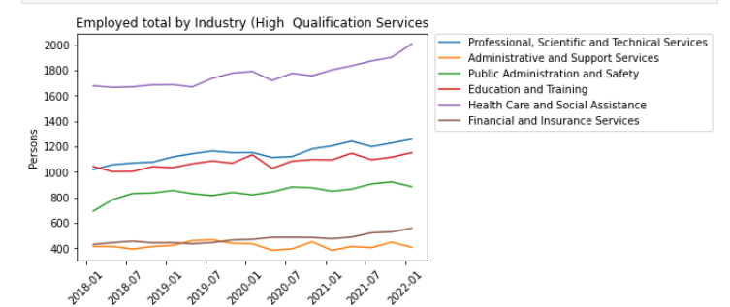
Update chart legend to show (‘000)
And only select top 3 from the employed (high)
Add number of person lost job from Accommodation and Art industry

Slide 5
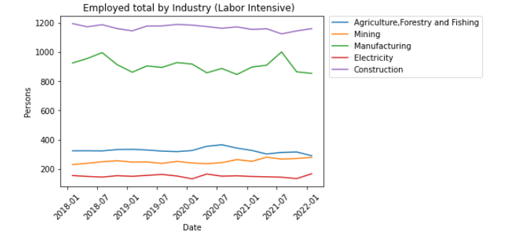
Employed by Industry

Slide 6
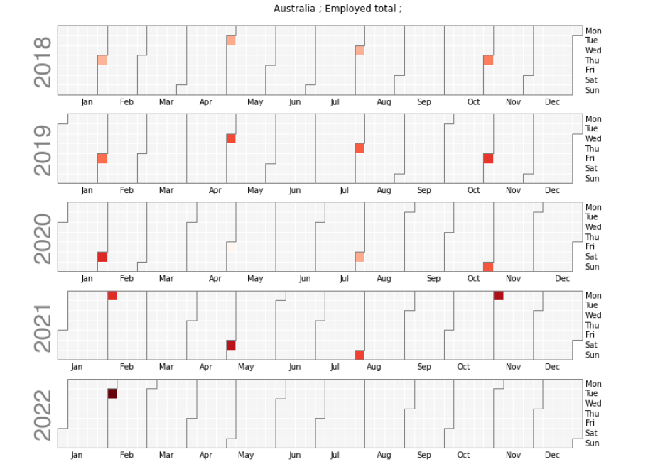
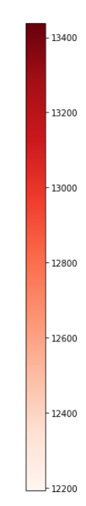
Changing in employment

Slide 7
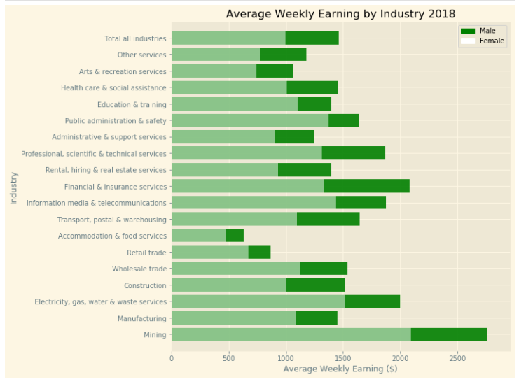
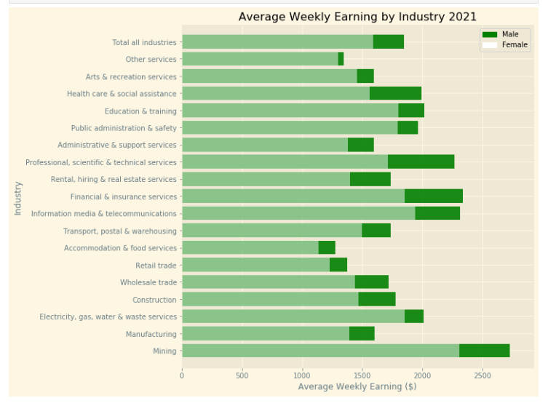
2018 vs 2021

Slide 8
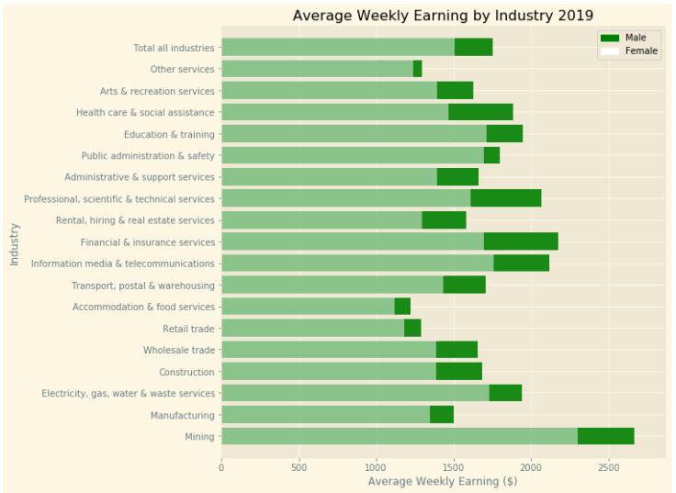
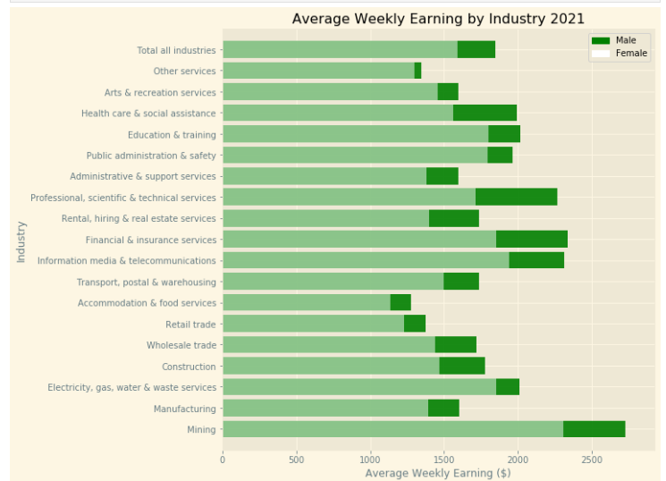
2019 vs 2021

Slide 9
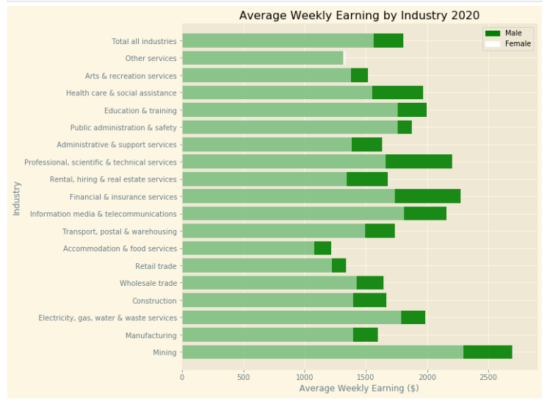
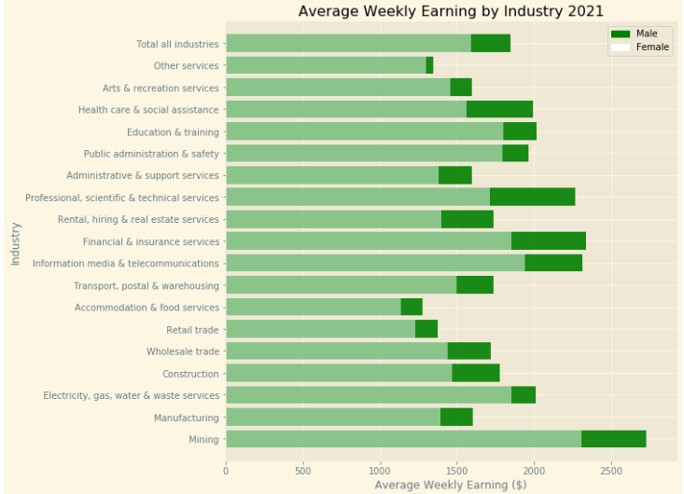
2020 vs 2021

Slide 10
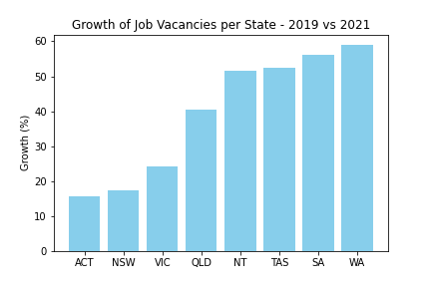
Job Vacancies by State
Data compiled by the National Skills Commission through job boards such as Seek, CareerOne and Australian JobSearch (https://labourmarketinsights.gov.au/our-research/internet-vacancy-index/#3)
Comparing the total vacancies between 2019 vs 2021, Western Australia had a growth of 59%.

Slide 11
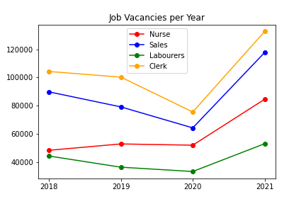
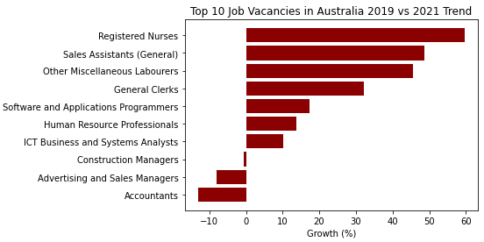
*****Insert info for the Top & bottom 5 industries – Avg wkly Earning

Slide 12
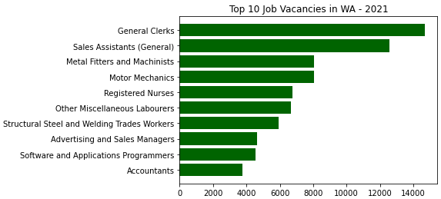
WA boarder policy

Slide 13
NSW / VIC boarder open date??
Employment / Unemployment post the boarder open

Slide 14
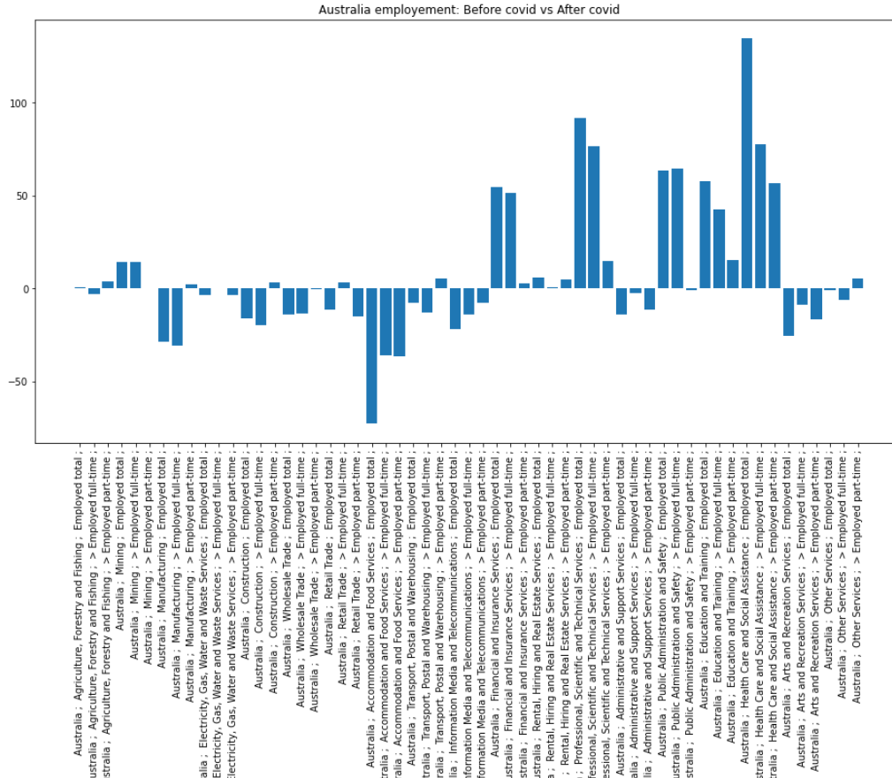
FT & PT (separate graph / Top 5 & bottom5)

Slide 15
WA FT/ PT (Top/Bottom)

Slide 16
Conclusion
Which Industries benefit from COVID/ suffer from COVID restriction
Impact on some industry’s average weekly earning (which are enjoying the uplift/ wages adjustment)
Although COVID impact on the job vacancy during the intense lockdown, it is evident the after boarder reopen, the job vacancy/ job market is upward trajectory
WA boarder closure have created shortage of labour across many industries. (Assumption: we can see improvement in the shortage issue after WA boarder reopen??)
Insight to job seeker ?
Preparation for next pandemic (move into high education industry)

