Slide 1
Impact of COVIID on Australian Employment

Slide 2
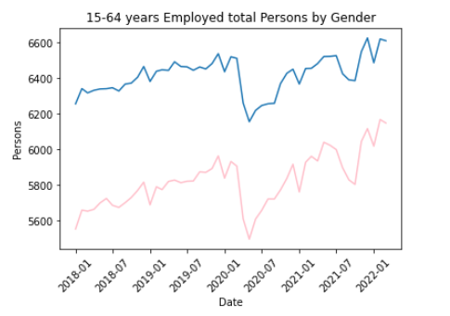
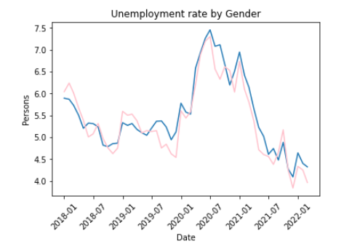
Employment vs Unemployment landscape
**Need to add more info:
First day of Lockdown in each state
Day for boarder closure?
When people line up outside Centrelink waiting for payment?

Slide 3
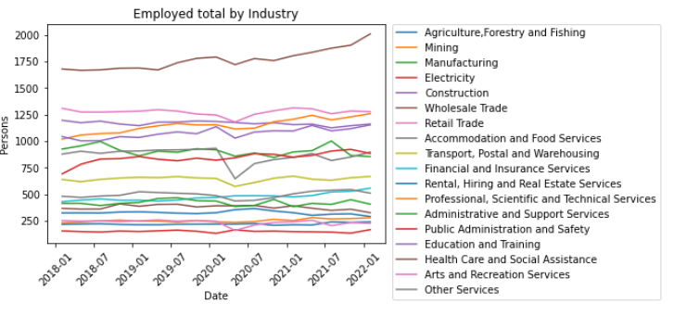
Employed by Industry ***Only include top 5 industries

Slide 4
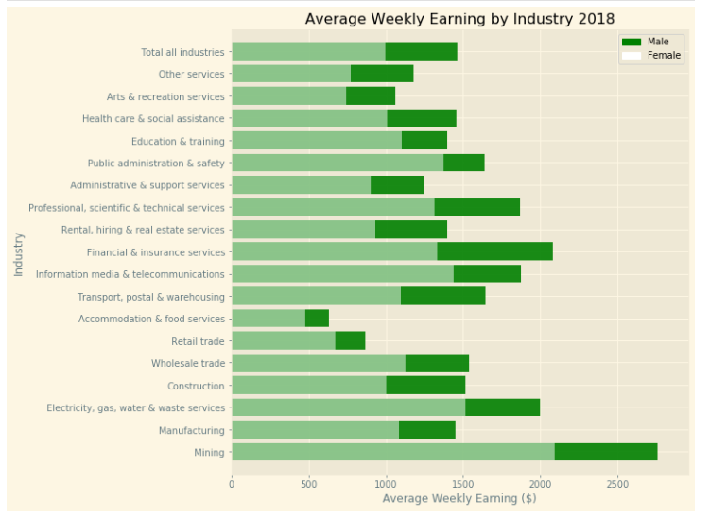
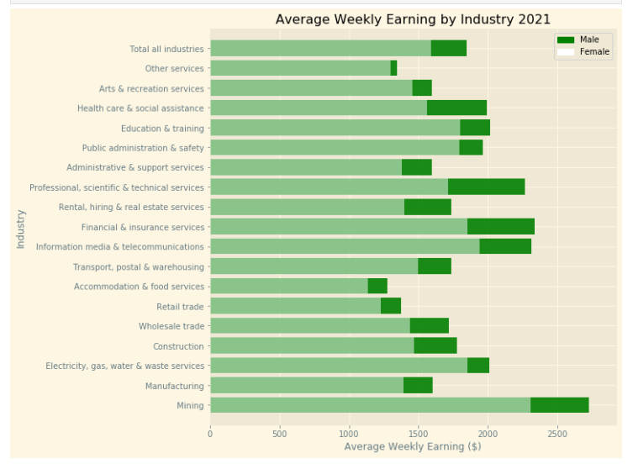
2018 vs 2021

Slide 5
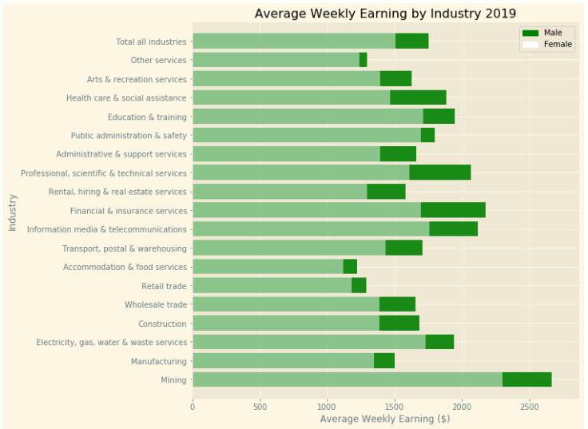
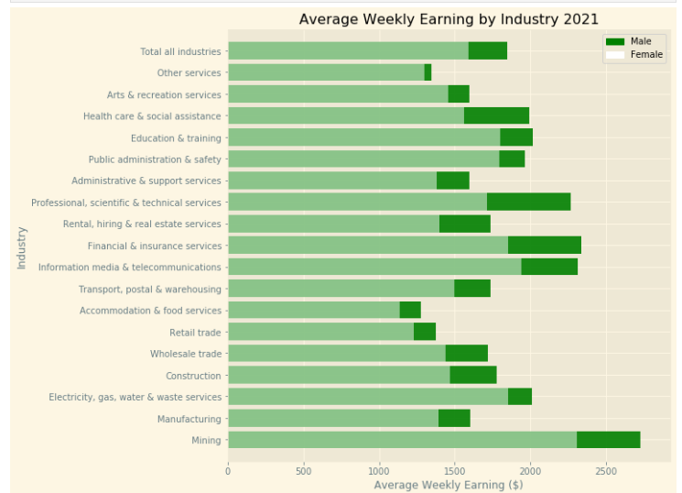
2019 vs 2021

Slide 6
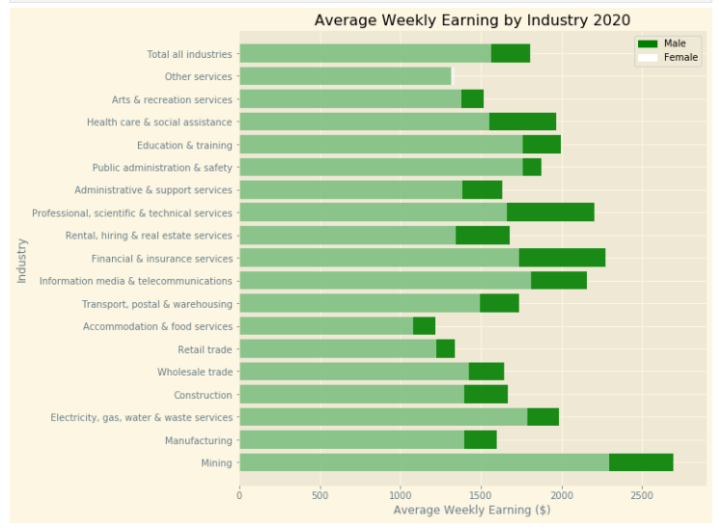
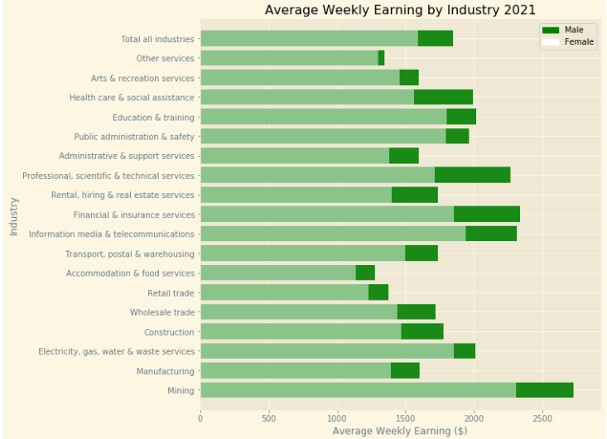
2020 vs 2021

Slide 7
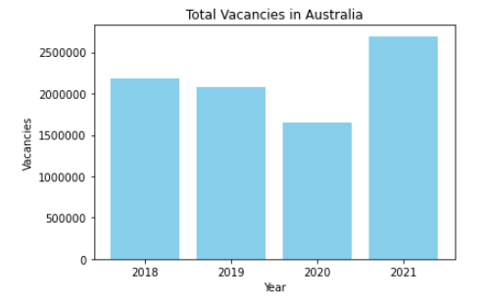
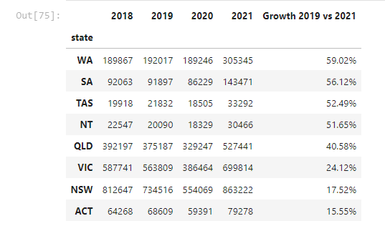
Job Vacancy
Insert bar chart %

Slide 8
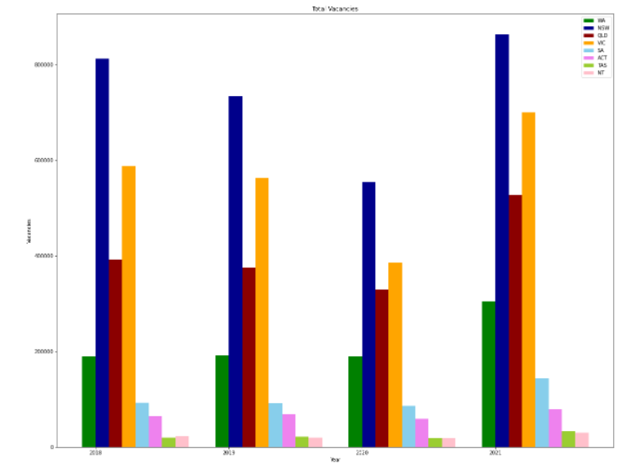
Vacanies by state (change from 2018-2021)

Slide 9
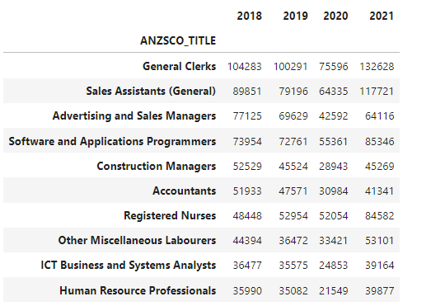
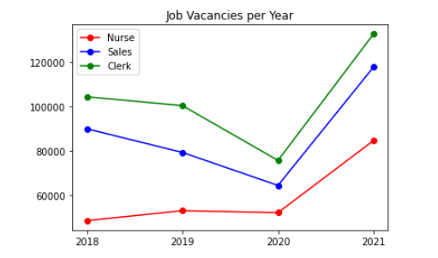
Job vacancies changes
*****Insert info for the Top & bottom 5 industries – Avg wkly Earning
Add % chart

Slide 10
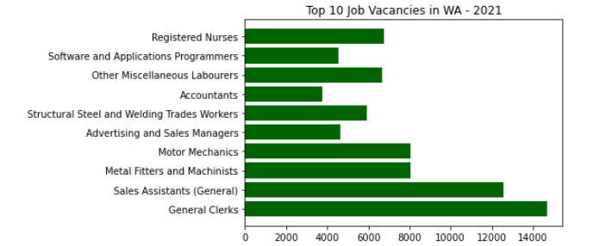
WA boarder policy
**Due to prolong boarder closure, it has an impact to employment

Slide 11
NSW / VIC boarder open date??
Employment / Unemployment post the boarder open

