Slide 1

Answer: 6 in 10 Australian said they are. (Source: Michael Page studies- “Make 2022 the Year of Opportunities)
When COVID happened, have you had a thought of changing careers? Are you planning to make a move in the next 6 months?
Impact of COVID on Australian Employment

Slide 2
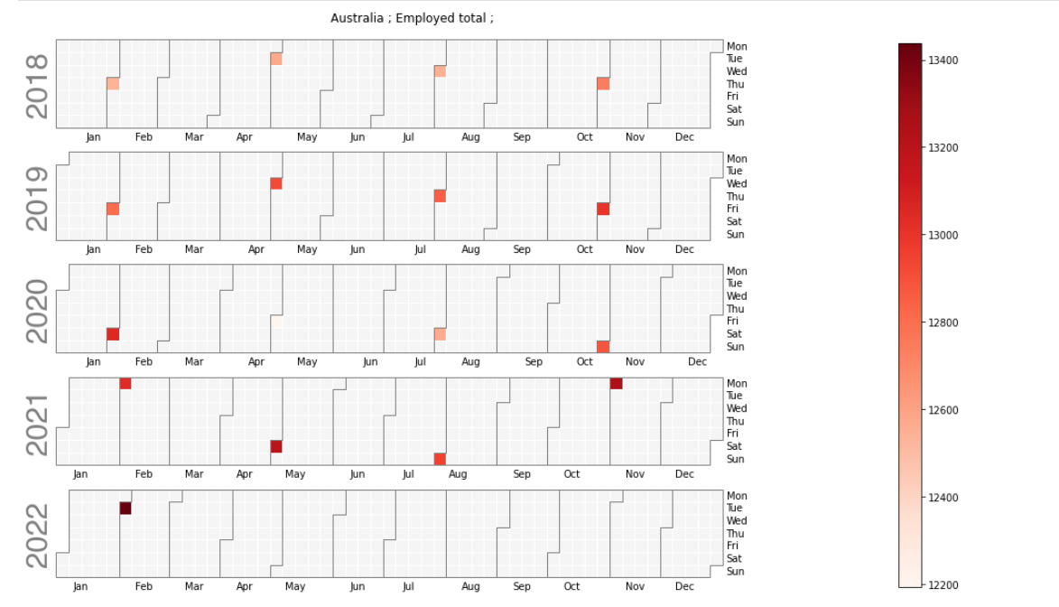
Australian Employed Total (Qtly)

Slide 3
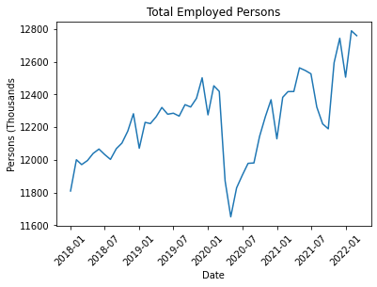
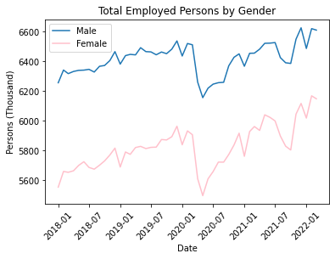
Employment evolution (pre/post COVID)
Lockdown Started on
13 March 2020
766K people got unemployed
356K men vs 410K women

Slide 4
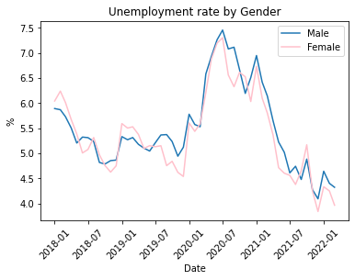

Unemployment rate
Current unemployment rate is even lower than pre-COVID

Slide 5
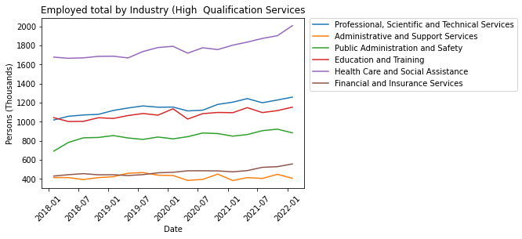

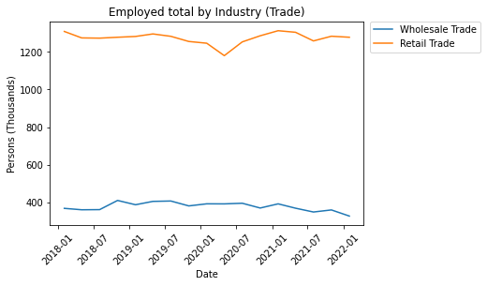

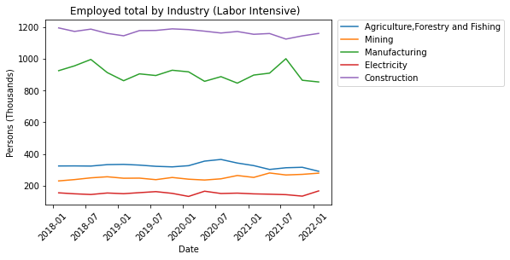
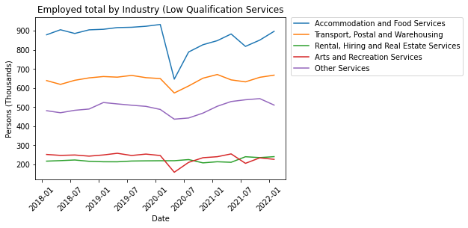
Evolution by Industry
Accommodation and arts services
High skilled jobs
Health care increase occupation

Slide 6
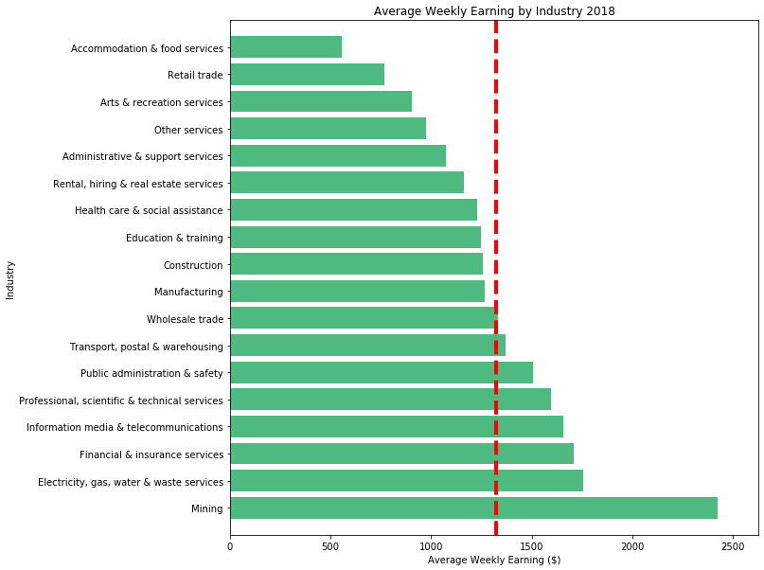
What happen to the average weekly earning?
2018 (Half year ended Nov 18)
Average
Weekly
Earning
$1,322.58
Hotel/FS is $767
Retails is $553
Mining is $1,104

Slide 7
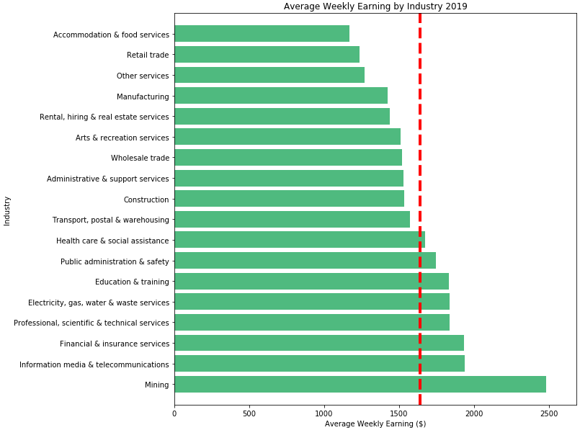
What happen to the average weekly earning?
2019 (Half year ended Nov 18)
Average
Weekly
Earning
$1,638.81
Hotel/FS is $468
Retails is $402
Mining is $846

Slide 8
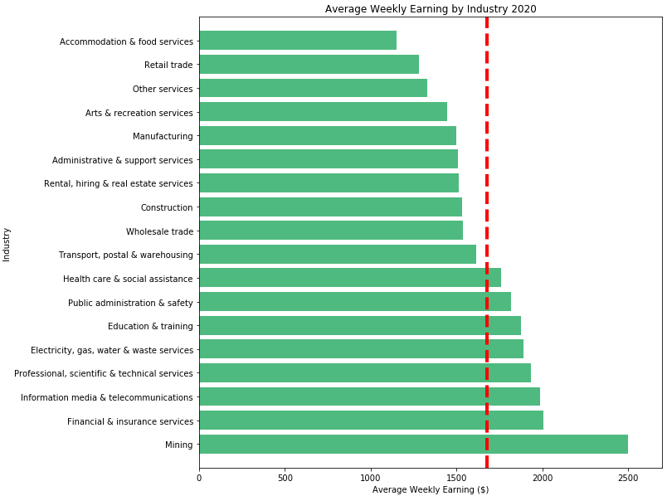
What happen to the average weekly earning?
2020 (Half year ended Nov 18)
Average
Weekly
Earning
$1,675.32
Hotel/FS is $527.42
Retails is $397
Mining is $821

Slide 9
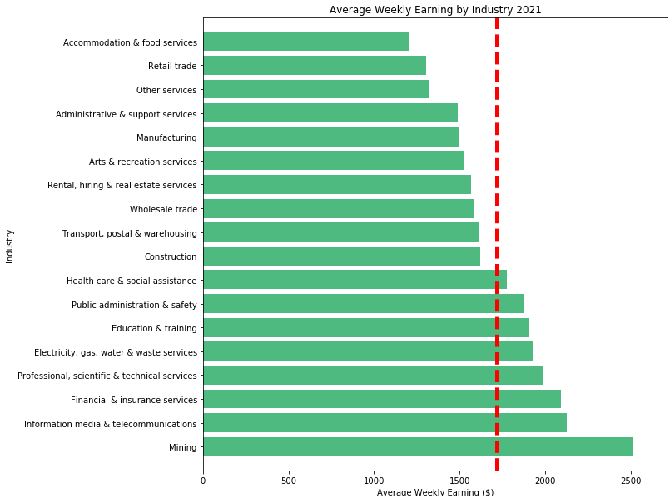
What happen to the average weekly earning?
2021 (Half year ended Nov 18)
Average
Weekly
Earning
$1,718.98
Hotel/FS is $514
Retails is $416
Mining is $821

Slide 10
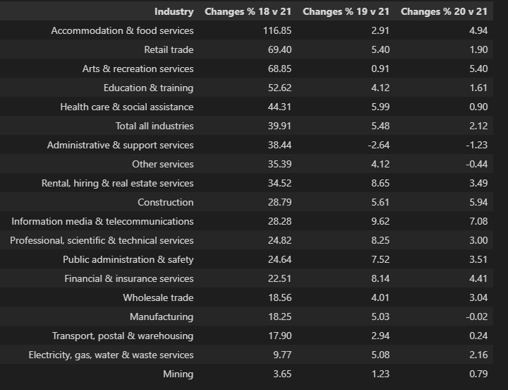
2018 -2021 Average Weekly Earning changes%
Top 5 Industries: unchanged 2018-2021
1.Mining
2.Financial & Insurance Service
3.Information media & Telecommunications
4.Professional, scientific & Tech Services
5.Educationi & Training
Bottom 5 Industries: unchanged 2018-2021
1.Accommodation & Food Services
2.Retails Services
3.Other Services
4.Art & recreation services
5.Admin and Support services

Slide 11
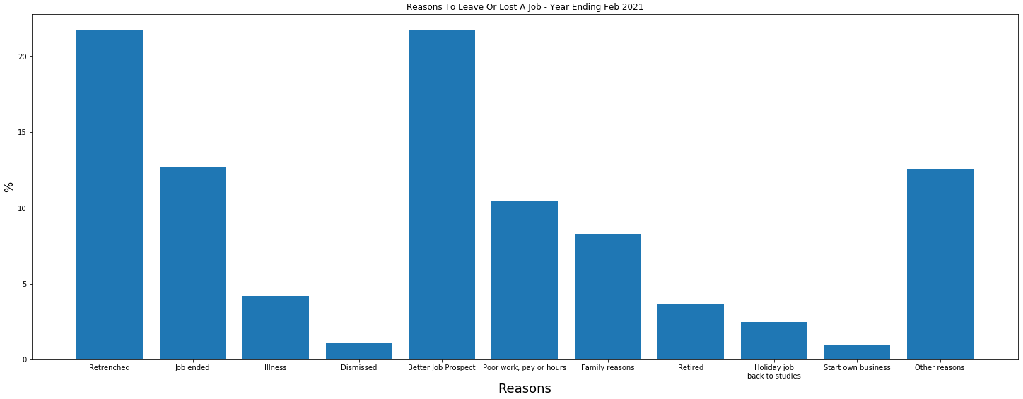
What make people to move during COVID?

Slide 12
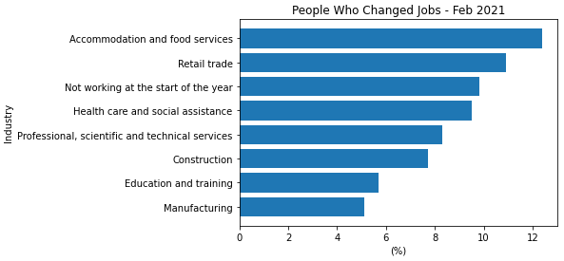
Changing Jobs
Data is from ABS - Job Mobility (Year Ending February 2021)
This figure shows that 12% of those working under Accommodation and Food Services decided to change jobs, next was Retail which was 11% and Health Care was 9.5%.

Slide 13
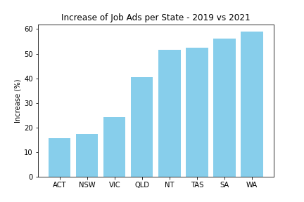
Job Ads by State
Internet Vacancy Index (IVI) which is a monthly count of online job advertisements compiled by the National Skills Commission through job boards such as Seek, CareerOne and Australian JobSearch. (https://labourmarketinsights.gov.au/our-research/internet-vacancy-index/#3)
Comparing the total vacancies between 2019 vs 2021, Western Australia had a growth of 59%.

Slide 14
Job Ads by State
Internet Vacancy Index (IVI) which is a monthly count of online job advertisements compiled by the National Skills Commission through job boards such as Seek, CareerOne and Australian JobSearch. (https://labourmarketinsights.gov.au/our-research/internet-vacancy-index/#3)
Comparing the total vacancies between 2019 vs 2021, Western Australia had a growth of 59%.

Slide 15
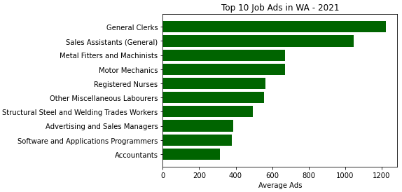
Job Ads in Western Australia
Occupations with the most job ads in WA are General Clerks (1200), Sales Assistants (1050), Metal Fitters and Machinists (670).

Slide 16
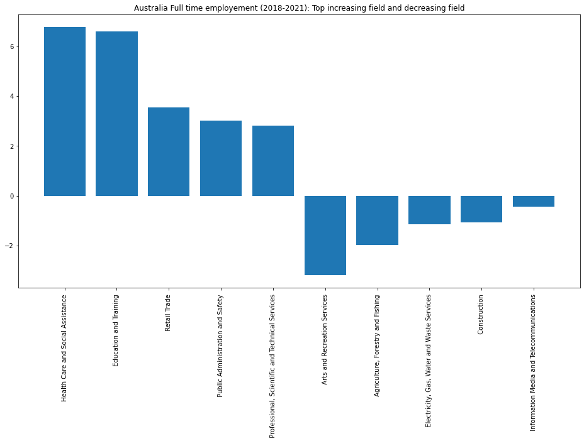
Australian FT employment

Slide 17

Australian PT employment

Slide 18
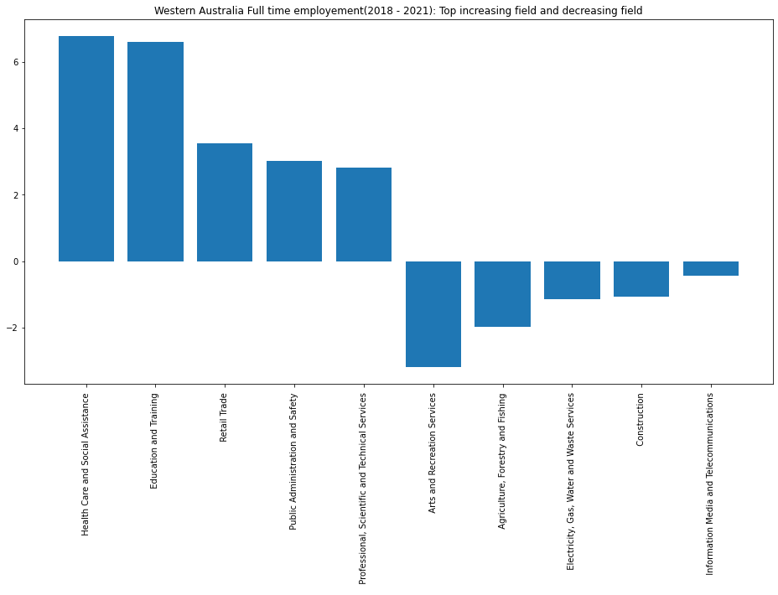
WA FT Employment

Slide 19
WA PT Employment

Slide 20
Conclusion
COVID have initially had negative impact to some industry but as we ride out of COVID peak, there are positive coming out from the COVID. Some industries are benefit from the restriction
Some industries are more susceptible to social distancing and restriction measures.
There are positive changes to some industry's average weekly earning
COVID also provide greater job vacancy / employment opportunity (Hybird working arraignment make it possible and accessible)
Job vacancy for the highlighted industry has been upward trajectory and exceed pre- COVID level
Insight for job seeker??
How can we prepare for the next potential pandemic? Moving into industry where they are less suspectable to social restriction measure? Upskill?

