Slide 1
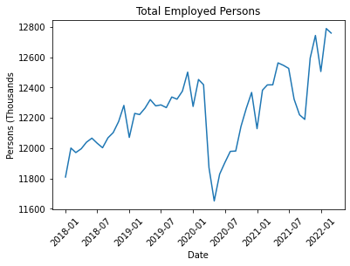
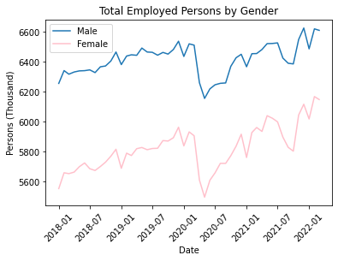
Employment evolution (pre/post COVID)
Lockdown Start 13 March 2020
766K people get into unemployment
356K men vs 410K women

Slide 2
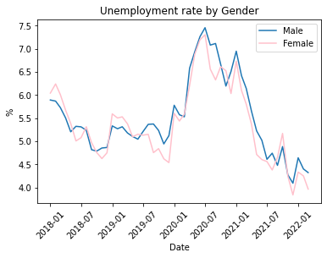

Unemployment rate
Current unemployment rate even lower than pre-COVID

Slide 3
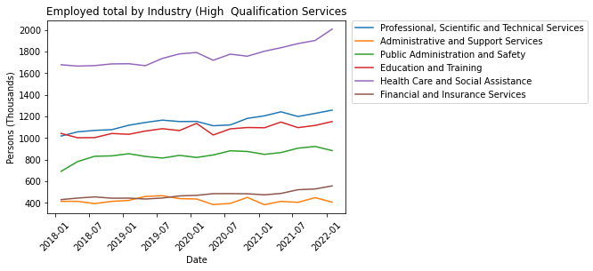

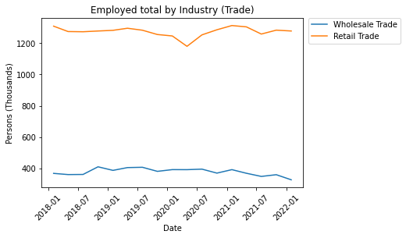

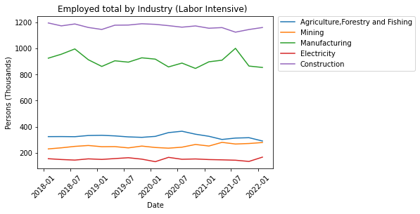
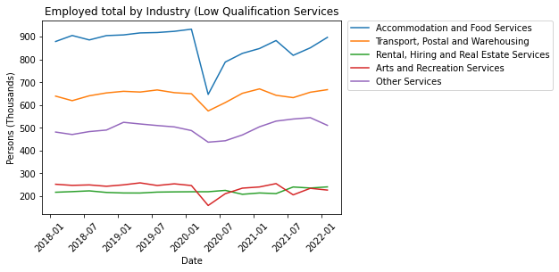
Evolution by Industry
Accommodation and arts services
High skilled jobs
Health care increase occupation

