Slide 1

CACE
Home
Visualisations
LET ME PICK YOUR MOVIE
Be our guest, be our guest. Put our service to the test.
Team members:
Camille Evangelista
Aline Hornoff
Edbert Widjaja
Carmen Sin

Slide 2
CACE
Home
Visualisations
LET ME PICK YOUR MOVIE
Be our guest, be our guest. Put our service to the test.
Data Story:
When was the last time on a rainy day, you curled up on the couch ready to watch a movie finding yourself overwhelmed by the sheer amount of movie choices spending ages figuring out what movie to watch?
Well, gone are the times of endless scrolling through movies to find the one to watch.
Enter your mood, the movie genre, release year of the movie or the time you have available to watch the movie in the interactive dashboard and it will give you a top 5 movie recommendation.
Project Link: https://movie-pick-uwa-project.herokuapp.com/

Slide 3
CACE
Home
Visualisations
LET ME PICK YOUR MOVIE
Be our guest, be our guest. Put our service to the test.
How did we get there?
1. Data sourcing including survey
2. ETL of movie data and survey data for Visualisation/ Machine Learning
3. Machine Learning – Naïve Bayes Model
Database creation for mood/movie filtering/randomisation
Flask and Heroku deployment
6. Summary - What we could have done with more time
7. Questions ☺

Slide 4
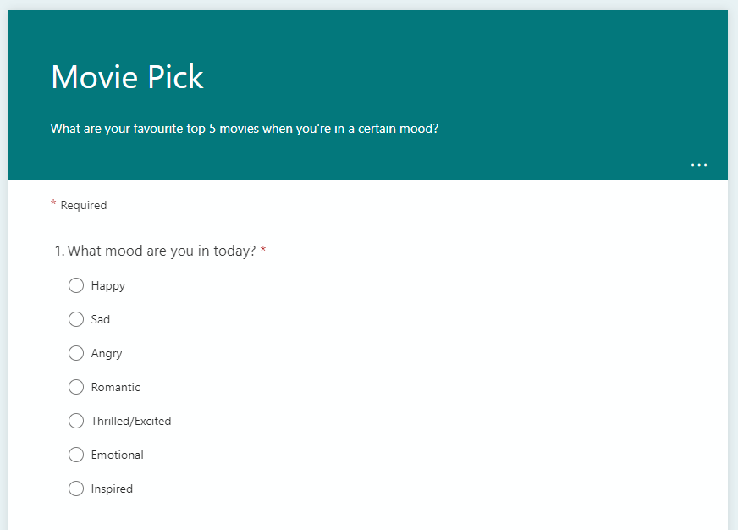
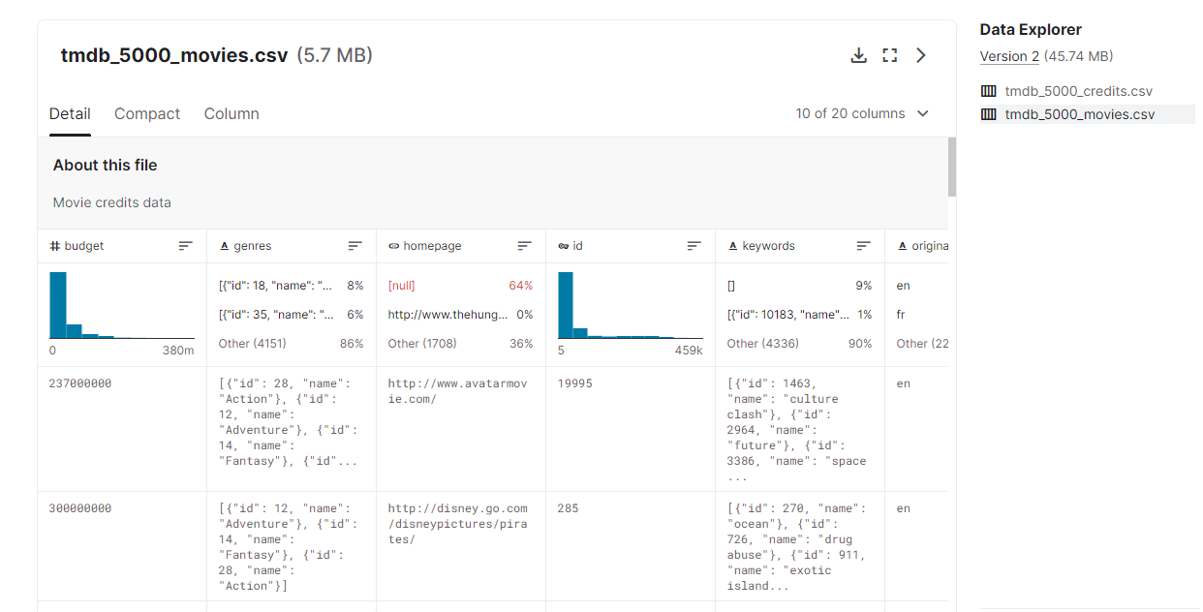
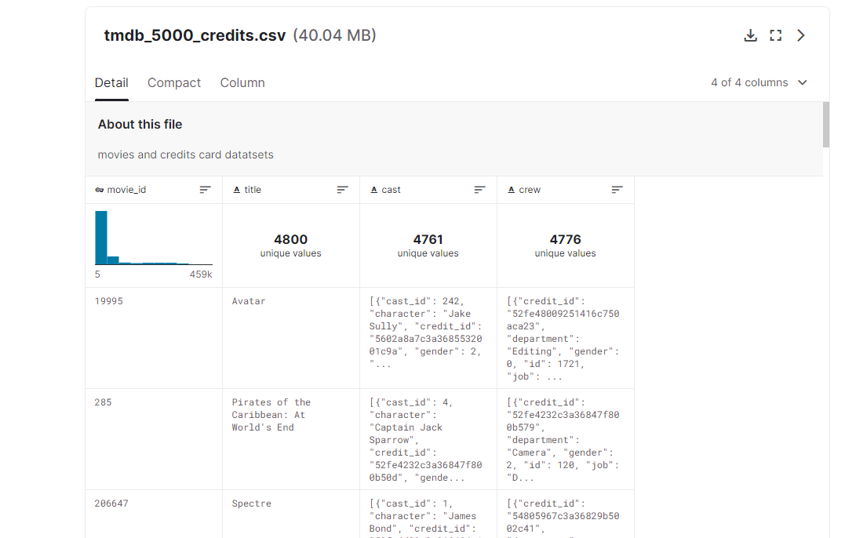
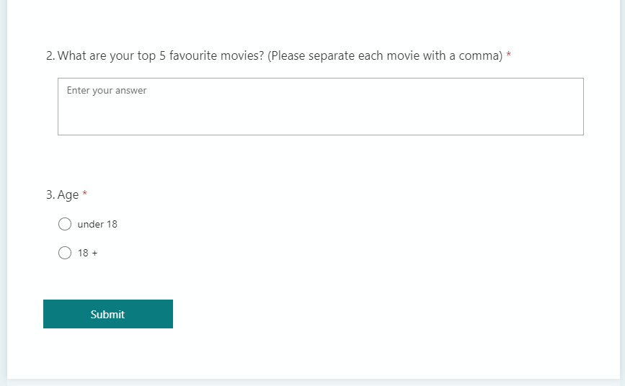
CACE
Home
Visualisations
LET ME PICK YOUR MOVIE
Be our guest, be our guest. Put our service to the test.
Data Sourcing
Two csv datasets from Kaggle
Created survey to link mood to movie titles

Slide 5






CACE
Home
Visualisations
LET ME PICK YOUR MOVIE
Be our guest, be our guest. Put our service to the test.
Data ETL
CSV datasets from Kaggle
Used pandas to for data cleaning
Merged and Dropped null values, duplicates, columns
Extracted lists of objects for various columns
Extracted release year from release date
Saved as csv
Stored in AWS for online access
Pushed file into pdAdmin to create database using CO
Imported database into Tableau for data visualisation
Challenges:
Extraction of lists of objects
Pushing data from AWS into pgAdmin – due to characters

Slide 6

CACE
Home
Visualisations
LET ME PICK YOUR MOVIE
Be our guest, be our guest. Put our service to the test.
Data ETL
Survey to link mood to movie titles
Data collection via Microsoft Forms
Used pandas to for data cleaning
Cleaning process:
dropped incorrect data/null values
corrected spelling to align with sourced movie data frame
Merged survey and sourced movie data frame
Uploaded cleaned data to AWS to use database in Google Colab for Machine Learning
Challenges:
Survey questions can be restructured and reworded

Slide 7
CACE
Home
Visualisations
LET ME PICK YOUR MOVIE
Be our guest, be our guest. Put our service to the test.
Machine Learning
Machine Learning Model – Naïve Bayes
Created all features to the data set (data transformation:
Positive/negative to number: mood, label
Tokenizer: overview
Created/fitted and transformed feature vectors and data processing pipeline
Breakdown into training and testing dataset
Accuracy of model: 0.167767
Trained sourced movie data to predict mood to movie
Saved data as csv
Challenges:
Limited amount of survey data
Overview description not consistent
Model accuracy

Slide 8

CACE
Home
Visualisations
LET ME PICK YOUR MOVIE
Be our guest, be our guest. Put our service to the test.
Movie Recommendation in HTML
Randomised Filter creation
Used pandas to for data cleaning
Uploaded CSV into AWS
Using Flask, the data was transformed into JSON and parsed into Javascript
Created filters in Javascript
Randomization of movie recommendation is done using Math.random
Challenges:
Pulling data from SQLite into Javascript

Slide 9


CACE
Home
Visualisations
LET ME PICK YOUR MOVIE
Be our guest, be our guest. Put our service to the test.
Flask and Heroku Deployment
Created flask environment including flask, jinja2, pandas, SQLAlchemy, gunicorn, flask_sqlalchemy, psycopg2-binary
Rendering of html pages including link to S3 bucket to extract csv file for filter function in Java Script
Deployment to Heroku
Challenges:
Couldn’t get sqlite date base to work for the filter function
Heroku deployment – having all environments

Slide 10
CACE
Home
Visualisations
LET ME PICK YOUR MOVIE
Be our guest, be our guest. Put our service to the test.
Summary
The model we’ve built using the naïve bayes machine learning model to predict movies to a user based on the mood they enter into the filter has a very low accuracy. This is due to the quality of the survey data which is too small and not extensive enough to provide data for the model to achieve better accuracy. In addition, the overview section which describes the movie content was vague for some of the movies which added to the low accuracy of the model.
If we had more time…
Spend more time on developing the survey to get cleaner data
Import our data into a database
Harvest the data input of users to predict user trends of movie genres and preferred movie length
Revise the movie overview to get a better movie description

Slide 11
CACE
Home
Visualisations
LET ME PICK YOUR MOVIE
Be our guest, be our guest. Put our service to the test.
THANK YOU! ☺
Any Questions?

Slide 12
CACE
Home
Visualisations
LET ME PICK YOUR MOVIE
Be our guest, be our guest. Put our service to the test.
Kaggle dataset ETL
Survey dataset ETL

Slide 13
CACE
Home
Visualisations
LET ME PICK YOUR MOVIE
Be our guest, be our guest. Put our service to the test.
Machine Learning –
Naïve Bayes Model
Randomised Filter for HTML
Flask and Heroku Deployment

