Slide 1
Introduction to Computer Science (371-1-1601)
Lectures by: Prof Hugo Guterman, Zion Siksik​​
Recitations by: Moshiko Davidian, Ofir Yaish, Dor Shamay, Bar Shaybet ​

Slide 2
Today’s topics
Stack
Queue
Binary tree

Slide 3
Stack

Slide 4
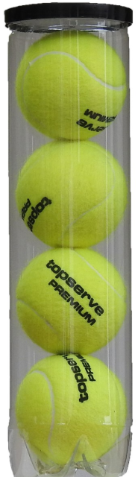
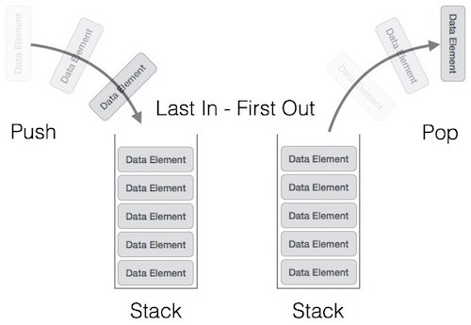
Stack
As its name implies, this structure offers to push elements to the top or pop them out
A Stack does not offer the operation of getting an element from the middle
This is called LIFO – Last In First Out

Slide 5
Stack
We saw a stack before – the call stack mechanism that handle function calls (showed well on the python tutor, especially with recursion)
Stack has many other useful for various applications
UNDO (e.g., ctrl + z)
Browser history
And any other mechanism based on LIFO

Slide 6
Stack
We saw in class the implantation of stack using Python list. This is a similar implantation:
class MyStack: def __init__(self): self.stack_vals = [] self.len = 0 def push(self, val): self.stack_vals.append(val) self.len += 1 def pop(self): if self.is_empty(): return None to_pop = self.stack_vals[-1] self.stack_vals = self.stack_vals[:-1] self.len -= 1 return to_pop
def peek(self): if self.is_empty(): return None return self.stack_vals[-1] def __len__(self): return self.len def is_empty(self): return not self.len def __repr__(self): return str(self.stack_vals) + " <-- head"

Slide 7

Exercise 1 – Reverse Stack
Add to the class a method that reverse the stack
Time Complexity: $O(n)$
Auxiliary Space: $O(n)$
def reverse_stack(self): """Reverse the stack"""
Solution:
def reverse_stack(self): """Reverse the stack""" temp = copy(self) # Empty stack while not self.is_empty(): self.pop() # move from temp to stack while not temp.is_empty(): self.push(temp.pop())
s = MyStack() s.push(1) s.push(2) print(s) s.reverse_stack() print(s)
[1, 2] <-- head
[2, 1] <-- head

Slide 8
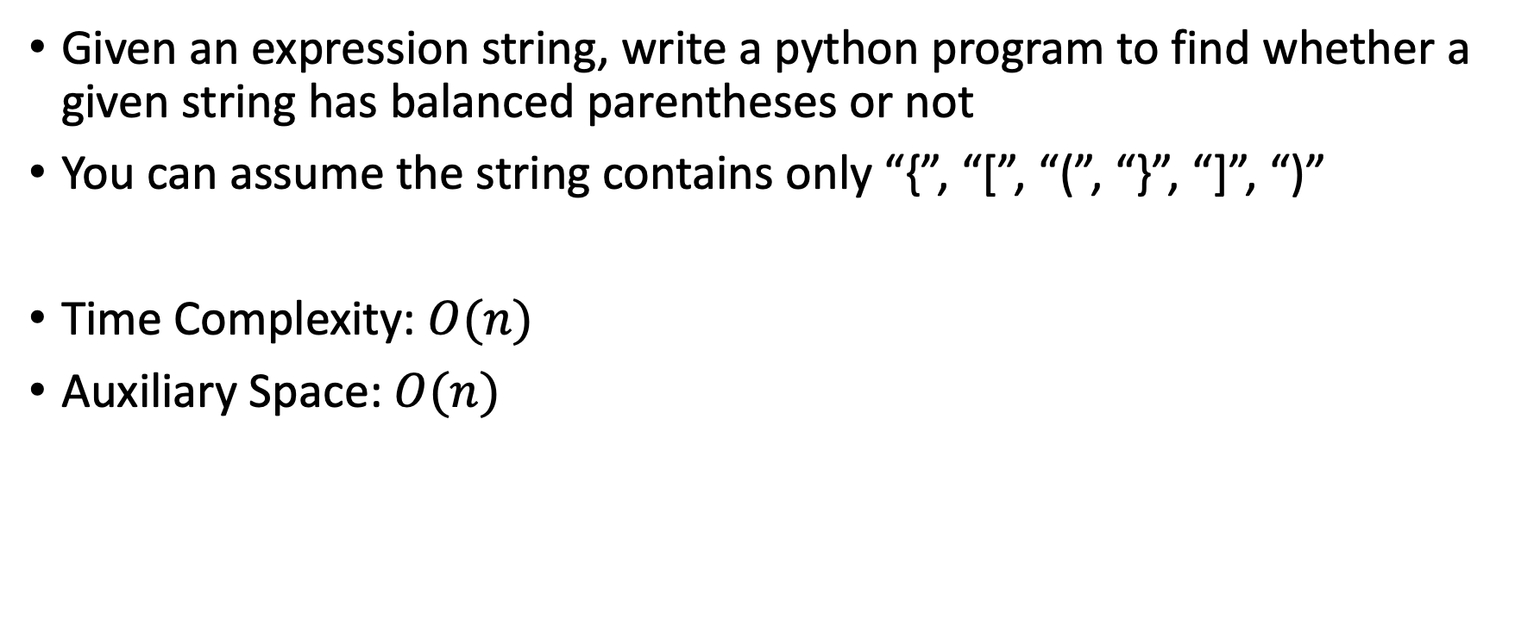
Exercise 2– Check for balanced parentheses
Given an expression string, write a python program to find whether a given string has balanced parentheses or not
You can assume the string contains only “{”, “[”, “(”, “}”, “]”, “)”
Time Complexity: $O(n)$
Auxiliary Space: $O(n)$
Examples:
Input : {[]{()}}
Output : True
Input : [{}{}(]
Output : False

Slide 9
Exercise 2 – Check for balanced parentheses
def check(my_str): open_list = ["[", "{", "("] close_list = ["]", "}", ")"] stack = MyStack() for i in my_str: if i in open_list: stack.push(i) elif i in close_list: pos = close_list.index(i) if len(stack) > 0 and open_list[pos] == stack.peek(): stack.pop() else: return False if len(stack) == 0: return True else: return False
from Stack import MyStack

Slide 10
Queue

Slide 11

Queue
If Stack is LIFO, Then Queue is FIFO (First In First Out)
We can see many mechanisms using FIFO such as:
Phone calls operator management
Task Scheduling
Line for tickets

Slide 12
Exercise 3 - Queue Implantation Stack
We want our Queue to support:
Queue() constructor
enqueue(val) inserting a new value
dequeue() removing and returning the oldest value
front() watching the oldest value without removing it
rear() watching the newest value without removing it
len() returning number of values
is_empty() check if the queue is empty
How can we do it?

Slide 13
Exercise 3 - Queue Implantation Using Stack
Queue with stack
Methods we can use
How implement
Methods we need implement
Stack
Reverse stack
Queue
push
pop
push
pop
enqueue
5
4
3
2
1
peek
5
4
3
2
1
peek
5
4
3
2
1
1
2
3
2
5
front
rear
front
is_empty
reverse_stack
dequeue

Slide 14
Exercise 3 - Queue Implantation Using Stack
class Queue: def __init__(self): self.stack = MyStack()
def __repr__(self): return str(self.stack).replace("head", "tail") def __len__(self): return len(self.stack) def is_empty(self): return len(self) == 0 def rear(self): if self.is_empty(): return None return self.stack.peek()
def enqueue(self, val): self.stack.push(val)
def dequeue(self): if self.is_empty(): return None self.stack.reverse_stack() res = self.stack.pop() self.stack.reverse_stack() return res def front(self): if self.is_empty(): return None self.stack.reverse_stack() res = self.stack.peek() self.stack.reverse_stack() return res

Slide 15
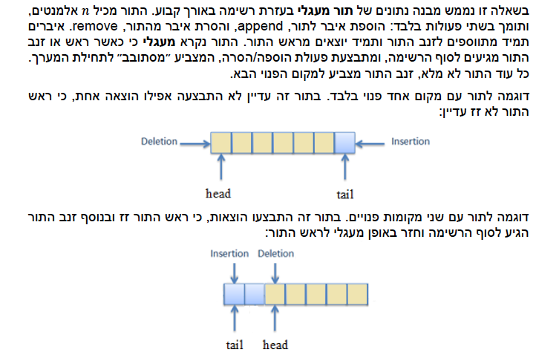
Exam Question – Circular Queue - 1

Slide 16
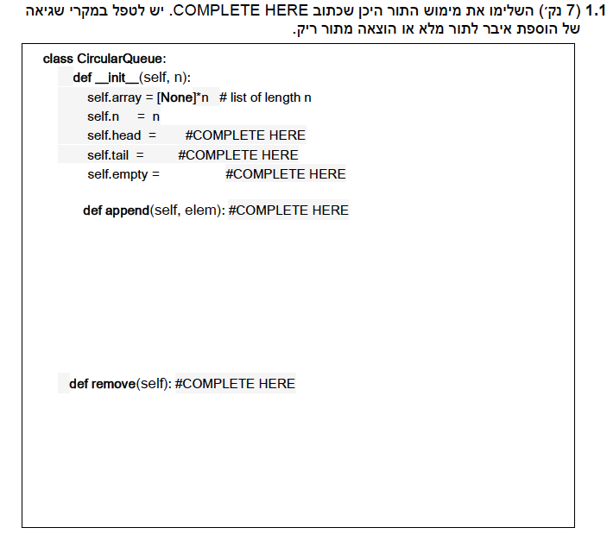
Exam Question – Circular Queue - 2

Slide 17
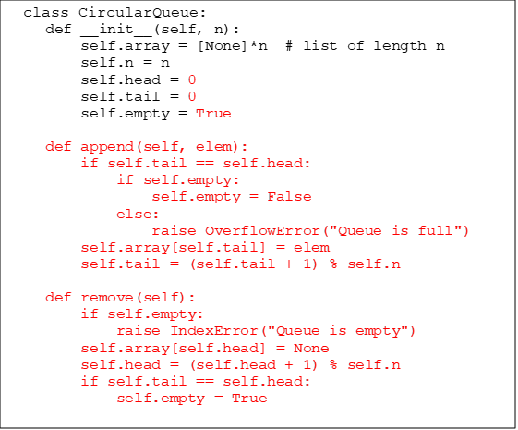
Exam Question – Circular Queue - 3

Slide 18
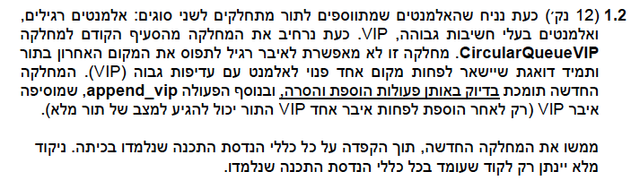
Exam Question – Circular Queue - 4

Slide 19
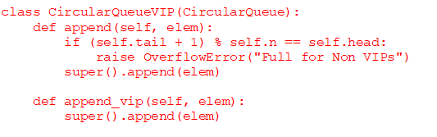
Exam Question – Circular Queue - 5

Slide 20
Binary Trees

Slide 21
Trees
Directed Rooted Trees are one particularly useful class of Graphs
They have a special node called “the root”
There is exactly one path from the root to every other node in the tree
Binary trees have the further property that each node has at most two others beneath it. Is the tree in the picture binary?
1
2
3
4
5
6
7
8

Slide 22
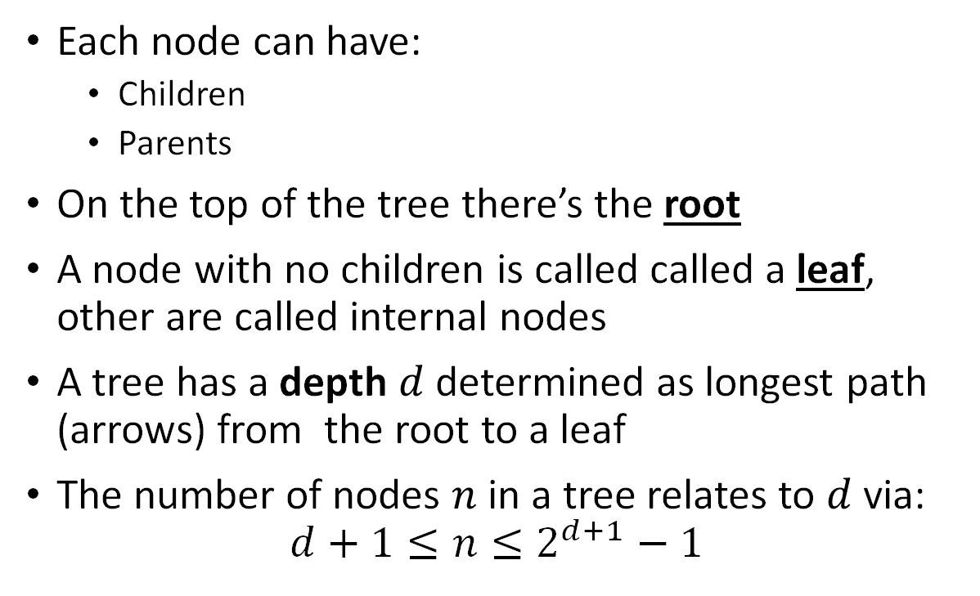
Tree Terminology
Each node can have:
Children
Parents
On the top of the tree there’s the root
A node with no children is called called a leaf, other are called internal nodes
A tree has a depth $d$ determined as longest path (arrows) from the root to a leaf
The number of nodes $n$ in a tree relates to $d$ via:
$$d+1≤n≤2^{d+1}−1$$
1
2
3
5
6
7
8

Slide 23
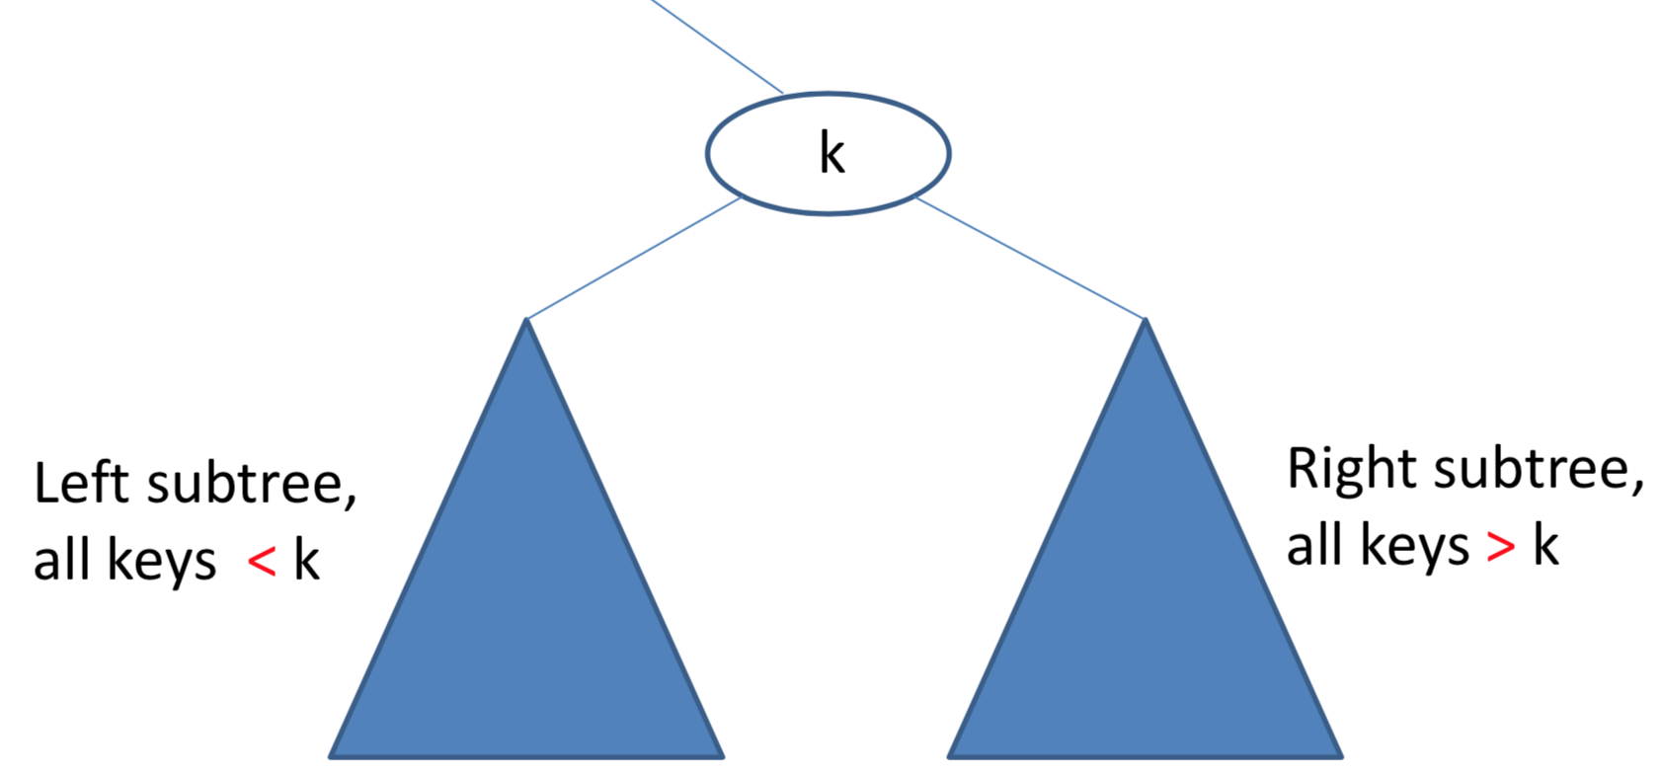
Binary Search Trees
Binary search trees have the additional property that they are ordered
They have many uses

Slide 24
Recall – Tree Lookup
Consider a binary search tree
Implement a method “find_val” for the class. The method accepts a single argument – a lookup value
The method returns true if the value is found and false otherwise
Avoid unnecessary checks
class Node: def __init__(self, data): self.left = None self.right = None self.data = data
def findval(self, lkpval) -> bool:
""" The method returns true if the value is found in the tree and false otherwise """

Slide 25
Lookup – recall
def findval(self, lkpval) -> bool: if lkpval < self.data: if self.left is None: return False return self.left.findval(lkpval) elif lkpval > self.data: if self.right is None: return False return self.right.findval(lkpval) else: return True
12
12
6
14
3
8

Slide 26
Exercise 3 – Tree Insert
Consider a binary search tree
Implement a method “insert” for the class. The method accepts a single argument – a new value to insert
The method inserts the new value in a current place
def insert(self, data):
""" The method the new data into the BST"""

Slide 27
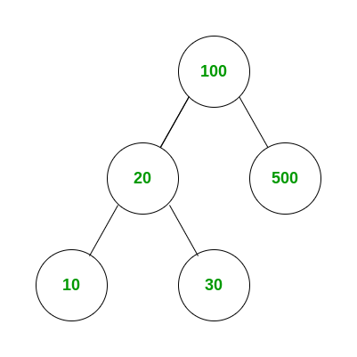
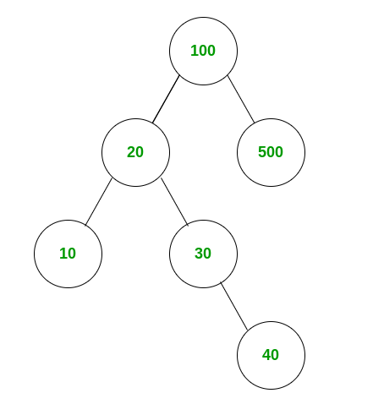
Insert
def insert(self, data): if self.data: if data <= self.data: # if new data is smaller insert in left if self.left is None: self.left = Node(data) else: self.left.insert(data) elif data > self.data: # if new data is larger insert in right if self.right is None: self.right = Node(data) else: self.right.insert(data) else: self.data = data

Slide 28
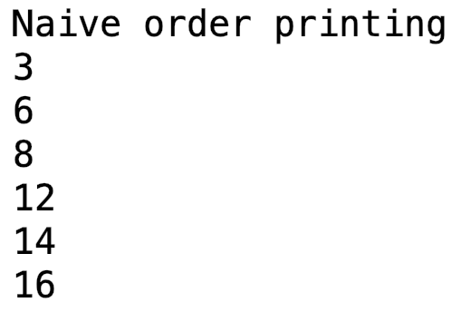
Traversing trees
What is the output for the follwing Tree:
12
12
Let us print a tree:
6
14
def print_tree(self): if self.left: self.left.print_tree() print(self.data) if self.right: self.right.print_tree()
3
8
16

Slide 29
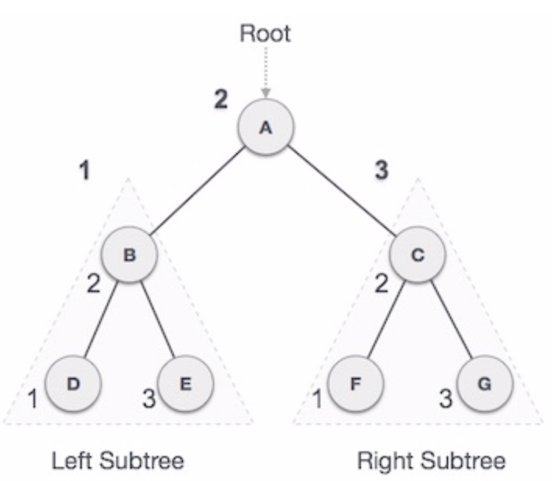
Standard traversal orders – In-Order
In-order Traversal - left subtree, root, right subtree
Good for generating sorted values in ascending order
Example of
Depth First Traversal
Uses a stack
Example without recursion:
here

Slide 30
Standard traversal orders – In-Order
# In order traversal def in_order_traversal(self): result = [] if self.left: result.extend(self.left.in_order_traversal()) result.append(self.data) if self.right: result.extend(self.right.in_order_traversal()) return result

Slide 31
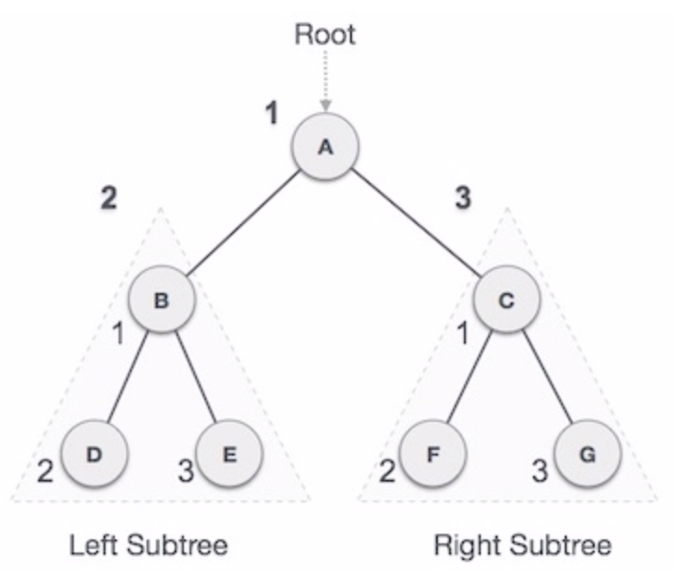
Standard traversal orders – Pre-Order
Pre-order Traversal - root , left subtree, right subtree
Good for copying trees
General description of traversal order:
General
In Python
Example without recursion:
here
Implementation in Supplementary code

Slide 32
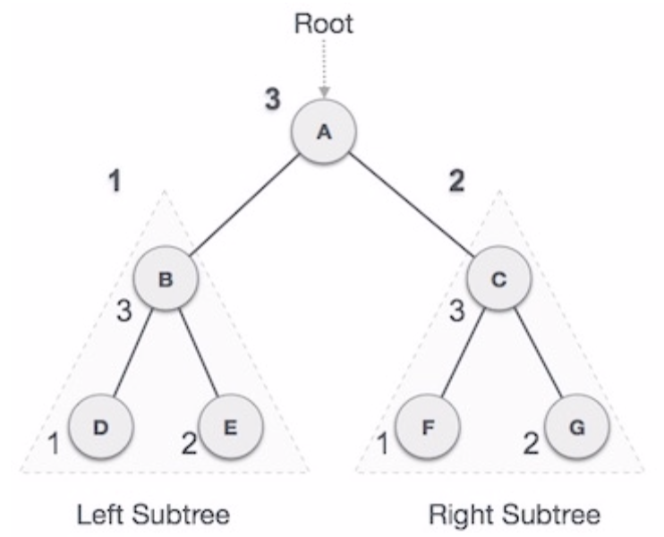
Standard traversal orders – Post-Order
Post-order Traversal - left subtree, right subtree, root
Good for deleting trees (where you’re responsible for it)
A bit more complex without recursion, can be done easily with two stacks
Example without recursion:
here
Implementation in Supplementary code

Slide 33
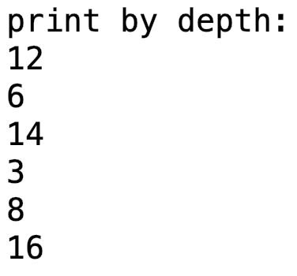
Print by depth
12
def print_by_depth(root): # Base Case if root is None: return # Create a queue for level order traversal and enqueue root queue = [root] while len(queue) > 0: # Print front of queue and remove it from queue node = queue.pop(0) print(node.data) # Enqueue left child if node.left is not None: queue.append(node.left) # Enqueue right child if node.right is not None: queue.append(node.right)
12
6
14
3
8
16
We use a queue to alter the order
Breadth First Traversal
How would you print right before left?

