Slide 1
Introduction to Computer Science (371-1-1601)
Lectures by: Prof Hugo Guterman, Zion Siksik​​
Recitations by: Moshiko Davidian, Ofir Yaish, Dor Shamay, Bar Shaybet ​

Slide 2
Today’s topics
Class definition
Inheritance

Slide 3
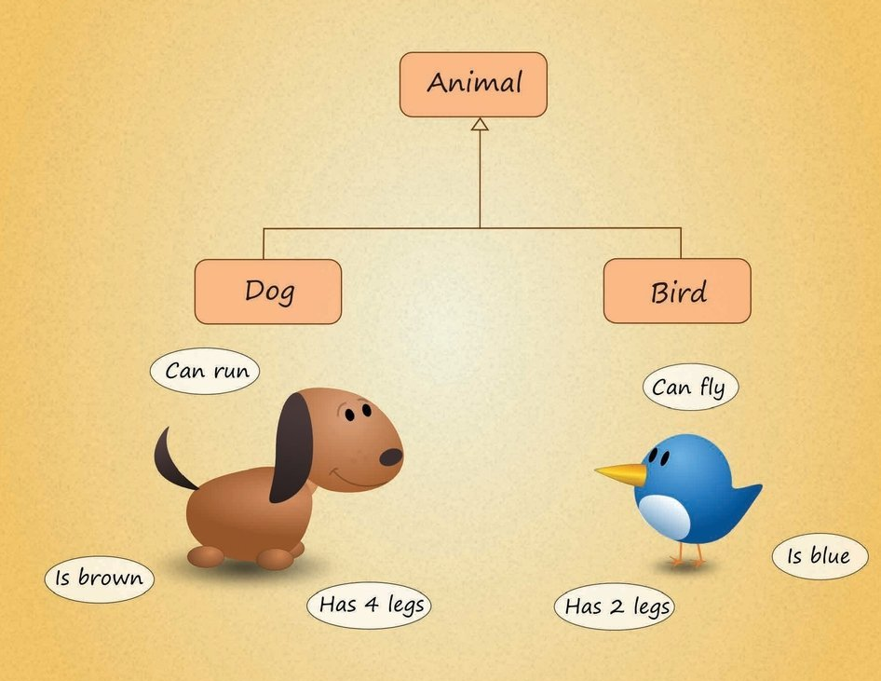
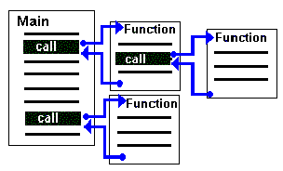
Classes
Procedural Programming
Object-Oriented Programming (OOP)

Slide 4
Object-Oriented Programming (OOP)
An object-oriented program may be viewed as a collection of interacting objects, as opposed to the conventional model, in which a program is seen as a list of tasks (subroutines) to perform
Objects holds both code (methods) and data (properties) for the entities they represent

Slide 5

Class Definition
Class name (CamelCase)
class ClassName: """documentation string""" def __init__(self, arg1): # initializer
self.name = arg1 def method_name(self, arg1, arg2): # method code
def method_name(self, arg1, arg2): # method code
...
Instance attributes/fields
Method
Two basic elements of the class are attributes/fields and methods:
Attributes/Fields – holds the objects data
Methods – define the operations the object can do

Slide 6
Example - Vector class (1)
What do we need to describe a vector?
self?
class Vector: """ A class used to represent a vector. attribute values: a list of numbers that describe the vector. ""”
def __init__(self, elements): """ initializer of vector class :param elements: a list of numbers """ self.elements = elements
self represents the object instance of the class. By using “self”, we can access the object instance attributes and the class methods.

Slide 7
object instance construction
Invokes the object construction
vec1 = Vector([3, 3, 7])
Calling Vector([3, 3, 7]) will first invoke the static method __new__() to create the new object instance of the class (i.e., create self)
Then, the new instance’s __init__() method will be invoked like __init__(self[, ...]), where self is the new instance, and the remaining arguments are the same as were passed to the object constructor
self.elements
vec1.elements
Inside class definition
On the instance variable

Slide 8
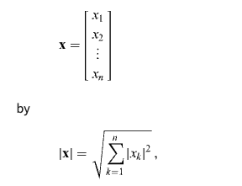

Example - Vector class (2)
Implement the L2-norm method
class Vector: def __init__(self, elements): self.elements = elements def l2_norm(self): return sum([x**2 for x in self.elements]) ** 0.5
Calling the method:
equivalent to
vec1 = Vector([3, 3, 7]) print(vec1.l2_norm())
Vector.l2_norm(vec1)

Slide 9

Example - Vector class (3)
class Vector: def __init__(self, elements): self.elements = elements
What will be the output?
To solve this, we should create a copy of the list when initializing the vector
lst = [3, 3, 7] vec1 = Vector(lst) vec2 = Vector(lst) vec1.elements.append(10) print("vec1.elements:", vec1.elements) print("vec2.elements:", vec2.elements)

Slide 10
Shallow copy
Constructs a new compound object and then (to the extent possible) inserts references into it to the objects found in the original
Python has a built-in library called copy which contains a shallow copy function:
import copy class Vector: def __init__(self, elements): self.elements = copy.copy(elements)
In case of list, we can also use slicing which creates a shallow copy of the list:
class Vector: def __init__(self, elements): self.elements = elements[:]
Why is it enough to use the shallow copy in the vector class case?
Notes:
Assignment statements in Python do not copy objects, they create bindings between a target and an object. For collections that are mutable or contain mutable items, a copy is sometimes needed so one can change one copy without changing the other. This module provides generic shallow and deep copy operations.
The difference between shallow and deep copying is only relevant for compound objects (objects that contain other objects, like lists or class instances):
A shallow copy constructs a new compound object and then (to the extent possible) inserts references into it to the objects found in the original.
A deep copy constructs a new compound object and then, recursively, inserts copies into it of the objects found in the original.

Slide 11
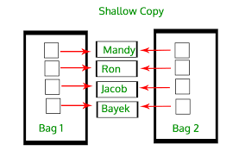
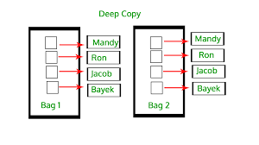
Shallow copy vs. deep copy

Slide 12
Example - Vector class (4)
class Vector: def __init__(self, elements): self.elements = copy.copy(elements) def l2_norm(self): return sum([x**2 for x in self.elements]) ** 0.5
What will be the output?
vec1 = Vector([1, "2", 1]) print(vec1.l2_norm())
Validating that an object instance is created according to our class design is essential and easy to apply with objects

Slide 13
Example - Vector class (5)
class Vector: def __init__(self, elements): if self.validate_vector(elements): raise ValueError("Wrong parameter type") self.elements = copy.copy(elements) def validate_vector(self, elements): return not isinstance(elements, list) or not all([isinstance(x, (int, float)) for x in elements])
The isinstance() function returns True if the specified object is of the specified type, otherwise False
If the type parameter is a tuple, this function will return True if the object is one of the types in the tuple

Slide 14
Static methods
Since validate_vector(self, elements) is not using the object instance, there is no reason for this method to be bound to the instance. We will replace it with a static method
Static method is a method that knows nothing about the class or instance it was called on. It just gets the arguments that were passed, no implicit first argument. Can be invoked without creating an object instance of the class.

Slide 15
Static methods
Can be invoked also using self.validate_vector(elements)
However, self is not passed
class Vector: def __init__(self, elements): if Vector.validate_vector(elements): raise ValueError("Wrong parameter type") self.elements = copy.copy(elements) @staticmethod def validate_vector(elements): return not isinstance(elements, list) or not all([isinstance(x, (int, float)) for x in elements])
@staticmethod is function decorator which converts the method into a static function. Read about decorators here and about the @staticmethod here

Slide 16
Class attributes and methods
A class attribute is a Python variable that belongs to a class rather than a particular object instance. It is shared between all the objects of this class
For example, lets try to give a unique ID to each Vector instance we construct:
Class attribute
class Vector: current_id = 0 def __init__(self, elements): if Vector.validate_vector(elements): raise ValueError("Wrong parameter type") self.elements = copy.copy(elements) self.vector_id = Vector.current_id Vector.current_id += 1
vec1 = Vector([1, 2, 3]) vec2 = Vector([5, 6, 8]) vec3 = Vector([1, 2, 3]) print("vec1 id:", vec1.vector_id, "vec2 id:", vec2.vector_id, "vec3 id:", vec3.vector_id)
Class attribution can be accessed also using self.current_id. However, self.current_id += 1 will create a new instance attribute

Slide 17
Class attributes and methods
A class method is a method that is bound to a class and not the object of the class. It does not require creation of a class instance, much like static method
The difference between a static method and a class method is:
Static method knows nothing about the class and just deals with the parameters
Class method works with the class since its parameter is always the class itself. It can modify a class state

Slide 18

Class attributes and methods
class Vector: current_id = 0 def __init__(self, elements): if Vector.validate_vector(elements): raise ValueError("Wrong parameter type") self.elements = copy.copy(elements) self.vector_id = Vector.current_id Vector.current_id += 1 @classmethod def id_reset(cls, initialize_value=0): cls.current_id = initialize_value
vec1 = Vector([1, 2, 3]) vec2 = Vector([5, 6, 8]) print("vec1 id:", vec1.vector_id, "vec2 id:", vec2.vector_id) Vector.id_reset(-10) vec1 = Vector([1, 2, 3]) vec2 = Vector([5, 6, 8]) print("vec1 id:", vec1.vector_id, "vec2 id:", vec2.vector_id)
A class method receives the class (cls) as an implicit first argument, just like an instance method receives the instance
@classmethod is function decorator which converts the method into a class function. Read about decorators here and about the @classmethod here

Slide 19
Example - Vector class (6)
What will be the output?
vec1 = Vector([1, 2, 1]) print(vec1)
To support objects printing, we should overload the __str__ method:
class Vector: … def __str__(self): """ print function override """ return "Vector values: {}".format(str(self.elements))
vec1 = Vector([1, 2, 1]) print(vec1)

Slide 20
HW – __str__ vs __repr__
Understand the difference between str() call and repr() call:
__str__ goal is to be readable
__repr__ goal is to be unambiguous
str() is used for creating output for end user while repr() is mainly used for debugging and development
Almost every object you implement should have a functional __repr__ that’s usable for understanding the object. Implementing __str__ is optional: do that if you need a “pretty print” functionality
Read more here

Slide 21
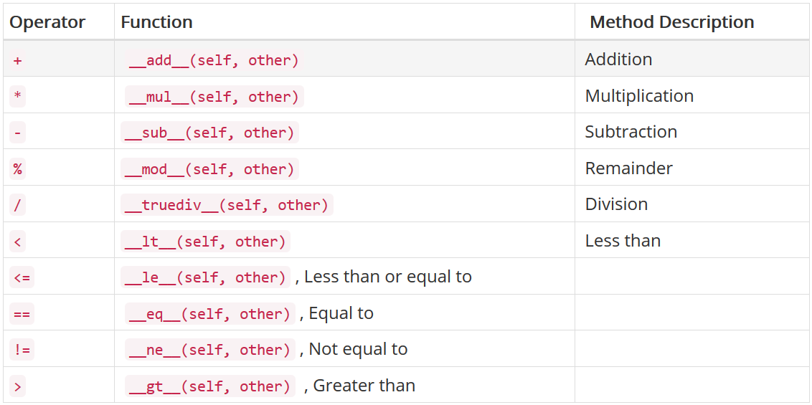
overriding (operators and methods)
overriding __str__ (or __repr__) are just one example. There are many operators we can override:
And more…
Notes:
Actually some of the were not implemented at all (there is no defaut implementation for them), therefore we implement those magic methods

Slide 22
Example - Equality operator
How can we check if two vectors are equal?
>>> Vector([1, 2, 3]) == Vector([1, 2, 3])
False
Why is it False?
The correct way is to override the eq operator:
>>> Vector([1, 2, 3]) == Vector([1, 2, 3])
True
def __eq__(self, other): if not isinstance(other, Vector): return False return self.elements == other.elements

Slide 23
Example - Indexing Operator
Accessing a specific value of the vector can be done using:
>>> Vector([1, 2, 3]).elements[i]
The right way is to override the getitem operator (it actually was not implemented; therefore, we do not override it):
>>> v1 = Vector([1, 2, 3])
>>> v1[2]
3
def __getitem__(self, i): return self.elements[i]

Slide 24
Example - len Function
A better way getting the vector length is to implement the len method:
>>> v1 = Vector([5, 1, 14, 7])
>>> len(v1)
4
def __len__(self): return len(self.elements)

Slide 25
Example - Multiplication Operator
We implement the multiplication operator (*) as dot product:
>>> vec1 = Vector([1, 2, 3])
>>> vec2 = Vector([4, 5, 6])
>>> print(vec1 * 2.5)
[2.5, 5.0, 7.5]
>>> print(vec1 * vec2) # dot product
Note that we return a new Vector instance
def __mul__(self, other): if isinstance(other, (int, float)): return Vector([other * x for x in self.elements]) if isinstance(other, Vector) and len(self) == len(other): return sum([self[i] * other[i] for i in range(len(self))]) raise ValueError("Wrong type or dimensions")

Slide 26
Exercise - Multiplication Operator
But what will be the output now:
>>> vec1 = Vector([1, 2, 3])
>>> print(5 * vec1)
TypeError: unsupported operand type(s) for *: 'int' and 'Vector’
How can we solve this?
def __rmul__(self, other): """ right side multiplication operator overload :param other: a Vector or number to multiply with self """ return self * other

Slide 27
Exercise - Multiplication Operator
Python looks at the first value, 5 ,which is an int
It calls int.__mul__ passing in the second value vec1 which is a Vector
Since int is a built-in type, its __mul__ function knows nothing of out Vector type, so it returns NotImplemented
Python checks if the second argument Vector has a__rmul__ method. If not, it gives an error

Slide 28
HW – add and subtract operators
Implement the __add__ operator (+) of the Vector class
Implement the __sub__ operator (-) of the Vector class using the __add__ operator
You might implement other operators to solve 2

Slide 29
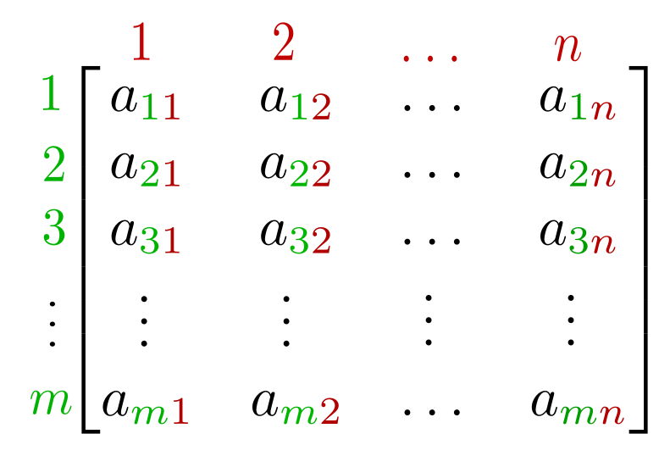
Example - Matrix Class (1)
How do you suggest to represent a matrix?
List of lists of number
List of Vectors
Implement Matrix class that holds a list of Vectors
>>> vec1 = Vector([1, 2, 3])
>>> vec2 = Vector([4, 5, 6])
>>> mx = Matrix([vec1, vec2])
>>> mx.vectors
[[1, 2, 3], [4, 5, 6]]
from Vector import Vector
class Matrix: def __init__(self, vectors): self.vectors = vectors

Slide 30
Example - Matrix Class (2)
In Matrix class, we will assume that all values and types are correct.
What is the right way to print a Matrix?
>>> mx = Matrix([Vector([1, 2, 3]), Vector([4, 5, 6])])
>>> print(mx)
[1, 2, 3]
[4, 5, 6]
Which str is called?
def __repr__(self): m = "" for vec in self.vectors: m = m + str(vec) + "\n" return m.strip()

Slide 31
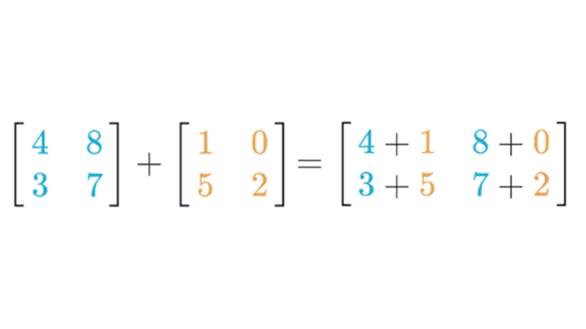
Example - Matrix Class (3)
To add two matrices, we can do an element-wise addition
Instead, we can use the Vector class addition operator:
def __add__(self, other): return Matrix([self[i] + other[i] for i in range(len(self))])
Does it work?
Which add operator will be called?
def __getitem__(self, i): return self.vectors[i]
def __len__(self): return len(self.vectors)

Slide 32
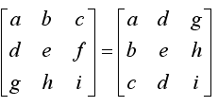
HW - Matrix Transpose
Write a method that returns the transposed matrix
>>> vec1 = Vector([1, 1, 1]),
>>> vec2 = Vector([2, 2, 2])
>>> mx1 = Matrix([vec1, vec2])
>>> mx1.transpose()
[1, 2]
[1, 2]
[1, 2]

Slide 33
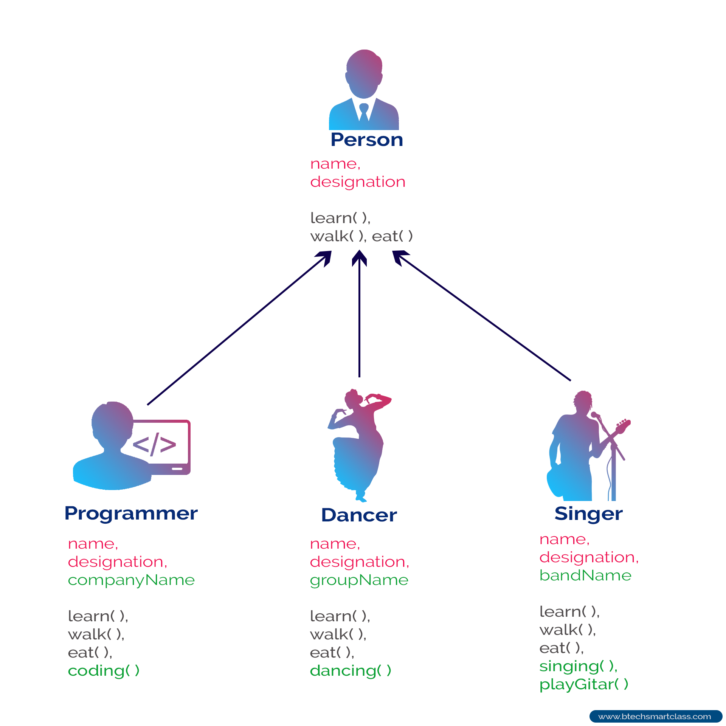
Inheritance

Slide 34

Exercise - Football Player Class
Implement a class that represent a football player
Class name: FootballPlayer
instance attributes (fields):
name (string)
salary (int – in millions)
performance (float – player’s performance)

Slide 35
Football Player Class
Implement an initializer for the FootballPlayer class and override the repr operator to print each field in different row
class FootballPlayer: def __init__(self, name, salary, performance): self.name = name self.salary = salary self.performance = performance def __repr__ (self): return f"Name: {self.name}\n" \ f"Salary: {self.salary}M \n" \ f"Performance: {self.performance}\n"
Input validation

Slide 36
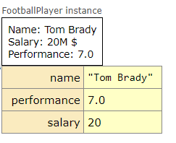
Football Player Class
>>> p = FootballPlayer('Tom Brady', 20, 7)
>>> print(p)
Name: Tom Brady
Salary: 20M $
Performance: 7.0

Slide 37

Example - Offense Player Class
Implement class that represents an offensive player.
instance attributes:
name (string)
salary (int – in millions)
performance (float)
total_yards (int – initialized to 0)
How would you implement this class?

Slide 38
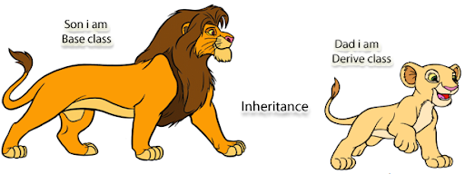
Offense Player Class
Inheritance
OffensePlayer implementation:
class OffensePlayer(FootballPlayer): def __init__(self, name, salary, performance): FootballPlayer.__init__(self, name, salary, performance) self.total_yards = 0
def __repr__(self): res = FootballPlayer.__repr__(self) return res + '\n' + f'Total Yards: {self.total_yards}'
Intro to Computer Science For electrical engineering

Slide 39
Offense Player Class
Implement run_yards method that takes yards as argument, and adds it to the total number of yards of that offensive player
def run_yards(self, yards): self.total_yards += yards

Slide 40

Offense Player Class
>>> p = OffensePlayer('John Smith', 22, 7)
>>> p.run_yards(1)
>>> p.run_yards(3)
>>> print(p)
Name: John Smith
Salary: 22M $
Performance: 7.0
Total Yards: 4

Slide 41
Exercise - Defense Player Class
Implement class that represents a defensive player
instance attributes:
name (string)
salary (int – in millions)
performance (float)
total_tackles (int – initialized to 0)
How would you implement this class?

Slide 42
Defense Player Class
Inheritance
DefensePlayer implementation:
class DefensePlayer(FootballPlayer): def __init__(self, name, salary, performance): super().__init__(name, salary, performance) self.total_tackles = 0 def __repr__(self): res = super().__ repr__() return res + '\n' + f'Total Tackles: {self. total_tackles}'
super()
returns a temporary object of the superclass that allows you to call that superclass’s methods.
Notes:
Calling the previously built methods with super() saves you from needing to rewrite those methods in your subclass, and allows you to swap out superclasses with minimal code changes.

Slide 43
Defense Player Class
Implement tackle method that does not take any argument, and adds 1 to the total number of tackles of that offensive player
def tackle(self): self.total_tackles += 1

Slide 44
Defense Player Class
>>> p = DefensePlayer('Janis Griffin', 15, 6.2)
>>> p.tackle()
>>> p.tackle()
>>> print(p)
Name: Janis Griffin
Salary: 15M $
Performance: 6.2
Total Tackles: 2

Slide 45

Memebership - Football Team
A secret team is working on building the ultimate Football team. To do so, we were asked to implement a class for them
The class has a list of FootballPlayers objects as an attribute
How would you define this attribute?
We will define it as a private attribute

Slide 46
Football Team Class
class FootballTeam: """ This class represents a football team """ def __init__(self, players): """ :param players: List - list of football players objects """ self.__players = players

Slide 47
Football Team Class
>>> p1 = DefensePlayer('Janis Griffin', 15, 6.2)
>>> p2 = OffensePlayer('John Smith', 22, 7)
>>> team = FootballTeam([p1, p2])
>>> team.__players
AttributeError: 'FootballTeam' object has no attribute '__players’

Slide 48
Football Team Class
>>> p1 = DefensePlayer('Janis Griffin', 15, 6.2)
>>> p2 = OffensePlayer('John Smith', 22, 7)
>>> team = FootballTeam([p1, p2])
>>> team.__players
AttributeError: 'FootballTeam' object has no attribute '__players’
So how can we access the team members?
def get_team(self): return self.__players

Slide 49

Private member
The private members of a class are only accessible within the class. In Python, a private member can be defined by using a prefix __ (double underscore)
So, in the private modifier’s case, we cannot access the attribute. So, is a private modifier the way ahead?
The answer would be No

Slide 50

Football Team Class
>>> p1 = DefensePlayer('Janis Griffin', 15, 6.2)
>>> p2 = OffensePlayer('John Smith', 22, 7)
>>> team = FootballTeam([p1, p2])
>>> for player in team.get_team():
>>> print(player.name)
Janis Griffin
John Smith
>>> team.get_team().append(OffensePlayer(‘hacker’, 1000, 999))
>>> for player in team.get_team():
>>> print(player.name)
Janis Griffin
John Smith
hacker

Slide 51
Football Team Class
The players list were modified!
How do you suggest to implement get_team method?
Use copy!
>>> team.get_team().append(OffensePlayer(‘hacker’, 1000, 999))
>>> for player in team.get_team():
>>> print(player.name)
Janis Griffin
John Smith
def get_team(self): return copy.copy(self.__players)

Slide 52
Football Team Class
But what will happen now:
>>> p1 = DefensePlayer('Janis Griffin', 15, 6.2)
>>> p2 = OffensePlayer('John Smith', 22, 7)
>>> team = FootballTeam([p1, p2])
>>> team.get_team()[0].name = 'hacker 2’
>>> for player in team.get_team():
>>> print(player.name)
hacker 2
John Smith
The reason of this behavior is because we have used shallow copy.
solution? Deep copy!

Slide 53
Football Team Class
def get_team(self): return copy.deepcopy(self.__players)
>>> p1 = DefensePlayer('Janis Griffin', 15, 6.2)
>>> p2 = OffensePlayer('John Smith', 22, 7)
>>> team = FootballTeam([p1, p2])
>>> team.get_team()[0].name = 'hacker 2’
>>> for player in team.get_team():
>>> print(player.name)
Janis Griffin
John Smith

Slide 54
Shallow copy vs. deep copy

