Slide 1
Introduction to Computer Science (371-1-1601)
Lectures by: Prof Hugo Guterman, Zion Siksik​​
Recitations by: Moshiko Davidian, Ofir Yaish, Dor Shamay, Bar Shaybet ​

Slide 2
Today’s topics
NumPy

Slide 3

NumPy

Slide 4
What is NumPy?
NumPy is a Python library that adds support for large, multi-dimensional arrays and matrices
It also provide a large collection of high-level mathematical functions to operate on these arrays

Slide 5
Why Use NumPy?
In Python, we have lists that serve the purpose of arrays, but they are slow to process
NumPy aims to provide an array object much faster than traditional Python lists. This is mainly because most of its mathematical operations are optimized and implemented using C or C++
The primary array object in NumPy is called ndarray

Slide 6
The attributes of ndarray
The important attributes of a ndarray object are:
Attributes | Explanation
ndarray.ndim | The number of axes (dimensions) of the array
ndarray.shape | The dimensions of the array. This is a tuple of integers indicating the size of the array in each dimension. matrix with n rows and m columns, shape will be (n, m)
ndarray.size | The total number of elements of the array. This is equal to the product of the elements of shape
ndarray.itemsize | the size in bytes of each element of the array

Slide 7
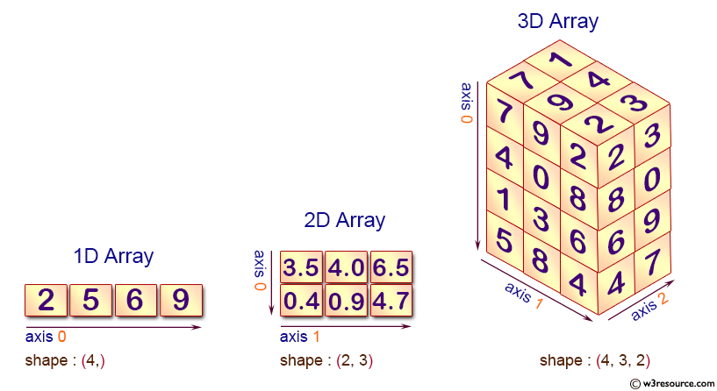
Axis of array
Another term for an array dimension. Axes are numbered left to right; axis 0 is the first element in the shape tuple

Slide 8
Warm-up exercises (1)
2 | 1 | 0
5 | 4 | 3
Print a 2x3 array holding the values 0..5
>>> import numpy as np
>>> np.array([[0, 1, 2], [3, 4, 5]])
[[0 1 2]
[3 4 5]]
>>> np.arange(6).reshape((2, 3))
[[0 1 2]
[3 4 5]]
>>> a = np.array([[0, 1, 2], [3, 4, 5]])
>>> a.shape
(2, 3)
>>> a.ndim
2
>>> a.size
6
>>> type(a)
<class 'numpy.ndarray'>
>>> a.dtype.name
'int64’
>>> a.itemsize
8
ndarray.dtype
an object describing the type of the elements in the array.
There are different array creation routines in Numpy.
You can read about them here

Slide 9
Mathematical operators
We will see that
Arithmetic operations are element-wise
Logical operators return a Boolean array
In place operations modify the array
Just as in Python, the result of a math operator is cast to the more general or precise datatype
uint64 + uint16 => uint64
float32 / int32 => float32
Warning: upcasting does not prevent overflow/underflow. You must manually cast first

Slide 10
Warm-up exercises (2)
Create a 5x5 array with random values (between 1 and 100) and print the minimum and maximum values of the entire array
>>> Z = np.random.random((5, 5))*99 + 1
>>> Z
array([[97.57935334, 37.21218112, 85.8394064 , 54.84623399, 57.71820578],
[52.3759324 , 28.97257665, 18.05743292, 74.38841988, 13.92938736],
[98.28565278, 36.7209352 , 22.39104046, 33.26565019, 60.71947564],
[85.85777885, 1.0803152 , 97.40209328, 19.49195478, 38.79846506],
[34.18405984, 92.84778758, 42.13540315, 53.5204781 , 49.86489806]])
>>> Zmin, Zmax = Z.min(), Z.max()
>>> print(Zmin, Zmax)
(1.0803152, 98.28565278)
Can you find the maximum values in each row?
Operation is performed along axis 1
Z.max(axis=1)

Slide 11
Ndarray methods
Many methods can be applied over a ndarray object. You can read the full API here
Among them, here is a list of the ones we will need to know:
all, any, argmax, argmin, argpartition, argsort, astype, choose, clip, copy, cumsum, diagonal, fill, flatten, max, mean, min, nonzero, partition, reshape, resize, round, sort, squeeze, std, sum, transpose, trace, var, view

Slide 12

Warm-up exercises (3)
The variance of a set of numbers is defined the average of the squared differences from the mean
The variance is a measure of the dispersion of the data
x = np.array([14, 22, 6, 30, 51, 44])
m = np.mean(x)
var = np.mean((x-m)**2)
print(var)
print(np.var(x))
250.80555555555554
250.80555555555554

Slide 13
Warm-up exercises (4)
Create a 5x5 array holding random integers from the range -5..5
Print the number of negative numbers in each column
Equivalent in result to d < np.zeros(d.shape)
Why?
>>> d = np.random.randint(-5, 6, (5, 5))
>>> d
array([[ 5, 0, 0, 3, -1],
[ 0, -3, 2, -3, -4],
[-3, -4, 0, -3, 2],
[-5, 2, 3, -2, -5],
[ 1, -3, 0, 2, 0]])
>>> d < 0
array([[False, False, False, False, True],
[False, True, False, True, True],
[ True, True, False, True, False],
[ True, False, False, True, True],
[False, True, False, False, False]], dtype=bool)
>>> np.sum(d < 0, axis=0)
[2 3 0 3 3]

Slide 14
Warm-up exercises (5)
What will be the result of the following code sections ?
>>> a = np.array([[1, 2], [3, 4]])
>>> b = np.array([10, 20, 30])
>>> a + b
>>> a = np.array([[1, 2], [3, 4]])
>>> c = np.array([[5, 10]]) # or np.array([5, 10])
>>> a += c
>>> a
Traceback (most recent call last):
File "<input>", line 1, in <module>
ValueError: operands could not be broadcast together with shapes (2,2) (3,)
An in-place operation that modifies the array rather than allocates a new one
array([[ 6, 12],
[ 8, 14]])
What is in common in the last four exercises?
Notes:
a = np.array([1,2,3])
b = np.array([[1],[2],[3]])
a + b ?

Slide 15
General Broadcasting Rules
broadcasting describes how NumPy treats arrays with different shapes during arithmetic operations. Subject to certain constraints, the smaller array is “broadcast” across the larger array so that they have compatible shapes
When operating on two arrays, NumPy compares their shapes element-wise. It starts with the trailing (i.e. rightmost) dimensions and works its way left. Two dimensions are compatible when
they are equal, or
one of them is 1
A (4d array): 8 x 1 x 6 x 1
B (3d array): 7 x 1 x 5
Result (4d array): 8 x 7 x 6 x 5
A (2d array): 2 x 1
B (3d array): 8 x 4 x 3
second from last dimensions mismatched
Read more about broadcasting here

Slide 16
HW exercise
Utilize the broadcasting principle to create a 5x5 matrix with row values ranging from 0 to 4
[[0 1 2 3 4]
[0 1 2 3 4]
[0 1 2 3 4]
[0 1 2 3 4]
[0 1 2 3 4]]
>>> Z = np.zeros((5, 5), dtype=int)
>>> Z += np.arange(5)
>>> print(Z)

Slide 17
Indexing, Slicing
One-dimensional arrays can be indexed, sliced and iterated over, much like lists and other Python sequences
Can also index or sliced by a list or Boolean array (Fancy indexing)
Basic slices are views. Writing to a basic slice overwrites the original array
If x is 2-D ndarray:
x[0,0] # top-left element
x[0,-1] # first row, last column
x[0,:] # first row (many entries)
x[:,0] # first column (many entries)
comma-separated
x[x<10] = 0 # set elements < 10 to 0
x[[1,3], :] # select 2nd and 4th row
x[obj] is a basic slicing, for us in this course, if obj is of type start:stop:step (i.e, slice type), integer.
Read more here
I = x[1:3, :] # returns a view

Slide 18
Copies and Views
In general, NumPy functions return either views or copies
While views are different objects than the original arrays, views share data with the original array. Altering entries of a view, changes the same entries in the original
np.copy, np.view make explicit copies and views

Slide 19
View
a = array([[ 0, 1, 2, 3],
[ 4, 5, 6, 7],
[ 8, 9, 10, 11]])
c = a.view()
>>> c is a
False
# c is a view of the data owned by a
>>> c.base is a
True
c = c.reshape((2, 6)) # a's shape doesn't change
>>> a.shape
(3, 4)
>>> c[0, 4] = 1234 # a's data changes
>>> a
array([[ 0, 1, 2, 3],
[1234, 5, 6, 7],
[ 8, 9, 10, 11]])

Slide 20
View
Slicing an array returns a view of it:
>>> s = a[:, 1:3]
>>> s[:] = 10 # s[:] is a view of s. Note the difference between s = 10 and s[:] = 10
>>> a
array([[ 0, 10, 10, 3],
[1234, 10, 10, 7],
[ 8, 10, 10, 11]])

Slide 21
Copy
The copy method makes a shallow copy of the array
It is enough when we are working with immutable elements as numerical values and not objects
>>> d = a.copy() # a new array object with new data is created
>>> d is a
False
>>> d.base is a # d doesn't share anything with a
False
>>> d[0, 0] = 9999
>>> a
array([[ 0, 10, 10, 3],
[1234, 10, 10, 7],
[ 8, 10, 10, 11]])

Slide 22
Warm-up exercises (6)
Create an 8x8 matrix and fill it with a checkerboard pattern (0 for white, 1 for black)
[[0 1 0 1 0 1 0 1]
[1 0 1 0 1 0 1 0]
[0 1 0 1 0 1 0 1]
[1 0 1 0 1 0 1 0]
[0 1 0 1 0 1 0 1]
[1 0 1 0 1 0 1 0]
[0 1 0 1 0 1 0 1]
[1 0 1 0 1 0 1 0]]
>>> Z = np.zeros((8, 8), dtype=int)
>>> Z[1::2, ::2] = 1
>>> Z[::2, 1::2] = 1
>>> print(Z)

Slide 23
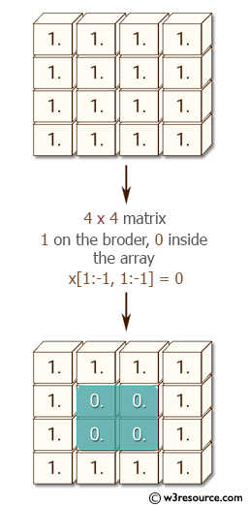
HW exercise
Write a NumPy program to create a 10x10 matrix, in which the elements on the borders will be equal to 1, and inside 0
[[ 1. 1. 1. 1. 1. 1. 1. 1. 1. 1.]
[ 1. 0. 0. 0. 0. 0. 0. 0. 0. 1.]
[ 1. 0. 0. 0. 0. 0. 0. 0. 0. 1.]
[ 1. 0. 0. 0. 0. 0. 0. 0. 0. 1.]
[ 1. 0. 0. 0. 0. 0. 0. 0. 0. 1.]
[ 1. 0. 0. 0. 0. 0. 0. 0. 0. 1.]
[ 1. 0. 0. 0. 0. 0. 0. 0. 0. 1.]
[ 1. 0. 0. 0. 0. 0. 0. 0. 0. 1.]
[ 1. 0. 0. 0. 0. 0. 0. 0. 0. 1.]
[ 1. 1. 1. 1. 1. 1. 1. 1. 1. 1.]]
x = np.ones((10, 10))
x[1:-1, 1:-1] = 0
print(x)

Slide 24
HW exercise
Read about the NumPy function tile, and create a checkerboard 8x8 matrix using the tile function (0 for white, 1 for black)
numpy.tile)A, reps(
Construct an array by repeating A the number of times given by reps.
Examples:
>>> a = np.array([0, 1, 2])
>>> np.tile(a, 2)
array([0, 1, 2, 0, 1, 2])
>>> np.tile(a, (2, 2))
array([[0, 1, 2, 0, 1, 2],
[0, 1, 2, 0, 1, 2]])
>>> Z = np.tile(np.array([[0, 1], [1, 0]]), (4, 4))
>>> print(Z)

Slide 25
Warm-up exercises (7)
Extract from the array [3, 4, 6, 10, 24, 89, 45, 43, 46, 99, 100] with Boolean masking all the numbers
which are not divisible by 3
which are divisible by 3 and 5
which are divisible by 3 and set them to 42
>>> A = np.array([3, 4, 6, 10, 24, 89, 45, 43, 46, 99, 100])
>>> print(A[A % 3 != 0])
>>> print(A[(A % 3 == 0) & (A % 5 == 0)])
>>> A[A % 3 == 0] = 42
>>> print(A)
[4 10 89 43 46 100]
[45]
[42 4 42 10 42 89 42 43 46 42 100]

Slide 26
Universal functions
A universal function (also called ufunc) is a function that operates on ndarrays in an element-by-element fashion
There are various functions, for example:
np.exp
np.sqrt
np.sin
np.cos
np.isnan
See more here
>>> a = np.array([20, 30, 40, 50])
>>> 10 * np.sin(a)
array([ 9.12945251, -9.88031624, 7.4511316 , -2.62374854])

Slide 27
Warm-up exercises (8)
Write a NumPy program to find the missing data in an array
nums = np.array([[3, 2, np.nan, 1],
[10, 12, 10, 9],
[5, np.nan, 1, np.nan]])
print("Original array:")
print(nums)
print("\nFind the missing data of the said array:")
print(np.isnan(nums))
Original array: [[ 3. 2. nan 1.]
[10. 12. 10. 9.]
[ 5. nan 1. nan]]
Find the missing data of the said array:
[[False False True False]
[False False False False]
[False True False True]]

Slide 28
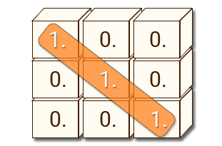
HW exercise
Find a NumPy array routine that creates the Identity matrix of size N in one command

Slide 29
Product
>>> A.dot(B)
array([[5, 4],
[3, 4]])
>>> A = np.array([[1, 1],
[0, 1]])
>>> B = np.array([[2, 0],
[3, 4]])
>>> A * B # elementwise product
array([[2, 0],
[0, 4]])
>>> A @ B # matrix product
array([[5, 4],
[3, 4]])
For 2-D arrays, it is equivalent to matrix multiplication. However, in the general case, they are different. Read here

Slide 30
Stacking together different arrays
Several arrays can be stacked together along different axes:
a = np.floor(10 * rg.random((2, 2)))
>>> a array([[9., 7.],
[5., 2.]])
>>> b = np.floor(10 * rg.random((2, 2)))
>>> b array([[1., 9.],
[5., 1.]])
>>> np.vstack((a, b))
array([[9., 7.],
[5., 2.],
[1., 9.],
[5., 1.]])
>>> np.hstack((a, b))
array([[9., 7., 1., 9.],
[5., 2., 5., 1.]])

Slide 31
Splitting one array into several smaller ones
Using hsplit, you can split an array along its horizontal axis, either by specifying the number of equally shaped arrays to return, or by specifying the columns after which the division should occur:
a = np.floor(10 * rg.random((2, 12)))
>>> a
array([[6., 7., 6., 9., 0., 5., 4., 0., 6., 8., 5., 2.],
[8., 5., 5., 7., 1., 8., 6., 7., 1., 8., 1., 0.]])
>>> np.hsplit(a, 3) # Split `a` into 3
[array([[6., 7., 6., 9.], [8., 5., 5., 7.]]),
array([[0., 5., 4., 0.], [1., 8., 6., 7.]]),
array([[6., 8., 5., 2.], [1., 8., 1., 0.]])]
>>> # Split `a` after the third and the fourth column
>>> np.hsplit(a, (3, 4))
[array([[6., 7., 6.],
[8., 5., 5.]]),
array([[9.],
[7.]]),
array([[0., 5., 4., 0., 6., 8., 5., 2.],
[1., 8., 6., 7., 1., 8., 1., 0.]])]

Slide 32
Exercise 1
Given two matrices that represent the gene expressions (numbers in the range 0 to 1) in different environmental conditions (i.e., temperature and so on)
Each row in the matrix represents a different gene, and each column represents a different environmental conditions
Matrix A represents measurements in human and B in mouse (both equally sized)
 | Human gene expression (A) |  |  |  |  |  | Mouse gene expression (B)
 | C1 | C2 | C3 | C4 |  |  | C1 | C2 | C3 | C4
gene x | 0.71 | 0.95 | 0.94 | 0.01 |  | gene q | 0.25 | 0.98 | 0.02 | 0.26
gene y | 0.7 | 0.31 | 0.99 | 0.33 |  | gene r | 0.27 | 0.15 | 0.29 | 0.78
gene z | 0.54 | 0.38 | 0.05 | 0.13 |  | gene s | 0.61 | 0.69 | 0.85 | 0.32

Slide 33
Exercise 1
Scientists would like to find a one-to-one and onto function between the human and mouse genes according to the assumption that corresponding genes are expressed under the conditions
To begin with, we will compute the distances matrix: for each pair of genes (one in human and one mouse), we will compute the Euclidean distance between the corresponding vectors
 | Human gene expression (A) |  |  |  |  |  | Mouse gene expression (B)
 | C1 | C2 | C3 | C4 |  |  | C1 | C2 | C3 | C4
gene x | 0.71 | 0.95 | 0.94 | 0.01 |  | gene q | 0.25 | 0.98 | 0.02 | 0.26
gene y | 0.7 | 0.31 | 0.99 | 0.33 |  | gene r | 0.27 | 0.15 | 0.29 | 0.78
gene z | 0.54 | 0.38 | 0.05 | 0.13 |  | gene s | 0.61 | 0.69 | 0.85 | 0.32

Slide 34
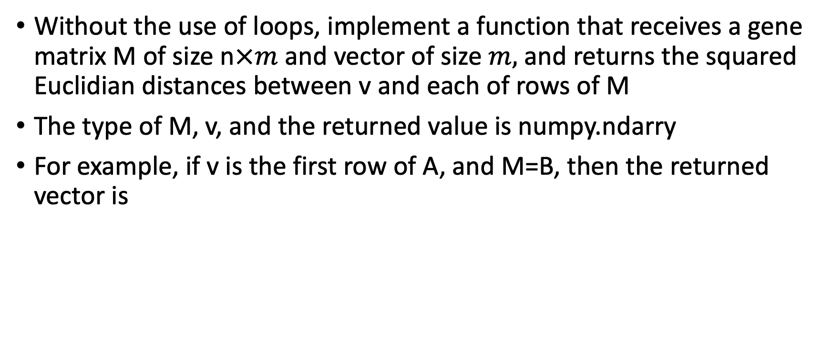
Exercise 1A
Without the use of loops, implement a function that receives a gene matrix M of size n$×m$ and vector of size $m,$ and returns the squared Euclidian distances between v and each of rows of M
The type of M, v, and the returned value is numpy.ndarry
For example, if v is the first row of A, and M=B, then the returned vector is
[(0.71-0.25)² + (0.95-0.98)² + (0.94-0.02)² + (0.01-0.26)²,
(0.71-0.27)² + (0.95-0.15)² + (0.94-0.29)² + (0.01-0.78)²,
(0.71-0.61)² + (0.95-0.69)² + (0.94-0.85)² + (0.01-0.32)²] =
[1.1214, 1.849, 0.1818]
 | Human gene expression (A) |  |  |  |  |  | Mouse gene expression (B)
 | C1 | C2 | C3 | C4 |  |  | C1 | C2 | C3 | C4
gene x | 0.71 | 0.95 | 0.94 | 0.01 |  | gene q | 0.25 | 0.98 | 0.02 | 0.26
gene y | 0.7 | 0.31 | 0.99 | 0.33 |  | gene r | 0.27 | 0.15 | 0.29 | 0.78
gene z | 0.54 | 0.38 | 0.05 | 0.13 |  | gene s | 0.61 | 0.69 | 0.85 | 0.32

Slide 35
Exercise 1A
def compute_distances(v, M):
diff = M - v
squaredDiff = diff * diff
squaredDistances = np.sum(squaredDiff, axis=1)
return squaredDistances

Slide 36

Exercise 1B
Implement a function that receives two genes matrices A and B (of size n$×m$), and returns a new matrix of size n$×n$ that represents the squared Euclidian distances between each row of A and B. In entry (i, j), the distance between the i-th row of A and the j-th row of B is located
def compute_distance_matrix(A, B):
numRows = A.shape[0]
distances = np.zeros((numRows, numRows))
for i in range(numRows):
distances[i] = compute_distances(A[i], B)
return distances

Slide 37
HW exercise (1)
A group of n candidates are reviewed in m subjects in two assessments on different dates
The candidate scores are provided in matrices M1 and M2. The examiner is interested in examining the consistency between the two assessments from various aspects, for example, whether everyone who succeeded in the first assessment also succeeded in the second
The two matrices describe the same set of candidates (rows) and subjects (columns). However, in contrast to the order of the candidates, the order of the subjects is different. This order in each matrix is given as a list of strings (L1 and L2 for M1 and M2, respectively)

Slide 38
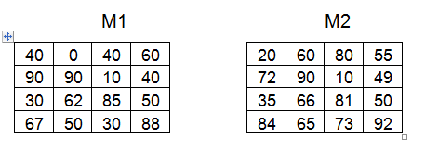
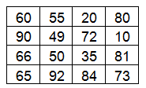
HW exercise (2)
Implement a function that receives two matrices M1, M2 and two lists of strings L1 and L2 as described earlier
The function returns a new matrix that contains the M2 columns in the order of M1 matrix
For example, for the matrices and lists:
The function need to return:
L1=['math', 'logic', 'english', 'bible']
L2=['english', 'math', 'bible', 'logic']

Slide 39
HW exercise (3)
def align_matrices(M1, M2, L1, L2):
perm = np.zeros(len(L1), dtype='int')
for i in range(len(L1)):
perm[i] = L2.index(L1[i])
return M2[:, perm]
Notes:
Perms = [0,0,0,0]
[1,3,0,2]
M2[:, Perms] - כלומר, אני רוצה את M2, כל השורות, אבל עמודות 1,3,0,2 של המטריצה המקורית כמו לכתוב – M[[0,1,2,3], [1,3,0,2]]

Slide 40
HW exercise (4)
For a candidate and a subject, the pair of scores in the two assessments "agrees" if both ≥60 or both <60
We will define the consistency ratio of a specific subject as the number of "agree" pairs divided by the number of candidates
For example, for 4 candidates whose math scores in both tests are [65,50,95,40] and [30,45,80,90], the consistency ratio is 0.5
Without using loops, Implement a function that receives two matrices M1, M2 and two lists L1, L2. The function calculates the consistency ratios for each subject. In the returned vector, the i-th element is the consistency ratio between the i-th column in M1 and the i-th column in the fixed ordered M2 matrix

Slide 41
HW exercise (5)
def compute_consistency_measure(M1, M2, L1, L2):
M2 = align_matrices(M1, M2, L1, L2)
consistencyMat = ((M1 >= 60) & (M2 >= 60)) | ((M1 < 60) & (M2 < 60))
return consistencyMat.sum(axis=0) / float(M1.shape[0])
Notes:
Consis_mat תחזיר לנו מטריצה בוליאנית שעומדת בתנאים
סכימה של איברי TRUE חלקי הכל, לפי עמודות (מקצוע)

Slide 42
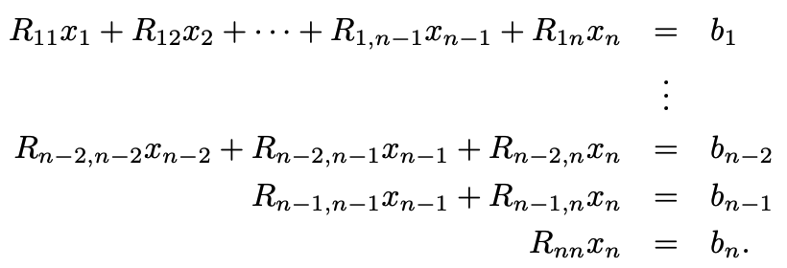
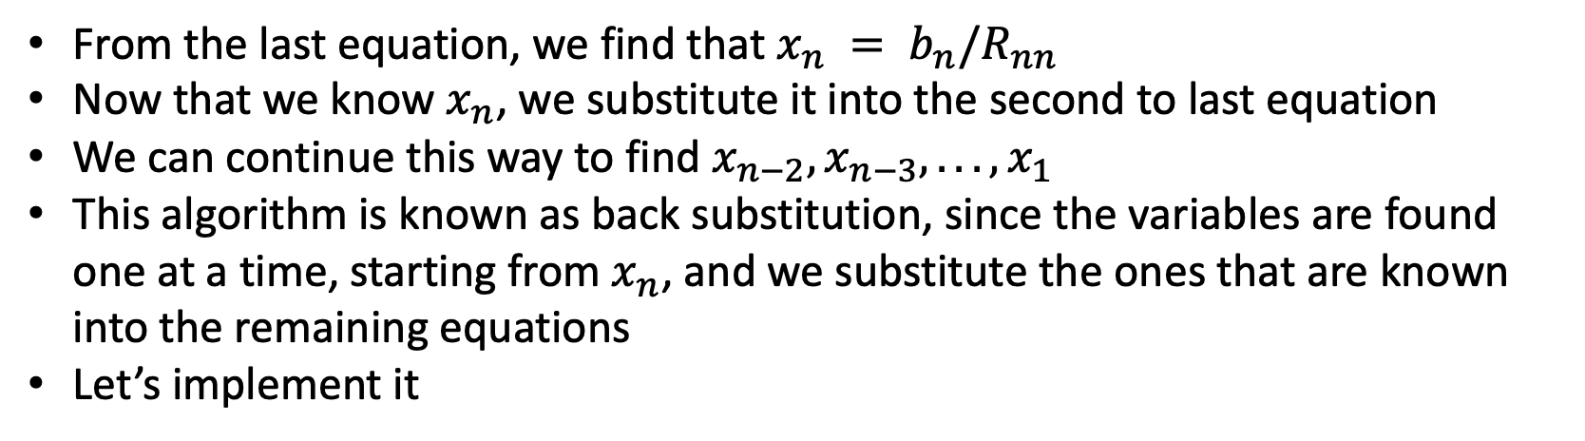
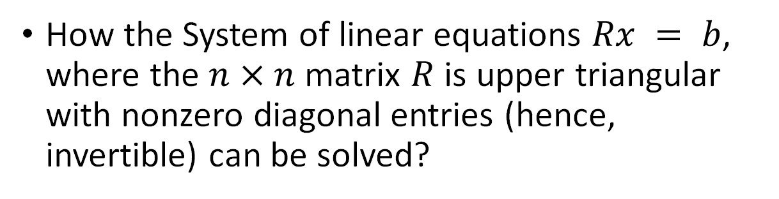
Exercise 2 – back substitution
How the System of linear equations $Rx = b$, where the $n×n$matrix $R$ is upper triangular with nonzero diagonal entries (hence, invertible) can be solved?
From the last equation, we find that $x_{n} = b_{n}/R_{nn}$
Now that we know $x_{n}$, we substitute it into the second to last equation
We can continue this way to find $x_{n−2}, x_{n−3}, . . . , x_{1}$
This algorithm is known as back substitution, since the variables are found one at a time, starting from $x_{n}$, and we substitute the ones that are known into the remaining equations
Let’s implement it

Slide 43
Exercise 2 – back substitution
def back_subst(R, b_tilde): n = R.shape[0] x = np.zeros(n) for i in reversed(range(n)): x[i] = b_tilde[i] for j in range(i+1, n): x[i] = x[i] - R[i, j]*x[j] x[i] = x[i]/R[i, i] return x
R = np.triu(np.random.random((4, 4))) b = np.random.random(4) x = back_subst(R, b) print(np.linalg.norm(R @ x - b))

