Slide 1
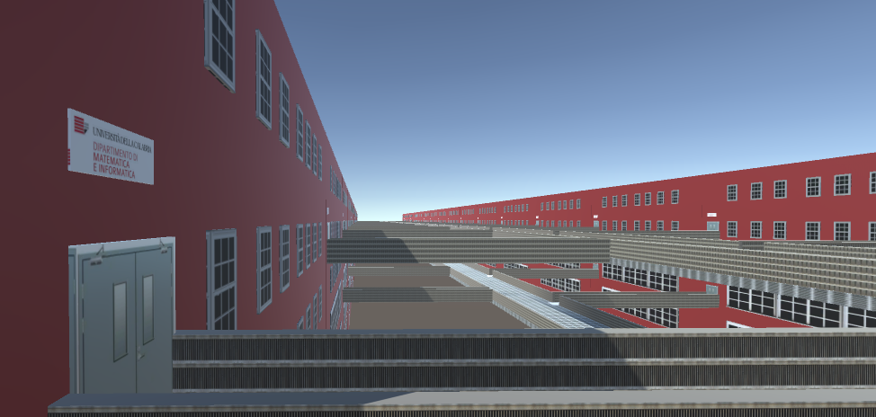

Presentation Whatever It Takes

Slide 2

Work Team The project was realized by the following students: Carmine Blefari Alessio Maresca Gabriele Tassone Giovambattista Crudo Giovanni Marasco
The work was carried out in symbiosis , with the active participation of each member of the group in order to create a realistic and satisfying game.

Slide 3
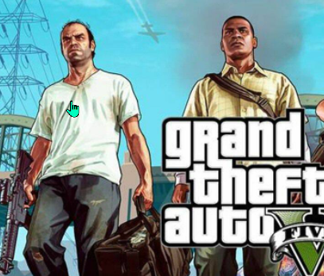
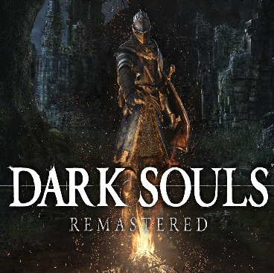

External Influences
The development of this game has been influenced by Grand Theft Auto, a series of videogames created and developed by Rockstar North, Rockstar Leeds and published by Rockstar Games.
This is a GTA style game with Third Person camera and a main quest to be completed. One has the Possibility to explore the world map in order to find objects and informations about the environment.
Another inspiration for our game is Dark souls. It helped us with learning how to handle boss fights, boss characterization and collectibles. We’ve been inspired by the way dark souls or souls-like games have collectibles to push you towards exploring world map in general, making it more interesting to wander around and spending time trying to catch all of them.

Slide 4
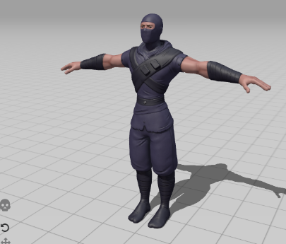
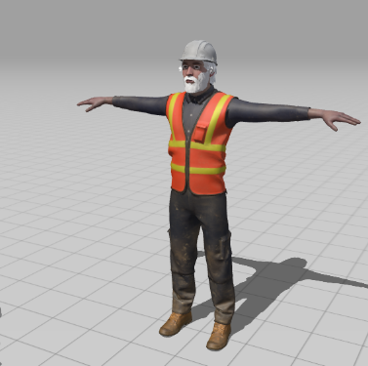
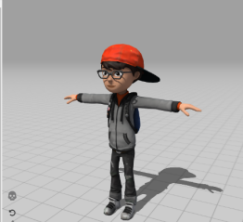
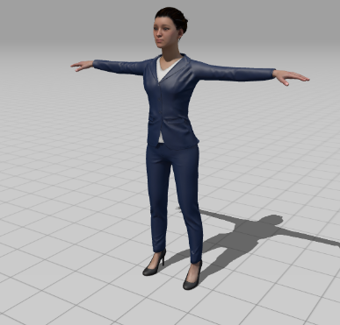
CHARACTERS
These are our main characters :
Pimona Serri : the good Teacher
Iovambattista Gianni : handyman
Darmine Codaro : The final Ninja
Our Main Character : FreshMan
FreshMan has to fight in the arenas against the bosses to go ahead and be able to conqueer the Degree.

Slide 5
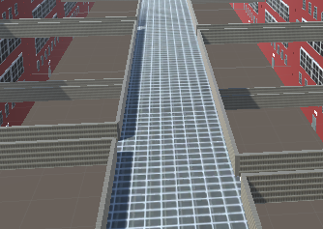
BRIDGE
On the bridge main character can access to all arenas and restricted areas , or have a walk if he wants : on the covered or uncovered one.

Slide 6
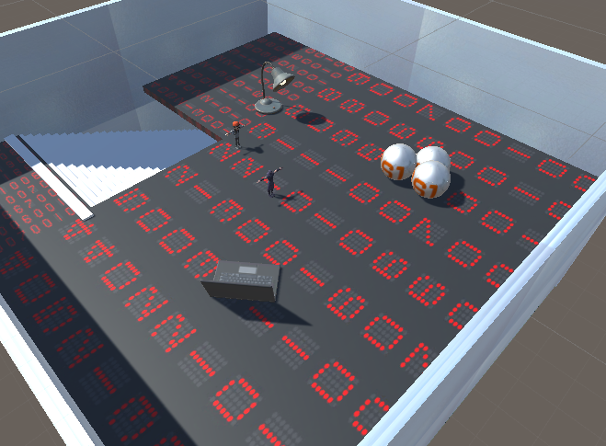
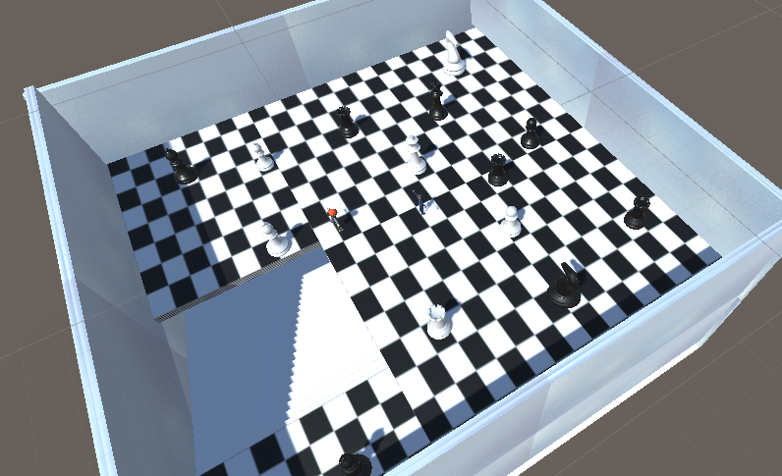
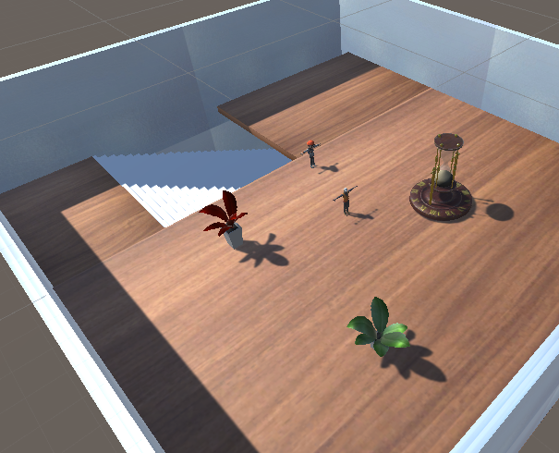
ARENAS
In the arenas our main character FreshMan can fight against the three bosses : Pimona Serri , Iovambattista Gianni , Darmine Codaro.
The power of the bosses increases in this order , they can fight only on the second floor.
Our main character can attack randomly.

Slide 7
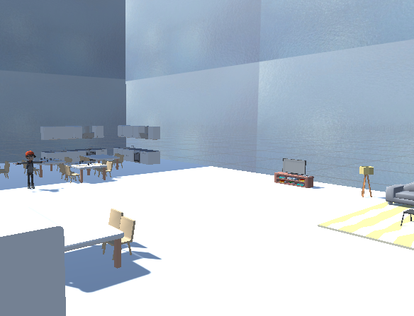
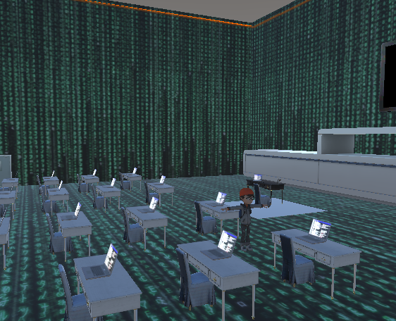
RESTICTED AREAS
In these areas our main character FreshMan can :
Improve himself in the Coding room
Recharge himself in the school canteen

