Slide 1

ClaritiFy Bridging the Financial Gap with Web3

Slide 2

The problem… The Financial Exclusion Crisis
1.4 billion adults are unbanked globally, lacking access to basic financial services.
Traditional finance excludes individuals without credit history, limiting access to loans and credit cards.
Crypto loans require high collateralization, making them inaccessible to those without significant assets

Slide 3
The solution… ClaritiFy: A Web3 Educational Portal
A Learn-to-Earn platform rewarding users with CTS tokens for completing educational content on crypto and DeFi.
Tokens earned serve as a crypto credit score, demonstrating users' knowledge and engagement in decentralized finance.
Accessible to underserved populations, providing an entry point to financial services without traditional credit requirements.

Slide 4
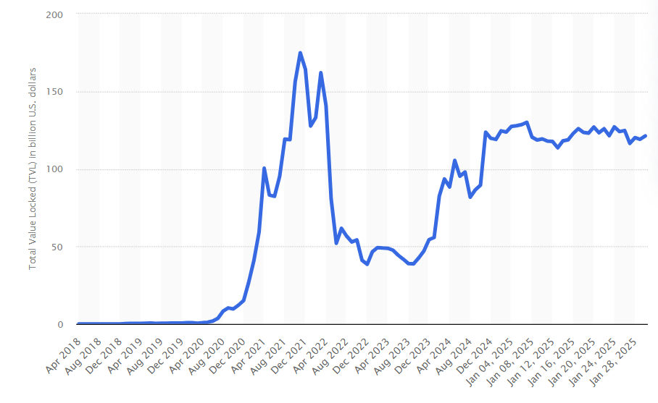
Opportunity Tapping Into a Growing Market
The DeFi market reached $100 billion in total value locked (TVL) in 2024, showcasing rapid adoption3.
Target audience: Unbanked populations, emerging markets, and crypto-curious individuals.
Increasing demand for financial literacy tools as Web3 adoption grows globally.
TVL (total value locked) across multiple Decentralized Finance (DeFi) blockchains from April 2018 to January 30, 2025(in billion U.S. dollars)

Slide 5
How it works? From Learning to Financial Empowerment
Users engage with bite-sized educational videos on crypto and DeFi topics.
AI generated quizzes assess understanding; performance determines CTS token rewards.
Tokens act as proof of knowledge, enabling access to DeFi services like loans or investments without high collateral requirements.

Slide 6

What Sets ClaritiFy Apart?
Combines financial literacy with practical utility through a crypto credit score system.
Focuses on underserved populations often ignored by traditional finance and existing Web3 platforms.
Rewards-based model incentivizes consistent user engagement.
On-chain data transparency

Slide 7

Powered by Blockchain
Decentralized identity solutions ensure secure user authentication.
Smart contracts automate token rewards and manage credit score calculations.
Built on scalable blockchain technology for transparency and cost-efficiency.

Slide 8

Our Business Model Sustainable Revenue Streams
Revenue from partnerships with crypto platforms offering services to users with CTS scores.
Premium educational content subscriptions for advanced topics in Web3 finance.
Transaction fees from token exchanges or withdrawals within the ecosystem.

Slide 9
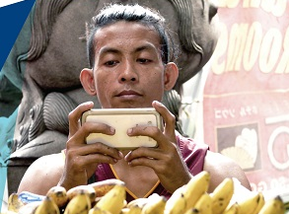
Social Impact Transforming Lives Through Financial Inclusion
Provides unbanked individuals with tools to access decentralized financial services.
Promotes economic empowerment by reducing reliance on traditional credit systems.
Enhances financial literacy, fostering informed participation in the global economy.

