Slide 1
TASK1:BASIC DEFINATION IN INTERNET PROGRAMMING AND MOBILE PROGRAMMING

Slide 2
What's An APP?
1-Review and compare the major types of mobile
Apps and their differences
An app is software that allows you to exchange information with customers and help them complete specific tasks.
. Web applications are delivered via a web browser. Users don't need to install them on their devices
. Native apps, on the other hand, are designed for a specific platform or device type
Hybrid apps are native, but have a web browser built in.

Slide 3
What are native applications?
Native apps developed for Android are written in java, while apps developed for iOS are written in Swift (you may find older iOS apps written in Objective-C).
Native mobile apps are typically faster and more reliable than hybrid or web apps, which lets them deliver a better user experience (UX).
They also let you interact with a device’s application programming interface (API) and internal hardware, granting your company’s app access to features like: camera, Device location tracking ,etc.
However, native features come with larger upfront development costs that organizations with smaller budgets likely can’t handle.

Slide 4
Advantages of native apps
Superior performance
Platform-specific features
Superior user interface
App store visibility

Slide 5
Disadvantages of native apps
Greater upfront costs
Requires experienced app developers
Start over with different platforms

Slide 6
What are web applications?
A web application is more or less a website that looks and feels more like a mobile application.
Web apps are written using JavaScript or HTML/CSS
There tend to be cheaper and easier to develop
The tradeoff is that web apps also tend to be slower and have less intuitive designs for their user interface (UI).
Apple and Android app stores can’t feature web apps , there by reducing their visibility

Slide 7
Advantages of web apps
Easy maintenance
Easy accessibility
Less expensive
Less user maintenance

Slide 8
Disadvantages of web apps
Smaller scope
Less focus on your app
Less speed

Slide 9
What are progressive web applications?
A Progressive Web App (PWA) is a type of web application that uses modern web technologies to deliver an app-like experience to users
It aims to combine the best features of both web and native mobile applications.
PWAs are built to be responsive and adaptive, offering a consistent experience across different devices and screen size.
PWAs make use of an app shell model, which separates the core application infrastructure from the dynamic content. This allows for faster loading
Service workers are JavaScript files that run in the background and enable PWAs to work offline or with a poor network connection

Slide 10
Advantages of Progressive Web Apps:
Cross-platform Compatibility
Offline Functionality
Discoverability
No App Store Dependency
Cost-Effectiveness

Slide 11
Disadvantages of Progressive Web Apps:
Limited Native Functionality
Browser and Platform Support
Limited User Awareness

Slide 12
What are hybrid mobile apps?
hybrid mobile apps combine elements of web apps and native apps.
These apps are built in two parts:The backend code,The native shell (which makes it downloadable on app stores)
Hybrid mobile apps can be installed on the device and run on a web browser, so they sit somewhere between native apps and web apps.

Slide 13
Advantages of hybrid apps
Developer productivity
Cheaper but greater discoverability
Internal API access
Cross-platform availability

Slide 14
Disadvantages of hybrid apps
Inconsistent user experience. Hybrid app performance depends on the user’s internet speed

Slide 15
Hybrid app vs. web app
Visibility. Hybrid apps can run in a web browser, but it’s also possible to feature them on the app store. This often gives them greater visibility than web apps.
API access. Unlike web apps, hybrid apps can access a device’s push notifications and location tracking.
Ease of development. Hybrid apps require knowledge of additional development frameworks besides JavaScript and CSS, making them more difficult to put together.
Speed. Mobile web apps are sometimes slower and less responsive than native apps

Slide 16
Native app vs. hybrid app
User interface. The user interface on native apps is often more consistent than what you may experience on a hybrid app.
Development. Hybrid apps use common web technologies, making them an easier project to take on for mobile app development teams who lack the experience or knowledge necessary to build a native app.
Platform-specific features. Hybrid apps are accessible on iOS and Android devices. Unlike native apps, you can’t build platform-specific features into your app.

Slide 17
Summary of Differences: Progressive Web Apps, Hybrid Apps, and Native Apps
Characteristics | Web application | Hybrid Application | Native app
Usage | Users can access directly from a browser | Users need to install the app on the device of their choice | Users need to install the app on the device of their choice
Inner workings | Client code in the browser communicates with remote server-side code and databases | Client code and browser code encapsulated in a native shell or container | Client code written in technology and language specific to the device or platform on which it will be installed
Native device features | Not accessible | Accessible | Accessible
User Experience | Inconsistent and browser-dependent | Consistent and engaging | Consistent and engaging
Access | Limited by browser and network connectivity | One-step access with offline features | One-step access with offline features
Performance | Slower and less responsive | Faster, but can consume more battery | Performance can be optimized for the device
Development | Cost-effective and faster time-to-market | Cost-effective and faster time-to-market | Costly and slower time-to-market

Slide 18
2.Review and Compare Mobile App Programming Languages
Introduction
Mobile programming languages have different criteria, strength and weakness that can impact the choice of a developer when it comes to choosing the best programming language.
The choice of a programming language can impact the development process and the app’s outcome. Choosing the best programming language can facilitate coding and optimize app performance. Below I will provide you the best mobile programming languages.

Slide 19
Best Native iOS Mobile Programming Languages
1.Swift
Swift is a modern, open-source programming language developed by Apple for ios app development. It is known for its speed, safety features, expressive syntax and hence empower developer to create robust applications.

Slide 20
Advantages of Swift
Safety and Performance: Swift eliminates common programming errors through features such as optimal typing and automatic memory management hence resulting in a safer and more stable app.
Modern syntax: Swift syntax is concise, expressive and user friendly making easier to read and write code.
Active Community: Swift has a thriving developer community, ensuring regular update and numerous open source libraries and frameworks.

Slide 21
Disadvantage of Swift
Platform Limitation: Swift is primarily developed for iOS app development thus limited for cross- platform development.

Slide 22
2. Objective C or C#
Objective C was the primary language used for iOS and macOS app development before the introduction of swift Objective C is known for its dynamic runtime and extensive frameworks and libraries.
C# provide a robust and familiar environment for creating powerful mobile app.

Slide 23
Advantages of objective C
Mature and Stable: C# has been used for a long time and has a mature and stable ecosystem. It has been tested and refined for years making reliable for developing robust app.
Interoperability with C: C# is a superset of c programming language which implies C libraries can be used to code. This provides developers with flexible and leverage existing C libraries to be part of C# projects
.
Legacy Codebase: C# is widely used in IOS app development before the introduction of swift. Working on a project with existing C# codebase using objective C makes it easier to maintain and extend the codebase without the need for complete rewrite.

Slide 24
Disadvantage of objective C
Syntax are complicated and tedious: C# is an older language and compare to swift whose syntax resembles plain modern English, Objective C syntax is more tedious and difficult to write.

Slide 25
Comparing objective C and Swift
Performance: Swift is faster compare to C#. This is why swift replaced objective C as an Apple’s native app development language.
Syntax: C# syntax is complicated and long. It using many brackets, symbols and semicolons. Meanwhile swift is easy to learn and similar to English with few lines of codes
Time-Efficiency: Swift is time efficient due to it concise syntax and reduces time spending in writing code. Swift has fast feedback to debug and faster compile time meanwhile C# is lengthy and complex.

Slide 26
Best Native Andriod Mobile Programming Languages
1.Java.
Java is a widely used mobile app programming language known for its “write once, runaway” philosophy.
Java’s key features are object-oriented, garbage collection and extensive libraries.
It’s stability, vast community support makes java the best choice for developer building scalable and reliable android application.

Slide 27
Java
Advantages
Platform independency: Java “write once, runaway” capability allows developers to build applications that can run on various platforms including android, desktop, web and embedded systems.
Robustness and Scalability: Java’s strong typing and exceptional handling provide a robust framework for building large scale applications with minimal errors.
Broad community Support: Java has a massive developer community, providing access to abundant resources, frameworks and libraries.

Slide 28
Java
Disadvantage
Heavy Code: Java’s syntax can be complex, resulting in long lines of codes compare to more concise language like kotlin.

Slide 29
2.Kotlin.
Kotlin is a modern ,statically –typed programming language known for its seamless interoperability with Java.
It is designed to be concise, safe and interoperable offering features such as data classes and co-routines for asynchronous programming.

Slide 30
kotlin
Advantages
Interoperability with Java: Kotlin is fully interoperable with Java, enabling developer to use developer to adopt Kotlin.
Concise and expressive syntax. Kotlin’s syntax is more expressive than Java and hence increasing developer productivity sine the codes are not complex as compare to Java.
Null Safety: Kotlin includes null safety features that help eliminate null pointer exceptions, a common source of bugs in Java.

Slide 31
kotlin
Disadvantages
Smaller Community than Java: Although Kotlin’s community is rapidly growing it’s still smaller compare to Java.

Slide 32
Comparing Java and Kotlin
Null Safety: Kotlin includes built-in null safety features, whereas Java does not. This makes Kotlin less prone to null pointer exceptions.
Extension Function: Kotlin supports extension functions, allowing developers to add new function to existing classes. Java lack this features.
Syntax: Kotlin has a more concise and expressive syntax compared to java. It reduces boilerplate code and provides a more readable and modern language structure.

Slide 33
Best Cross-platform mobile programming Language
Javascript (React Native).
React Native is a popular Javascript framework that allows developer to build Native mobile app for iOS and Android using a single codebase.
It utilizes Javascript to creates reusable UI component that are translated to native code at runtime.

Slide 34
Javascript
Advantages
Cross-platform development: React Native enable developers to write code once and deloys it on both iOS and Android platform, saving time and resources.
Reusability: React Native promotes code reusability, allowing developers to share a significant portion of their codebase between platforms. This streamlines development and maintenance efforts, as changes made to shared code automatically reflect on both platforms.
Large developer community and ecosystem: JavaScript has a vast and active developer community, providing access to many resources, libraries, and frameworks. React Native benefits from this ecosystem, ensuring continuous support, updates, and contributions.

Slide 35
Javascript
Disadvantage
Platform limitations: Although React Native aims for cross-platform compatibility, certain platform-specific functionalities may require additional native coding or third-party libraries, adding complexity to the development process.

Slide 36
2.Flutter(Dart).
Flutter is an open-source UI to build natively compiled mobile, web and desktop application from a single codebase.
Flutter utilizes the Dart programming language, also developed by Google, as its primary language.

Slide 37
Flutter
Advantages
Cross-platform development: Flutter allows developers to write code once and deploy it on multiple platforms, including iOS, Android, web, and desktop. This reduces development time , efforts and ressources.
Strong community and support: Flutter has a growing and enthusiastic community, providing ample resources, packages, and third-party libraries.
Fast and customizable UI: Flutter offers a rich set of pre-built UI components called widgets, enabling developers to create visually appealing and highly customizable user interfaces.

Slide 38
Flutter
Disadvantage
Limited libraries and integrations: Compared to more established languages like Java or Swift, the Flutter ecosystem may have fewer libraries and integrations available.

Slide 39
Comparing Javascript and Flutter
Speed: Javascript is an interpreted language so it is lighter and faster.However ,Dart is much more faster compared to Javascript.
Ease to Use: Javascript has been longer in the industry so it is mature and stable language .Dart is hard for developpers to find solution for specific problems .In terms of coding style and syntax it looks like java so Javascript is easier to use compare to Dart.
Support Typing: Javascript gives best support for dynamic and duck typing.Compare to Javascript ,Dart is a more typer safer and it support both open and robust prototyping.

Slide 40
Question 3 Here

Slide 41
4.Mobile Applications Architecture and design patterns.
Introduction
They have had a significant impact on software development, including mobile app development.
The implementation of mobile apps has established some proven models and standards to overcome the challenges and limitations of mobile app development.
Most mobile applications were built with low code and were not based on architecture. Mobile app development with the right design patterns can effectively integrate user interfaces with data models and business logic. This will affect the quality of your source code.

Slide 42
Singleton Method Design Pattern
The singleton policy ensures that there is only one instance of a class and provides global access.
This is especially useful when you want to manage a single instance of an object or control access to a delayed object.

Slide 43
Factory Method Design Pattern
The Factory Method model defines an interface for creating an object but allows subclasses to modify the type of the created object.
Especially useful when you need to create objects with a common interface but different functionality

Slide 44
Observer Method Design Pattern
The observer structure defines one to many dependencies between objects, so when one object changes its state, all its dependents are automatically notified and updated.
This is useful for scheduling distributed events.

Slide 45
Dependency Injection (DI) Method Design Pattern
Dependency Injection is a method of providing class dependencies from the outside, rather than creating them in the class.
It improves code modularity and testability by making classes independent of their dependencies

Slide 46
Adapter Method Design Pattern
The adapter configuration allows you to use the interface of an existing class as a link to a new one.
It is often used to work with others without modifying the source code of existing classes.

Slide 47
Strategy Method Design Pattern
The strategy model defines a family of algorithms, contains each of them, and provides them with flexibility.
It allows you to select the appropriate algorithm at runtime. This example is useful when you want to provide different options for a task.

Slide 48
Composite Method Design Pattern
A composite pattern allows you to arrange objects in a tree structure to represent a part-of-the-whole structure.
This is helpful when you have to deal with individual objects and sets of objects accurately
Unlike the design pattern that focuses on the implementation of the idea, the architecture pattern focuses on the abstract view of the idea.
Below are the different mobile application architecture patterns.

Slide 49
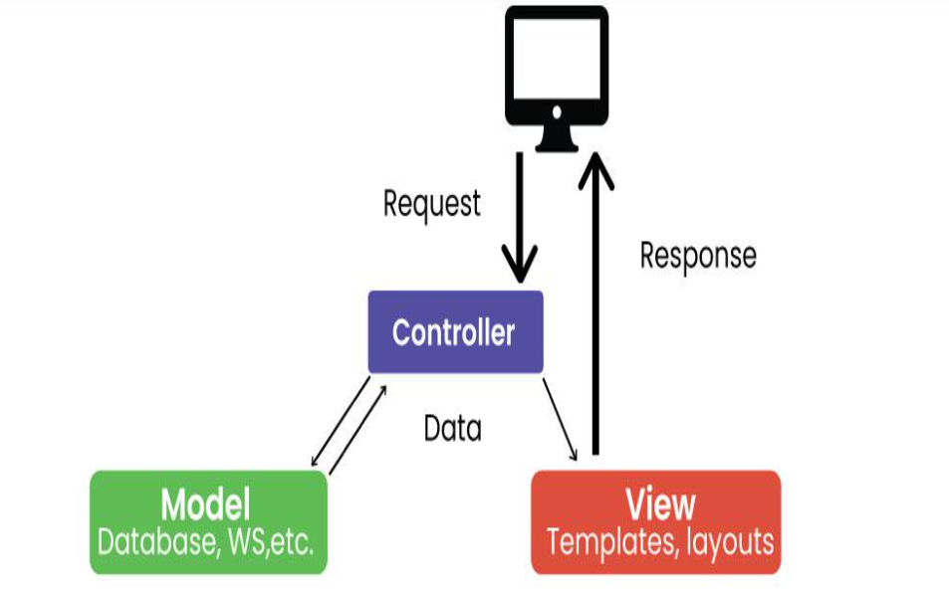
Model View Controller (MVC) Architecture
MVC is a design model that separates an application into three interacting parts: Model, View, and Controller.
This separation allows for better code design and modularization.

Slide 50
Model: Represents application data and business logic.
View: Displays data to the user.
Controller: Processes user input and controls data flow between Model and View.

Slide 51
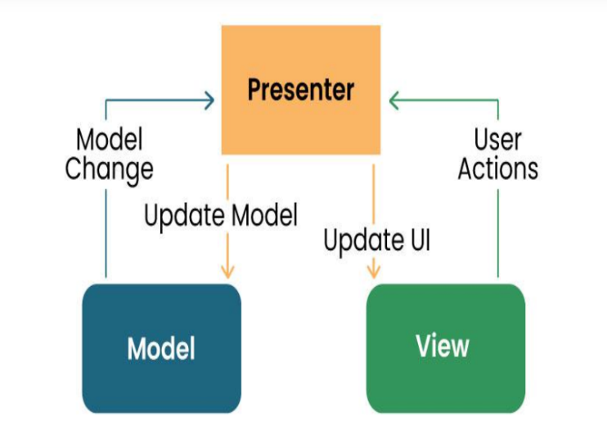
Model View Presenter (MVP) Architecture 1/2
MVP is a new architecture that separates an application into three parts: Model, View, and Presenter.
This is similar to MVC but puts more responsibility on the Teacher to manage the interaction between Model and View.

Slide 52
Model View Presenter (MVP) Architecture 2/2
Model: Manages data and business logic.
View: Represents the user interface.
Designer: Acts as an intermediary processing user input and updating the View and Model.

Slide 53
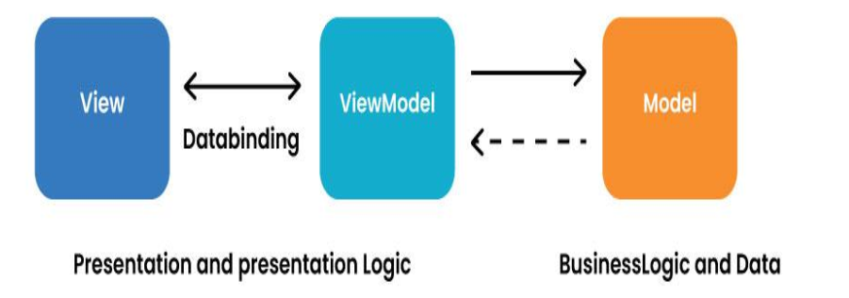
Model View View Model (MVVM) Architecture 1/2
MVVM is a design model widely used in mobile development, especially in frameworks like Android’s Jetpack.
Its purpose is to separate the application into three parts: Model, View, and ViewModel.

Slide 54
Model View View Model (MVVM) Architecture 2/2
Model: Represents data and business logic.
View: Represents the user interface.
ViewModel: Acts as an interface between the Model and the View, which contains the reference logic.

Slide 55
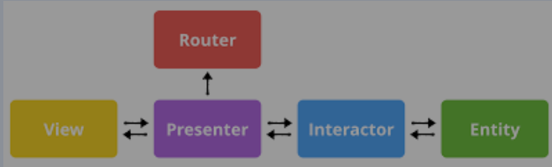
VIPER Architecture
VIPER stands for View, Interactor, Presenter, Entity, and Router.
VIPER is primarily based at the clean architecture ideas, which purpose to separate the concerns of different layers of the utility.
Each layer has a single duty and communicates with different layers through properly-defined interfaces.

Slide 56
VIPER Architecture
View: This is the consumer interface layer, wherein the perspectives and look at controllers are defined. The view is chargeable for showing the information provided by way of the presenter and forwarding the person moves to the presenter.
Presenter: This is the presentation layer, where the good judgment for formatting and imparting the records is defined. The presenter is liable for fetching the records from the interactor, reworking it right into a suitable layout for the view, and updating the view hence. The presenter additionally handles the consumer movements acquired from the view and calls the router to navigate to other screens.
Interactor: This is the enterprise good judgment layer, where the common sense for manipulating the data and interacting with external services is described. The interactor is accountable for gaining access to the facts from the service layer, acting any vital operations on it, and returning it to the presenter. The interactor additionally communicates with the entity layer to store and retrieve the information fashions.

Slide 57
VIPER Architecture
Entity: This is the information layer, wherein the data models and systems are described. The entity is responsible for representing the data in a constant and coherent manner throughout the software. The entity layer also can encompass records get entry to gadgets (DAOs) or repositories that summary the information of records patience and retrieval.
Router: This is the navigation layer, where the logic for routing and transitioning among different monitors is defined. The router is chargeable for developing and providing the view controllers, passing any vital facts to them, and coping with any dependencies or configurations. The router also communicates with the presenter to get hold of the navigation requests and execute them.

Slide 58
5-HOW TO COLLECT AND ANALYSE USER REQUIREMENTS FOR MOBILE APP DEVELOPMENT
Introduction
According to the software development life cycle the first phase of this process is the requirement gathering phase followed by requirement analysis phase. These phases are very essential for the overall efficiency of a software and acts as a blue print for quality assurance.
Requirement gathering can be done using different methods such as
Focus group meetings
Surveys
By examining pre-requisite data to bring about statistical facts
Questionnaires

Slide 59
User requirements focuses on who you are targeting with your application.
What are your target audience’s age group, lifestyle, and social background?
Which geographical regions and languages are you targeting?
What issues are your potential users facing that your app can solve?
With which requests are they turning to your app?
Which device types (smartphone, tablet, etc.) and OS (Android, iOS) do your potential users prefer?
What are the parameters they value a lot in a digital product (e.g., simplicity, unusual design, wearables integration)

Slide 60
After the requirement gathering phase these requirements have to be analyzed. This analysis is done by the business analyst although some institutes have a requirement analyst. Analysis is very important as it helps:
Capturing user stories or use cases
Defining system constrains and interfaces
Prioritized requirements based on their importance and feasibility
Indicate a measurement of the total budget
Outline functional and non-functional requirements

Slide 61
Functional requirements:
Functional requirements describe the specific functionalities, features and behaviors that a software system must exhibit in other to fulfil the needs of the user.
It typically answers questions like what should the system do?
Examples of this requirements include
The system should allow users to create accounts and login
The system should allow the prices of each item in a shopping cart

Slide 62
Non-functional requirements
Also known as quality attributes or constraints, define the characteristics and qualities that the software system should possess. They are not directly related to specific functionalities but rather focus on aspects of the system’s performance, usability, security, scalability and other qualities that impacts its overall effectiveness. Examples include:
Security
Reliability
Usability

Slide 63
6. Study how to estimate mobile app development cost
Methods for Estimating Mobile App Development Costs
Fixed Price Model:
Under this model, itCrafts estimates the total cost of the project based on the defined requirements and specifications before the development starts.
This method is most suitable for small projects with clear, unchanging requirements. The main advantage is that the client knows the exact cost upfront, helping with budget planning. However, it lacks flexibility for changes or additions once the project is underway.

Slide 64
Methods for Estimating Mobile App Development Costs
Time and Material Model:
This model is based on the actual time and resources utilized on the project.
Clients are billed according to the hours worked by the development team.
This approach is suitable for projects where requirements are expected to evolve or are not fully defined at the beginning.
It offers high flexibility as changes can be made during the development process, but the final cost might exceed the initial estimates if the project scope expands or unexpected challenges occur.

Slide 65
Dedicated Team Model:
In this model, itCraft provides a dedicated team of professionals who work exclusively on your project.
The cost is based on the team size and composition, and the time they spend on the project.
This model is ideal for long-term projects where requirements might change over time.
It gives you greater control over the development process and ensures that the team is fully invested in your project.

Slide 66
Tips for Accurate Cost Estimation
Ensuring Clear Communication with the Development Team
Open and continuous communication with your development team is critical for accurate cost estimation. As a client, you should be clear and precise about your requirements, expectations, and budget.
At itCraft, we value transparency and encourage clients to discuss their project thoroughly with us.
This helps in understanding the project scope better, eliminating misunderstandings, and providing an accurate estimate.

Slide 67
Tips for Accurate Cost Estimation
Taking into Account Unexpected Costs
No matter how well you plan, there will always be some unforeseen expenses during the app development process.
These could be due to sudden changes in requirements, extra time spent on bug fixing, or additional features requested by users after launch.
Therefore, it’s wise to set aside a contingency fund as part of your budget.
This prepares you for unexpected costs and ensures that the development process isn’t hampered due to budget constraints.

Slide 68
Tips for Accurate Cost Estimation
Regularly Revisiting and Revising the Budget
Mobile app development is a dynamic process, and costs can fluctuate based on a variety of factors.
For example, additional features may be needed, or development could take longer than expected.
It’s important to revisit and revise your budget periodically, keeping track of the actual spend against the estimated cost.
This will help identify if the project is on track financially, and if not, corrective actions can be taken early.

