Slide 1
Project Sketches
Yann Kirsch
Simon Stolz
Mohamed Houssein Zaghdane
Max Vollath
Florian Leichtl

Slide 2
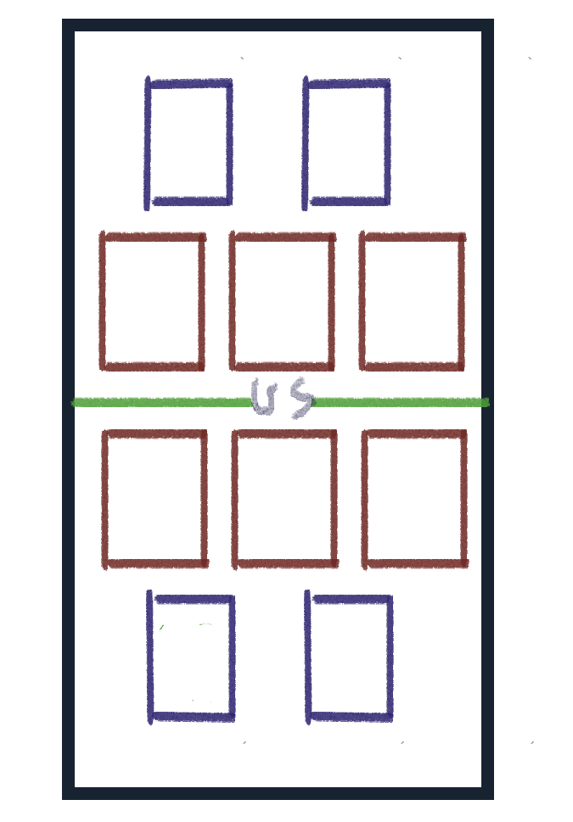
Detail 1 : Duel Field
Own cards obtain buffs depending on the actual weather

Slide 3
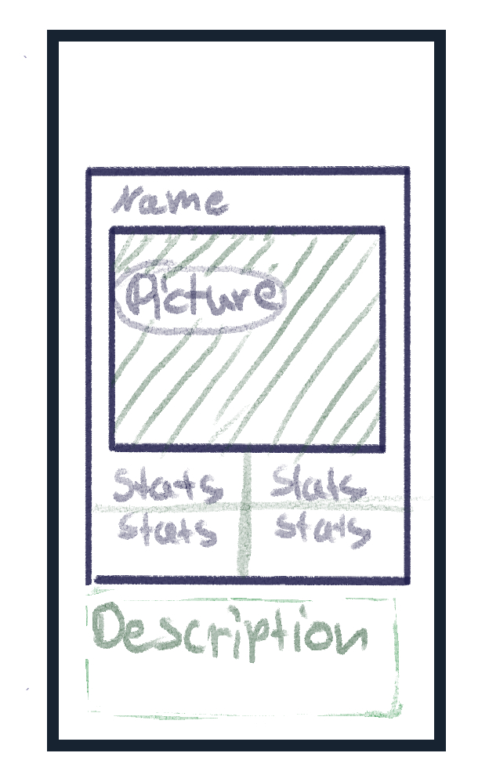
Detail 2 : Card Layout
Card’s name and stats are fixed (cannot be changed)
The player can add his own custom picture

Slide 4
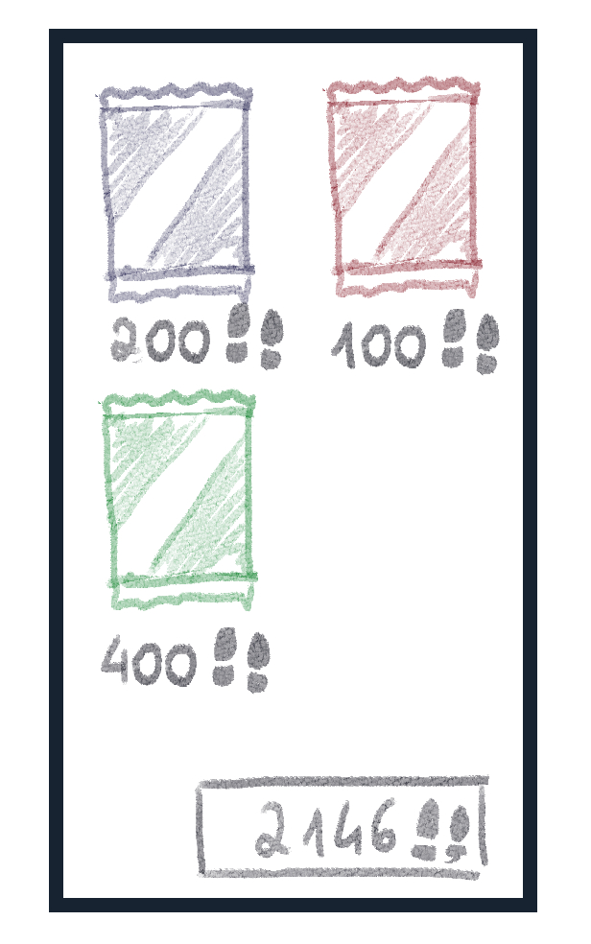
Detail 3 : Booster packs
Booster packs can be bought with the steps walked by the player

Slide 5

Detail 4 : Card Types
There are different type of cards each affected by specific weather
Cards can be monster cards or spell cards

Slide 6
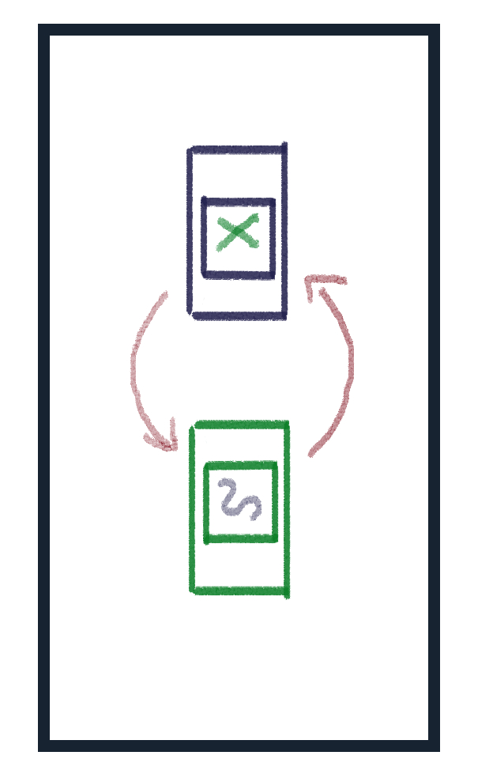
Detail 5 : Trading
Players can trade their created cards with each others
Trading can only happen locally

Slide 7
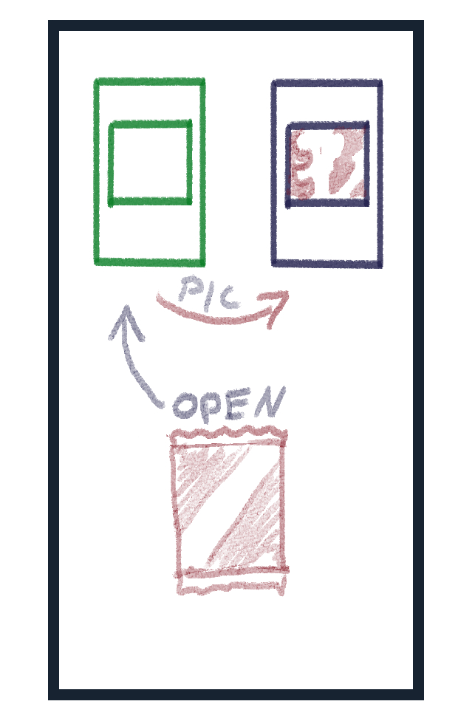
Detail 6 : Custom pictures
Players must add pictures to their cards to be able to use them

Slide 8
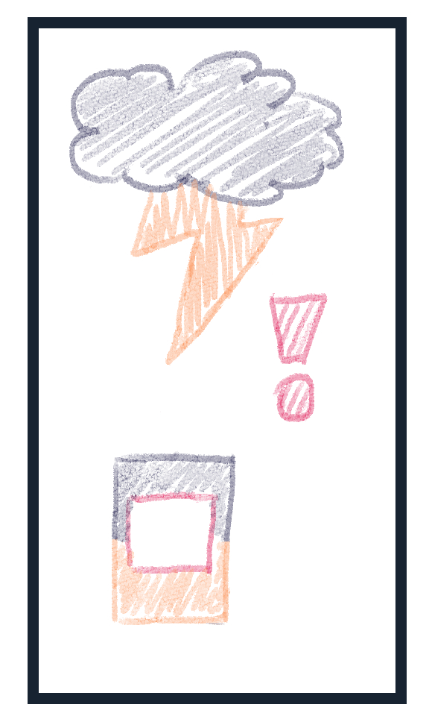
Detail 7 : Weather effects
Card types receive in game buffs depending on the actual weather
e.g. Electric monsters get more attack when there is a storm at your location
Independent other players

Slide 9
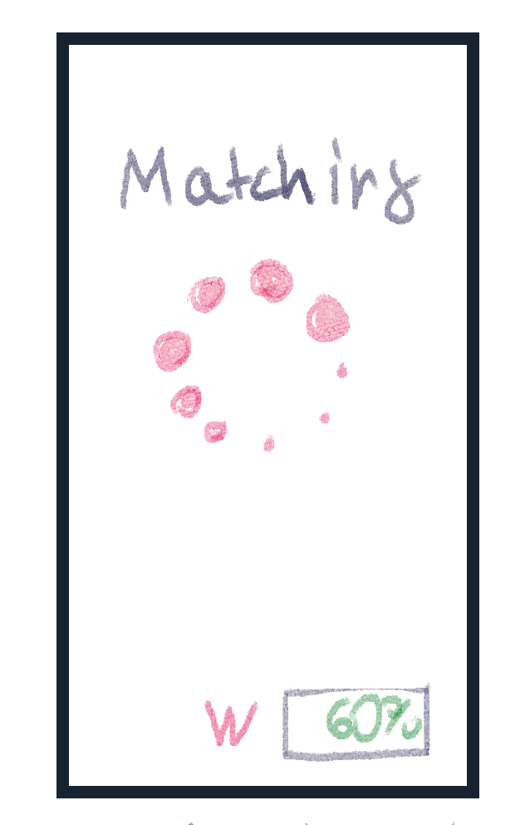
Detail 8 : Matchmaking
Random matchmaking depends on the player’s winrate
Players can also challenge their friends

Slide 10
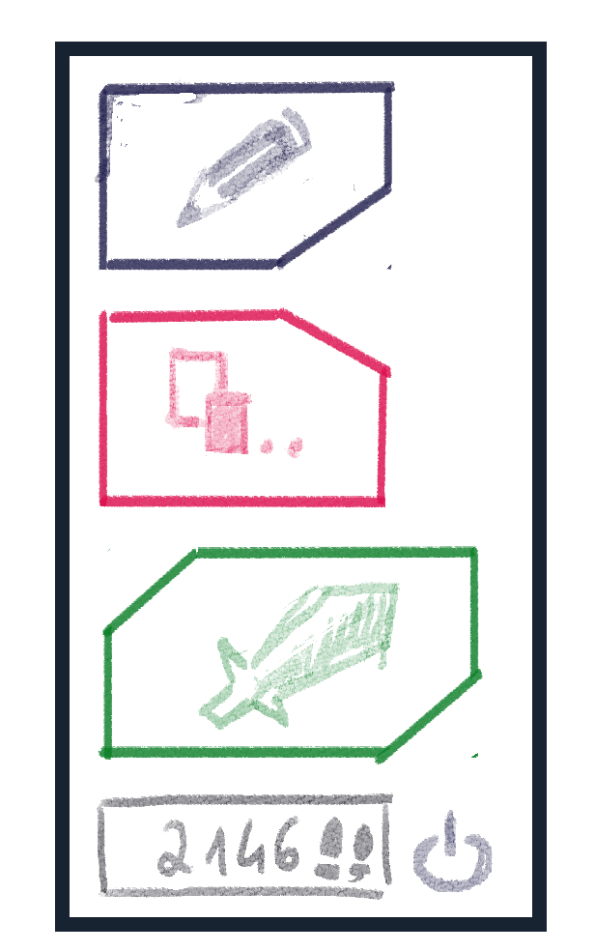
Detail 9 : UI
-> “Paint” cards
-> Edit deck
-> Matchmaking
-> Actual steps (currency)

Slide 11
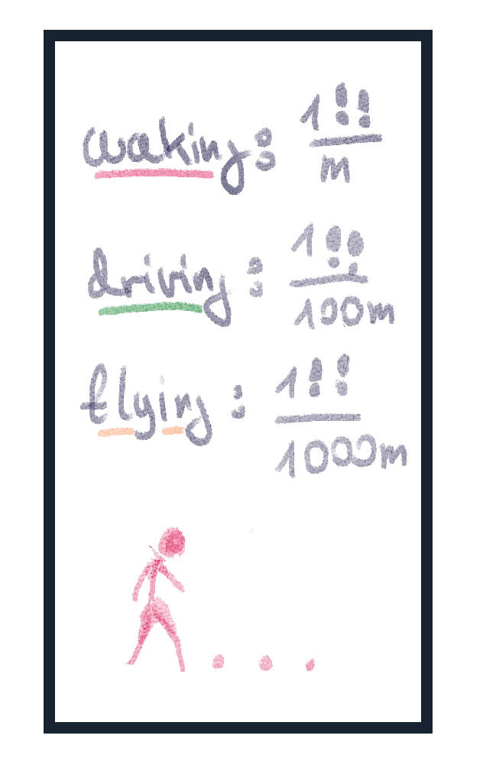
Detail 10 : Walking
Walking mode for farming steps

