Slide 1
GROUP 6 · GENERATION GHANA & KENYA DATA ANALYTICS PROGRAMME
Workforce Analytics
A Data-Driven Diagnosis of Talent, Performance & Retention Risk
Capstone Project · Roblox HRMS Dashboard · 30,000-Employee Workforce Study
Prepared by Group 6
Data Cleaning · MySQL · Power BI · Executive Reporting

Slide 2
HOW WE GOT HERE
From Raw Spreadsheets to Boardroom Insight
A four-stage analytics pipeline behind every number in this deck
1
2
3
4
Data Cleaning
Database Build
Dashboard Design
Executive Reporting
Raw cleaned and standardised in Excel duplicates, nulls and inconsistent categories resolved.
Cleaned data imported into MySQL, structured into relational tables for reliable, repeatable querying.
Power BI dashboard built across five analytical pages, using DAX measures and interactive slicers.
Dashboard visuals from Power BI.
02

Slide 3
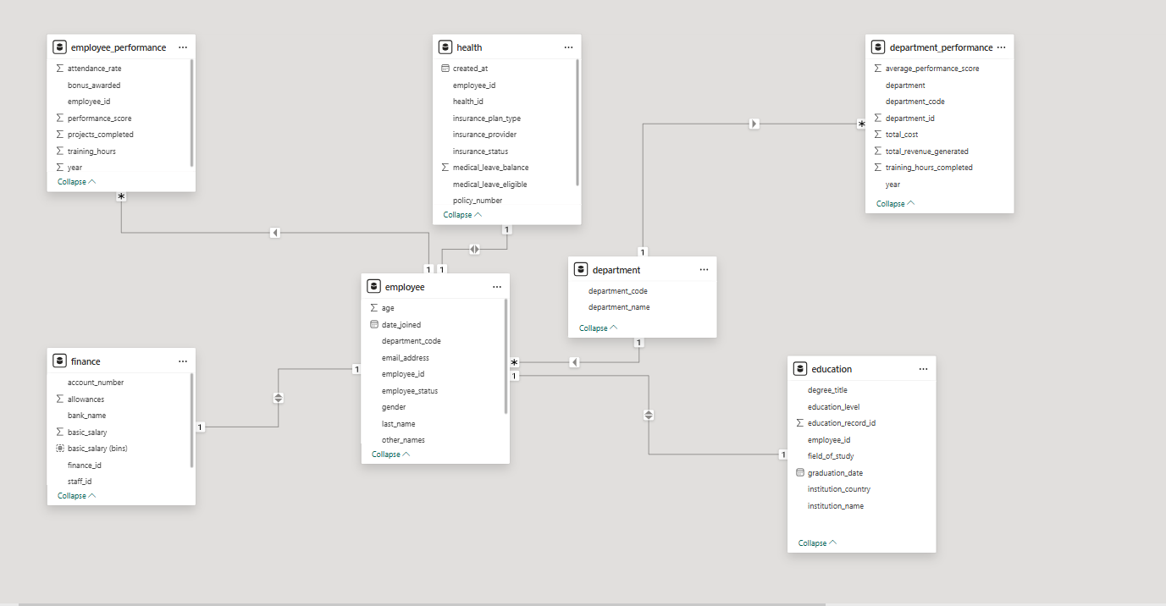
HOW WE GOT HERE
A Relational Model Built for Analysis
Seven tables in Power BI, star-schemed around a single employee hub for reliable DAX measures
Schema Design
employee sits at the centre, joined 1-to-many to performance, health, finance and education records.
department and department_performance roll up individual staff into departmental KPIs via department_code.
One-to-one links (employee - health, employee - finance) keep sensitive attributes in separate, permission-friendly tables.
This structure lets every dashboard page slice by department, education or role without duplicating data.
03

Slide 4
EXECUTIVE SUMMARY
The Workforce, By the Numbers
A 30,000-employee organisation across 8 departments — high performance, but real retention risk
30,000
8
40.98
$104.07M
Total Employees
Departments
Average Age (yrs)
Total Department Revenue
49.8%
32.9%
67.8%
$8.8K
Master's Degree or Higher
Attrition Rate
Employees Flagged At Risk
Average Basic Salary
04

Slide 5
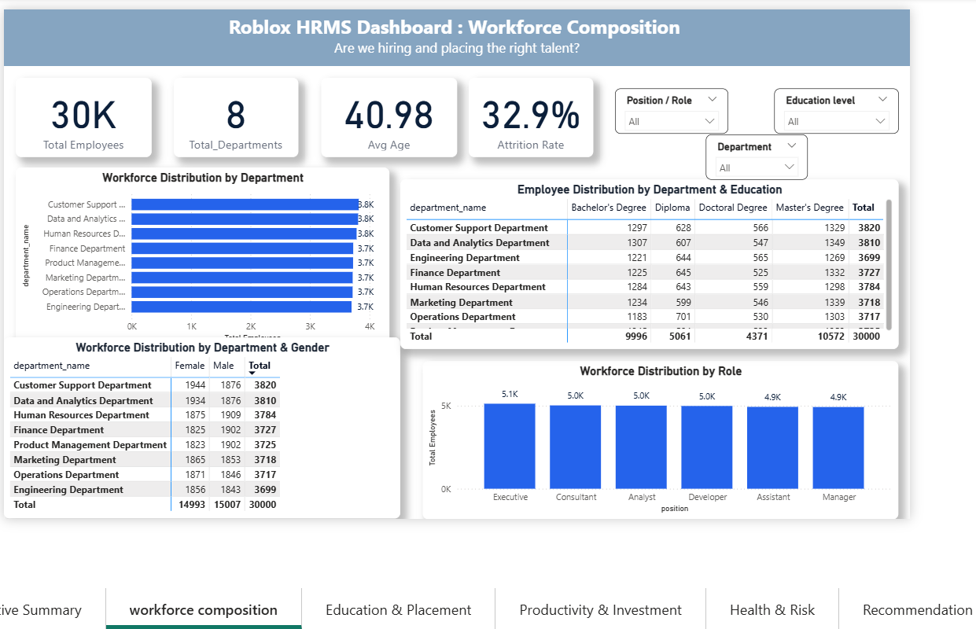
DASHBOARD 01 · WORKFORCE COMPOSITION
Are We Hiring and Placing the Right Talent?
30,000 employees spread evenly across 8 departments, with balanced gender representation
Key Reads
All 8 departments sit within a tight 3.7K–3.8K headcount band - no single function dominates.
Gender split is close to even organisation-wide: 15,007 male vs 14,993 female.
Bachelor's and Master's degree holders make up roughly two-thirds of the workforce.
Role distribution is flat: Executive, Consultant, Analyst and Developer each carry ~5K staff, suggesting limited hierarchy depth.
05

Slide 6
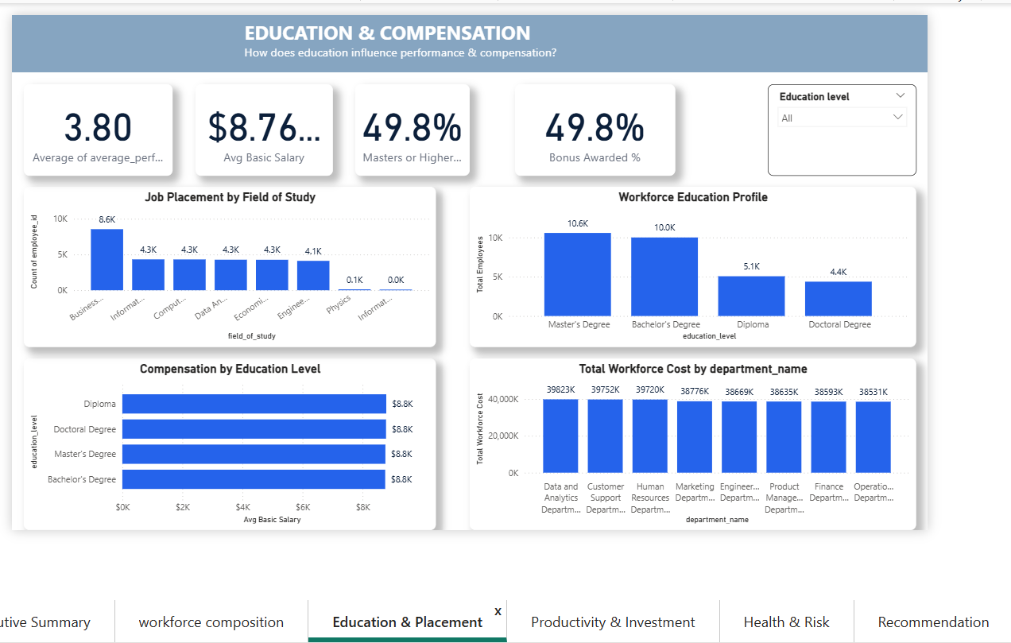
DASHBOARD 02 · EDUCATION & COMPENSATION
Does Education Influence Performance & Pay?
Qualification shapes where people land — but barely moves what they earn
Key Reads
Business, Information Systems and Computer Science graduates account for the largest share of placements.
Master's degree holders are the largest education segment (10.6K), just ahead of Bachelor's (10.0K).
Average basic salary is flat at ~$8.8K across every education level - pay isn't scaling with qualification.
Data & Analytics carries the highest total workforce cost ($39.8M); Operations the lowest ($38.5M).
06

Slide 7
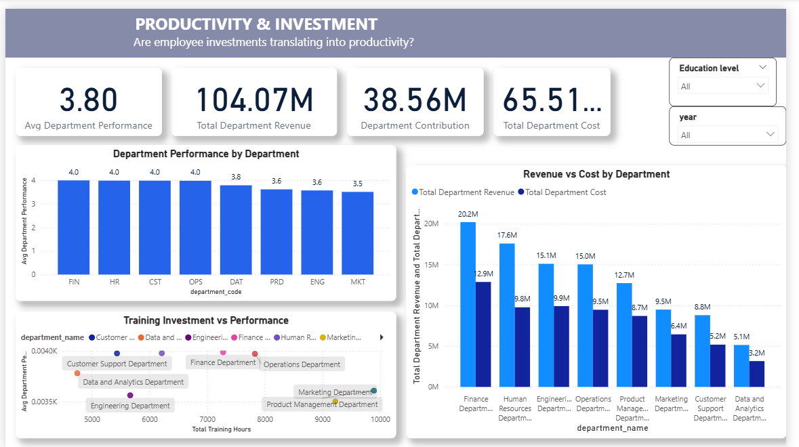
DASHBOARD 03 · PRODUCTIVITY & INVESTMENT
Are Employee Investments Translating Into Output?
Performance is consistently strong, but revenue efficiency diverges sharply by department
Key Reads
Finance, HR, Customer Support and Operations all post the top average performance score of 4.0.
Marketing (3.5) and Engineering (3.6) trail the rest despite comparable training investment.
Finance delivers the strongest revenue-to-cost spread: $20.2M revenue against just $12.9M cost.
Training spend doesn't clearly predict performance - several lean-budget teams outperform bigger-spend ones.
07

Slide 8
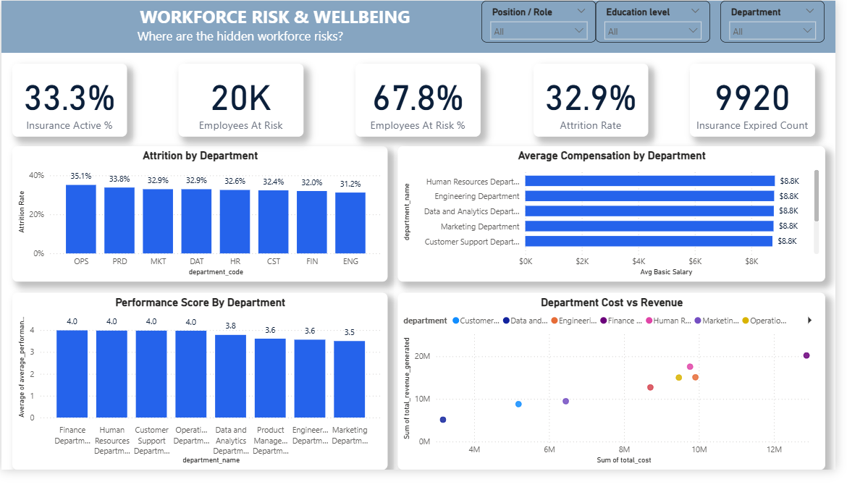
DASHBOARD 04 · WORKFORCE RISK & WELLBEING
Where Are the Hidden Workforce Risks?
Attrition and coverage gaps point to a retention problem hiding behind strong performance scores
Key Reads
Organisation-wide attrition sits at 32.9% - roughly one in three employees.
Operations has the highest departmental attrition at 35.1%, despite steady 4.0 performance.
9,920 employees have expired insurance coverage a compliance and wellbeing exposure.
67.8% of the workforce falls into the “at risk” band the single biggest flag in this study.
08

Slide 9
TURNING ANALYTICS INTO ACTION
Leadership Recommendations
Grounded in workforce composition, performance, compensation, training and risk findings
01
RETENTION
02
PERFORMANCE
Finding: Operations — 35.1% attrition despite 4.0 performance.
Action: Investigate workload, compensation and working conditions.
Impact: Protect high-performing workforce capacity.
Finding: Marketing — 3.5 performance; $9.5M revenue vs $6.4M cost.
Action: Review processes, role allocation and training effectiveness.
Impact: Improve productivity before increasing investment.
03
WORKFORCE PLANNING
04
WORKFORCE RISK
Finding: Data & Analytics — 3.8 performance but lowest departmental revenue ($5.1M).
Action: Validate workforce utilisation and how internal value is measured.
Impact: Enable evidence-based hiring and resource allocation.
Finding: Product Management — second-highest attrition (33.8%) at 3.6 performance.
Action: Investigate retention drivers and capability gaps.
Impact: Reduce workforce risk and lift performance.
ORGANISATION-WIDE PRIORITY RETAIN → Operations & Product Management OPTIMISE → Marketing & Data and Analytics PROTECT → Finance & HR
09

Slide 10
Thank You
Questions & Discussion — Group 6 Workforce Analytics Capstone
Group 6 Members: Dennis, Daniel, Comfort, Henry
Generation Ghana & Kenya Data Analytics Programme
Power BI · MySQL · Excel

