Slide 1

HDSC SUMMER ‘22 CAPSTONE PROJECT
Gender Statistics:
Earnings of Male and Female Employees
(ANALYSIS BY TEAM DATA WAREHOUSE)
October 29, 2022.

Slide 2
Problem Statement
•Gender disparity is a global issue and it is present in the workplace in the form of the gender pay gap.
•The Workplace Gender Equality Agency (WGEA) estimates that Australian women earn, on average, 15.3% less than men.
•This leads to sex segregation channeling women into lower value-added sectors and occupations.
•Team Data Warehouse provides insights from available data on the disparity between the average male and female earnings in Australia.

Slide 3

METHODOLOGY
DATA COLLECTION
DATA PRE-PROCESSING
EXPLORATORY DATA ANALYSIS
FEATURE ENGINEERING
TIME SERIES ANALYSIS AND MODELLING

Slide 4
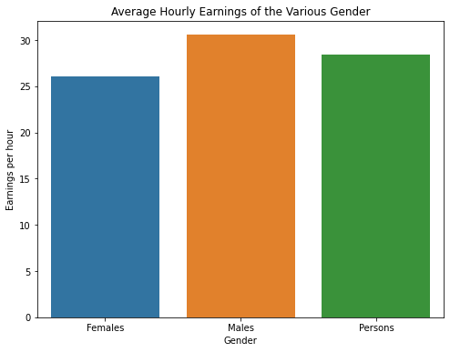
The figure above shows the average hourly earning of the eight job roles over the total period of analysis (2004 - 2017) for the various gender. The male gender receives the highest hourly wage of AUD30.59 while the female gender receives the least of AUD26.05.

Slide 5
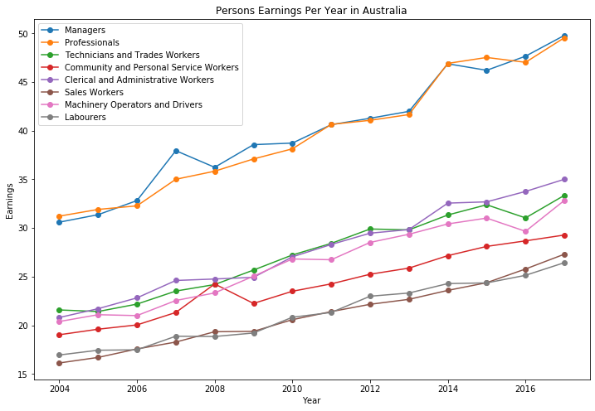
Exploratory Data Analysis

Slide 6
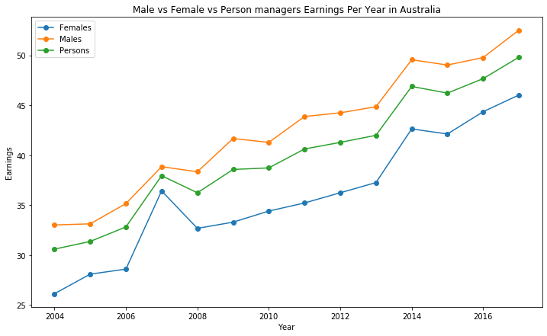

Slide 7
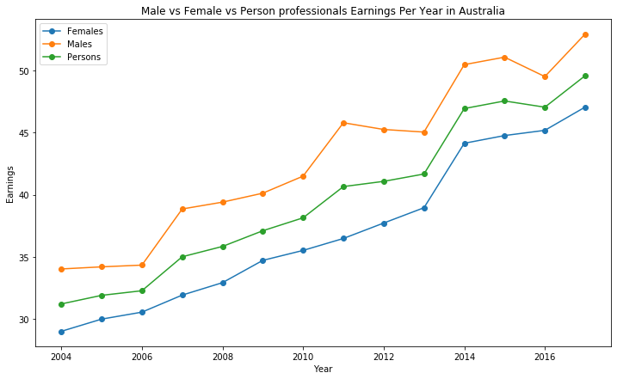

Slide 8
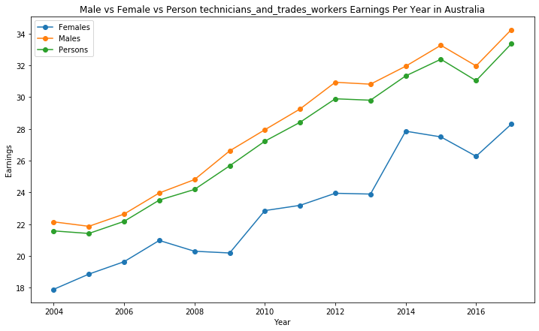

Slide 9
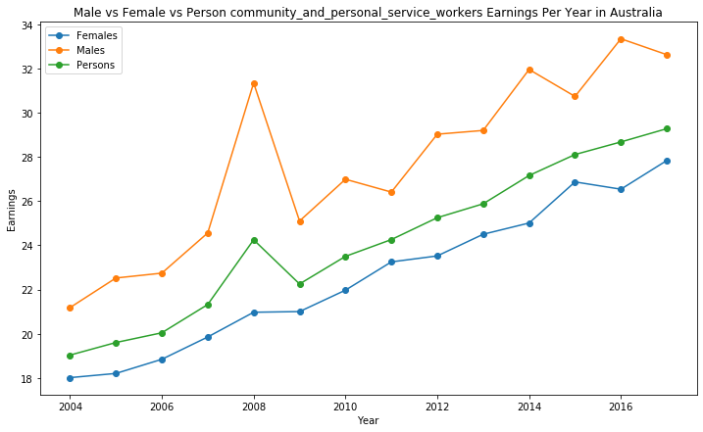

Slide 10
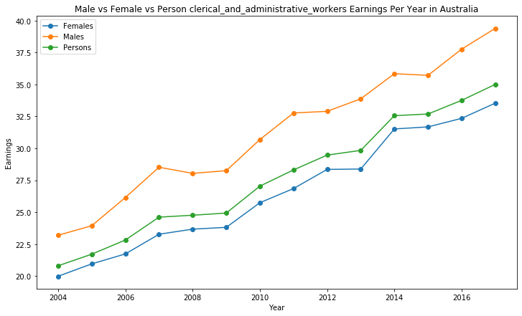

Slide 11
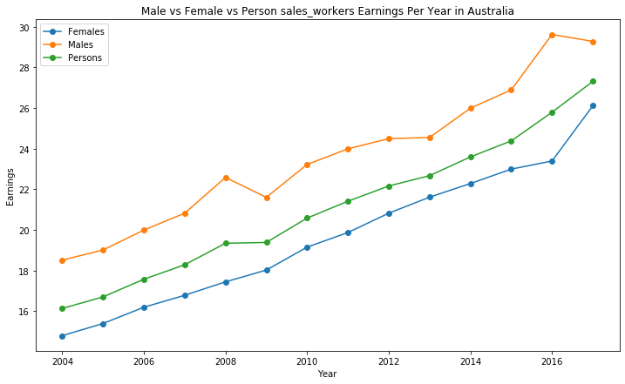

Slide 12
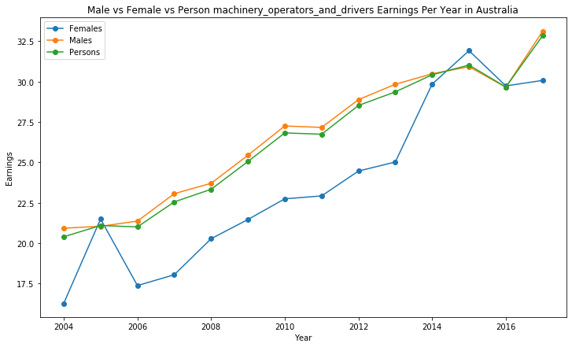

Slide 13
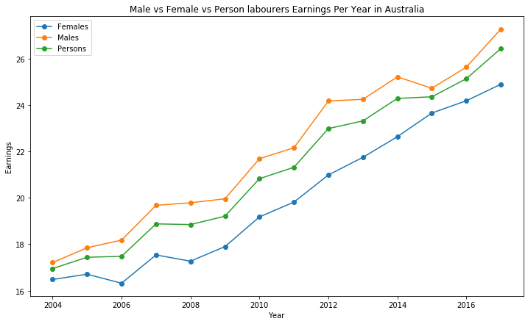

Slide 14
Insights from Exploratory Data Analysis
Managers and Professionals earn more than other job roles over the years regardless of the gender
Males earn more than females over the years regardless of the job role except in 2005 and 2015 when female machinery operators and drivers earned higher than their counterparts.
Also in 2016, male and female machinery operators and drivers approximately earned the same.
In 2007, female managers had a sharp increase in their earnings

Slide 15
Insights from Exploratory Data Analysis Contd.
In 2014, female technicians and trade workers had a sharp increase in their earnings
In 2008, male community and personal service workers had a sharp increase in their earnings
In 2005, hourly earnings for female machinery operators and drivers had a sharp increase and then again in 2014 and 2015
In 2005, 2015 and 2016, the females earned more in the Machinery Operator and Driver Job roles than the male and ‘person’ genders

Slide 16
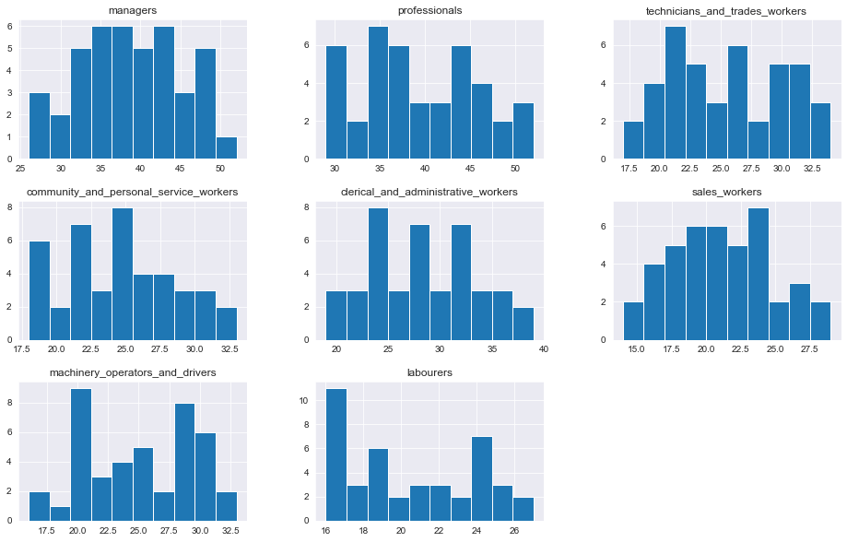
The plot above shows distribution of the different job roles and the percentages of their salaries irrespective of gender.
The 'managers' and 'professionals' seem to be the categories with higher payment in salaries .
Majority of the managers earn within the range of 35-40 Australian dollars (AUD) .

Slide 17
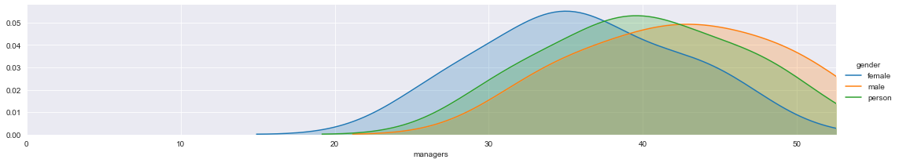
A Kernel Distribution Estimation(KDE) plot comparing the salaries of managers by Gender
The minimum salary for female managers is less than that of males and persons.
The mean salary of male managers is about 43 Australian dollars (AUD).
The mean salary of female managers is about AUD35.
The mean salary of persons managers is about AUD40
Only few managers of the 3 genders earn above AUD50 .

Slide 18
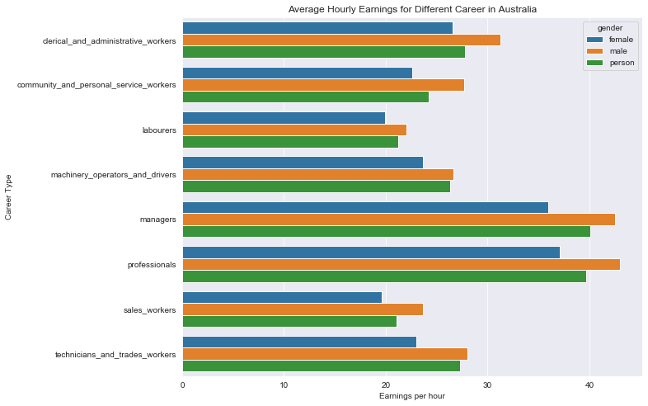
Rhe figure shows that irrespective of job role, the males have the highest hourly pay while females have the least. Also the difference between male and the other genders tends to increase for job roles with better hourly pay.
It is observed that the managers and the professionals are the best paid job roles.

Slide 19
SUMMARY
•The examination of the statistics revealed, that the average hourly wages for men across all job titles were greater than those for women in Australia.
•In the years 2005 and 2015, females who worked as drivers and machinery operators made more money than their male counterparts.
•A challenge we encountered while modeling the data was that independent features (variables) to reliably forecast our target variable without bias were inadequate.
•The analysis conducted through the depiction of the ACF and PACF plots, respectively, resulted in the selection of the ARIMA model order, i.e. q and p.

Slide 20
RECOMMENDATIONS
•To automate and predict the gap across all industries, data on the main causes of the wage gap should be made public.
•
•Formal policies and/or strategies that support gender equality should be in place inside organizations.
•Most professional professions most likely had a lower proportion of women. But more women ought to be inspired to enroll in university professional programs.
•To determine whether and where discrepancies may exist, the employer should always do a pay gap analysis for all the roles. And perhaps the reason for the salary disparity and how to close it.
•Consistent efforts should be made to lessen the impact of the major causes of the pay disparity.

Slide 21

THANKS FOR LISTENING

