Slide 1


HDSC SUMMER ‘22 CAPSTONE PROJECT Gender Statistics: Earnings of Male and Female Employees
29th of October, 2022.

Slide 2


TEAM DATA WAREHOUSE
Other Active Members
Obiabuchi Nnanna | Daniel Oyewale
Corazon Odhiambo | Saka Kafayat
Precious Nnodi | Rajnikant Roy
Osazuwa Igbinavbiere | Samuel Egbevurie
James Okechukwu | Martin Chidi
Chidubem Ndukwe | Oluwatimilehin Idowu
Jacobs Opeyemi Aremu | Abilehita Azamegbe
Sandra Udeh | Abdulmujeeb Opatola
Ayomide Oladele
Role: Presenter 1
Kazeem Fatai
Role: Presenter 2
Project Lead
Name: Kelechi Ugochukwu
Assistant Project Lead
Name: Ayomide Oladele
Query Analyst
Name: Adepeju Shittu

Slide 3
Problem Statement ------------------------------------------------------------------------------------------------------------------------------------
Gender disparity has always been an issue and it is present in the workplace in the form of the gender pay gap.
This leads to sex segregation channeling women into lower value-added sectors and occupations.
Our job as a team of data-driven professionals is to extract insights that show the disparity between the average male and female earnings in Australia.

Slide 4
Methodology ------------------------------------------------------------------------------------------------------------------------------------
Data collection
Data preprocessing
Exploratory Data Analysis
Feature Engineering
Time Series Analysis and Modelling
Model Evaluation

Slide 5
Data Collection / Data Preprocessing ------------------------------------------------------------------------------------------------------------------------------------
The data was collected and downloaded from the Kaggle website
The dataset used for the analysis is a CSV file of 14 rows and 28 columns containing the average hourly earnings of different gender from 2004 to 2017 in Australia.
No missing or duplicated values were found.
The data was cleaned and manipulated by renaming its columns.

Slide 6
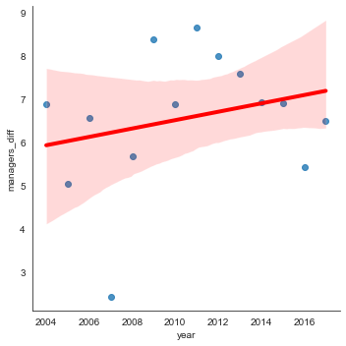
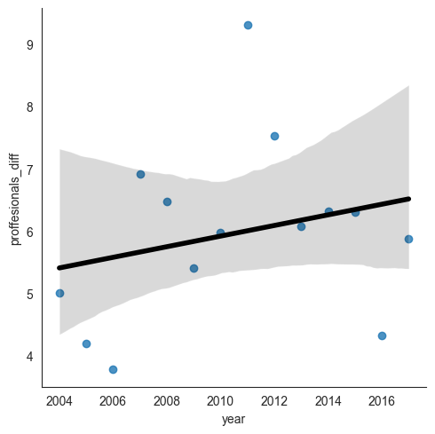
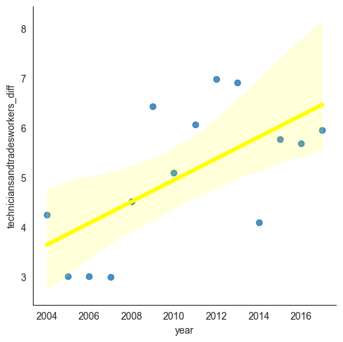
Exploratory Data Analysis -----------------------------------------------------------------------------------------------------------------------------------
Regression plot visualizations showing the slope of male and female wage differences from 2004 to 2017
Managers
Technicians and Trade workers
Professionals

Slide 7
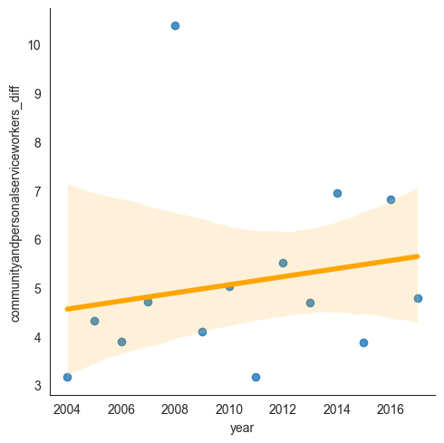
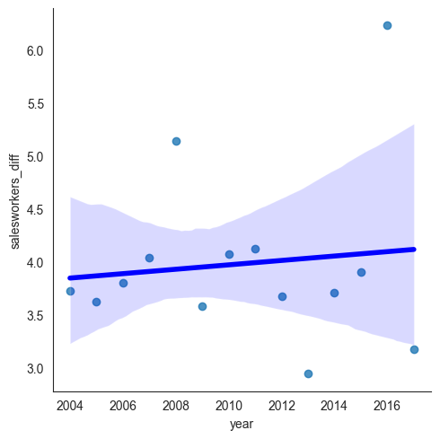
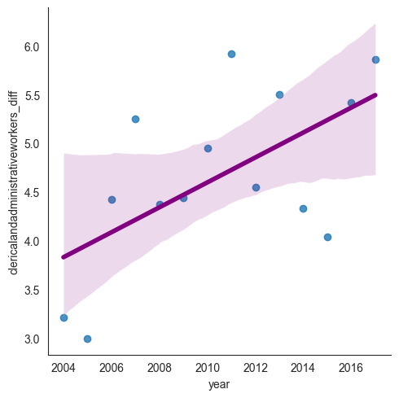
Exploratory Data Analysis -----------------------------------------------------------------------------------------------------------------------------------
Community and personal service workers
Clerical and Administrative workers
Sales workers

Slide 8
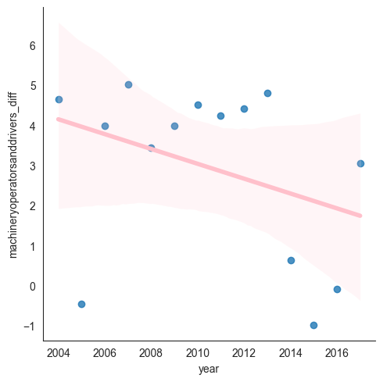
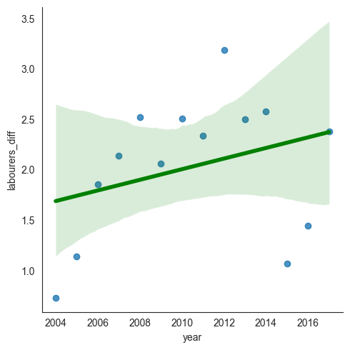
Exploratory Data Analysis -----------------------------------------------------------------------------------------------------------------------------------
Machinery operators and Drivers
Labourers

Slide 9
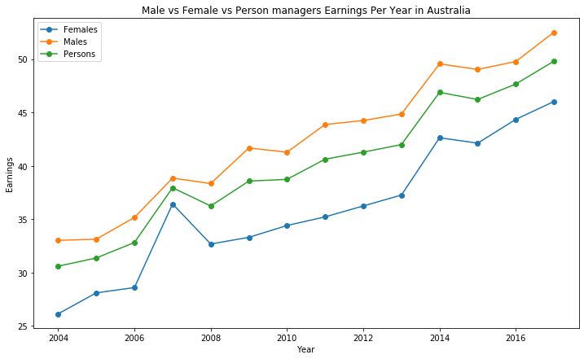
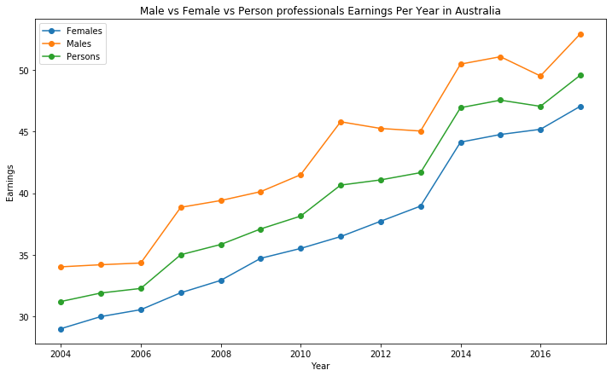
Exploratory Data Analysis ------------------------------------------------------------------------------------------------------------------------------------

Slide 10
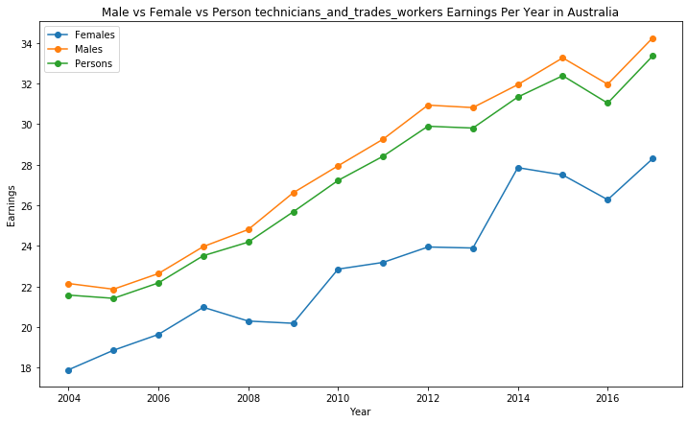
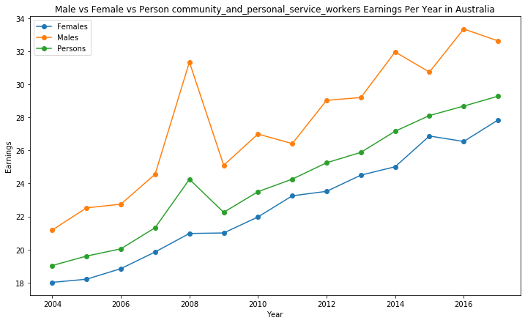
Exploratory Data Analysis ------------------------------------------------------------------------------------------------------------------------------------

Slide 11
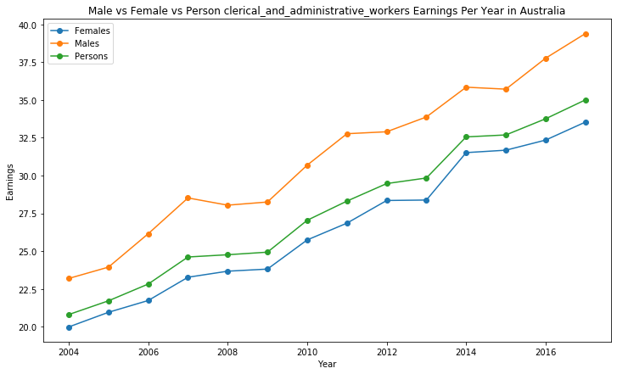
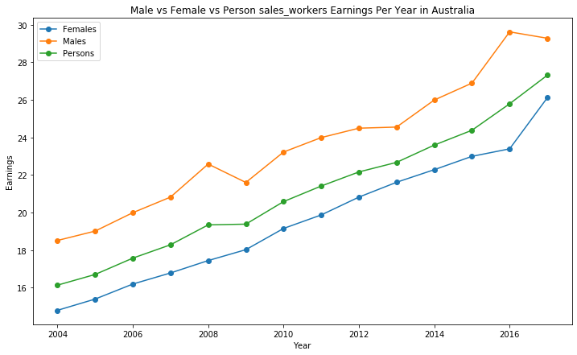
Exploratory Data Analysis ------------------------------------------------------------------------------------------------------------------------------------

Slide 12
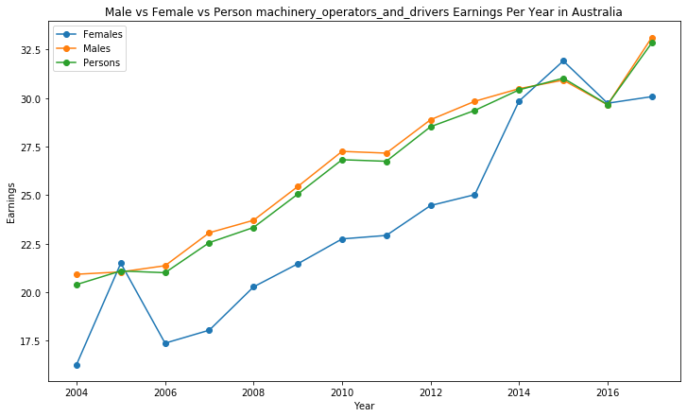
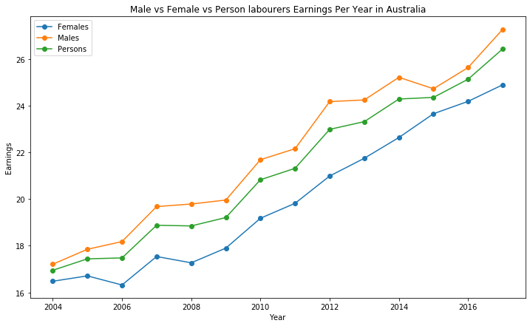
Exploratory Data Analysis ------------------------------------------------------------------------------------------------------------------------------------

Slide 13
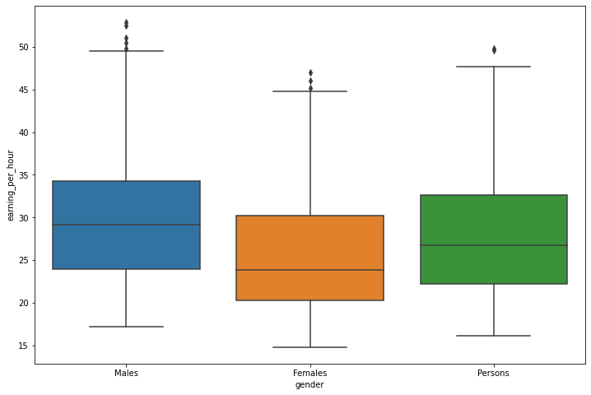
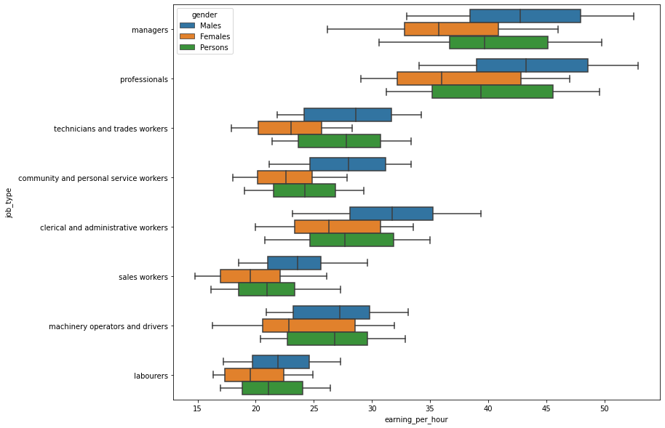
Exploratory Data Analysis ------------------------------------------------------------------------------------------------------------------------------------
The distribution of earnings, skewness and their quartiles

Slide 14
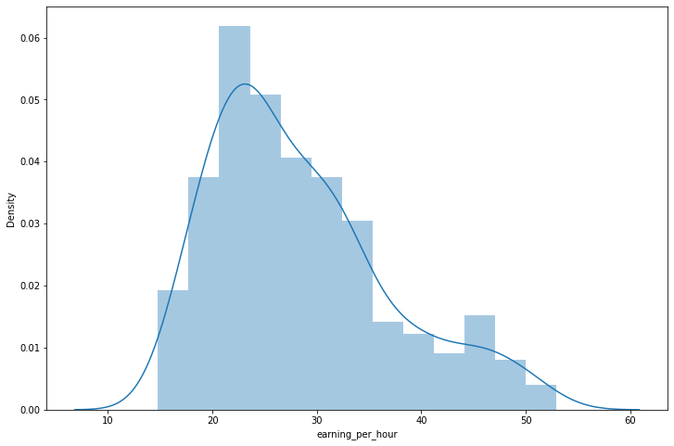
Exploratory Data Analysis ------------------------------------------------------------------------------------------------------------------------------------
The general distribution of earnings irrespective of job categories in Australia

Slide 15
Feature Engineering ------------------------------------------------------------------------------------------------------------------------------------
The target variable — wage gap, was created from the difference between the average male and female earnings for each year in the dataset.
The data was partitioned into 10 and 4 data points for the train and test sets respectively.

Slide 16
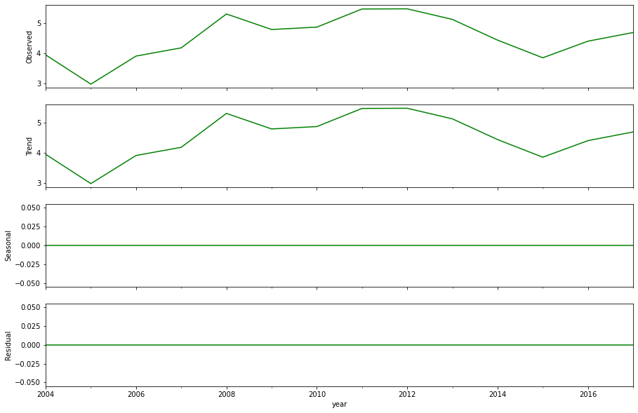
Time Series Analysis ------------------------------------------------------------------------------------------------------------------------------------

Slide 17
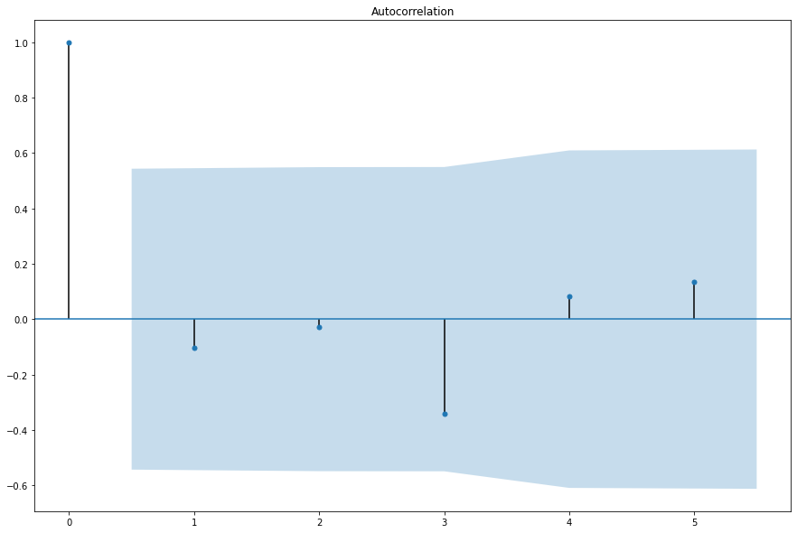
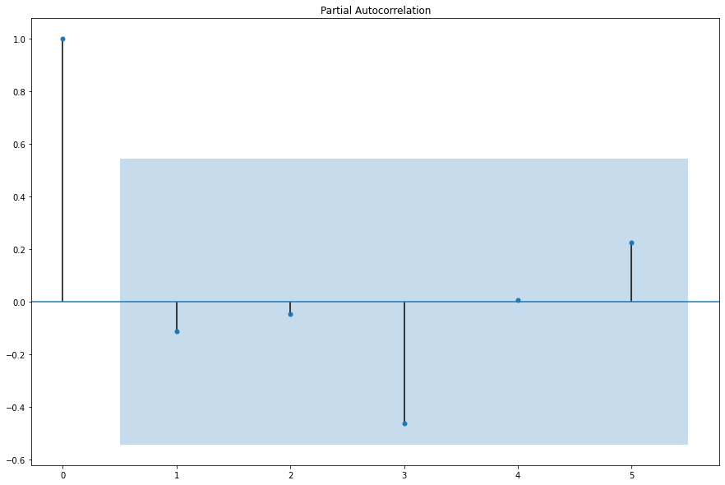
Time Series Analysis ------------------------------------------------------------------------------------------------------------------------------------
No lag crossed the significant level in either the ACF or PACF plots, hence q=p=0. the ARIMA order is as a result (0,0,0)

Slide 18
Time Series Modelling ------------------------------------------------------------------------------------------------------------------------------------
Data Collection
Feature Definition
Create ML model
Train ML model
Testdata
Makepredictions
First-order differencing was used to treat the trend, thereby making the data stationary.
Time series models used:
ARIMA(Autoregressive Integrated Moving Average) with order = (0,0,0)
Prophet

Slide 19
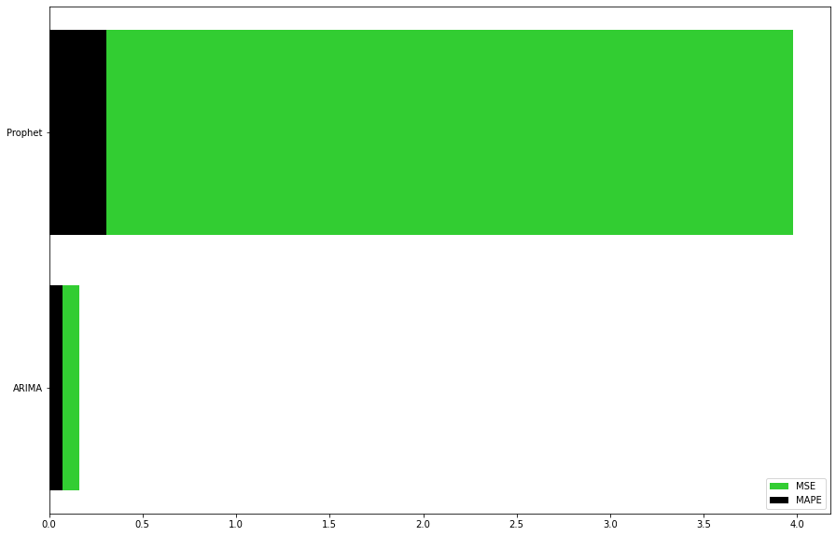
Model Evaluation ------------------------------------------------------------------------------------------------------------------------------------
Models | MSE | MAPE
ARIMA | 0.16 | 0.07
Prophet | 3.98 | 0.30

Slide 20
Summary ------------------------------------------------------------------------------------------------------------------------------------
Lack of enough independent features (variables) to reliably forecast our target variable without bias was one of the challenges we encountered while modeling the data.
The examination of the statistics revealed, that the average hourly wages for men across all job titles were greater than those for women in Australia.
In the years 2005 and 2015, there was an exceptional event where women who worked as drivers and machinery operators made more money.
The analysis conducted through the depiction of the ACF and PACF plots, respectively, resulted in the selection of the ARIMA model order, i.e. q and p.

Slide 21
Recommendations ------------------------------------------------------------------------------------------------------------------------------------
To automate and predict the gap across all industries, data on the main causes of the wage gap should be made public.
Formal policies and/or strategies that support gender equality should be in place inside organizations.
Top cadres have lower proportion of women, hence more women ought to be inspired to enroll in university professional programs.
To determine whether and where discrepancies may exist, the employer should always do a pay gap analysis for all the roles. And perhaps the reason for the salary disparity and how to close it.
Consistent efforts should be made to lessen the impact of the major causes of the pay disparity.

Slide 22
THANKS FOR LISTENING!

