Slide 1
Brand management
Carol Luca Gasan Teodora Andreea Voicu

Slide 2
Project description
This project develops a system to control the flow of the in and out products of a couple of stores with the same merchandise range

Slide 3

Type of entities
Time
Store
Event
Auxiliar structs:
Hashtable
Trie
PriorityQueue

Slide 4
Time
struct time
{
int hour;
int minute;
int second;
};
typedef struct time Time;

Slide 5
Store
struct store
{
char *name;
int productExistence;
int *productCount;
int xCoordinate;
int yCoordinate;
};
typedef struct store Store;

Slide 6
Event
struct event
{
char *name;
Time *time;
Store *store;
enum eventTypes type;
int productExistence;
int *productCount;
};
typedef struct event Event;

Slide 7

Event types
enum eventTypes
{
Client = 1,
Manager = 2,
StockUpdate = 3,
Feedback = 4
};

Slide 8
Client event
Client
hh:mm:ss
ClientName
product(1) quantity(1)
product(2) quantity(2)
...
product(k) quantity(k)
-1 -1
StoreName

Slide 9
StockUpdate event
StockUpdate
hh:mm:ss
product(1) quantity(1)
product(2) quantity(2)
...
product(k) quantity(k)
-1 -1
StoreName

Slide 10
Manager event
Manager
hh:mm:ss
StoreName

Slide 11
Feedback event
Feedback
hh:mm:ss
ClientName

Slide 12
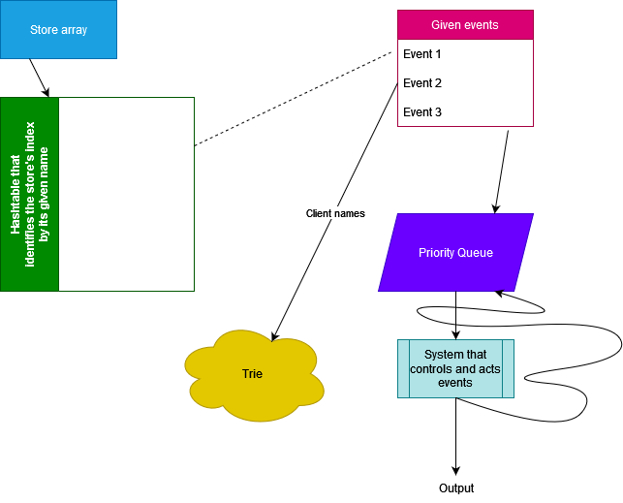
Behind logic

Slide 13
Thank you!

