Slide 1

Ma'ayan Laboratory
Computational Systems Biology
GEO2Enrichr analysis of MCF10A cells

Slide 2
Esquema geo >>>errichr supported plats >>>>created tag >>>>further analysis

Slide 3
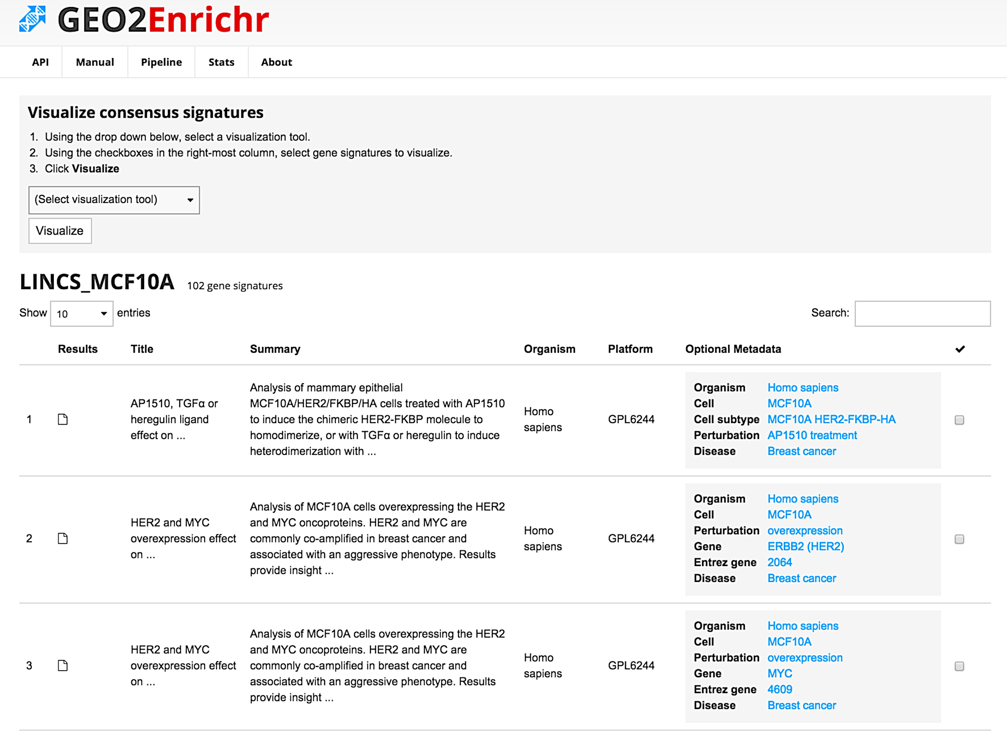


Slide 4
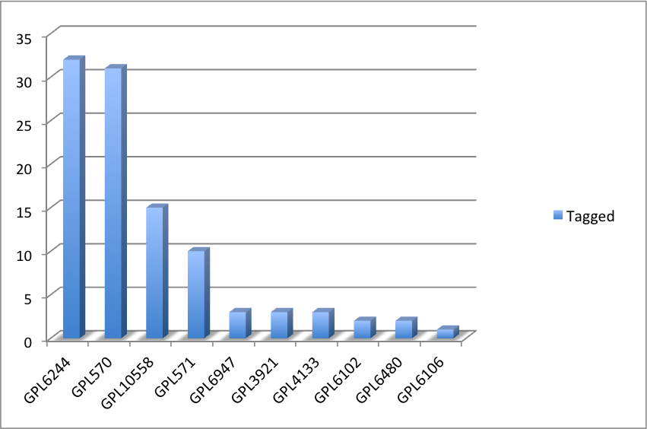
General information
All GEO2Enrichr tagged studies for MCF10A
 | Total entries | 102
Tag | LINCS_MCF10A
Link | http://amp.pharm.mssm.edu/g2e/explore/tags/LINCS_MCF10A
Due to the number of entries GPL6244 and GPL570 were chosen for further analysis

Slide 5
