Slide 1

Work Update
Department of Pharmacological Sciences
Caroline Monteiro
Ma’ayan Lab
Nov-2016

Slide 2
RNA-Seq
1
Mouse
Rat
 | GENE | Drug | Disease | Total
Total accessions | 511 | 192 | 131 | 834
Unique accession | 268 | 74 | 26 | 368
Samples Control | 1917 | 646 | 656 | 3219
Unique Control | 1130 | 393 | 196 | 1719
Samples Condition | 1702 | 339 | 464 | 2505
Unique Condition | 1608 | 333 | 463 | 2404
Total samples |  |  |  | 5724
Total Unique samples |  |  |  | 4123
 | GENE | Drug | Disease | Total
Total accessions | 13 | 46 | 4 | 63
Unique accession | 5 | 15 | 1 | 21
Samples Control | 30 | 41 | 38 | 109
Unique Control | 30 | 41 | 38 | 109
Samples Condition | 30 | 41 | 38 | 109
Unique Condition | 30 | 41 | 38 | 109
Total samples |  |  |  | 218
Total Unique samples |  |  |  | 218
Current Tally:
Accessions: 897 Samples: 5942
Notes:
I mentioned this before, but a few more entries were added. And now I have some actual ‘statistics’ on what we have.
Instead of just some guesstimates.

Slide 3
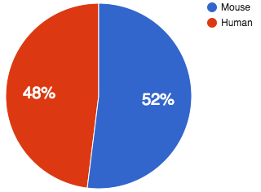
Platforms
2
GPL13112 | Illumina HiSeq 2000 | 55317 | Mus musculus
GPL17021 | Illumina HiSeq 2500 | 23879 | Mus musculus
GPL16791 | Illumina HiSeq 2500 | 25273 | Homo sapiens
GPL11154 | Illumina HiSeq 2000 | 47941 | Homo sapiens
 | Total | 152410
Notes:
I talked to Alex about this… So that instead of just aligned the samples we identificated. We could aligned Most of mouse and human RNA-seq samples In GEO because. These here are the biggest 4 platforms.
I thought it would be interesting to have ‘all’ these samples already aligned, so whenever a user chose a control and condition for analysis. This analysis would be almost instantaneous and this would open a number of possibilities.
Then I just got a soft file with all the GSM IDS and GSE IDS, accessed the sra database and mapped the GSMs to the SRRs (runs). And created an SQL database for this data.

Slide 4
Total : 158303
GSM = 157881
Unique GSM = 121627
Duplicates = 36 675 (Sample runs)
Notes:
GEO makes it hard to get this data.
So i wrote a script to join the tables and give us the output we need.

Slide 5
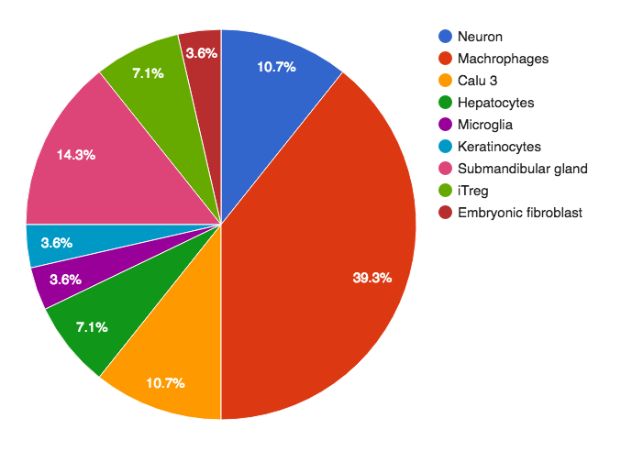
Gen3va report - IFNgamma
3
Total signatures: 28
Unique accessions: 13
Sample distribution per tissue
Tag:
http://amp.pharm.mssm.edu/gen3va/tag/IFNgamma
General Report:
http://amp.pharm.mssm.edu/gen3va/report/IFNgamma
Report by cell/tissue:
http://amp.pharm.mssm.edu/gen3va/report/291/IFNgamma
Notes:
Gen3va. The report you had asked for Interferon gamma has been available for a while.
you, but since these tend to get lost in a sea of other stuff. I just added here.

Slide 6
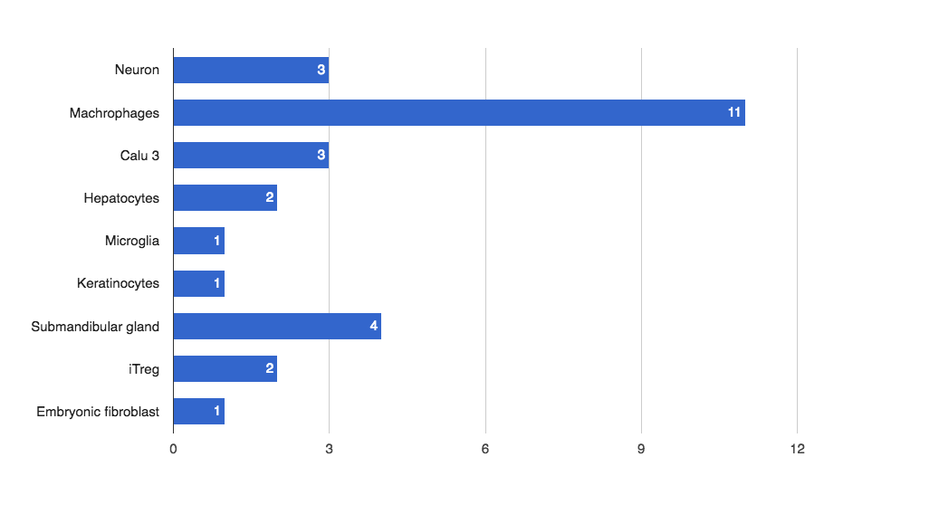
Tissue distribution:
Notes:
This is the tissue distribution on the tag.

Slide 7
Aging tags
4
 | Tag | Signatures
1 | AGING_BD2K_LINCS_DCIC_COURSERA | 244
2 | AGING_PHILLIP | 87
3 | AGING_M | 64
4 | AGING_BRAIN | 58
5 | AGING | 31
Disease
Duplicates
Surgery
-
Treated
Tumor
Fractures
Total signatures: 182
Unique accessions: 91
AG tag
Notes:
So we had 5 aging tags. I looked through all of them. Ignored the duplicates and then verified each signature and cleaned the metadata. Cleaned it up and subtracted the unrelated the unrelated conditions. The resulting signatures are in thia AG tag. With a total of 182 signatures from 91 accessions.
5 tags total : 485

Slide 8
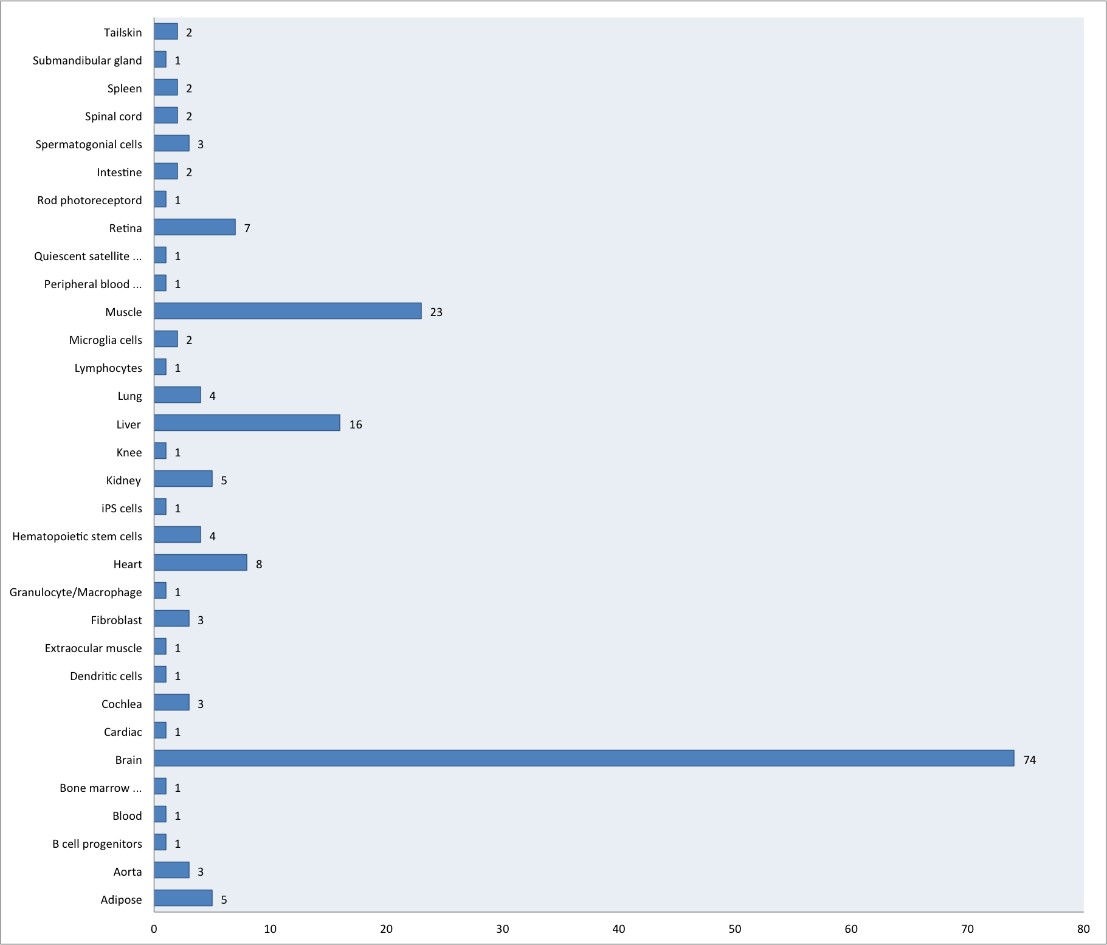
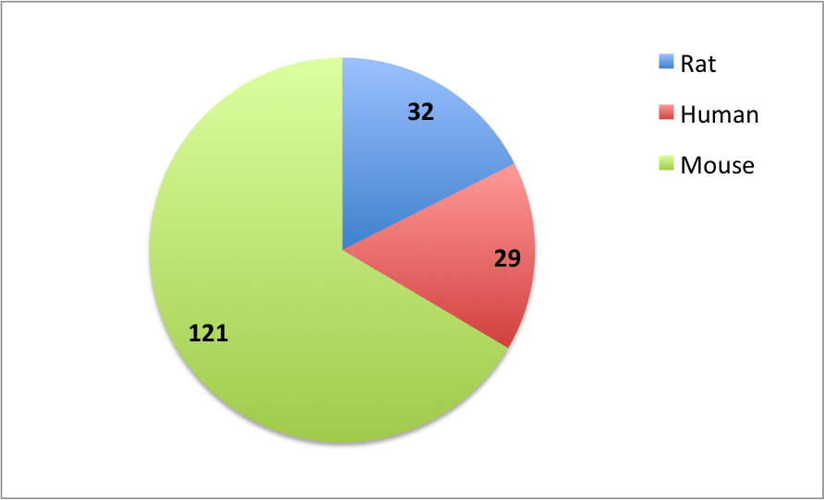
Notes:
Tissue and organism distribution on the tag.

Slide 9
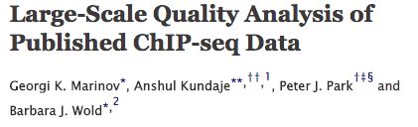
ChEA Update
5
Not added:
- Histones
- DNA polimerase
- Drug treated samples
- Immunoglobulins
- Multiple replicates
- Different organisms
> 900 Chip-seq samples
Notes:
The CHEA update grew a great deal after ALEX found this paper. With over 900 chip-seq samples listed. I went through each of them and the following were not added to our update.

Slide 10
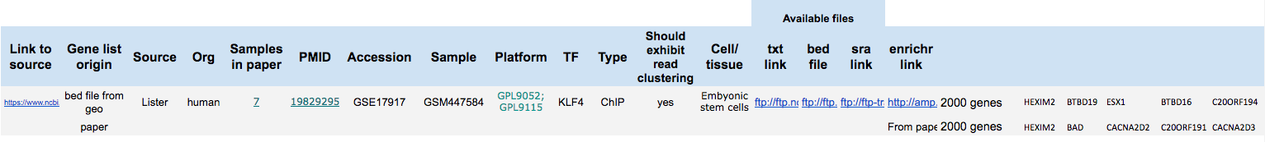
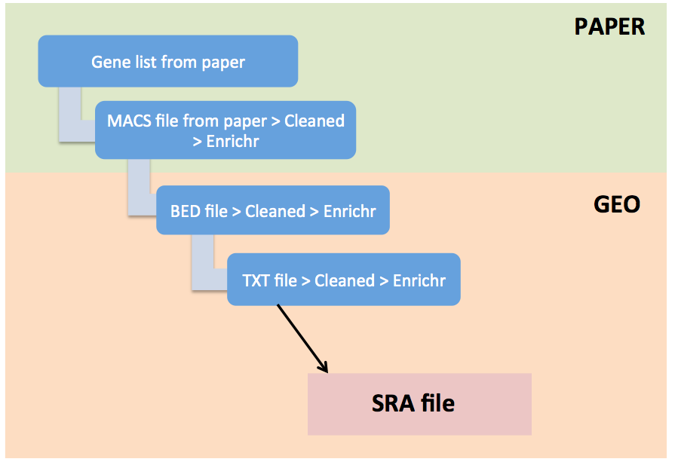
Multiple pubmed IDs Platform >> sample platform
Notes:
Then we ran into this issue with multiple platforms listed in one accession, so I went back and listed the platform for the specific sample.
If there was a file available in the paper and also a bed or txt file available in geo, both these lists have been added.
There is always a link to the sra file and if available to the bed and/ or txt file.
----
If list of alphabetically ordered ( full list is added )
List from paper
If list of alphabetically ordered ( full list is added )
MACS - Peak calling files, if not mapped to > cleaned > submitted to Enrichr from paper submitted to enrichr to map to genes
Bed file from Geo submitted to Enrichr (cleaned if necessary)
Txt file from Geo submitted to Enrichr (cleaned if necessary)

Slide 11
Extras
Lincsproject.org
6
Data mining course
Syllabus Needs update
“Box of goodies”
Last check : Nov - 11
- Gen3va
- GEO2Enrichr
- L1000CDS2
- Links
- Functions
Links
Tools
Center pages
Workflows
Publications
Marketplace links
Notes:
Just a couple of things:
The syllabus has or need to be updated.
And I put everything needed for the lab meeting and the course lectures in this box. Speakers, cable, extension cord.

Slide 12
Here is the new version of the Chip-seq update.
https://docs.google.com/spreadsheets/d/1oF-nq9lXcZKomwySLmIxTJ4TrLUCErOIQ4RRibP0XJU/edit?usp=sharing
Adding both tabs (phase1 & phase 2) there are a total of 517 entries and 247 different TF targets.
I was in doubt about a few (and didn't add them) so this number might change slightly.
Explanations:
First in the tab named Phase1: Are all the entries from the previous table, but the matrix has been transposed. This table is color coded for the chip-seq studies with 2000 gene lists, shorter gene lists and those with only sra files.
Next in the tab named Phase2: Are the chip-seq samples from the paper.
Notes:
The full chea library now has over 670 entries. But there is still 257 entries with only sra files available, all cleaned and organized that need to be aligned. But the metadata is ready.

Slide 13
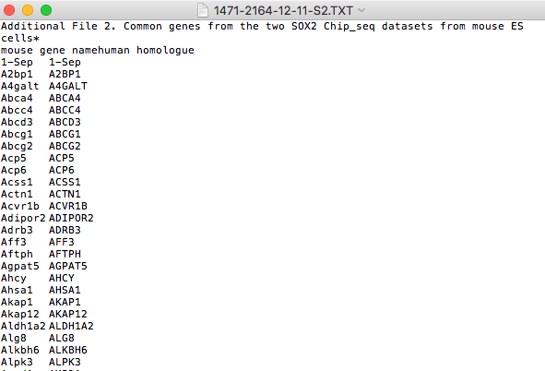
OBS
Notes:
And this just something i been meaning to bring up. Since its been fairly common with these files. And that is the EXCEL plague. This is just one of many, many examples.

Slide 14
ABout the CHEA
Missing org in a few

