Slide 1


Ma’ayan lab
Fibroblast to Dermal papilla

Slide 2
GEO search
Useful search results selected
L1000CDS²
Differentially expressed gene list uploaded
Gene signatures extracted with GEO2Enrichr
Mimic
Rank | 1-cos(α) | Perturbation | Perturbation LIFE URL | Perturbation PubChem URL | Perturbation DrugBank URL | Cell-line | Dose | Time | Signature URL
1 | 0.817 | BRD-K68548958 | http://life.ccs.miami.edu/life/summary?mode=SmallMolecule&source=BROAD&input=BRD-K68548958 | http://pubchem.ncbi.nlm.nih.gov/summary/summary.cgi?cid=1285940 | None | MCF7 | 20.0um | 24.0h | http://amp.pharm.mssm.edu/L1000CDS2/meta?sig_id=CPC006_MCF7_24H:BRD-K68548958:20.0
2 | 0.8208 | BRD-K67439147 | http://life.ccs.miami.edu/life/summary?mode=SmallMolecule&source=BROAD&input=BRD-K67439147 | http://pubchem.ncbi.nlm.nih.gov/summary/summary.cgi?cid=5311432 | None | MCF7 | 10.0um | 24.0h | http://amp.pharm.mssm.edu/L1000CDS2/meta?sig_id=CPC018_MCF7_24H:BRD-K67439147:10.0
3 | 0.8252 | Trifluridine | http://life.ccs.miami.edu/life/summary?mode=SmallMolecule&source=BROAD&input=BRD-K03243820 | http://pubchem.ncbi.nlm.nih.gov/summary/summary.cgi?cid=6256 | http://www.drugbank.ca/drugs/DB00432 | MCF7 | 10.0um | 24.0h | http://amp.pharm.mssm.edu/L1000CDS2/meta?sig_id=CPD003_MCF7_24H:BRD-K03243820:10.0

Slide 3
Drug perturbations predicted to mimic the different expression from the uploaded gene lists.
Perturbation | Total Hits in all conditions and organisms | Have hits in same study and organism | Multiple hits in same condition | Organism |  |  | Number of hits found in multiple conditions |  | Number of conditions across all studies with hits | Number of different studies
 |  |  |  | Mouse | Human | Human and Mouse | In Human Study | In Mouse Study
3544 | 1 | Y | N |  | X |  | N | N | 1 | 1
7061815 | 1 | Y | N | X |  |  | N | N | 1 | 1
4-Demethoxydaunorubicin hydrochloride (65) | 3 | Y | Y |  | X |  | N | N | 1 | 1
5-fluorouracil | 1 | Y | N |  | X |  | N | N | 1 | 1
A443654 | 6 | N | Y |  |  | X | 1 | 5 | 2 | 2
afatinib | 1 | Y | N |  | X |  | N | N | 1 | 1
AMIODARONE HYDROCHLORIDE | 1 | Y | N |  | X |  | N | N | 1 | 1
Angiogenesis Inhibitor | 1 | Y | N |  | X |  | N | N | 1 | 1
AZD-5438 | 2 | N | N |  |  | X | N | N | 1 | 2
AZD-8330 | 1 | Y | N | X |  |  | N | N | 1 | 1
BI-2536 | 1 | Y | N | X |  |  | N | N | 1 | 1
BJM-ctd2-9 | 1 | Y | N |  | X |  | N | N | 1 | 1
BRD-A10715913 | 1 | Y | N | X |  |  | N | N | 1 | 1
BRD-A30655177 | 1 | Y | N | X |  |  | N | N | 1 | 1
BRD-A35588707 | 1 | Y | N |  | X |  | N | N | 1 | 1
BRD-A36630025 | 3 | Y | Y |  | X |  | 3 | N | 1 | 1
BRD-A43155244 | 1 | Y | N | X |  |  | N | N | 1 | 1
Accession | GSE31324 | GSE31324 | GSE31324 | GDS1323 | GSE70288
G2E link | 142430a1f1 | ec6e63c2a5 | 163035b609 | d6679a5205 | 2ef250339b
Organism | human | human | human | mouse | mouse
3 unique GEO studies generated 5 gene signature entries to GEO2Enrichr.

Slide 4
Most commonly found drug perturbations

Slide 5
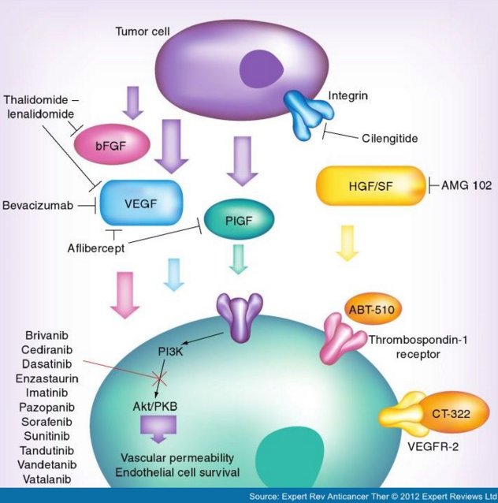
Dasatinib

Slide 6
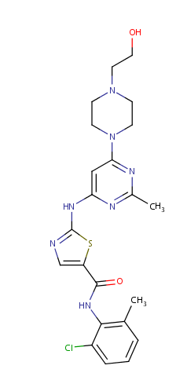
Mechanism of action | Inhibits kinases: BCR-ABL, SRC family (SRC, LCK, YES, FYN), c-KIT, EPHA2, and PDGFRβ. Based on modeling studies, is predicted to bind to multiple conformations of the ABL kinase. Was active (in vitro) in leukemic cell lines representing variants of imatinib mesylate sensitive and resistant disease.
Protein binding | 96%
Metabolism | Dasatinib is extensively metabolized in humans, primarily by the cytochrome P450 enzyme 3A4
Elimination | Primarily via the feces.
Half life | The overall mean terminal half-life is 3-5 hours.
http://www.drugbank.ca/drugs/DB01254

Slide 7
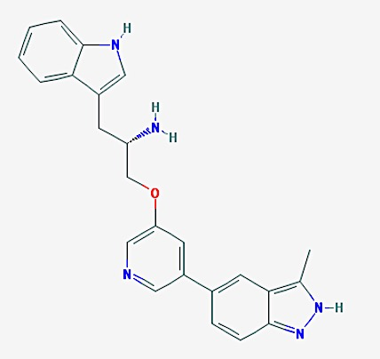
A443654
Experimental
Experimental Properties | NA
Predicted Properties | Property | Value | Source
 | Water Solubility | 0.00172 mg/mL | ALOGPS
 | logP | 3.72 | ALOGPS
 | logP | 3.07 | ChemAxon
 | logS | -5.4 | ALOGPS
 | pKa (Strongest Acidic) | 14.17 | ChemAxon
 | pKa (Strongest Basic) | 9.24 | ChemAxon
 | Physiological Charge | 1 | ChemAxon
 | Hydrogen Acceptor Count | 4 | ChemAxon
 | Hydrogen Donor Count | 3 | ChemAxon
 | Polar Surface Area | 92.61 Å2 | ChemAxon
 | Rotatable Bond Count | 6 | ChemAxon
 | Refractivity | 118.18 m3·mol-1 | ChemAxon
 | Polarizability | 44.51 Å3 | ChemAxon
 | Number of Rings | 5 | ChemAxon
 | Bioavailability | 1 | ChemAxon
 | Rule of Five | Yes | ChemAxon
 | Ghose Filter | Yes | ChemAxon
 | Veber's Rule | Yes | ChemAxon
 | MDDR-like Rule | Yes | ChemAxon
(2S)-1-(1H-INDOL-3-YL)-3-{[5-(3-METHYL-1H-INDAZOL-5-YL)PYRIDIN-3-YL]OXY}PROPAN-2-AMINE
http://www.drugbank.ca/drugs/DB08073

Slide 8
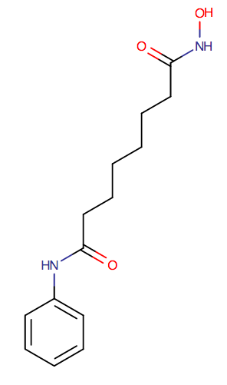
Vorinostat
Mechanism of action | Inhibits the enzymatic activity of histone deacetylases: HDAC1, HDAC2 and HDAC3 (Class I) and HDAC6 (Class II) at nanomolar concentrations (IC50< 86 nM). These enzymes catalyze the removal of acetyl groups from the lysine residues of histones proteins. In some cancer cells, there is an overexpression of HDACs, or an aberrant recruitment of HDACs to oncogenic transcription factors causing hypoacetylation of core nucleosomal histones. By inhibiting histone deacetylase, causes the accumulation of acetylated histones and induces cell cycle arrest and/or apoptosis of some transformed cells. The antineoplastic mechanism of vorinostat has not been fully characterized.
Protein binding | 71%
Metabolism | Involves glucuronidation and hydrolysis followed by β-oxidation.
Route of elimination | Predominantly through metabolism with less than 1% of the dose recovered as unchanged drug in urine
Half life | 2 hours
http://www.drugbank.ca/drugs/DB02546

