Slide 1
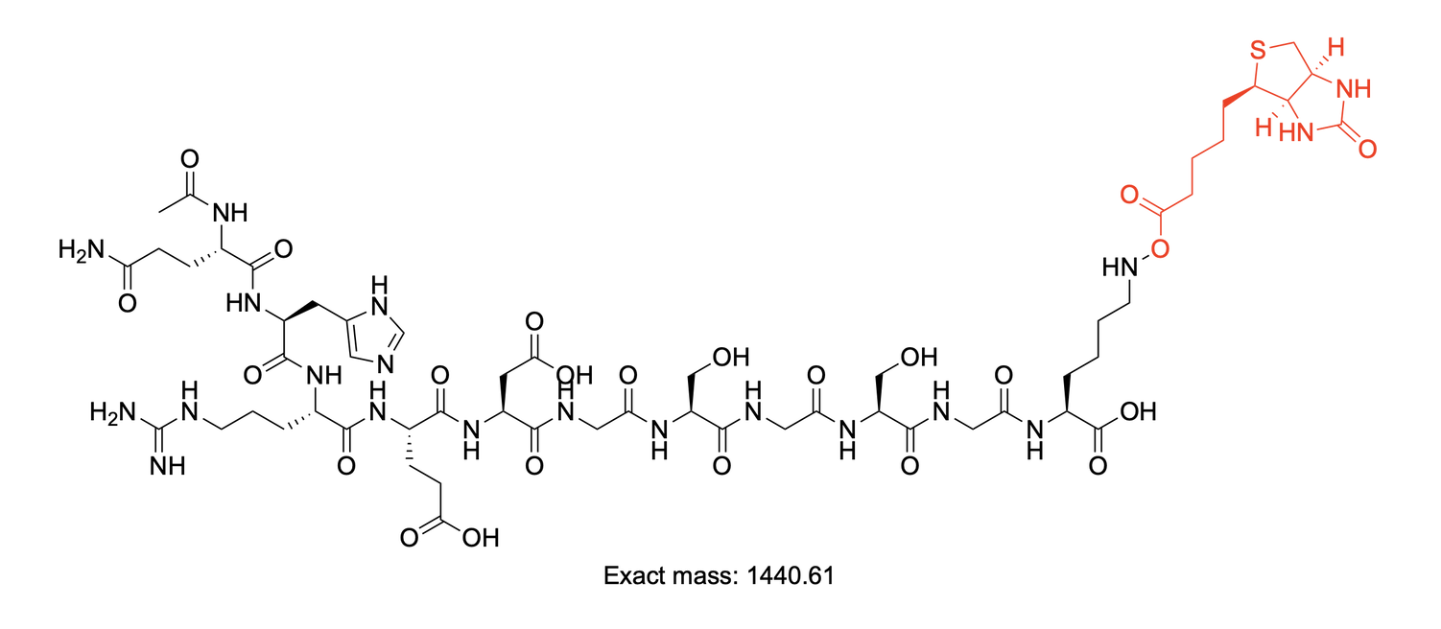
Q-peptide C-TAMRA-P1:
Q-peptide TAMRA-P1: Ac--Gln-His-Arg-Glu-Asp-Gly-Ser-Gly-Ser-Gly-Lys(TAMRA)--OH
A.
B.
+98% pure by Abs 214 nm integration
C.
Calculated (mono.) Observed Error, ppm
M 1610.67
M+H 1611.67
M+2H 1173.4951 1173.4989 3.2
M+3H 782.6658 782.6687 3.7
M+4H 587.2512 587.2538 4.4
E.
D.

Slide 2
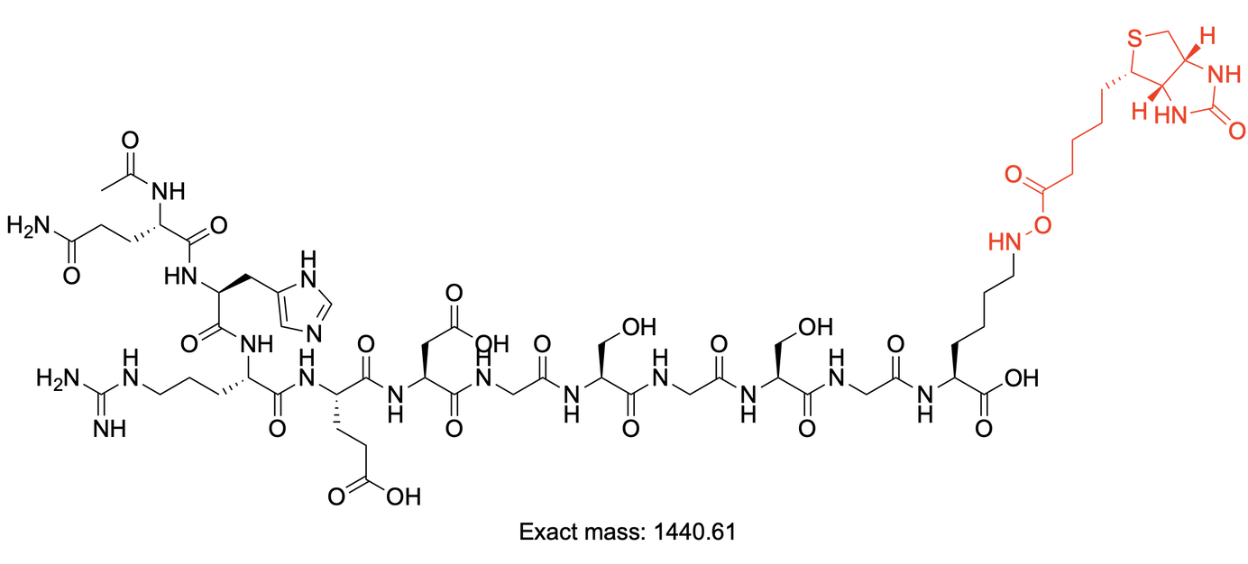
Scrambled Q-peptide C-TAMRA-P2:
Scrambled Q-peptide TAMRA-P2: : H--(TAMRA)Gly-Ser-Gly-Gln-His-Arg-Glu-Asp-Gly-Ser--OH
B.
A.
+98% pure by Abs 214 nm integration
C.
Calculated (mono.) Observed Error, ppm
M 2344.9756
M+H 2345.9829
M+2H 1173.4951 1173.4989 3.2
M+3H 782.6658 782.6687 3.7
M+4H 587.2512 587.2538 4.4
E.
D.

Slide 3
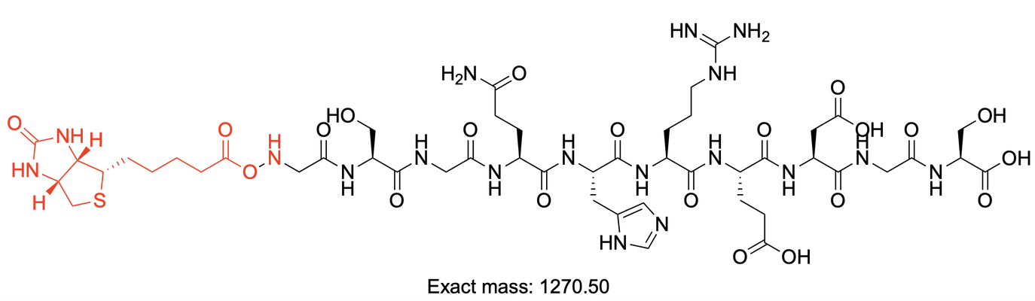
Q-peptide N-TAMRA-P3:
A.
Noncanonical peptide 2: H--Gly-Ser-Gly-Gln-His-Arg-Glu-Asp-Gly-Ser--OH
B.
+98% pure by Abs 214 nm integration
C.
Calculated (mono.) Observed Error, ppm
M 2344.9756
M+H 2345.9829
M+2H 1173.4951 1173.4989 3.2
M+3H 782.6658 782.6687 3.7
M+4H 587.2512 587.2538 4.4
E.
D.

Slide 4
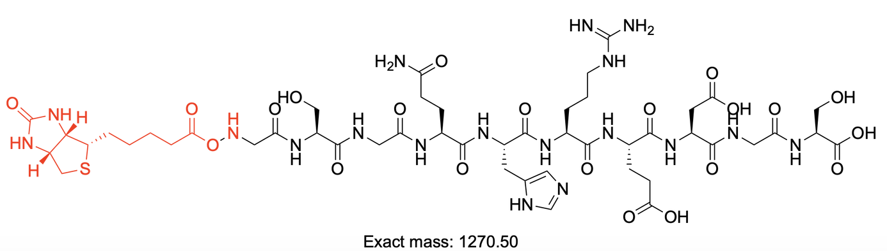
Scrambled Q-peptide N-TAMRA-P4:
A.
Noncanonical peptide 2: giibmDpoDYAiK
(Thp)(Tha)(Tha)(Aib)(3fF)D(hCit)(hArg)DYA(Tha)KSGGK(Biotin)
B.
+98% pure by Abs 214 nm integration
C.
Calculated (mono.) Observed Error, ppm
M 2344.9756
M+H 2345.9829
M+2H 1173.4951 1173.4989 3.2
M+3H 782.6658 782.6687 3.7
M+4H 587.2512 587.2538 4.4
E.
D.

Slide 5
Quick Template
Screenshots, but you must save and backup your data
Noncanonical peptide 2: giibmDpoDYAiK
(Thp)(Tha)(Tha)(Aib)(3fF)D(hCit)(hArg)DYA(Tha)KSGGK(Biotin)
Optional, if no HPLC, show the TIC (mass chromatogram)
+98% pure by Abs 214 nm integration
M+4H
M+3H
M+2H
Calculated (mono.) Observed Error, ppm
M 2344.9756
M+H 2345.9829
M+2H 1173.4951 1173.4989 3.2
M+3H 782.6658 782.6687 3.7
M+4H 587.2512 587.2538 4.4

Slide 6
A.
Canonical peptide 21: WAPDYLANLGDE
WAPDYLANLGDEKSGGK(Biotin)
B.
95% pure by Abs 214 nm integration
C.
Calculated Observed Error, ppm
M 2851.2340
M+H 2852.2413
M+2H 1426.6243 1426.6259 1.1
M+3H 951.4186 951.4210 2.5
M+4H 713.8158 713.8177 2.7
E.
D.

