Slide 1

Can a fast calculation tell us which peptides to make?
Publication direction
October 2026
Carlos Liu
PhD Student, Leslie Dan Faculty of Pharmacy
Supervisor: Joseph S Brown
University of Toronto

Slide 2
The problem: we can design hundreds, but only make a handful
Design is cheap now. Synthesis is not.
  We have 212 designed peptides against LptA. Non-canonical building blocks cost on the order of $1000 each, so the real question is which ten to make.
So we need a way to rank them before committing
  Not a prediction of the binding constant — just a reliable answer to “of these two, which one binds tighter?”
The honest starting point: nobody has shown this works for peptides
  Most published validation is on small drug-like molecules. Macrocyclic peptides are bigger, floppier, and sit in shallower sites. Whether the usual tools transfer is an open question — and that is the gap this work fills.
212
~10
designed peptides in hand
we can realistically make
Three branches: 20 canonical de novo designs, 96 non-canonical swaps on those parents, and 96 non-canonical swaps on a thanatin derivative with a known co-crystal structure.

Slide 3
What the calculation actually does, in one slide
MM/PBSA — the fast option we are testing
  Take the structure of the peptide sitting in the protein's binding site. Relax it briefly. Add up the physical interaction energy between them — electrostatics and van der Waals — then subtract the energy cost of stripping water off both surfaces to let them touch. One structure, one number, a few minutes per peptide.
FEP+ — the gold standard we compare against
  Gradually morphs one peptide into another inside a full simulation and tracks the free energy as it goes. This is the rigorous answer. It costs GPU-days per compound and needs a commercial licence.
The trade is roughly a thousand-fold in cost. The question is what we give up.
MM/PBSA protocol replicated from Zhao et al., Briefings in Bioinformatics 2025;26(6):bbaf632. We did not invent it — we are testing whether it transfers to peptides.

Slide 4
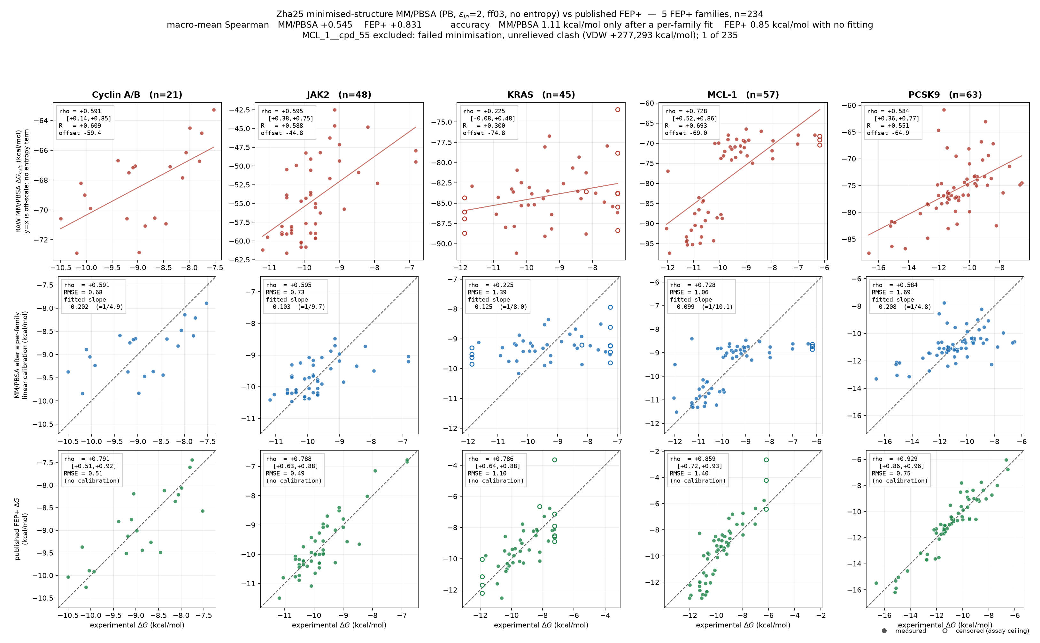
We tested it on 234 peptides where the answer was already known
A published benchmark, not our own data
  Awoonor-Williams et al. 2026 measured binding for >230 macrocyclic peptides and peptide-like compounds across five proteins, and published FEP+ predictions alongside.
  Cyclin A/B, JAK2, KRAS, MCL-1, PCSK9
Why this cohort is the right one
  Measured affinities we did not generate, so we cannot fool ourselves. And their FEP+ numbers give us a ceiling for free — we know what the expensive method achieves on exactly these compounds.
Everything that follows is on these 234.
Awoonor-Williams E, Beautrait A, Petridis L, Hu X. J Chem Inf Model 2026;66(14):8545. PMID 42396675. Each column is one protein; each point one peptide.

Slide 5
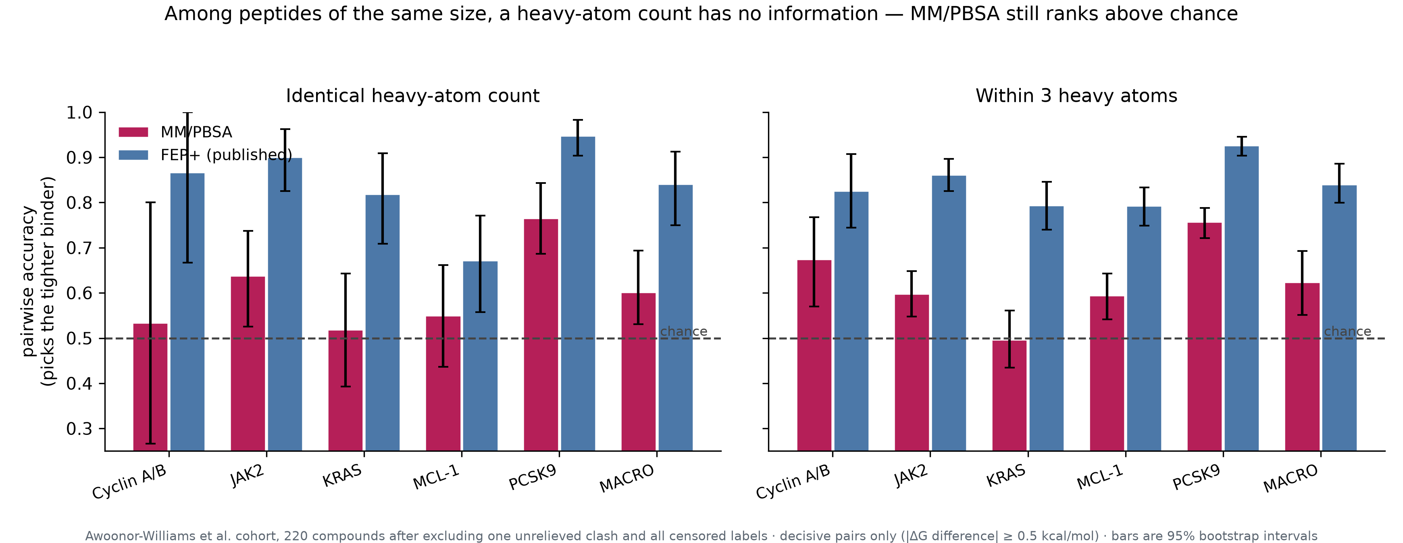
The sharp test: can it tell apart peptides of the same size?
Bigger peptides bind tighter — that is real physics, and it is a trap for benchmarking
  More atoms bury more surface, so almost any method looks good if you let size vary. To know whether the physics adds anything, we compare only peptides of the same heavy-atom count, where size cannot possibly be the thing doing the work.
  The measure is simple: hand it two peptides whose affinities genuinely differ, ask which is tighter. A coin gets 50%.
Decisive pairs only (affinities differing by ≥ 0.5 kcal/mol). Bars are 95% bootstrap intervals. A heavy-atom count has no information at all in the left panel — the sizes are equal — which is exactly why this is the honest comparison.

Slide 6
It works, modestly, and we can say exactly how much
Among peptides matched on size
  Within a 3-atom window MM/PBSA picks the tighter binder 62.4% of the time, 95% CI [55.5, 68.9] — the interval clears chance.
  At exactly equal size the estimate is 62.4% but the interval [47.2, 72.0] includes chance: too few same-size pairs exist.
But it is concentrated, and we should say so
  Only PCSK9 (75.7%) is individually above chance. Cyclin A/B, JAK2, KRAS and MCL-1 all span 50% once intervals resample compounds rather than pairs.
So: a cheap triage filter with measurable but uneven skill — not a replacement for rigorous free-energy calculation.
62.4%
83.9%
MM/PBSA, size-matched
95% CI [55.5, 68.9]
FEP+, same pairs
1 of 5
~1000×
proteins individually
above chance
cheaper than FEP+
Macro average weights each protein equally. Bootstrap over proteins for the macro interval, over pairs within each protein.

Slide 7
What the paper claims — and what it deliberately does not
The claim
  On the first published macrocyclic-peptide benchmark with measured affinities and a matched FEP+ reference, end-point MM/PBSA retains genuine size-independent ranking skill — 60% pairwise accuracy among identically sized peptides — at roughly a thousandth of the cost, with the skill concentrated in polar interfaces.
What we do not claim
  Not a predictor of binding constants. With entropy omitted the raw score sits 45–75 kcal/mol off experiment, and matching the experimental scale needs compounds already measured in that series.
  Not uniform across proteins. Three of five show no demonstrable size-free skill.
Why it is publishable
  The size-matched comparison is the control nobody runs, and it is the only way to show the physics is contributing rather than re-reading molecular weight. That framing, plus a matched FEP+ ceiling on the same compounds, is the contribution.
Cohort, protocol, and every statistic are reproducible from published data plus our deposited scripts.

Slide 8
Next: a prospective test on one of our own targets
Everything above is retrospective — compounds already measured by someone else
  The strongest version of this paper adds one forward test: rank a set of our designs before any measurement, then measure them.
What would make that test count
  Rankings registered and frozen before assay — no adjustment afterwards.
  Designs spanning the predicted range, not just the predicted winners, so the comparison has somewhere to fail.
  Ideally same-size analogues, which is the regime where we have shown the method has skill — single-residue swaps on a fixed scaffold are exactly that.
Roughly 8–12 compounds is enough to tell a real ranking from a coin flip.
  That is the experiment I would like your view on — which target, and what is realistic to measure.
A frozen prospective prediction converts this from a benchmark study into a method validation, and it is the figure reviewers will look for first.

