Slide 1

What the MM/PBSA oracle actually predicts — and what we can publish
Project review
October 2026
Carlos Liu
PhD Student, Leslie Dan Faculty of Pharmacy
Supervisor: Joseph S Brown
University of Toronto

Slide 2
First correction: the 0.6 is Pearson r, not R²
The parity figure's “R =” box is a correlation, not a coefficient of determination
  Per target: 0.609, 0.588, 0.300, 0.693, 0.551
  Mean Pearson r = 0.548 → R² = 0.318
  Mean Spearman ρ = 0.545
For comparison, the FEP+ values published with the same compounds
  Pearson r = 0.845 → R² = 0.719
Worth fixing now rather than in review — it is a two-fold difference in how the result reads.
0.55
0.32
mean Pearson r, MM/PBSA
mean R², MM/PBSA
0.85
0.72
mean Pearson r, FEP+
mean R², FEP+
Per-family statistics: grand_results/zha25_fepplus_perfamily_parity_stats.csv

Slide 3
What the oracle is: one minimised structure, scored
A replication of Zhao et al. 2025, not a new method
  Fine-tuned MM/PBSA for protein–cyclic-peptide complexes: energy-minimise once, score that single structure. Not an MD ensemble — that is their design, not our shortcut.
  ff03 protein, GAFF2 + AM1-BCC ligand, PB with interior dielectric 2, LCPO nonpolar, no entropy term.
Because entropy is omitted, the raw score is not a free energy
  It sits 45–75 kcal/mol below experimental ΔG, and the per-target fitted slope is 0.10–0.21 — ΔΔG spread inflated five- to tenfold.
  The 1.11 kcal/mol accuracy figure is achievable only after fitting slope and intercept within a target, which needs measured compounds in that series. It is not a prospective accuracy.
So the honest framing is a ranking device, not a predictor of affinity.
Zhao H, Huang J, Weng G, Jiang D, Hu R, Kang Y, Hou T. Briefings in Bioinformatics 2025;26(6):bbaf632. doi:10.1093/bib/bbaf632

Slide 4
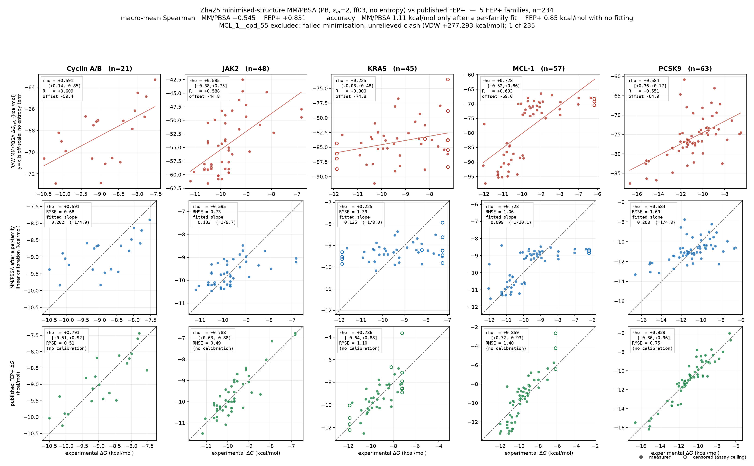
Validated on 234 macrocycles from Awoonor-Williams et al.
Five targets, one published source
  Cyclin A/B (21), JAK2 (48), KRAS (45), MCL-1 (57), PCSK9 (63)
  234 compounds with measured ΔG, 8 receptor crystal forms
Their FEP+ predictions are our ceiling
  Same compounds, published alongside the affinities — so we get a like-for-like comparator for free.
One exclusion
  MCL_1__cpd_55 carried an unrelieved clash (VDW +277,293 kcal/mol) and passed the pipeline's own status check. Screening on VDW > 0 is now mandatory.
Awoonor-Williams E, Beautrait A, Petridis L, Hu X. Derisking Affinity Optimization for Macrocycles and Cyclic Peptides. J Chem Inf Model 2026;66(14):8545. PMID 42396675

Slide 5
How you average decides what the answer is
Pooling compounds from different receptor structures inflates the result
  KRAS is the clean case: its 45 compounds span two crystal forms, 7YUZ and 8JJS
MM/PBSA Spearman ρ on KRAS
  within 7YUZ (n=17) −0.307 within 8JJS (n=28) +0.046
  macro over forms −0.130 pooled over both +0.225
The score is offset −3.05 kcal/mol between the forms, in the same direction as a −1.15 kcal/mol offset in the measured labels.
So the pooled value is credit for separating two groups, not for ranking inside either.
+0.225
−0.130
KRAS pooled across its two crystal forms
KRAS averaged within each form
FEP+ is far less affected on the same split: +0.679 macro against +0.786 pooled, as expected of a method whose signal is not a group offset.

Slide 6
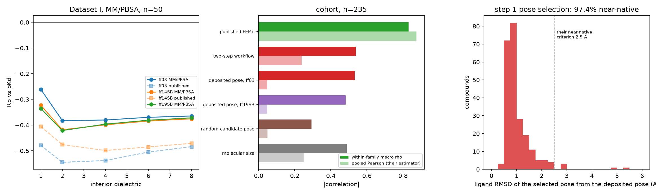
Conditioned on receptor, it loses to a heavy-atom count
Macro Spearman ρ on the same 234 compounds
  Published FEP+ 0.831 pooled in-family · 0.805 within receptor
  Zha25 MM/PBSA 0.545 · 0.459
  Heavy-atom count 0.488 · 0.613
MM/PBSA minus size = −0.164, 95% CI [−0.299, −0.026], cluster bootstrap over 8 receptor groups. Partialling out size, four of five targets collapse to CIs including zero — only PCSK9 keeps skill (0.606 [0.413, 0.758]), the most polar interface.
Any reviewer will run this control. The paper cannot claim a predictive affinity oracle while it stands.

Slide 7
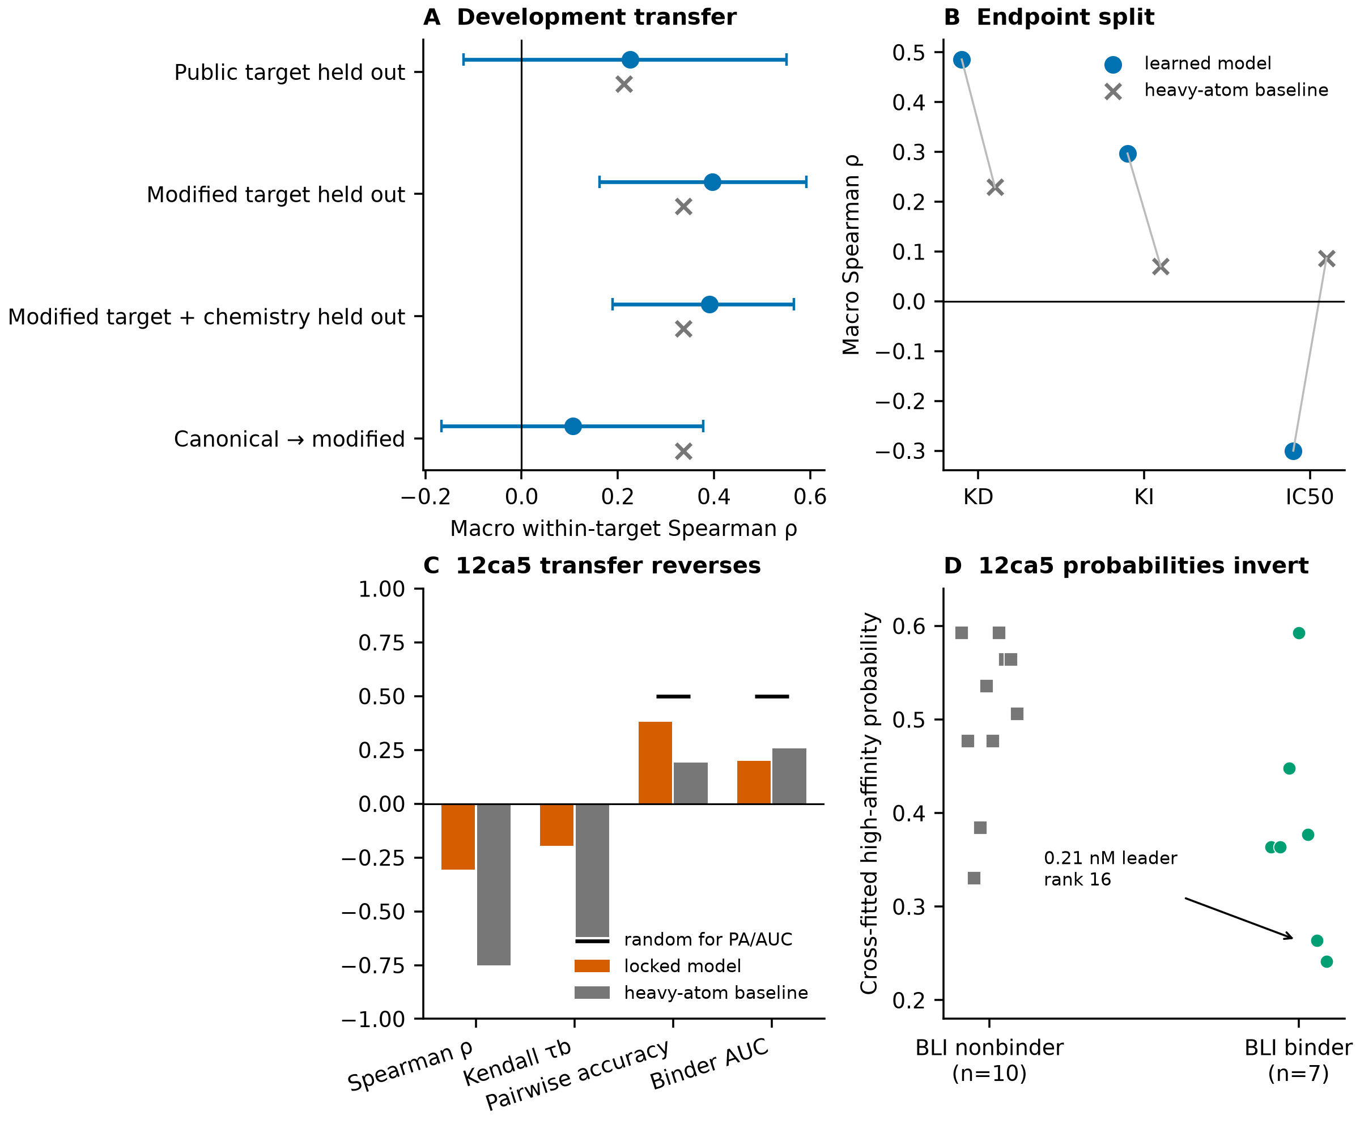
Hold-one-protein-out is already measured: ρ 0.22–0.40
Panel A, four held-out designs
  Public target held out: 0.22 [−0.13, +0.56] — the heavy-atom baseline (0.33) beats it
  Modified target held out: 0.40 [+0.16, +0.59] vs 0.33
  Modified target + chemistry: 0.39 [+0.19, +0.57] vs 0.29
  Canonical → modified: 0.11 [−0.17, +0.38] vs 0.33
So the held-out number is roughly half the headline
  0.22–0.40, not 0.55 — and the wide CIs come from having only a handful of targets to hold out.
  Panel B: it works on KD (0.48), weakens on Ki (0.29), inverts on IC50 (−0.30).
grand_results/target_held_out_to_12ca5_transfer.png · macro within-target Spearman, learned model with CI (blue) against the heavy-atom baseline (grey).

Slide 8
And on a sixth protein never used in development, it reversed
12CA5 anti-HA antibody, 17 peptidomimetics, BLI: 7 binders (0.21–77 nM) and 10 non-binders
  Sealed before prediction. Max training-target similarity 0.081 — genuinely out of domain.
Every zero-shot method landed on the wrong side of random
  Heavy atoms ρ = −0.750 on the binders (benchmark: +0.49 to +0.61). The size prior does not weaken — it inverts.
  Locked model ρ = −0.306; binder AUC 0.20; the 0.21 nM leader ranked 16 of 17; top-5 overlap zero for every method.
  MM/PBSA could not even score it: 3 of 17 clashed out (VDW > 0), one had no score, and pose quality explained the rest (ρ = −0.891 against clash count).
The known D-Y-A epitope motif classifies the same panel at 88% (Fisher p = 0.0037).
A one-line rule from decades-old epitope mapping beats every physics and ML arm we ran.

Slide 9
What I think we publish, and when
The defensible paper is a methods paper, not an oracle paper
  “End-point MM/PBSA on macrocyclic peptides does not beat a heavy-atom count once conditioned on receptor, and its apparent performance depends on the estimator.” That is well-evidenced, useful, and ours.
Draw the retrospective line at the Awoonor-Williams cohort
  234 compounds, 5 targets, one citable source, published FEP+ as ceiling. Adding the in-house KRAS / IL23R / Rosetta material brings heterogeneous provenance and far more development exposure for no gain in strength.
Hold-one-protein-out is necessary but will overestimate — and we can prove it
  The five targets are congeneric series against folded pockets from one industrial campaign; they resemble each other more than a new target. Held-out gives 0.22–0.40, 12CA5 gives negative. That contrast is the paper's most valuable figure.
LptA: run it for the programme, do not gate the paper on it.
Open question for discussion: is the claim narrow enough that we can submit without new wet-lab data, and do we want 12CA5 as the headline or as a limitation?

