Slide 1
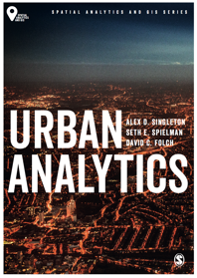
Introducing Urban Models
Alex D Singleton, Seth E Spielman, David C Folch (2017) Urban Analytics. London: Sage.

Slide 2
Learning Objectives
Models can be descriptive, predictive, or explanatory.
Exploratory data analysis can help uncover meaningful patterns in data, which can in turn help guide model development.
Regression is a exible tool for helping to understand complex relationships within cities.

Slide 3
Explaining Cities
There are a variety of strategies to explain what is happening within cities through developing and testing hypotheses.
A model is a mathematical representation of some real-world phenomenon.
all models are wrong, but some are useful.

Slide 4
Example: Simple Gravity Model
Understand the economic, social, and migratory attraction between two locations
F_{ij} = G(m_{i} m_{j} / d²_{ij})
m_{i}
m_{j}
d²_{ij}

Slide 5
From data to models
Data are a set of observations, with each observation containing attributes.
An observation is the organizing unit for the inputs to a model.
An attribute is a characteristic of the observation.

Slide 6

From data to models
The nature of a crime, policing, and location are all examples of attributes that might be collected by the police
Source: Pixabay (CC0 Public Domain)

Slide 7
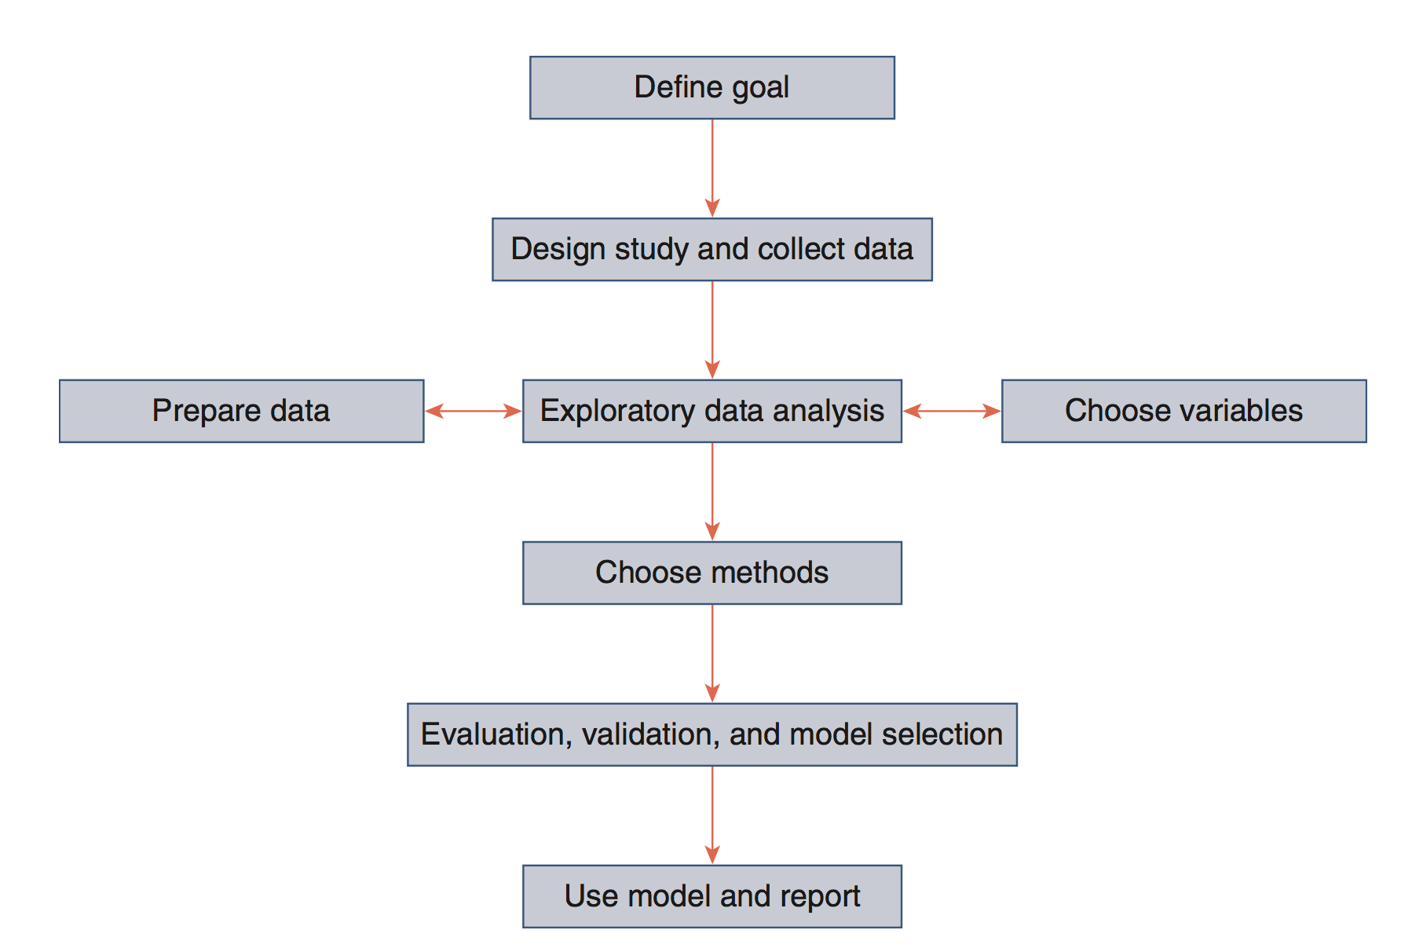
Modeling
Modeling Flowchart Source: Authors’ own, but based on Shmueli (2010)

Slide 8
Modeling Goals
Three research goals that underlie most modeling efforts
Description - summarizing large amounts of data into meaningful statistics and computing basic relationships between variables
Prediction - predict the values of attributes that we do not have
Explanation - Explain the relationships between variables, that is, to test causal relationships

Slide 9
Descriptive Analysis
Developing procedures to clean a dataset and identify missing data and erroneous attributes is a critical early step in an analysis.
Problem data
Missing data
Distinction between values that are “missing” or “zero.”
Extraordinary data values, called outliers, can be real or erroneous.
In general outliers should only be removed when they are the result of measurement error since “unexpected” findings are not necessarily wrong.
Median is often a useful measure of central tendency when outliers are present

Slide 10
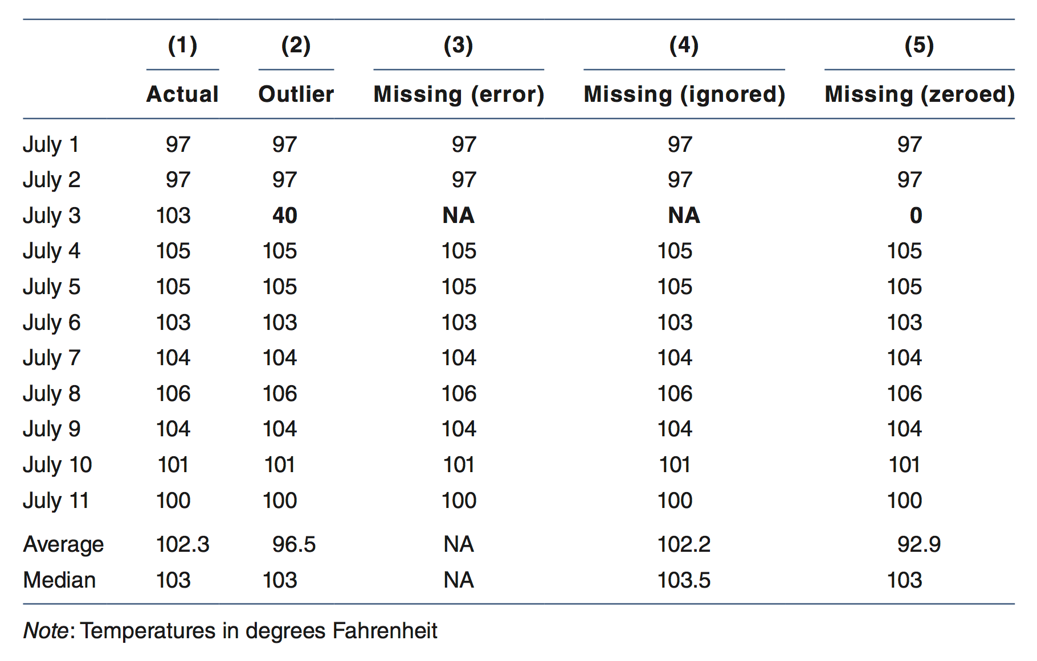
Missing Values
Outliers and missing data can cause problems when modeling data

Slide 11
Exploratory Data Analysis
Identification of patterns via data visualization
Two common univariate data distribution visualizations
Histograms
A specialized bar chart that shows the shape of the distribution.
The width of each bar represents the size of the class interval
Box Plot
A visual representation of five key points in a distribution: the minimum, 25th percentile, median, 75th percentile, and maximum. The “box” highlights the interquartile range (IQR), with a line through the box marking the median

Slide 12
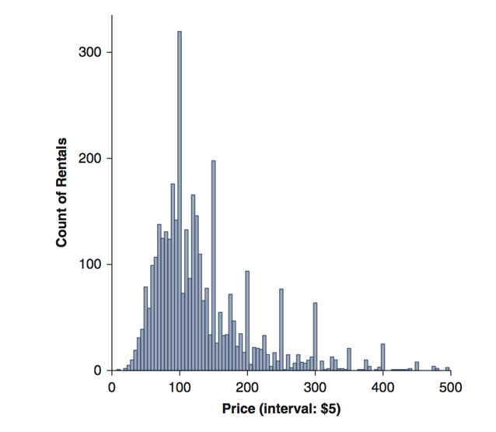
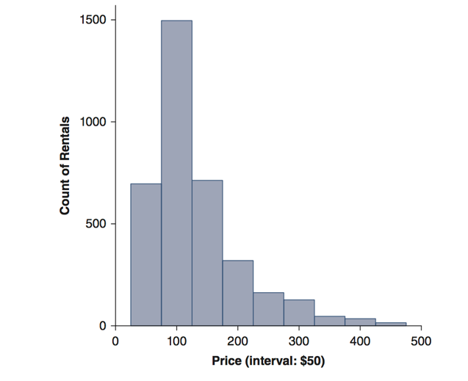
Histogram
Histograms of Airbnb prices in Washington, DC

Slide 13
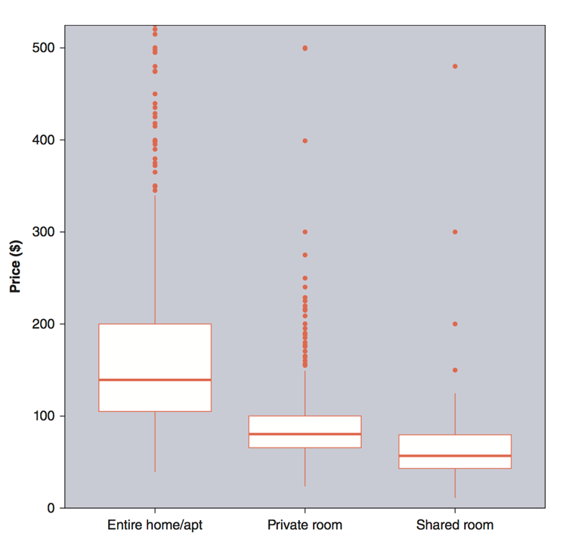
Box Plot
Boxplots of Airbnb prices in Washington, DC

Slide 14
Conclusion
Modeling has various meanings; ranging in complexity and what the aims of analysis are trying to show
A model is a mathematically representation of some real world phenomenon
Exploratory data analysis is a useful first step when getting to know your data
Have to be cautious of outlier and missing values
Visualization can be helpful when describing characteristics of your data

