Slide 1
NFL STATISTICS THAT WILL NOT HELP YOU IN FANTASY FOOTBALL
Vidusha Rao
Institute for Advanced Analytics, NC State University
Carolina Data Challenge 2020
10/04/2020
Notes:
Hello everyone, my name is Vidusha Rao. I am a student at the Institute for Advanced Analytics, and I will be talking about NFL data and statistics that will not help you win Fantasy Football.

Slide 2
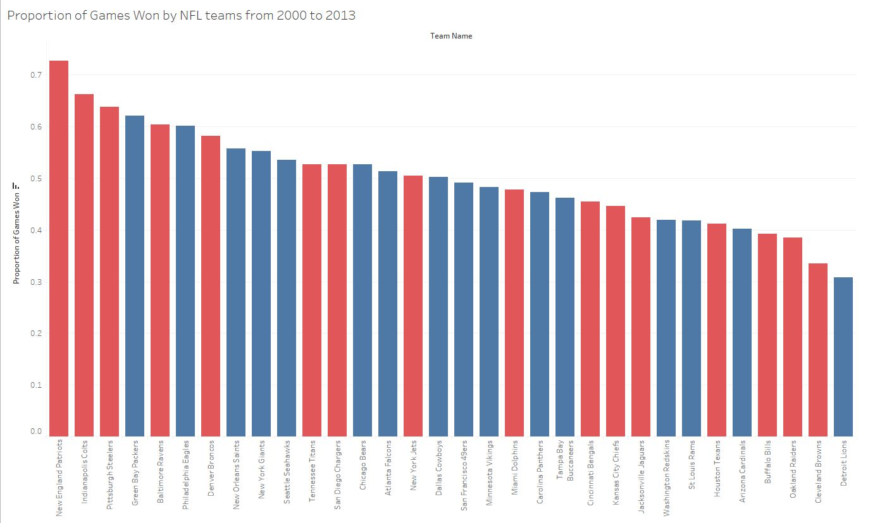
THE PATRIOTS ARE THE NFL
Notes:
The first thing that needs to be said is that from 2000 to 2013, the New England Patriots had a 73% Win Percentage.
That is nuts. I am by no means a Patriots fan and I am definitely not a Tom Brady fan, but I have to respect the fact that they know how to win.
I feel gross hyping up the Patriots but as an aspiring data scientist I have represent my findings honestly.

Slide 3

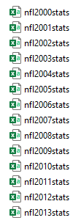
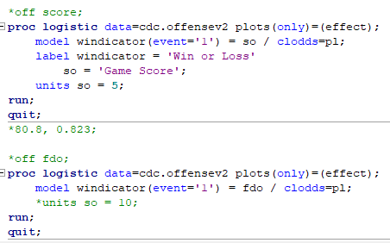
SHOW ME THE DATA
14 data sets → 1 large data set
7156 observations
30 variables → 13 variables
Variables related to Offense
Notes:
On to the data. The NFL data set I worked with, after combining all the data sets, had 7156 observations and 31 variables and spanned 14 seasons.
I then ordered the data by seasons and filtered out variables that were not relevant to statistics related to Offense (leaving me with 13 variables).
Even though Defense wins championships, I filtered out the Defense-related data as there would be a high degree of alignment with the other teams’ Offense data.
I then grouped the data by season, then by team, and then completed logistic regression analysis on the variables.

Slide 4


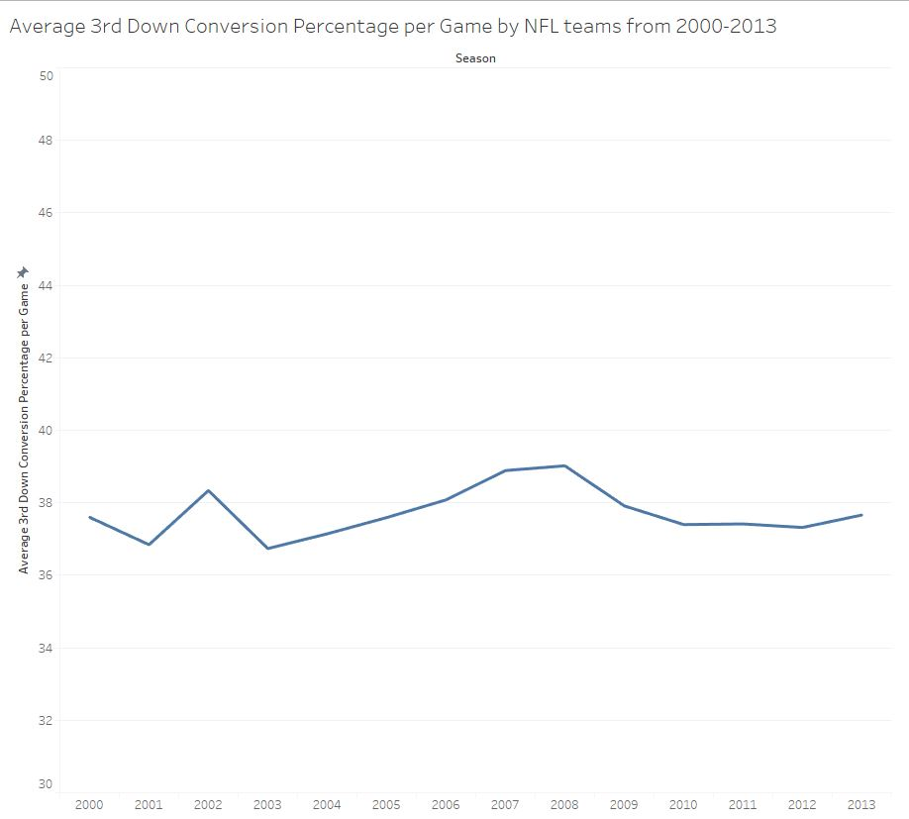
YA LIKE LINES?
No noticeable change in the average 3rd Down Conversion Percentage over the 14-season time frame
Notes:
For the season grouping, I looked for trends over time for different variables.
Some variables showed a positive trend, some showed a negative trend, and some showed trends flatter than the footballs that were used during Deflate-Gate.
3rd Down Conversion Percentages stayed relatively consistent over the 14-year time frame.
It seems that clutch situations have not been improved upon during this time period.

Slide 5
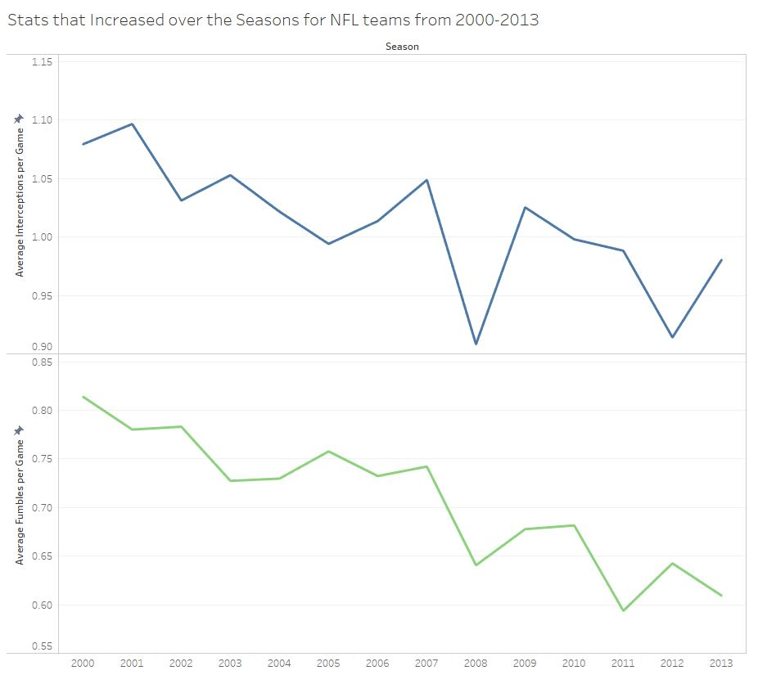
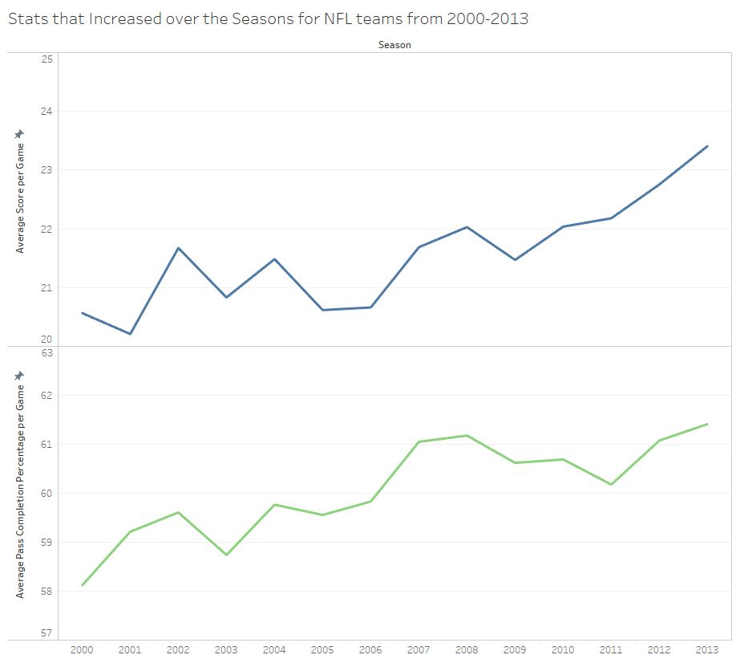
BY-SEASON ANALYSIS CONTINUED
Notes:
Average Fumbles per Game and Average Interceptions per Game showed a visible decline over the 14 seasons.
Average Score per Game and Average Pass Completion Percentage per Game both showed increased over the time frame.
My best guesses for explaining these patterns are:
Offenses became more structured and organized, which helped to minimize the errors made and improve upon the amount of successful plays
Defenses have been deteriorating in quality over time and cannot keep up with Offense-related skills
These guesses come from a guy who spends more time coding about the NFL than actually watching it, so who knows what the actual reasons are.

Slide 6
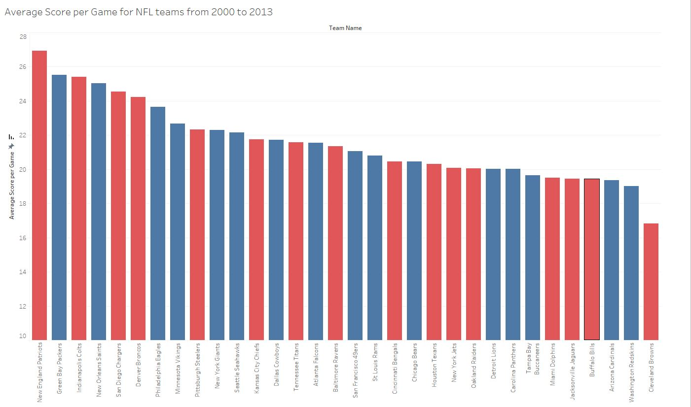
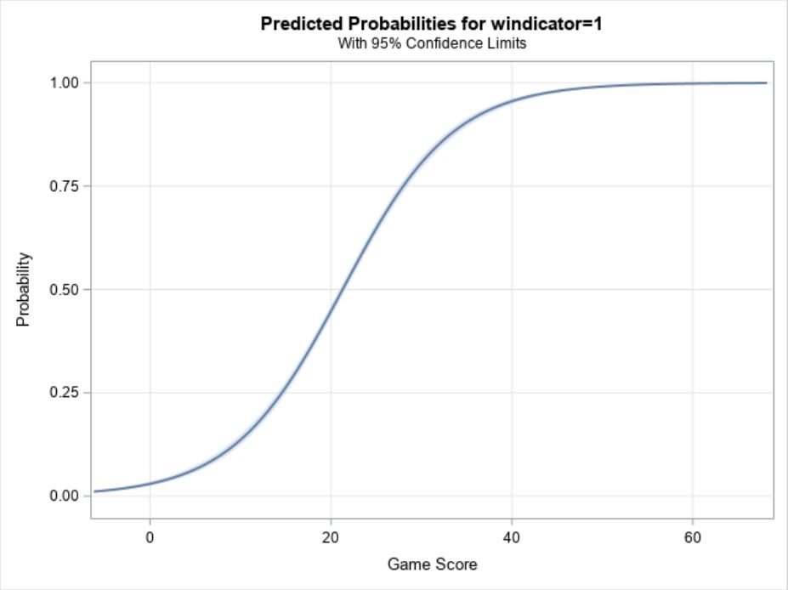
LOOK AT THOSE CURVES
New England Patriots – 27 points
Cleveland Browns – 17 points
Notes:
Next, I will show you the wonderful world of bar graphs and logistic regression.
The first graph shows the Average Score per Game for all the NFL teams (Red teams belong to the AFC, blue to the NFC) along with the logistic regression plot.
Higher scores have higher predicted probabilities of winning, but having more points does not guarantee a win.
If the opposing team scores more points, you lose the game, regardless of how much you scored.

Slide 7
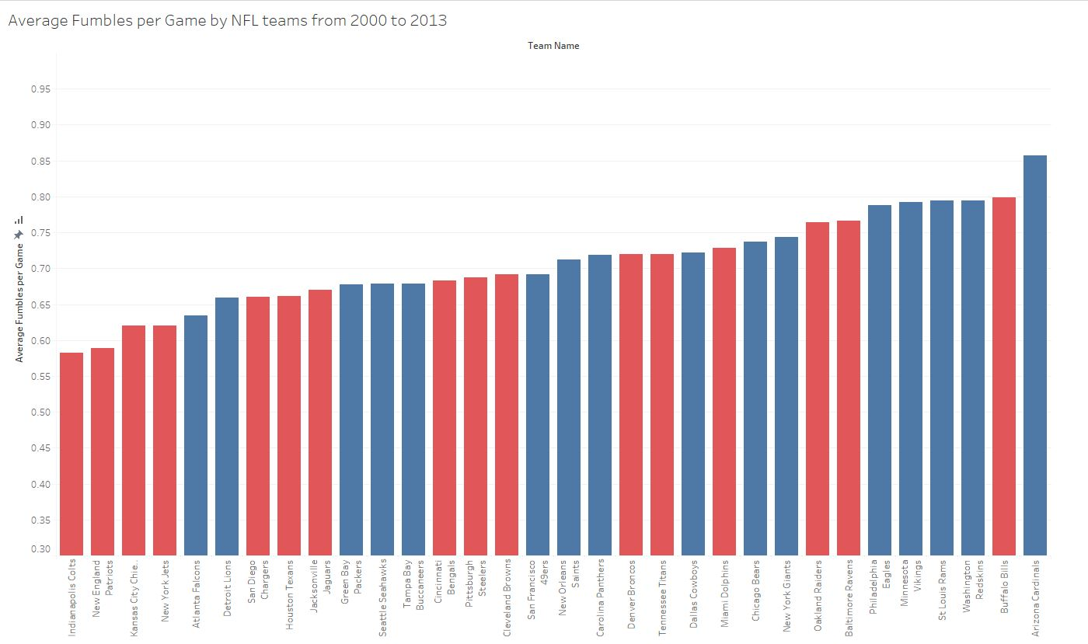
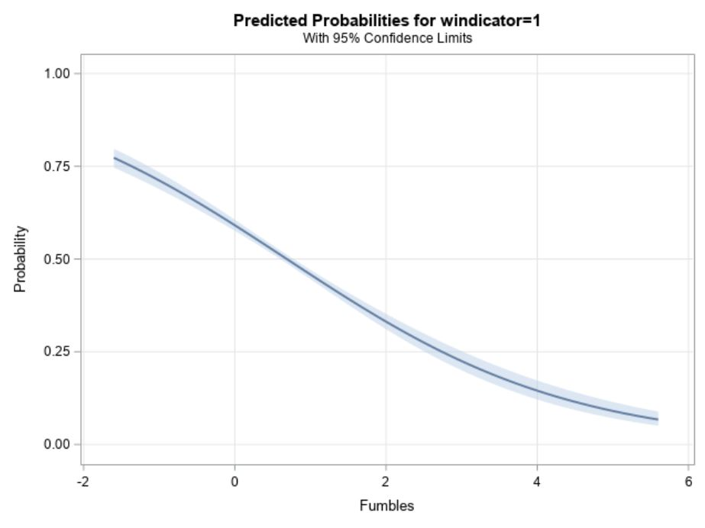
LOGISTIC REGRESSION CONTINUED
Indianapolis Colts – 0.58 Fumbles per Game
Arizona Cardinals – 0.85 Fumbles per Game
Notes:
Here is an example of a negative relationship with fumbles.
The predicted probabilities of winning the game decrease as the number of fumbles per game increases.

Slide 8
RANKINGS
Offense Score | New England | 29.94
First Downs per Game | New England | 21.58
3rd Down Percentage per Game | Indianapolis Colts | 44.33
Rush Yards per Game | Denver Broncos | 132.12
Yards Per Rush | Minnesota Vikings | 4.67
Pass Yards per Game | New Orleans Saints | 269.41
Pass Completion Percent per Game | Indianapolis Colts | 64.02
Yards Per Pass | Pittsburgh Steelers | 12.15
Interceptions per Game | New England Patriots | 0.75
Fumbles per Game | Indianapolis Colts | 0.58
Overall Win Proportion | New England Patriots | 0.73
Top performers for each variable
Notes:
This slide shows which team had the best average for each variable.
As you can see, New England hogs the leaderboard as they have the top stats for 4 out of the 11 variables.

Slide 9


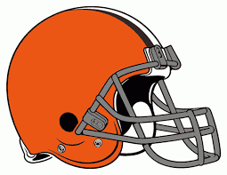







RANKINGS CONTINUED
Top 5 Teams for 2000 to 2013:
New England Patriots
Denver Broncos
Indianapolis Colts
Green Bay Packers
Pittsburgh Steelers
Bottom 5 Teams for 2000 to 2013:
Cleveland Browns
Arizona Cardinals
Chicago Bears
Buffalo Bills
Detroit Lions

Slide 10
QUESTIONS?

