Slide 1
Using the Carolina Hysterectomy Cohort GitHub
Natalie Rivadeneira
natriv@ad.unc.edu
Notes:
Please email me if there are any questions about the presentation and/or GitHub in general!

Slide 2
What is Git?
Git is a version control system
Uses command-line interface (CLI) called Bash
Installed locally
Notes:
High level overview of Git. A basic understanding of Git will give you insight on how to do version control on GitHub itself.

Slide 3
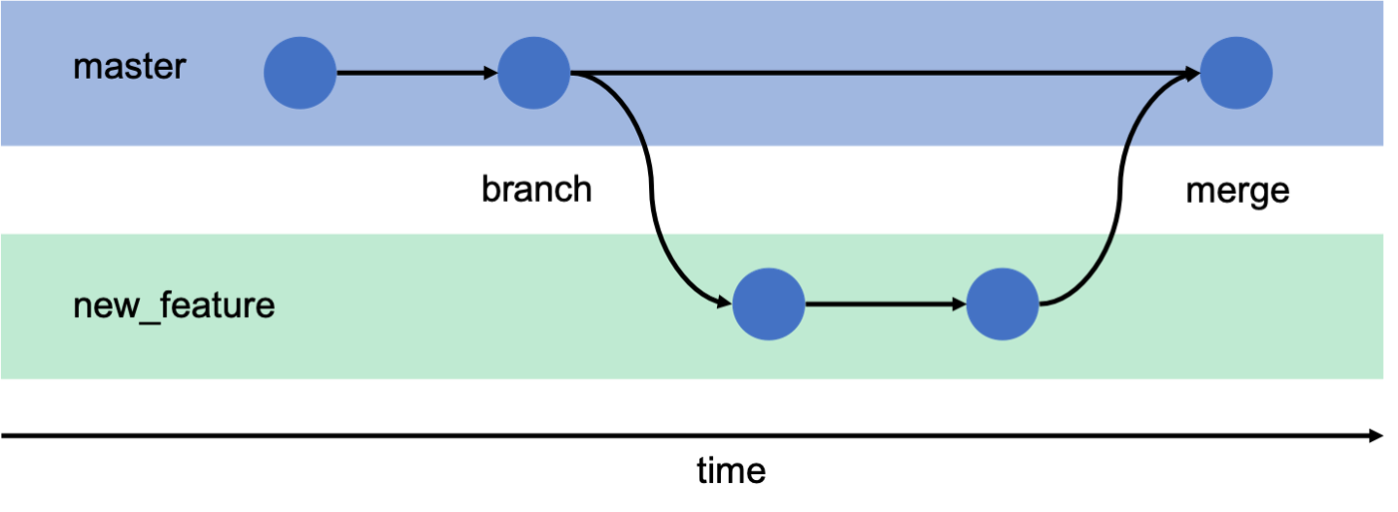
How Git works
Notes:
Git works on the concept of ‘branches’
The main branch is where the main files live.
Changes are pulled into a new branch. All the work in the new branch is also tracked by git. Once everyone agrees to changes, they can be committed and merged back to the main file.

Slide 4
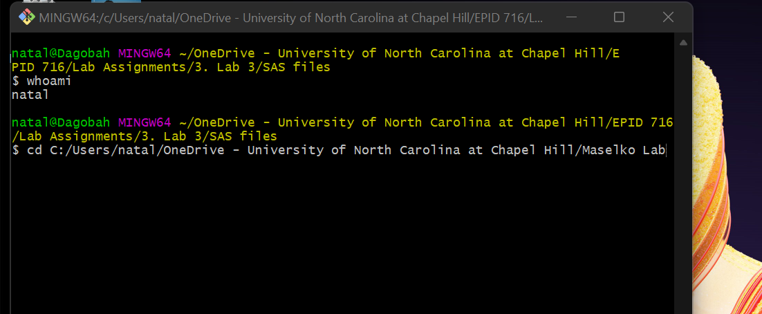

Slide 5
Bash and Unix shell
Bash refers to the CLI and language used to process commands
Bash is based on Unix shell
Windows users need to download Git Bash
Mac users use “Terminal”
Git commands using CLI v GUI

Slide 6
Where to learn
Data Carpentry
Learning Unix Shell
https://swcarpentry.github.io/shell-novice/
Learning Git
https://swcarpentry.github.io/git-novice/
Notes:
Here are tutorials on how Unix Shell (the tool need to use Git) and Git (How to track changes using this program)

Slide 7
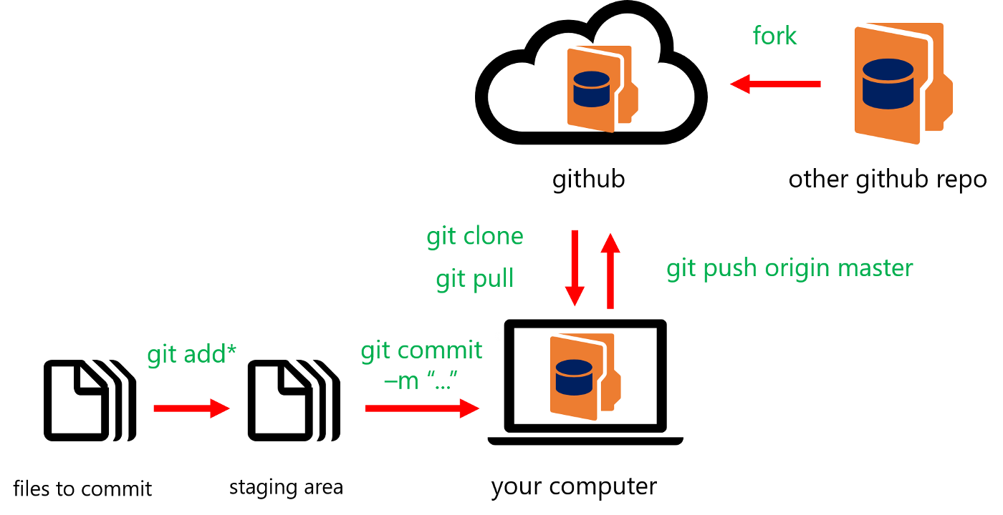
GitHub
Cloud based platform where you can upload your tracked files and download tracked files from others

Slide 8
Why use it?
Data transparency and open science
Reproducibility
Exposure
Your research will reach a bigger audience
Collaboration
individuals work independently, then send work back to GitHub for reconciliation and transmission to the rest of the team.

Slide 9
Working on GitHub
1. Create an account
https.www.github.com
2. Create Repositories
Stores everything pertinent to a specific project including files, images, spreadsheets, data sets
Private v public
Create a branch
Allows you to edit files
Definitive branch is called ‘master’
Notes:
All paper/project repository will be public on CHC GitHub

Slide 10
Working on GitHub
5. Create and Commit Changes to a Branch
Click the file you want to change, then hit the pencil icon in the upper right. Make edits, describe changes by writing a commit message, and then click “commit changes.”
6. Open A Pull Request
This notifies collaborators about your request to incorporate changes into their branch.
A pull request will show in red and green the differences of the content between branches.
7. Merge Your Pull Request
Incorporate changes to the file on the main branch
* Data Carpentry GitHub tutorial: https://datacarpentry.org/rr-version-control/02-git-in-github/index.html

Slide 11
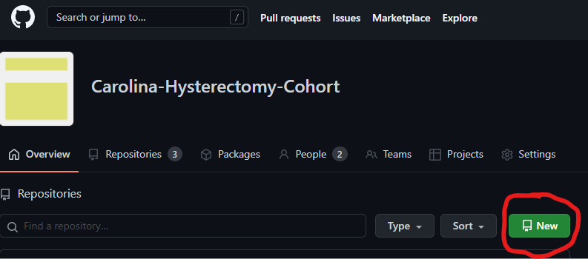
How to start your repository

Slide 12
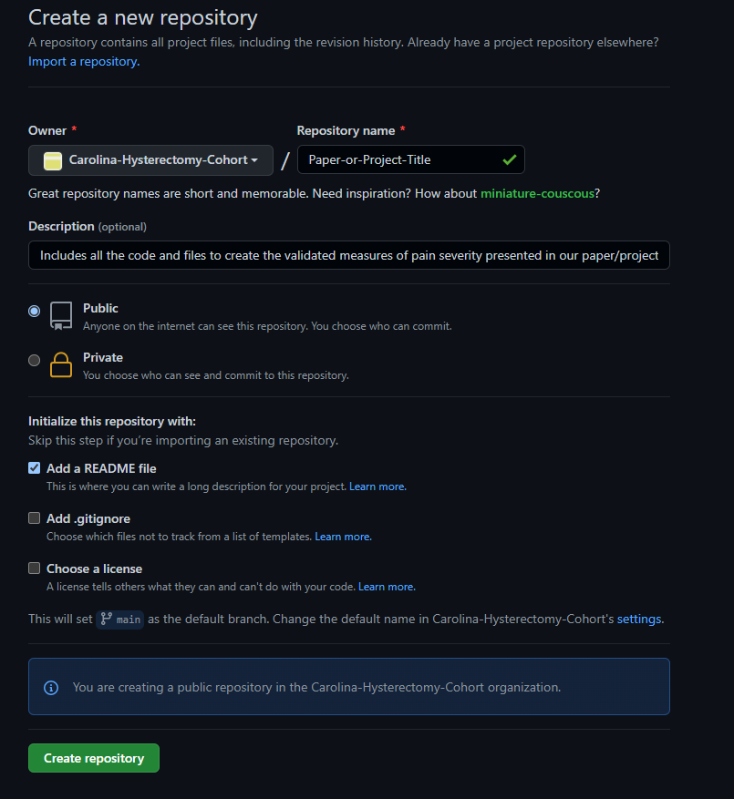
How to start your repository
Required
Required
Required
Notes:
All repositories on CHC GitHub page will be public. Do not upload files with protected health information.
Use the README for project/paper description and directory of files
An aside: The ‘Choose a license’ is an option reserved for any thing you wish to have additional protection to your code or other IP that isn’t covered by standard U.S. copyright law. If this applies to you (not that common in research, but say you are developing software based on your work), then research the types of license to see which best applies to your work.

Slide 13
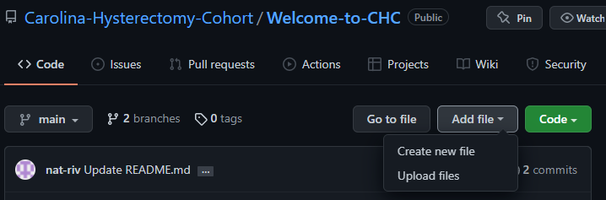
Uploading files onto repository
Notes:
Click ‘Add File’ on top right of repository page. Two options will appear. Either is fine.

Slide 14
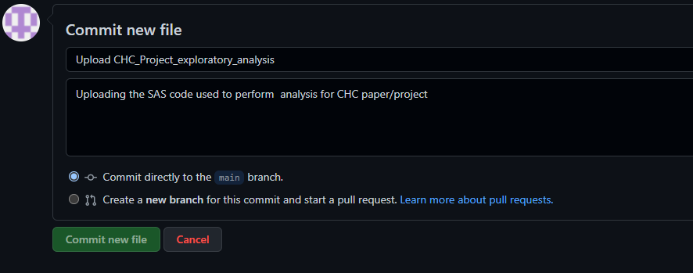
Uploading files onto repository
Brief description of file
Detailed description of file
Notes:
Add a brief description of what file you are uploading on the top line (80-character max). Use the larger box to put more information on the file, such as file format and program purpose. Do not upload files with protected health information.

Slide 15
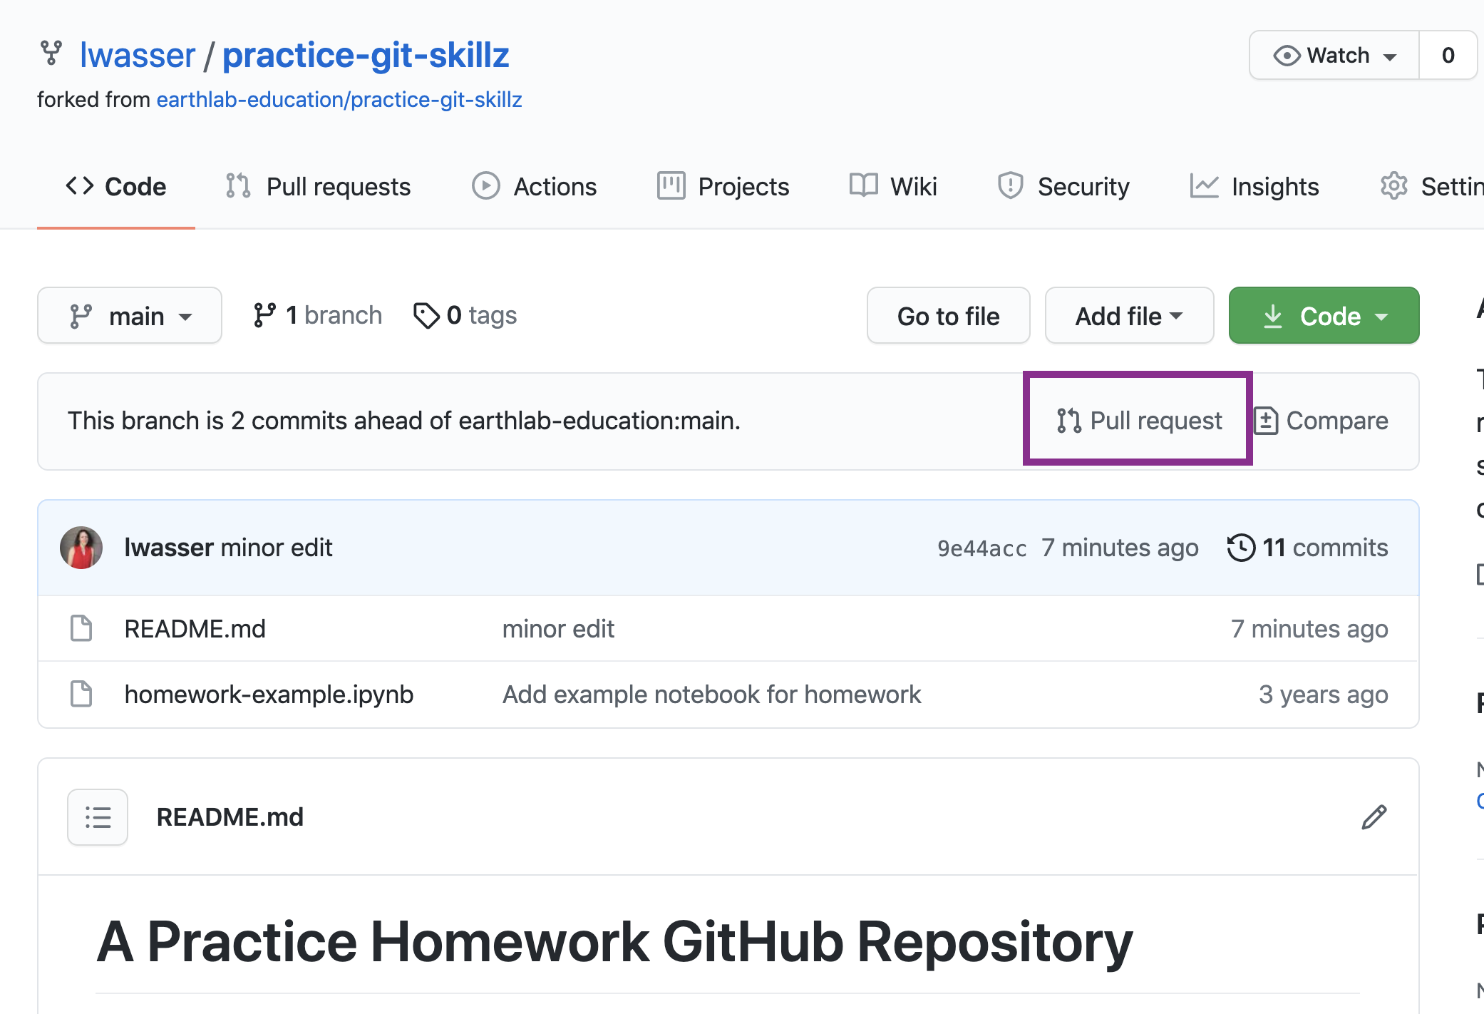
Making changes to files
Notes:
Done through pull requests. Will demonstrate. For more information on pull request, read this tutorial https://www.earthdatascience.org/courses/intro-to-earth-data-science/git-github/github-collaboration/how-to-submit-pull-requests-on-github/

Slide 16

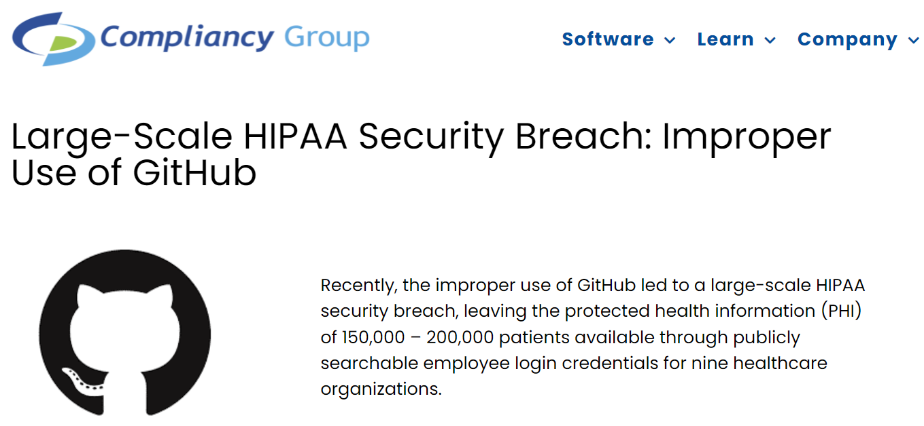
WARNING
Do not upload any protected health information (PHI) or any other identifying information on GitHub.

Slide 17
Data Use Agreement
Will be distributed to those using CHC data
As part of agreement, those working on CHC analyses will need to upload de-identified codes to GitHub

