Slide 1
B9.aa
Dimensionality reduction with PCA (principal component analysis)
Huitian Diao

Slide 2
Objectives
Understand why & when to use PCA
Get familiarized with how to perform PCA in R
Basic understanding of differences between PCA and other dimensionality reduction methods (t-SNE, UMAP)

Slide 3
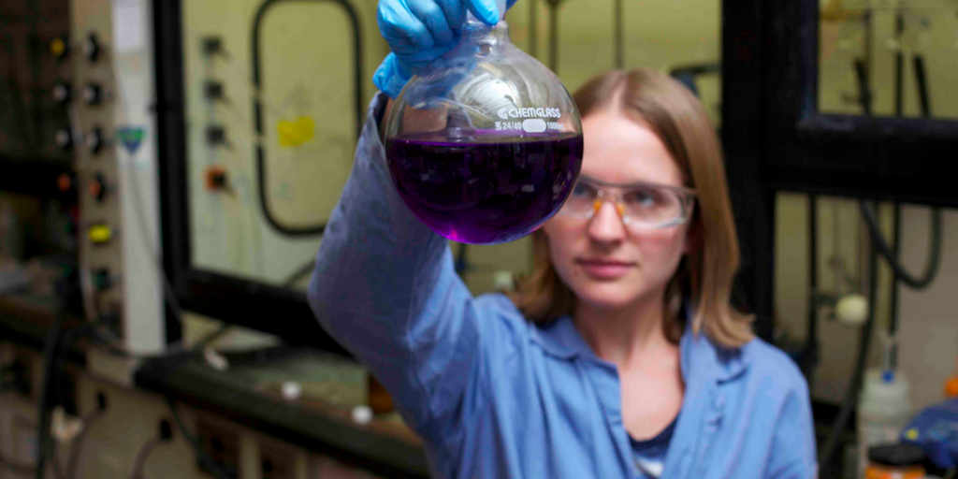
Why we need dimension reduction?
What’s in the picture?
Hood
Human
Goggles
Brown hair
Blue lab coat
Wires
Pipes
Flask with purple liquid
Water squeeze spout
Blue gloves
Bottles
Age 20-30
Female

Slide 4
Why we need dimension reduction?
What’s in the picture?
Hood
Human
Goggles
Brown hair
Blue lab coat
Wires
Pipes
Flask with purple liquid
Water squeeze spout
Blue gloves
Bottles
Age 20-30
Female
Lab
A young person

Slide 5
Why we need dimension reduction?
Graduate student
What’s in the picture?
Hood
Human
Goggles
Brown hair
Blue lab coat
Wires
Pipes
Flask with purple liquid
Water squeeze spout
Blue gloves
Bottles
Age 20-30
Female
Lab
A young person
Dimensionality reduction helps with simplify observations

Slide 6
Contents
Concepts of dimensionality reduction & PCA
Concepts of dimensionality reduction
Concepts of PCA
Application of PCA in bioinformatics
Algorithmic overview of PCA
Hands on practice of PCA with R
Synthesized datasets
Differences in PCA performance with linear datasets & nonlinear
Difference in PCA performance with / without linearly correlated variables
RNAseq TPM matrix
PCA & other dimensionality reduction methods (t-SNE, UMAP)
Overview of dimensionality reduction methods
Pros and Cons of different methods
Application of t-SNE / UMAP in bioinformatics
Resources

Slide 7
Contents
Concepts of dimensionality reduction & PCA
Concepts of dimensionality reduction
Concepts of PCA
Application of PCA in bioinformatics
Algorithmic overview of PCA
Hands on practice of PCA with R
Synthesized datasets
Differences in PCA performance with linear datasets & nonlinear
Difference in PCA performance with / without linearly correlated variables
RNAseq TPM matrix
PCA & other dimensionality reduction methods (t-SNE, UMAP)
Overview of dimensionality reduction methods
Pros and Cons of different methods
Application of t-SNE / UMAP in bioinformatics
Resources

Slide 8
Concepts of dimensionality reduction
Definition:
Transformation of data from high-dimensional space into low-dimensional space
Aim:
Use less dimensions to represent high dimension dataset
Why dimensionality reduction:
For interpretation of data
Reduce computational cost (curse of dimensionality)
Application in bioinformatics:
Feature selection (e.g. feature gene extraction from expression matrix)
Preprocessing data for clustering (e.g. sample clustering / gene clustering)
…
Notes:
https://yolanda-ht.github.io/BioinformaticsRandomSeed/machineLearning/Unsupervised/DimensionalityReduction.html

Slide 9
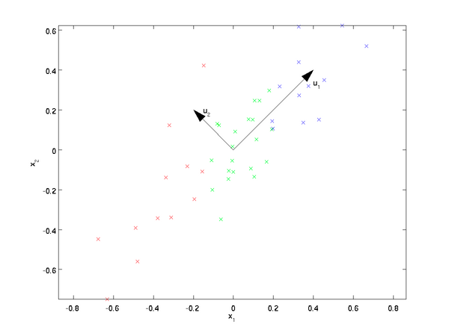
Concepts of PCA (principal component analysis)
Generalized description:
Maximize variance in the first few dimensions in a new coordinate system
Most of variances explained by u1

Slide 10
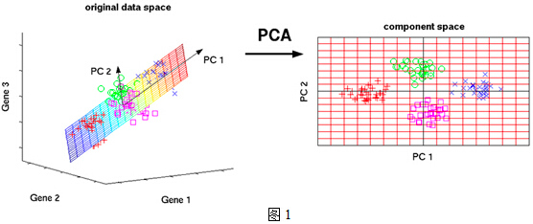
Concepts of PCA (principal component analysis)
Generalized description:
Maximize variance in the first few dimensions in a new coordinate system
Most of variances explained by u1
Most of variances explained PC1-PC2 plane

Slide 11
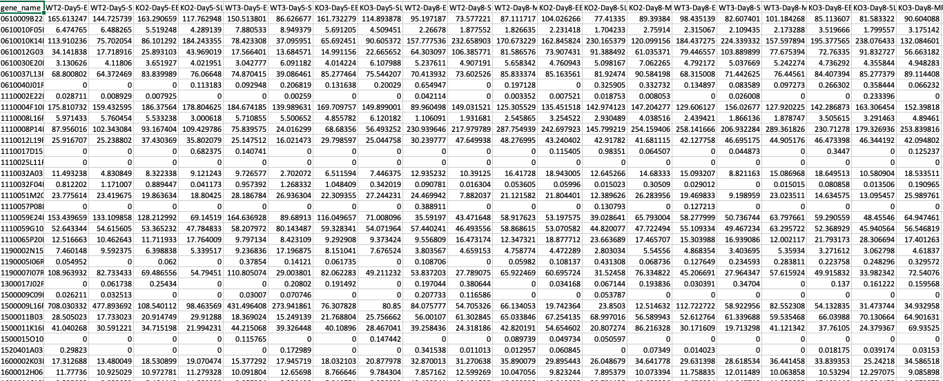
Sample application of PCA in bioinformatics
RNA-seq TPM matrix

Slide 12
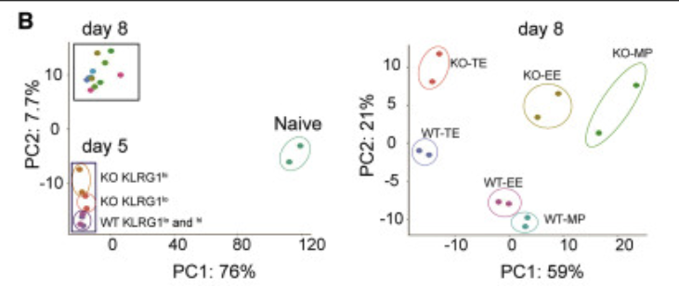
Sample application of PCA in bioinformatics
RNA-seq TPM matrix
Visualize sample similarity & differences with lower dimensional embedding

Slide 13
Sample application of PCA in bioinformatics
RNA-seq TPM matrix
Advantage:
Fast & simple (comparing with other dimensionality reduction methods)
Explainable distance & variance contribution (linear transformation)
Visualize sample similarity & differences with lower dimensional embedding

Slide 14
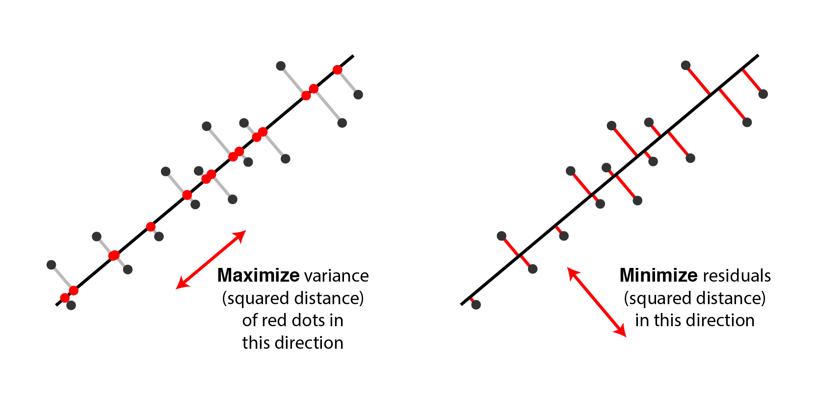
PCA algorithm step by step
Normalize the data
Calculate covariance matrix
Calculate eigenvalues and eigenvectors
Rank eigenvalues to choose feature vectors
Forming principal components
Detailed algorithm ->
http://alexhwilliams.info/itsneuronalblog/2016/03/27/pca/

Slide 15
Contents
Concepts of dimensionality reduction & PCA
Concepts of dimensionality reduction
Concepts of PCA
Application of PCA in bioinformatics
Algorithmic overview of PCA
Hands on practice of PCA with R
Synthesized datasets
Differences in PCA performance with linear datasets & nonlinear
Difference in PCA performance with / without linearly correlated variables
RNAseq TPM matrix
PCA & other dimensionality reduction methods (t-SNE, UMAP)
Overview of dimensionality reduction methods
Pros and Cons of different methods
Application of t-SNE / UMAP in bioinformatics
Resources

Slide 16
Demo: PCA with R

Slide 17
Hands on practice: PCA with R

Slide 18
Contents
Concepts of dimensionality reduction & PCA
Concepts of dimensionality reduction
Concepts of PCA
Application of PCA in bioinformatics
Algorithmic overview of PCA
Hands on practice of PCA with R
Synthesized datasets
Differences in PCA performance with linear datasets & nonlinear
Difference in PCA performance with / without linearly correlated variables
RNAseq TPM matrix
PCA & other dimensionality reduction methods (t-SNE, UMAP)
Overview of dimensionality reduction methods
Pros and Cons of different methods
Application of t-SNE / UMAP in bioinformatics
Resources

Slide 19
Overview of dimensionality methods (explaining some terminologies)
* Dimensionality reduction is a type of unsupervised machine learning
Linear (Euclidean space)
PCA / ICA / SVD, etc.
Non-linear (NLDR, including manifold learning)
Kernelling
Kernel PCA
Nearest neighbor
SNE / t-SNE / UMAP

Slide 20
Pros and Cons of PCA v.s t-SNE
 | PCA (linear) | t-SNE / UMAP (non-linear)
Pros | Higher interpretability; preserves global structure; lower computational cost; good for data pre-processing | Better performance with dataset with local structures; handles outliers better
Cons | Trouble with dataset with local structures | Low interpretability; high computational cost; require adjustment of parameters
* Search for benchmarks of different methods!

Slide 21
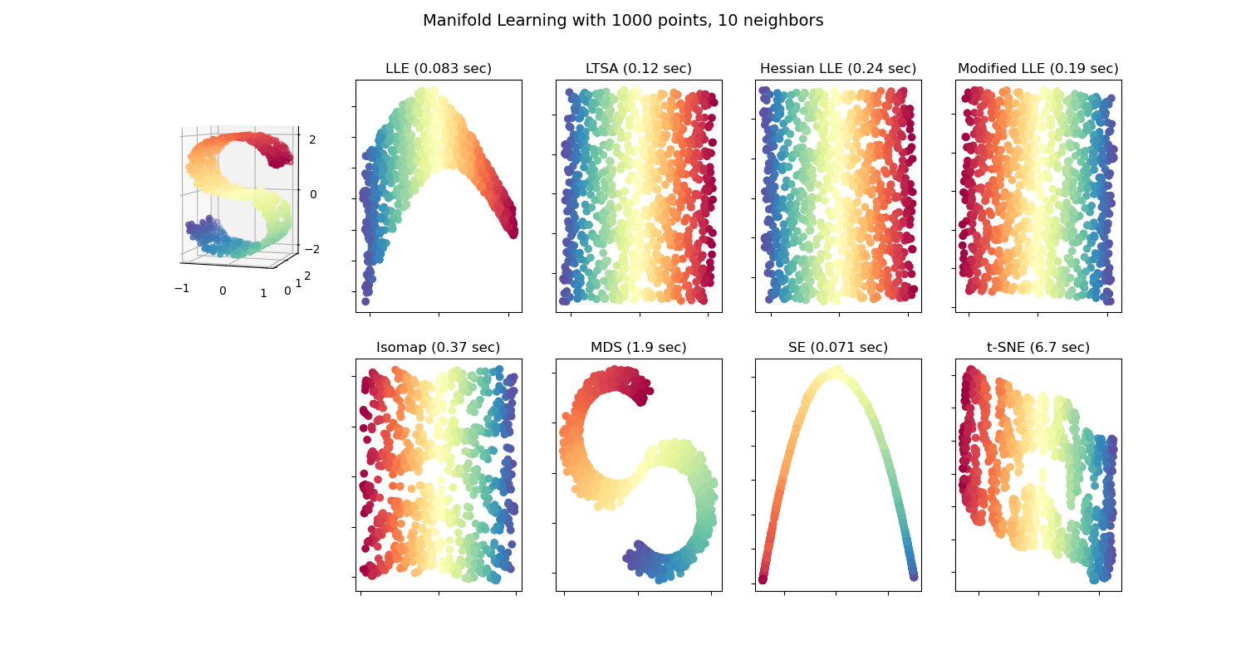
Pros and Cons of different methods
Remember the S shaped dataset that PCA was not able to solve?
https://scikit-learn.org/stable/modules/manifold.html

Slide 22
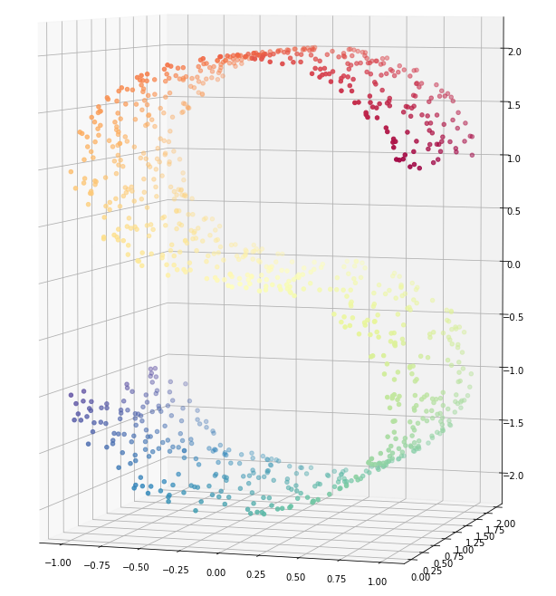
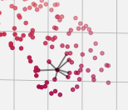
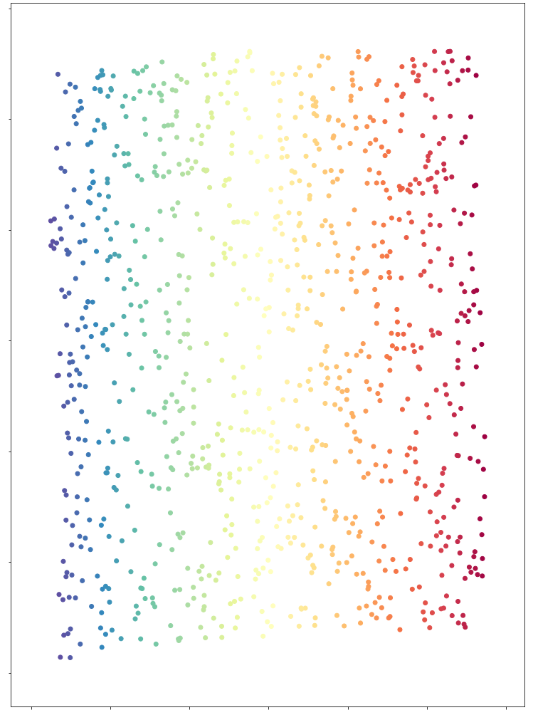
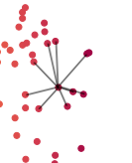
SNE algorithm simplified overview
Convert the high-dimensional Euclidean distances between data points into conditional probabilities that represent similarities
Use low-dimensional counterparts with similar conditional probability to represent high dimensional counterparts
3D
2D
Notes:
http://qiancy.com/2016/11/12/sne-tsne/

Slide 23
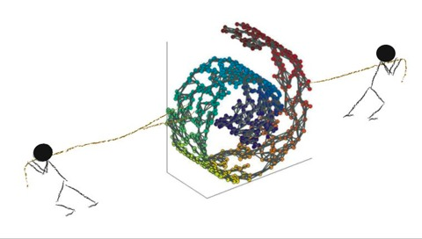
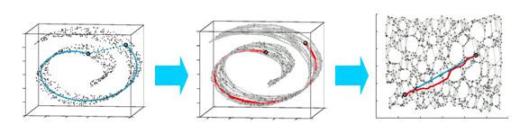
SNE algorithm simplified overview
Summary:
Neighboring probability calculation
Project to lower dimension
http://qiancy.com/2016/11/12/sne-tsne/
Weinberger Lab, Cornell
Notes:
https://blog.csdn.net/witnessai1/article/details/79377975

Slide 24
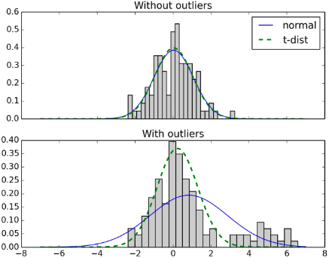
SNE v.s. t-SNE
SNE
+
In neighboring probability calculation, use t-distribution instead of normal distribution
t-SNE
https://bindog.github.io/blog/2016/06/04/from-sne-to-tsne-to-largevis/

Slide 25
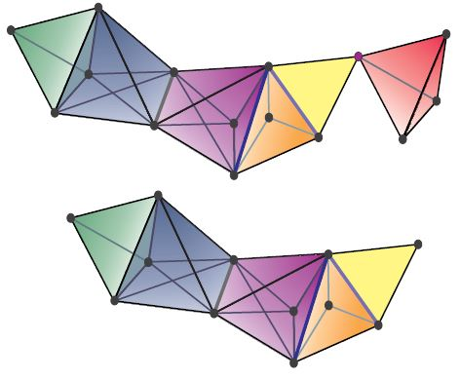
t-SNE v.s. UMAP
Fuzzy simplicial complex
Comparing with t-SNE, UMAP employed topological method (fuzzy simplicial complex) for low dimensional embedding calculation
https://johncarlosbaez.wordpress.com/2020/02/10/the-category-theory-behind-umap/

Slide 26
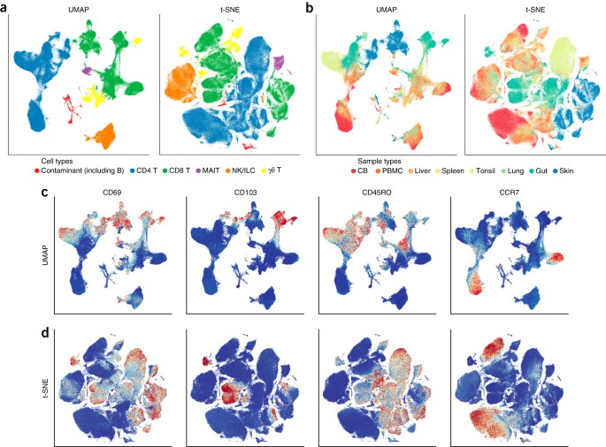
Application of t-SNE / UMAP in bioinformatics
https://www.nature.com/articles/nbt.4314

Slide 27
Resources
PCA algorithm
A step-by-step explanation of principal component analysis – Zakaria Jaadi
Comparisons
PCA v.s. MDS – U Michigan
PCA v.s. t-SNE – GreeksforGeeks
Scikit-learn manifold learning methods comparison
Dimensionality reduction for visualizing single-cell data using UMAP
Interactive trials
How to use t-SNE effectively
Understanding UMAP – Andy Coenen, Adam Pearce
Embedding projector (UMAP / t-SNE / PCA / etc) – Tensorflow
Functions & packages
[R] Principal component analysis in R – Datacamp
[R] Getting started with t-SNE for biologist – Ajitjohnson.com
[R] UMAP in R
[Python] sklearn.decomposition.PCA
[Python] sklearn.manifold.TSNE
[Python] UMAP

Slide 28
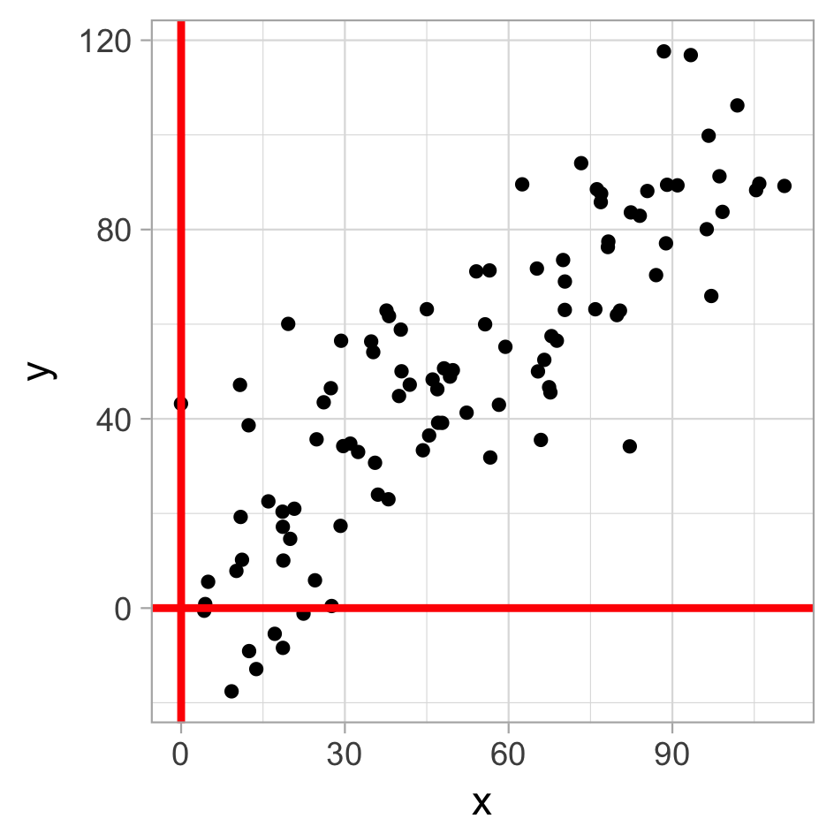
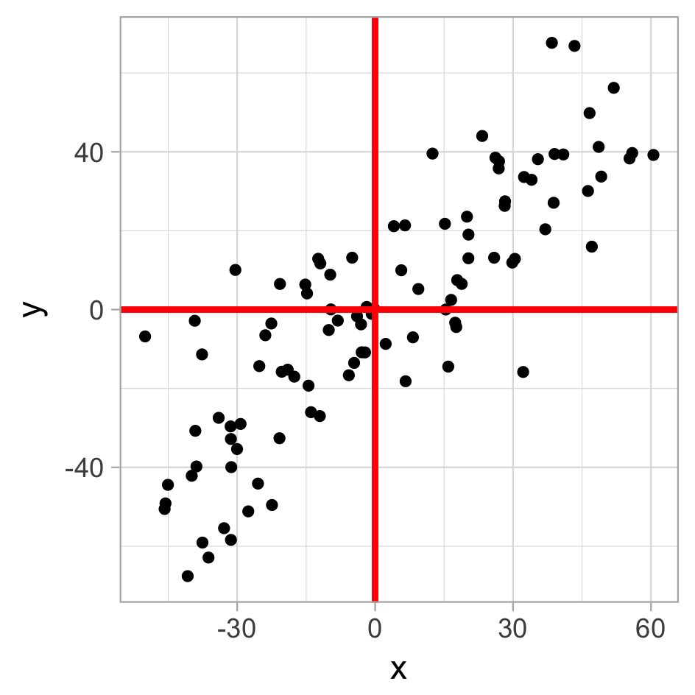
PCA algorithm step by step
Normalize the data
Calculate covariance matrix
Calculate eigenvalues and eigenvectors
Rank eigenvalues to choose feature vectors
Forming principal components
Back

Slide 29
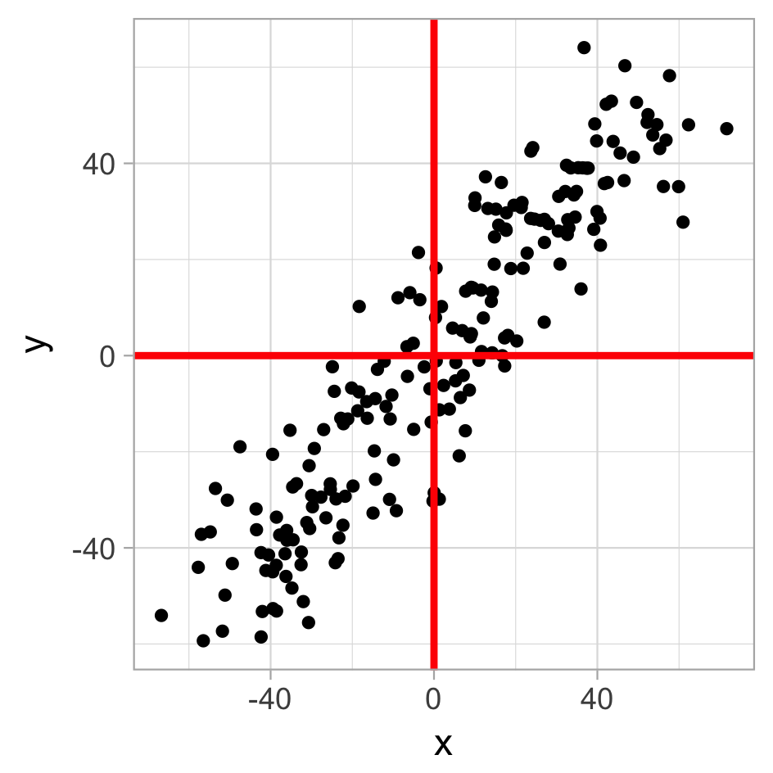
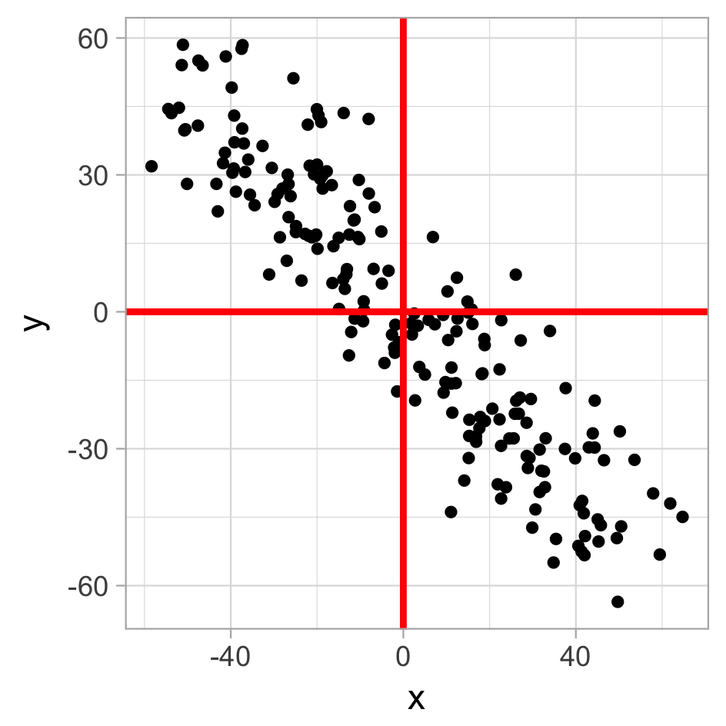
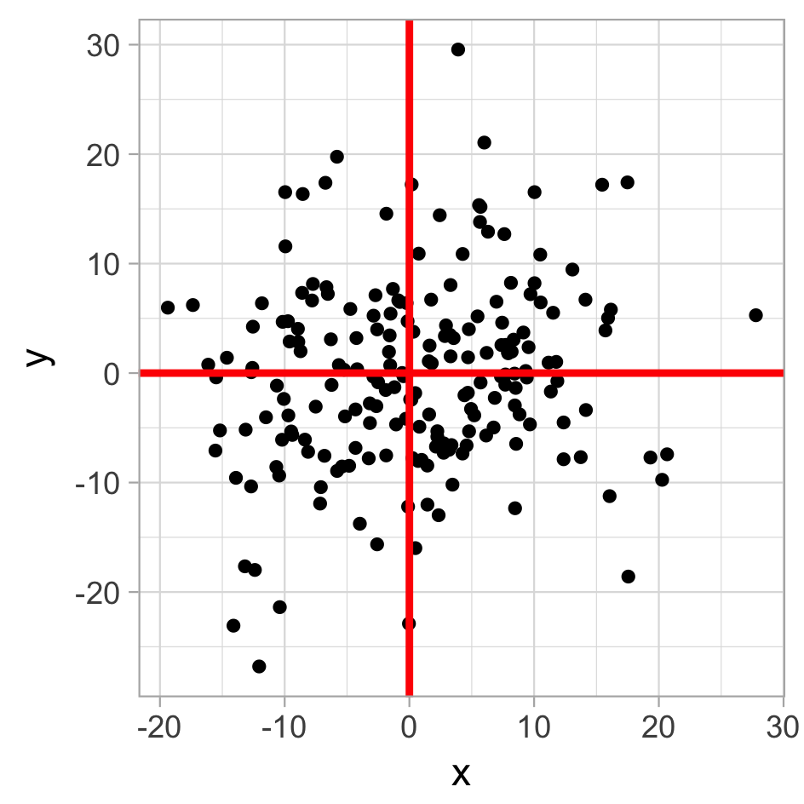
PCA algorithm step by step
cov(x, x) | cov(x, y)
cov(y, x) | cov(y, y)
Matrix (covariance) = [ ]
Normalize the data
Calculate covariance matrix
Calculate eigenvalues and eigenvectors
Rank eigenvalues to choose feature vectors
Forming principal components
984.8 | 905.9
905.9 | 991.3
[ ]
883.6 | -814.4
-814.4 | 905.6
[ ]
76.3 | 11.4
11.4 | 74.8
[ ]
Back
*cov() covariance of two variables, measuring how two are linearly related
Notes:
Covariance: a measure of the joint variability of two random variables

Slide 30
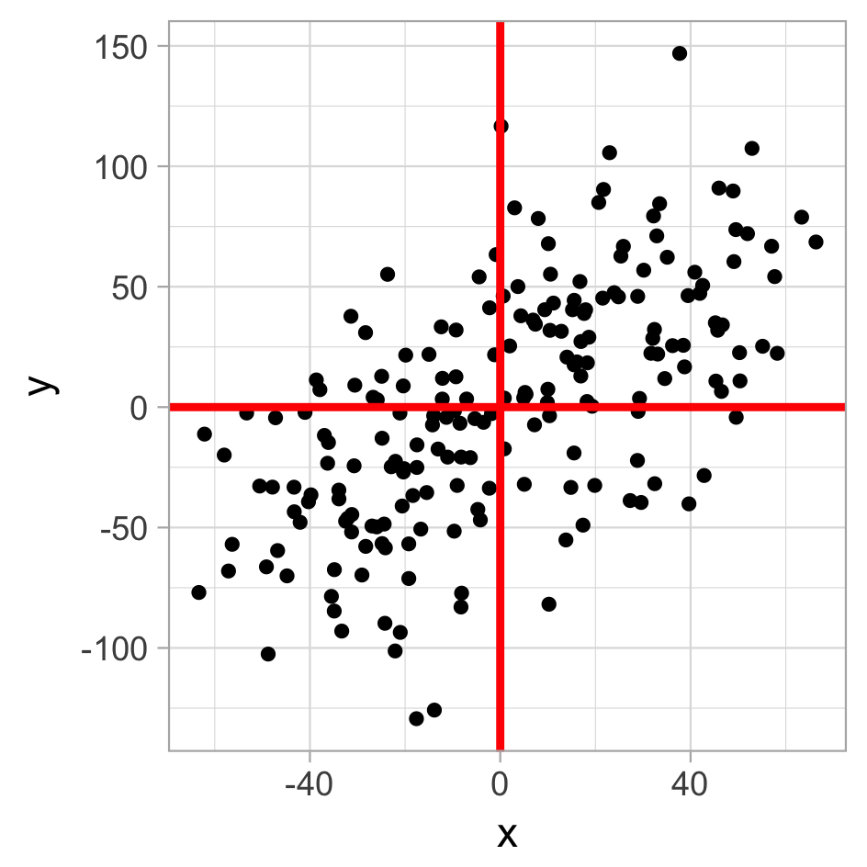
PCA algorithm step by step
cov(x, x) | cov(x, y)
cov(y, x) | cov(y, y)
A = Matrix (covariance) = [ ]
Av = ƛv
Normalize the data
Calculate covariance matrix
Calculate eigenvalues and eigenvectors
Rank eigenvalues to choose feature vectors
Forming principal components
984.8 | 905.9
905.9 | 991.3
[ ]
987.3 | 869.4
869.4 | 2764.4
[ ]
Back
Notes:
Plot6
Plot7

Slide 31
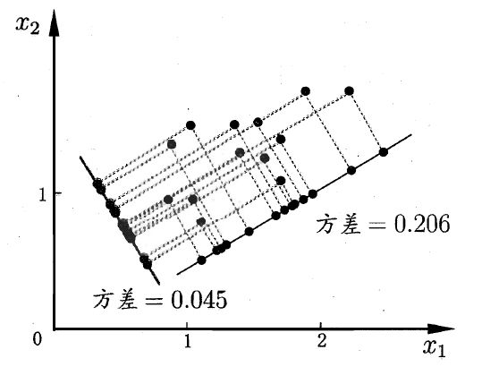
PCA algorithm step by step
Normalize the data
Calculate covariance matrix
Calculate eigenvalues and eigenvectors
Rank eigenvalues to choose feature vectors
Forming principal components
Eigenvalue 1
Eigenvalue 2
Back
Notes:
Plot6
Plot7

Slide 32
PCA algorithm step by step
Normalize the data
Calculate covariance matrix
Calculate eigenvalues and eigenvectors
Rank eigenvalues to choose feature vectors
Forming principal components
PC2
PC1
Eigenvalue 1
Eigenvalue 2
Back
Notes:
Plot6
Plot7

