Slide 1
Kaiser Permanente
Empowering Healthy Habits
Product Owner: Carolina Schincariol
© 2019 Udacity. All rights reserved.

Slide 2
Background
Why Are We Here?
Advancement in Medicine:
  Effective Treatment: enabled effective treatment of many diseases.
  New Information: revealed new information about diseases.
  Prevention and Avoidance: expanded knowledge on how to prevent and avoid diseases.
Empowering Healthy Habits
for a Healthier Future
© 2019 Udacity. All rights reserved.

Slide 3
Business Case
© 2019 Udacity. All rights reserved.
Notes:
[ALL PARTICIPATION]

Slide 4
Initial Focus
Where are we starting?
High Incidence of Preventable Diseases:
Diabetes:
  Over 38 million Americans affected (1 in 10)
  90% have type 2 diabetes
Pre-diabetes:
  98 million Americans affected (1 in 3)
High Blood Pressure:
  48% of the population affected (120 million people)
  *US Centers for Disease Control and Prevention
© 2019 Udacity. All rights reserved.

Slide 5
Initial Focus
Where are we starting?
Associated Costs:
Diabetes Treatment:
  $413 billion spent in 2022
  Represents 1 in every 4 healthcare dollars
High Blood Pressure Treatment:
  $131 billion spent annually (average since 2003)
  *US Centers for Disease Control and Prevention
© 2019 Udacity. All rights reserved.

Slide 6

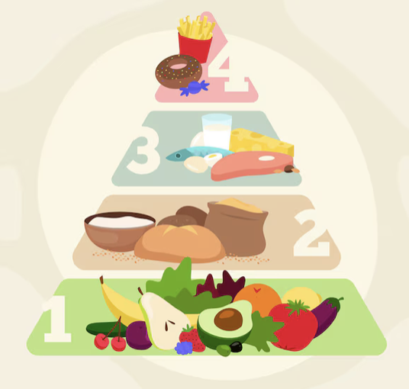
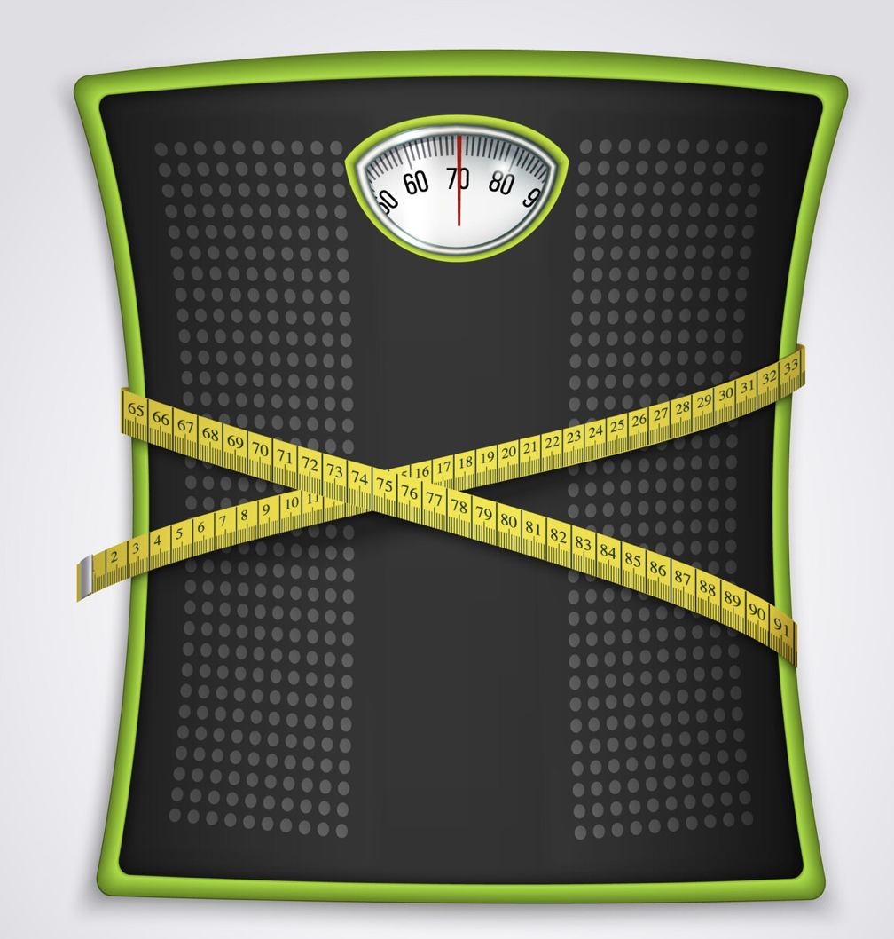
Initial Focus
Where are we starting?
Primary Cause:
Lifestyle Factors:
  Known as lifestyle-related diseases
  Can be prevented and potentially reversed with lifestyle changes:
  Captura de Tela 2
  *US Centers for Disease Control and Prevention
© 2019 Udacity. All rights reserved.

Slide 7
Opportunity
What’s the problem?
Impact on Kaiser Permanente:
  Diabetes:
    Estimated 1,060,000 users with diabetes
    90% type 2 diabetes = 954,000
  Pre-diabetes:
    Estimated 3,500,000 users with pre-diabetes
  Hypertension:
    Estimated 5,800,000 users with hypertension
© 2019 Udacity. All rights reserved.

Slide 8
Opportunity
What’s the problem?
Health Trends and Interest:
Diet and Nutrition:
  71% consider diet important and are making changes to improve it
  (International Food Information Council)
Mental Health:
  56% making efforts to improve mental health through lifestyle changes
  (American Psychological Association)
© 2019 Udacity. All rights reserved.

Slide 9
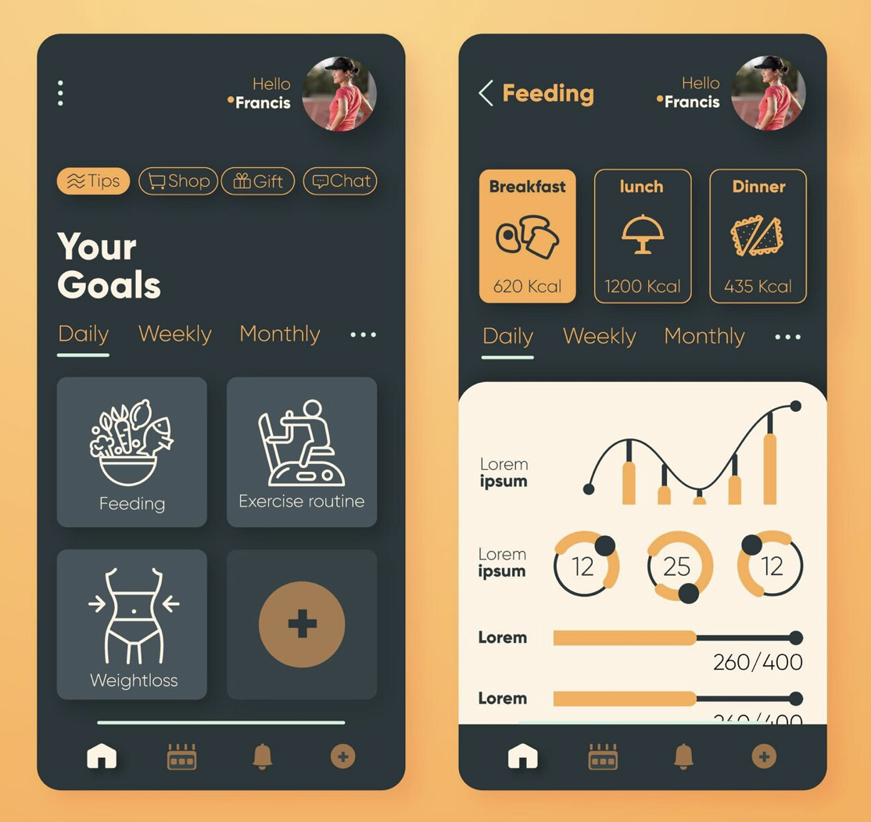
Proposal
What’s Our Solution?
Lifestyle App for Kaiser Permanente Patients
Features:
  Exercise for Beginners
  Healthy Meal Ideas
  Short Breathing Programs
© 2019 Udacity. All rights reserved.

Slide 10
Return On Investment
What can we do?
Cost Estimation
Development:
  Design and Prototyping: $100,000
  App Development (iOS & Android): $200,000
  Integration with Existing KP Systems: $50,000
Content Creation:
  Health and Fitness Content: $30,000
  Educational Materials: $20,000
Marketing and Launch:
  Promotional Campaigns: $50,000
  Initial User Acquisition: $20,000
Maintenance and Updates (First Year): $50,000
Total Estimated Initial Cost: $500,000
© 2019 Udacity. All rights reserved.

Slide 11
Return On Investment
What can we do?
ROI
85% member with digital access
Download 5%: 620,000 members
Conversion rate 3%: 18.750 subscribers
Potential Revenue: $1,1 mi – six months of $10 subscription
Development cost: $500,000 (six months)
ROI: 125% - six months
© 2019 Udacity. All rights reserved.

Slide 12
Measurement
How will we know if we’re successful?
Key Performance Indicators (KPI):
Conversion Rate: track the number of paying users.
Daily/Weekly Active Users: Measure how frequently users interact with the app.
Patient Feedback: Collect and analyze user feedback and satisfaction surveys to gauge the application's impact on patient satisfaction.
First-year Metrics:
Churn Rate: 5% per month - rate of user loss and identify potential areas for improvement.
Lifetime Value: $150 - average value a paying user generates over their usage time.
© 2019 Udacity. All rights reserved.

Slide 13
Competitors
© 2019 Udacity. All rights reserved.
Notes:
[ALL PARTICIPATION]

Slide 14
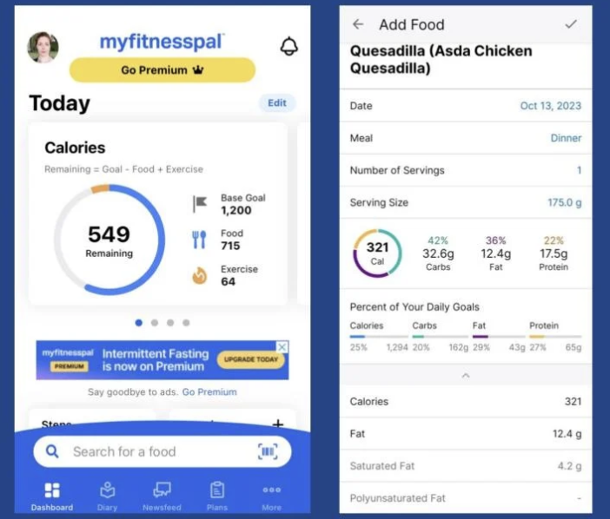
Diet and Exercise Tracking App
MyFitnessPal - weight loss and overall health management
Features:
Food and calorie tracking
Personalized meal plans
Exercise plans and workouts
Integration with fitness devices
Wellness features
Strong market penetration
© 2019 Udacity. All rights reserved.

Slide 15
Our Advantages
Why are we better?
Established Credibility: As a well-known healthcare provider, we offer credibility and security, giving users confidence in our expertise to provide the best recommendations.
Integration: Our app seamlessly integrates with Kaiser Permanente's already robust digital system, utilizing pre-existing user information and eliminating lengthy registration processes.
Enhanced User Experience: Users can easily share data between the provider's system and the app, facilitating ongoing monitoring of patient progress over time.
© 2019 Udacity. All rights reserved.

Slide 16
Roadmap and Vision
© 2019 Udacity. All rights reserved.
Notes:
[ALL PARTICIPATION]

Slide 17
Roadmap Pillars
Where do we go from here?
Vision
Enable every Kaiser Permanente member to proactively manage their health for a healthier and more sustainable lifestyle.
Future Strategy
Integration and Connectivity
Personalized Health Management
© 2019 Udacity. All rights reserved.

Slide 18
Integration and Connectivity
Integrate the app with Kaiser Permanente's existing digital infrastructure
Features
Smart Health Profile Sync
Automatically syncs and updates the user’s health profile within the app based on data from Kaiser Permanente’s digital system, including medical history, prescriptions, and recent lab results.
Appointment and Medication Reminders Integration
Integrates with Kaiser Permanente's scheduling system to send personalized reminders for upcoming appointments and medication refills directly to the app.
© 2019 Udacity. All rights reserved.

Slide 19
Personalized Health Management
Making healthcare management more effective and relevant
Features
AI-Driven Health Recommendations
AI to analyze the user’s health data and habits, providing personalized diet, exercise, and wellness recommendations tailored to their specific health goals and conditions.
Customizable Health Goals and Tracking
Allows users to set specific health goals and tracks progress with personalized dashboards that integrate with wearables and other health data sources.
© 2019 Udacity. All rights reserved.

Slide 20
Where do we go from here?
Widening the scope
Risk Reduction
-58%
Cost Savings
-10%
Chronic Disease
Management
*American Diabetes Association and US Centers for Disease Control and Prevention
© 2019 Udacity. All rights reserved.

