Slide 1
WellPath
Design Sprint
Product Manager: Carolina Schincariol
© 2019 Udacity. All rights reserved.

Slide 2
Set the stage
Set the stage for the Design Sprint by framing the problem
© 2019 Udacity. All rights reserved.
Notes:
[ALL PARTICIPATION]

Slide 3
Initial PRD
Background
According to the CDC – Centers for Disease Control and Prevention, there is currently a high incidence of diseases that medicine classifies as preventable.
Diabetes: 1 in 10 Americans has diabetes; 90% being type 2 diabetes
Prediabetes: 1 in 3 Americans has prediabetes, an important risk factor for the development of type 2 diabetes.
High blood pressure: 48% of the population already has the disease.
The high numbers translate into high costs: according to the CDC diabetes treatment costs $413 billion annually and the average spending on high blood pressure exceeds $130 billion.

Slide 4
Initial PRD
Problem
As healthcare providers, Kaiser Permanente is directly impacted by these medical conditions. If we apply national metrics to the context of Kaiser Permanente's more than 12 million members, we can estimate that over 1 million have diabetes, 940,000 having type 2 diabetes. Estimated over 3 million have prediabetes, and possibly nearly 6 million with hypertension.
The good news is that we can react to this situation: medicine already knows that these diseases are mainly influenced by lifestyle. They are even called lifestyle-related diseases and can be prevented, controlled, and even reversed with three main changes: physical activity, a balanced diet, and weight loss.

Slide 5
Initial PRD
Goals
Build a lifestyle app for Kaiser Permanente members that offers exercise for beginners, healthy meal ideas and short breathing programs
Encourage the adoption of a healthier lifestyle
Decrease spending on conditions such as lifestyle-related diseases
Success Metrics
NPS (Net Promoter Score) of 60 or higher
35% to 40% of total users interacting Weekly
Reduce the incidence of patients with preventable diseases in the long term

Slide 6
Understand
Create a shared understanding of the space, problem, and goals
© 2019 Udacity. All rights reserved.
Notes:
[ALL PARTICIPATION]

Slide 7
How Might We
How might we include mental health?
How might we involve healthcare professionals?
How might we motivate patients to engage physical activities?
How might we accurate healthy
suggestions?
How might we promote physical activity and healthy habits?
How might we measure and track progress?
How might we suggest health diet?
How might we keep patients motivated?
How might we offer social support online?
How might we appeal for young age groups?
How might we provide feedback to patients?

Slide 8
Encourage good habits
How might we offer social support online?
How might we promote physical activity and healthy habits?
How might we suggest health diet?
How might we gamify healthy habits?
How might we create a rewards system?
How might we make patients feel accountable?
How might we build a social support system?
How might we promote health habits?
How might we get people to build healthier habits?
How might we reward people for good behaviors?
How might we reduce healthcare costs for healthy patients?
How might we provide feedback to patients?
How might we keep patients motivated?
Accountability
Routines
Incentives

Slide 9
Change specific behaviors
How might we include mental health?
How do we teach patients how to mediate?
How might we motivate patients to engage physical activities?
How do we convince people to exercise regularly?
How might we make it easier to make healthy choices?
How might we help reduce high blood pressure?
How do we reduce a patient’s alcohol intake?
How might we get people to walk 30 minutes every day?
How might we reduce sedentarism?
How might we warn users about unhealthy choices?
How might we prevent patients from making unhealthy choices?
How might we help patients stop smoking?
How might we encourage people to drink more water?
Be more active
Prevent bad choices
Change other behavior

Slide 10
Planning & Tracking
How might we provide activity tracking?
How might we provider diet tracking?
How might we measure and track progress?
How might we create a personalized plan?
How might we help patients set health goals?
How might we accurate healthy
suggestions?
How might we help patients monitor their goals?
How might we help people manage their weight?
Personalized planning
Personal tracking towards plan

Slide 11
Education
How might we help people better understand diabetes?
How might we identify and warn pre-diabetic patients
How might we make people aware of their current state of health?
How might we appeal for young age groups?
How might we build good habits at a young age?
How might we make people aware of risk factors?
How might we raise awareness across society?
Young age
Personal assessment
General education

Slide 12
Other
How might we involve healthcare professionals?
How might we provide better insights to doctors?

Slide 13
Sprint Focus
Focus | Routines
Slide # | 08
I selected this theme because | Focusing on routines is essential for promoting sustainable behavior change and improving health outcomes. By helping users integrate physical activity, healthy eating, and overall wellness into their daily routines, the app can turn these behaviors into automatic habits, enhancing long-term adherence. This approach also aligns with Kaiser Permanente's goal of preventing chronic conditions and reducing healthcare costs. Leveraging behavioral science insights, the app can create lasting, positive changes in users' health by embedding healthy habits into their daily lives.

Slide 14
Define
With an understanding of the problem space, create focus and align on specific outcomes for the Design Sprint
Notes:
[ALL PARTICIPATION]

Slide 15
WellPath: A New App for a Healthier Life by Kaiser Permanente
As a Kaiser Permanente member, I’ve been eagerly anticipating a solution that would help me seamlessly integrate healthy habits into my daily life. The new Kaiser Permanente health app has finally arrived, and it’s very helpful. Designed for Kaiser Permanente members, this app addresses the challenge of maintaining consistent physical activity and healthy eating in a busy lifestyle.
What sets this app apart is its ability to simplify the process of building and sticking to healthy routines. Instead of overwhelming me with complex health advice, it offers recommendations that fit effortlessly into my day-to-day life.
The app has transformed how I approach my health by turning beneficial behaviors into regular habits, making it easier to achieve my wellness goals. I love how the app doesn’t just track my progress but actively supports and motivates me, making the journey to better health both manageable and enjoyable. It’s a game-changer for anyone looking to improve their lifestyle, and it is clear why Kaiser Permanente members are enthusiastic about this innovative tool.

Slide 16
Sketch
Generate tons of ideas, then narrow them down to two in depth solution sketches
Notes:
[ALL PARTICIPATION]

Slide 17
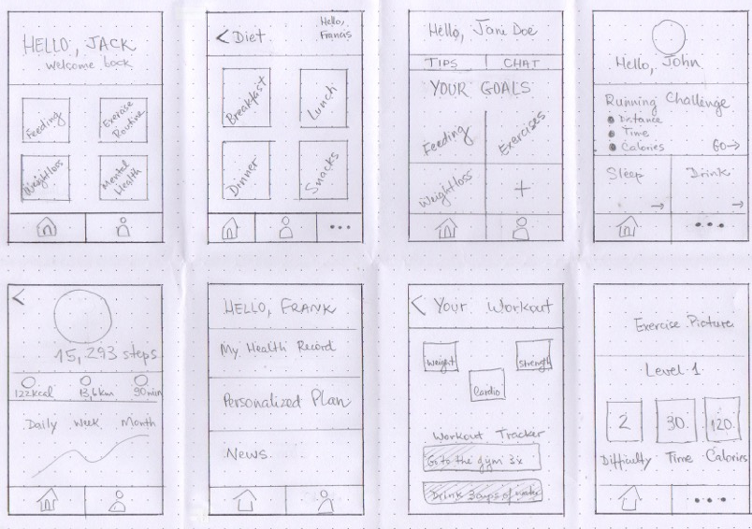
8 Sketches

Slide 18
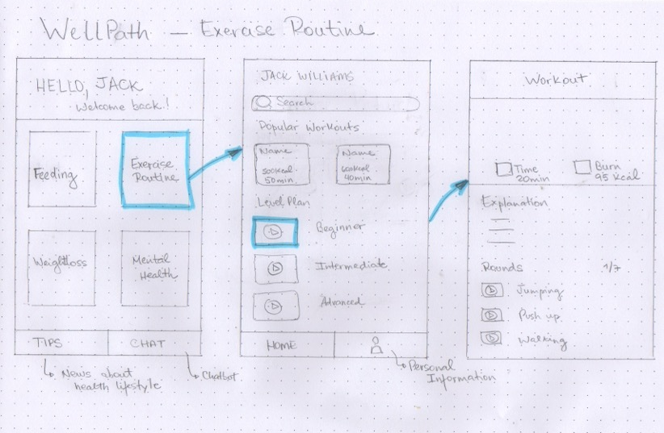
Solution Sketch 1

Slide 19
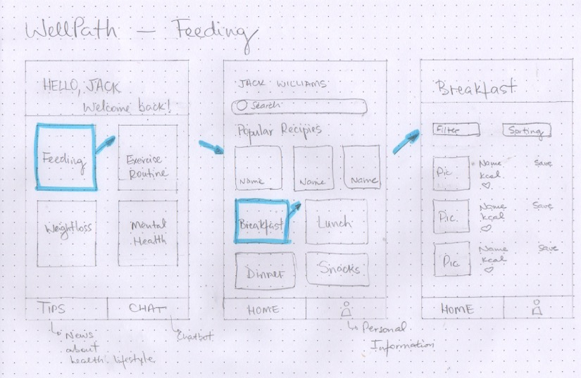
Solution Sketch 2

Slide 20
Decide
Pick the final concept that you develop into a prototype
Notes:
[ALL PARTICIPATION]

Slide 21
Decision
Decision | WellPath – Feeding
Rationale | Feeding (Diet/Nutrition) might have a broader immediate impact because dietary changes can directly influence blood glucose levels and blood pressure. Education around nutrition can also be more impactful in preventing and managing lifestyle-related diseases, especially for those at risk or newly diagnosed. By addressing diet first, we lay a strong foundation for overall health improvement, which can make it easier to integrate exercise and build a more comprehensive lifestyle intervention strategy.

Slide 22
Prototype
Turn your concept into a realistic, interactive prototype that you will use to validate your assumptions and ideas
Notes:
[ALL PARTICIPATION]

Slide 23

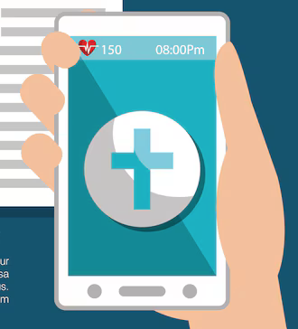
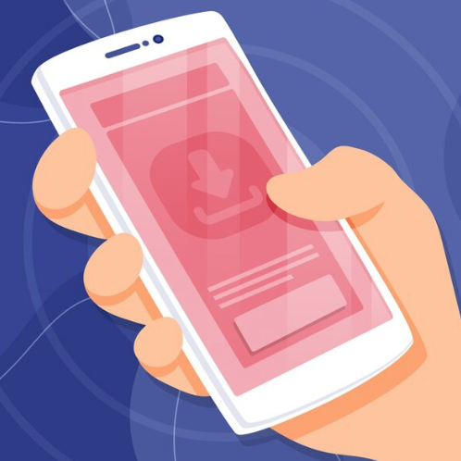
Storyboard
Jack Williams is a Kaiser Permanente member with type 2 diabetes. After his recent check-up, his doctor discussed some lifestyle changes to help manage his condition. | Jack's doctor mentioned a new health lifestyle app launched by Kaiser Permanente, designed to help manage diabetes through better lifestyle choices. | Trusting his doctor's recommendation, Jack decides to download the app from the App Store. He feels hopeful and ready to make positive changes.

Slide 24
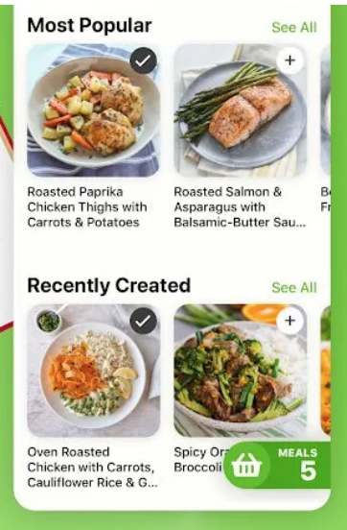
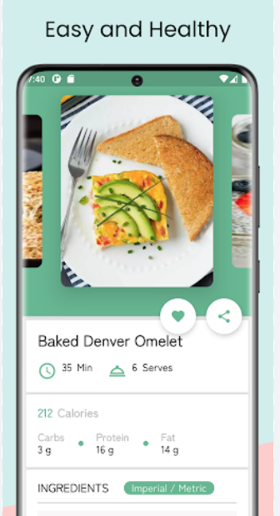
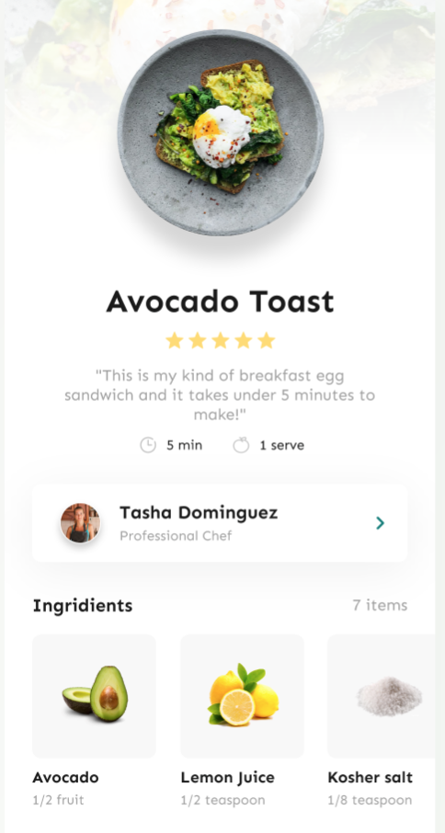
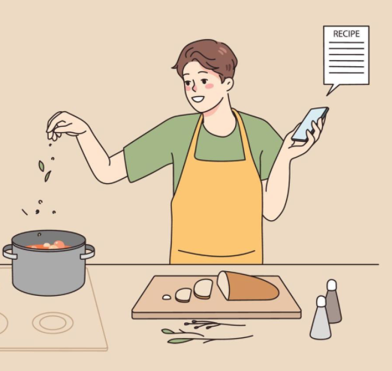
Storyboard
After opening the app, Jack discovers the 'Feeding' section, which offers a variety of healthy recipes tailored for managing diabetes. | Jack check some recipes for a balanced breakfast. The app provides detailed ingredients and step-by-step cooking instructions. | Feeling confident, Jack follows the app’s recipe to prepare his meal. He’s excited to try new, healthy foods that will help manage his diabetes.

Slide 25

Storyboard
After some time using the app and following the recipes, Jack notices improvements in his diabetes management. He feels healthier and more in control.

Slide 26
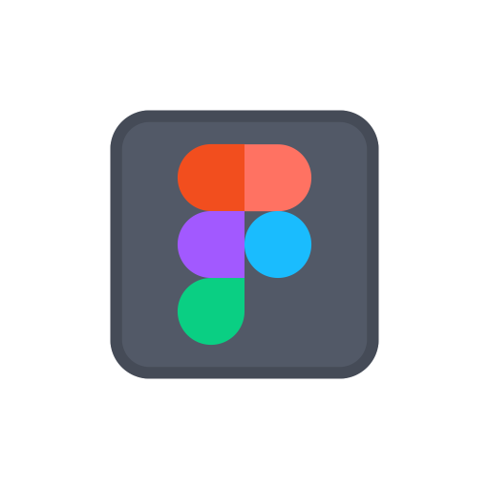
Prototype
Description High level overview of the prototype What does it do? | The prototype shows the user of the new Kaiser Permanente app one of the planned features: healthy meal recipes. To exemplify the intended use, the app provides the 'Breakfast' option to demonstrate how a user would consult a recipe in the app. In the proposed prototype, an Avocado Toast recipe is displayed. The user accesses the app through a code sent via text message, making it easier to use and eliminating the need for the user to memorize a password.
Assumptions Any assumptions within the prototype | User Access: Users have access to a smartphone or compatible device. Text Message Reception: Users can receive and access text messages. No Password Needed: Code for authentication is secure and convenient. Interest in Healthy Recipes: Users will find the recipe feature useful. User Interface: Designed to be intuitive and easy to navigate. Recipe Display Functionality: the prototype demonstrate how recipes will be displayed and used within the app.
Tasks What are the tasks that a user can complete in the prototype? | User downloads the app and enters their phone number to receive the code. User enters the received code and accesses the app’s main menu. User chooses to search for meals. User selects the breakfast option. User chooses to view the recipe/suggestion for avocado toast. User checks the ingredients and preparation instructions for the avocado toast.
Link your prototype

Slide 27
Validate
Users will go through your prototype and provide feedback on your concept. This is also an opportunity to have an engineering feasibility discussion
Notes:
[ALL PARTICIPATION]

Slide 28
WellPath Research Plan
PM: Carolina Schincariol
STATUS: DRAFT
Objectives
The key research questions we are trying to answer:
How do Kaiser Permanente members currently manage their health and wellness routines, including nutrition, exercise, and weight loss?
Have they already used health-focused app?
How was the experience?
What factors influence user engagement with health apps?
Methodology
Interview sessions will last approximately 30 minutes. During the interviews, participants will be asked about their current health habits, challenges in maintaining a healthy lifestyle, and their expectations from a health app. Open-ended questions will allow for in-depth exploration of their experiences and preferences.
Participants
We will interview a diverse group of Kaiser Permanente members, aged 25-55, with varying health goals and levels of app usage experience. Participants will include individuals actively trying to improve their health through diet and exercise, as well as those who may struggle to stay consistent with health routines. This mix of users will help us understand different perspectives and needs in relation to the app’s features and usability.

Slide 29
WellPath: Interview Sessions
Introduction and Overview
Hi, my name is Carolina, and I’m a Product Manager at Kaiser Permanente. We have been working on new ideas for a healthy lifestyle app and we wanted to share them with you and get your feedback.
For this interview I have a few background questions to know you a little bit better and also to know more about how you currently manage your health and wellness routines and your experience with fitness apps.
Then I’ll show you a prototype that the team has been working on and ask you for your feedback.
Before we get started, please review this NDA and sign it. It’s important that the things we show you and the ideas that we discuss today stay confidential.
Do you have any questions before we get started?
No questions… Great! Is it ok if I record this session? The recording is only going to be used internally by the team to refer back to our conversation. It also helps make sure that we don’t miss anything in the notes.

Slide 30
WellPath: Interview Sessions
Background Questions
Can you tell me a little bit about yourself?
Can you tell me a little bit about your lifestyle?
More specific questions about the user's experiences
Have you already used health-focused app? Why?
How was the experience?
What factors influence your engagement with health apps? Why?
Do you have any concerns about health-focused apps? Why?
If you were to use health-focused apps, how would you like to access? Why?

Slide 31
WellPath: Interview Sessions
Tasks
Now I’m going to show you a prototype of the app. Keep in mind that this isn’t a test… And there’s no right or wrong answer. We’re trying to understand how well this idea works for you. And because it’s a prototype, not everything you see in the app may work.
One more thing… As you start using the prototype, I’m going to ask you to think out loud. I’m interested in hearing what you are seeing on the screen, how you are interpreting it, and what you expect things to do.
Task 1
Go ahead and take a look. Can you describe what you see?
Task 2
How would you access the app? Can you show me?
Task 3
Let’s say that you wanted to find recipes. How would you do that?
Task 4
Now you are looking for recipes, what can you see? Can you please describe for me?
Task 5
Let’s say that you wanted to find recipes for breakfast. How would you do that?
Task 6
You have selected breakfast, what are your options now?
Task 7
How do you get your recipe?

Slide 32
WellPath: Interview Sessions
Wrap Up
Awesome! Thanks so much for going through all of that with us. Just a few more questions
Do you think this is something you would use? Why or why not?
Is there anything you think could be improved?
Is there any other feedback you want to share with us?
Thanks so much for coming in! We really appreciate you taking the time to share your thoughts about what we’ve been working on.

Slide 33

User Testing: Participant 1 Key Findings
What worked well | Understanding of functionality and objectives Clear logical sequence Fluidity between pages Positive receptivity
Where participants got stuck | Enter the code: it was not immediately clear how to get the code Expected more interactive functions
Other observations | Is it a good idea to include a video of the recipe? Is it possible to add some functionality to copy and paste the code to access?

Slide 34
Participant 1: Interview Notes
The user is familiar with apps and seems proficient in their use.
The user is unclear about how they will receive the access code but can intuit that it will be via SMS.
The user navigates smoothly through different parts of the app.
The user seems receptive to the idea of having access to healthy recipes.
The user would like personalization and interactivity (videos for the recipes).
Suggested Improvements: more personalization, interactive features (videos of the recipes, for example), function “copy and paste” for the enter code.

Slide 35
User Testing: Participant 2 Key Findings
What worked well | Access to the app Flow of the tasks Comprehension of the usability Logic sequence
Where participants got stuck | - Enter the code: the user need to open other table/app to get the code
Other observations | - Is it possible to add some functionality to copy and paste the code to access?

Slide 36
Participant 2: Interview Notes
The user liked not having to enter an email and password.
The user seems confused about how to access the code to enter the app.
The user approves the division of functionalities.
The user finds it interesting that the recipes are separated by meal (breakfast, lunch, and dinner).
Suggested improvments: function “copy and paste” of the enter code, insert directions for enter code page (“enter your code here” for example), personalization, more options for recipes (more than just three listed in main section).

Slide 37
Handoff
© 2019 Udacity. All rights reserved.
Notes:
[ALL PARTICIPATION]

Slide 38
Updated PRD
Background
According to the CDC – Centers for Disease Control and Prevention, there is currently a high incidence of diseases that medicine classifies as preventable.
- Diabetes: 1 in 10 Americans has diabetes; 90% being type 2 diabetes
- Prediabetes: 1 in 3 Americans has prediabetes, an important risk factor for the development of type 2 diabetes.
- High blood pressure: 48% of the population already has the disease.
The high numbers translate into high costs: according to the CDC diabetes treatment costs $413 billion annually and the average spending on high blood pressure exceeds $130 billion.
Problem
As healthcare providers, Kaiser Permanente is directly impacted by these medical conditions. If we apply national metrics to the context of Kaiser Permanente's more than 12 million members, we can estimate that over 1 million have diabetes, 940,000 having type 2 diabetes. Estimated over 3 million have prediabetes, and possibly nearly 6 million with hypertension.
The good news is that we can react to this situation: medicine already knows that these diseases are mainly influenced by lifestyle. They are even called lifestyle-related diseases and can be prevented, controlled, and even reversed with three main changes: physical activity, a balanced diet, and weight loss.
Goals
- Build a lifestyle app for Kaiser Permanente members that offers exercise for beginners, healthy meal ideas and short breathing programs
- Encourage the adoption of a healthier lifestyle
- Decrease spending on conditions such as lifestyle-related diseases

Slide 39
Updated PRD (page 2)
Core UX Flow: Link to mocks
Key Features & Scope
Priority | Feature | Description
P0 | Sign-in with phone number | The user can log into the app by entering the phone number. No e-mail or password is required. The user will be sent a text message with a 4 digit code.
P0 | Automatic SMS code entering | As soon as the SMS is received, the phone offers the user the option to enter the code. This means that the SMS needs to be constructed in a way that identifies it contains a code to be used in another app.
P1 | Selecting Meal | The user should be able to access at least one recipe for each of the suggested meals so that you can see the difference between suggestions and usability.
P1 | Favorite | The user should be able to favorite the recipe, if they liked it, by clicking on the icon represented by the heart.

