Slide 1
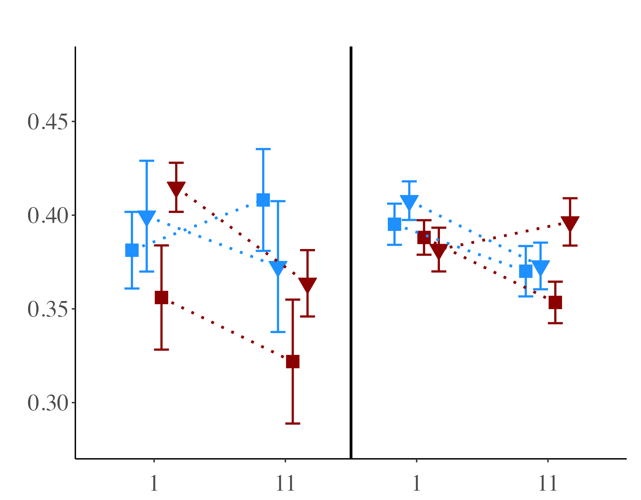
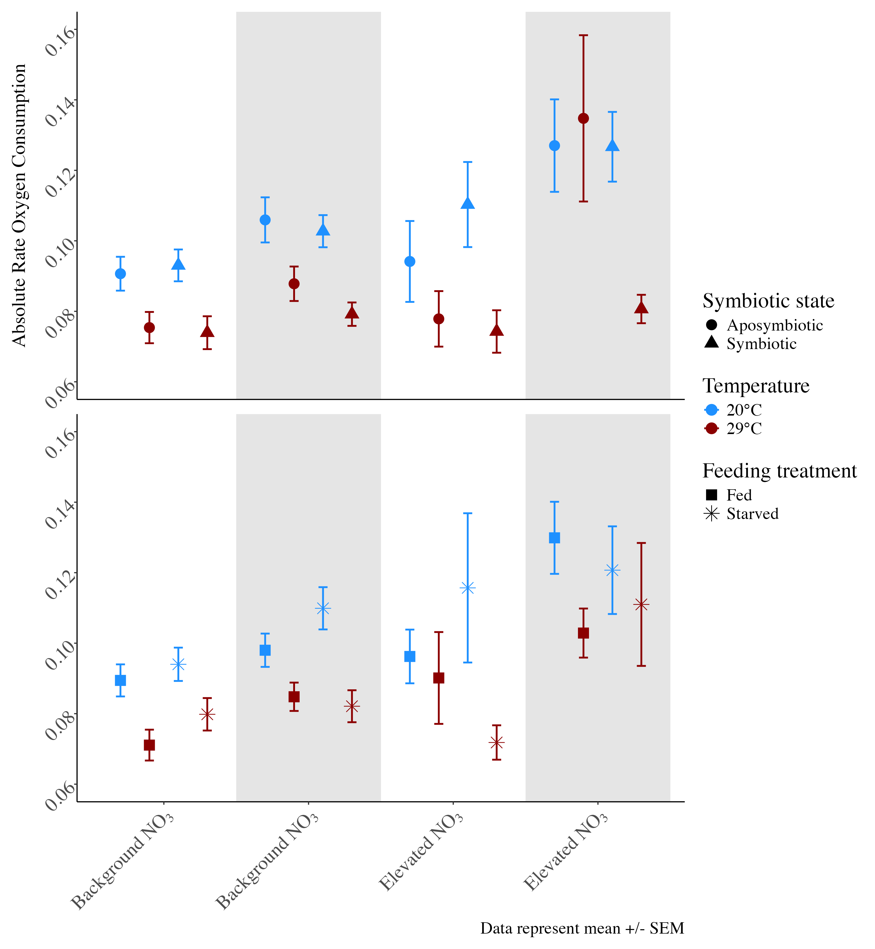
Photosynthetic efficiency (Fv/Fm)
A)
B)
Background NO₃
Elevated NO₃
Notes:
25

Slide 2
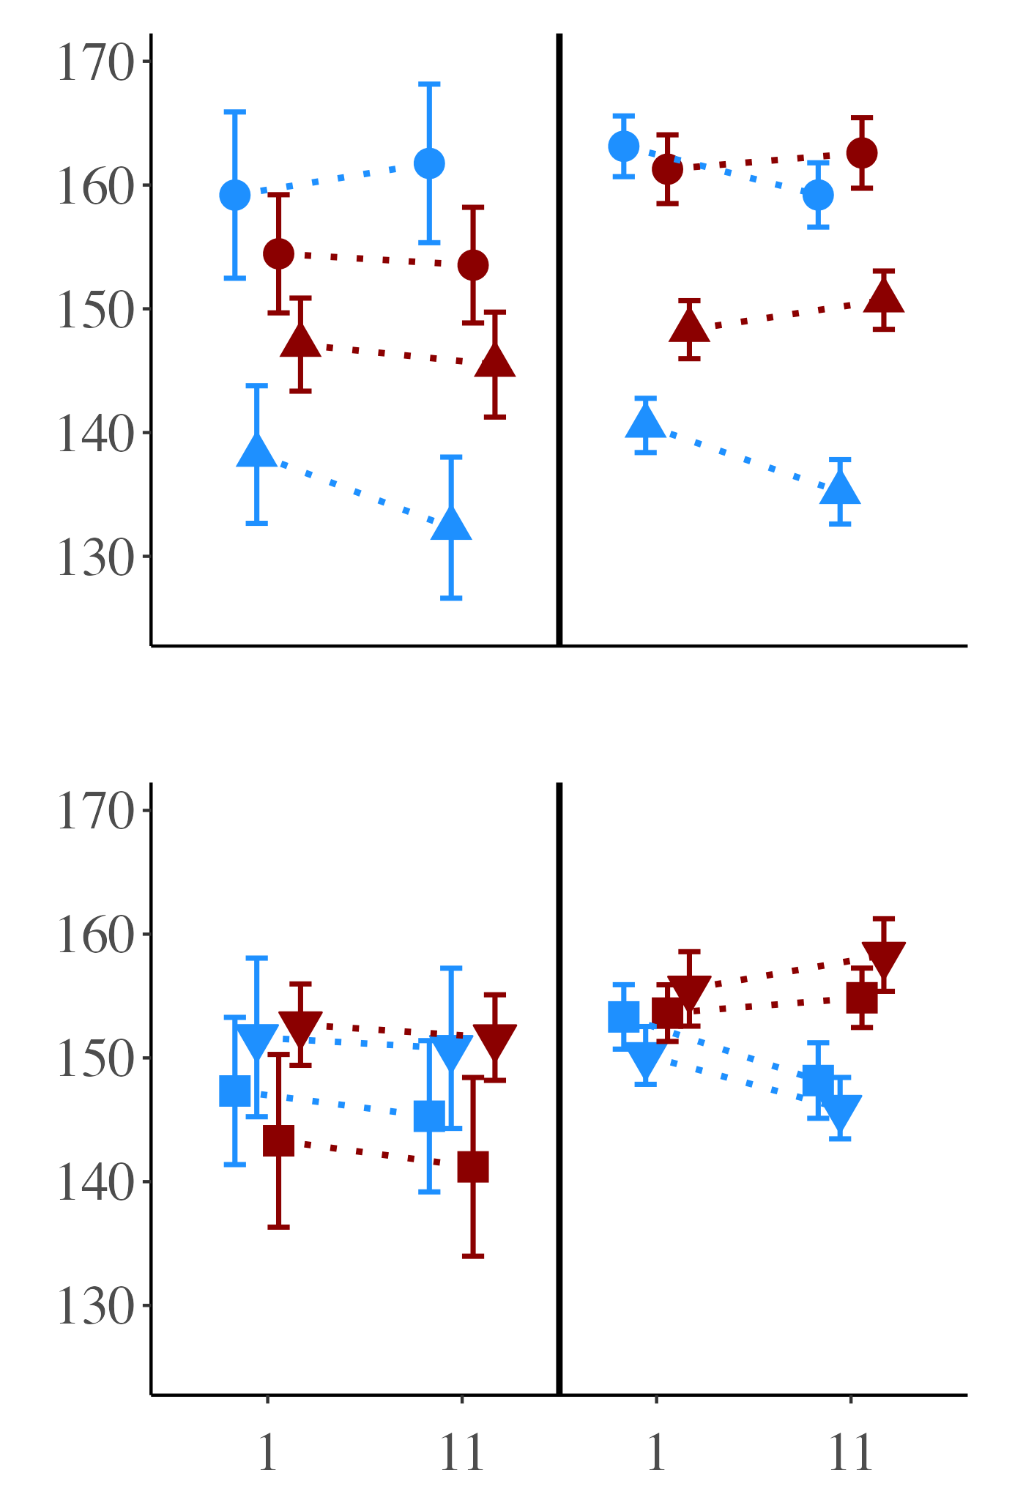
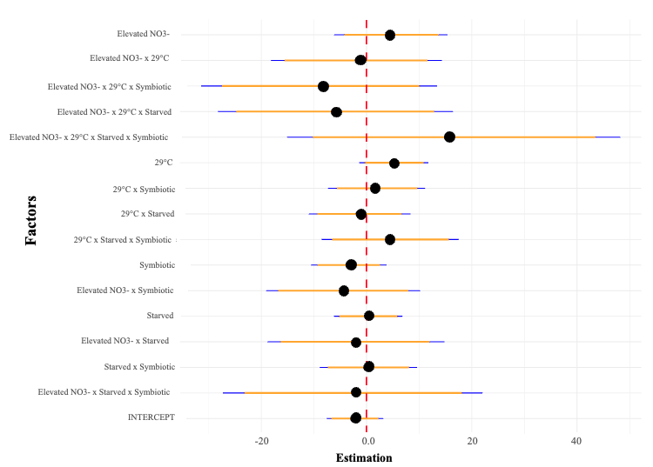
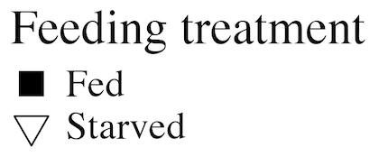
Symbiotic state: symbiotic vs. aposymbiotic
A)
B)
E)
Red Channel Value
Feeding treatment: fed vs. starved
C)
D)
Background NO₃
Elevated NO₃
Notes:
25

Slide 3
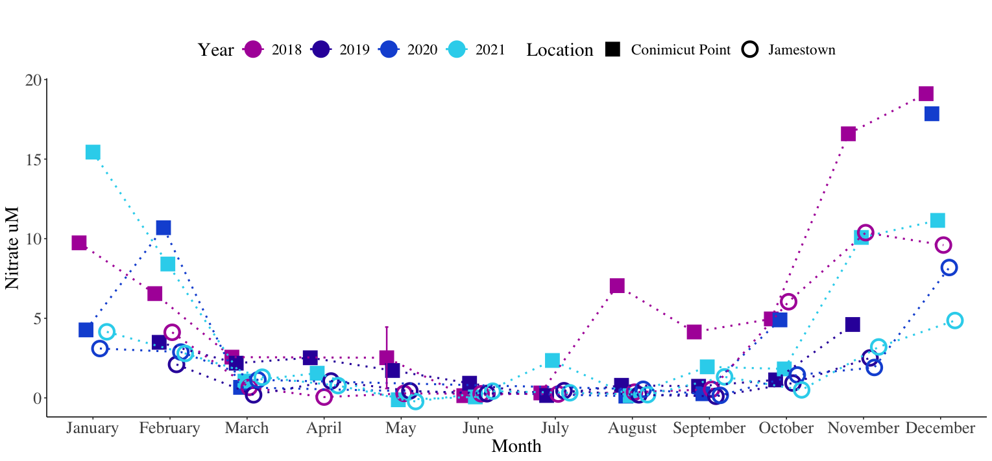

Slide 4
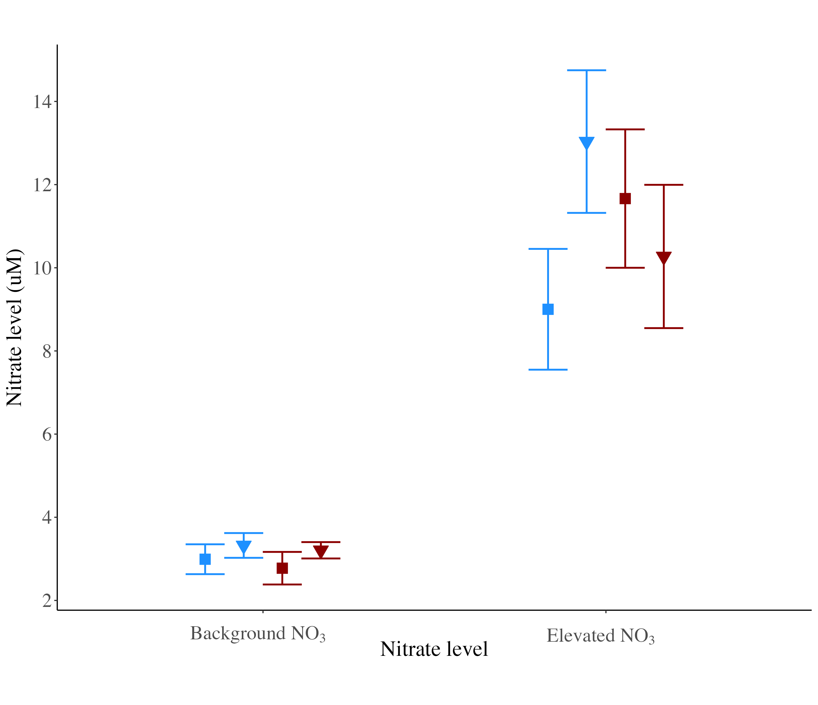

Slide 5
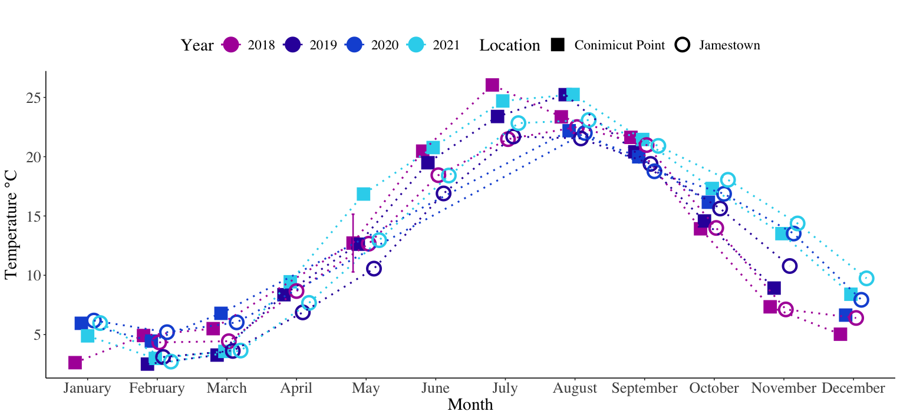

Slide 6
