Slide 1
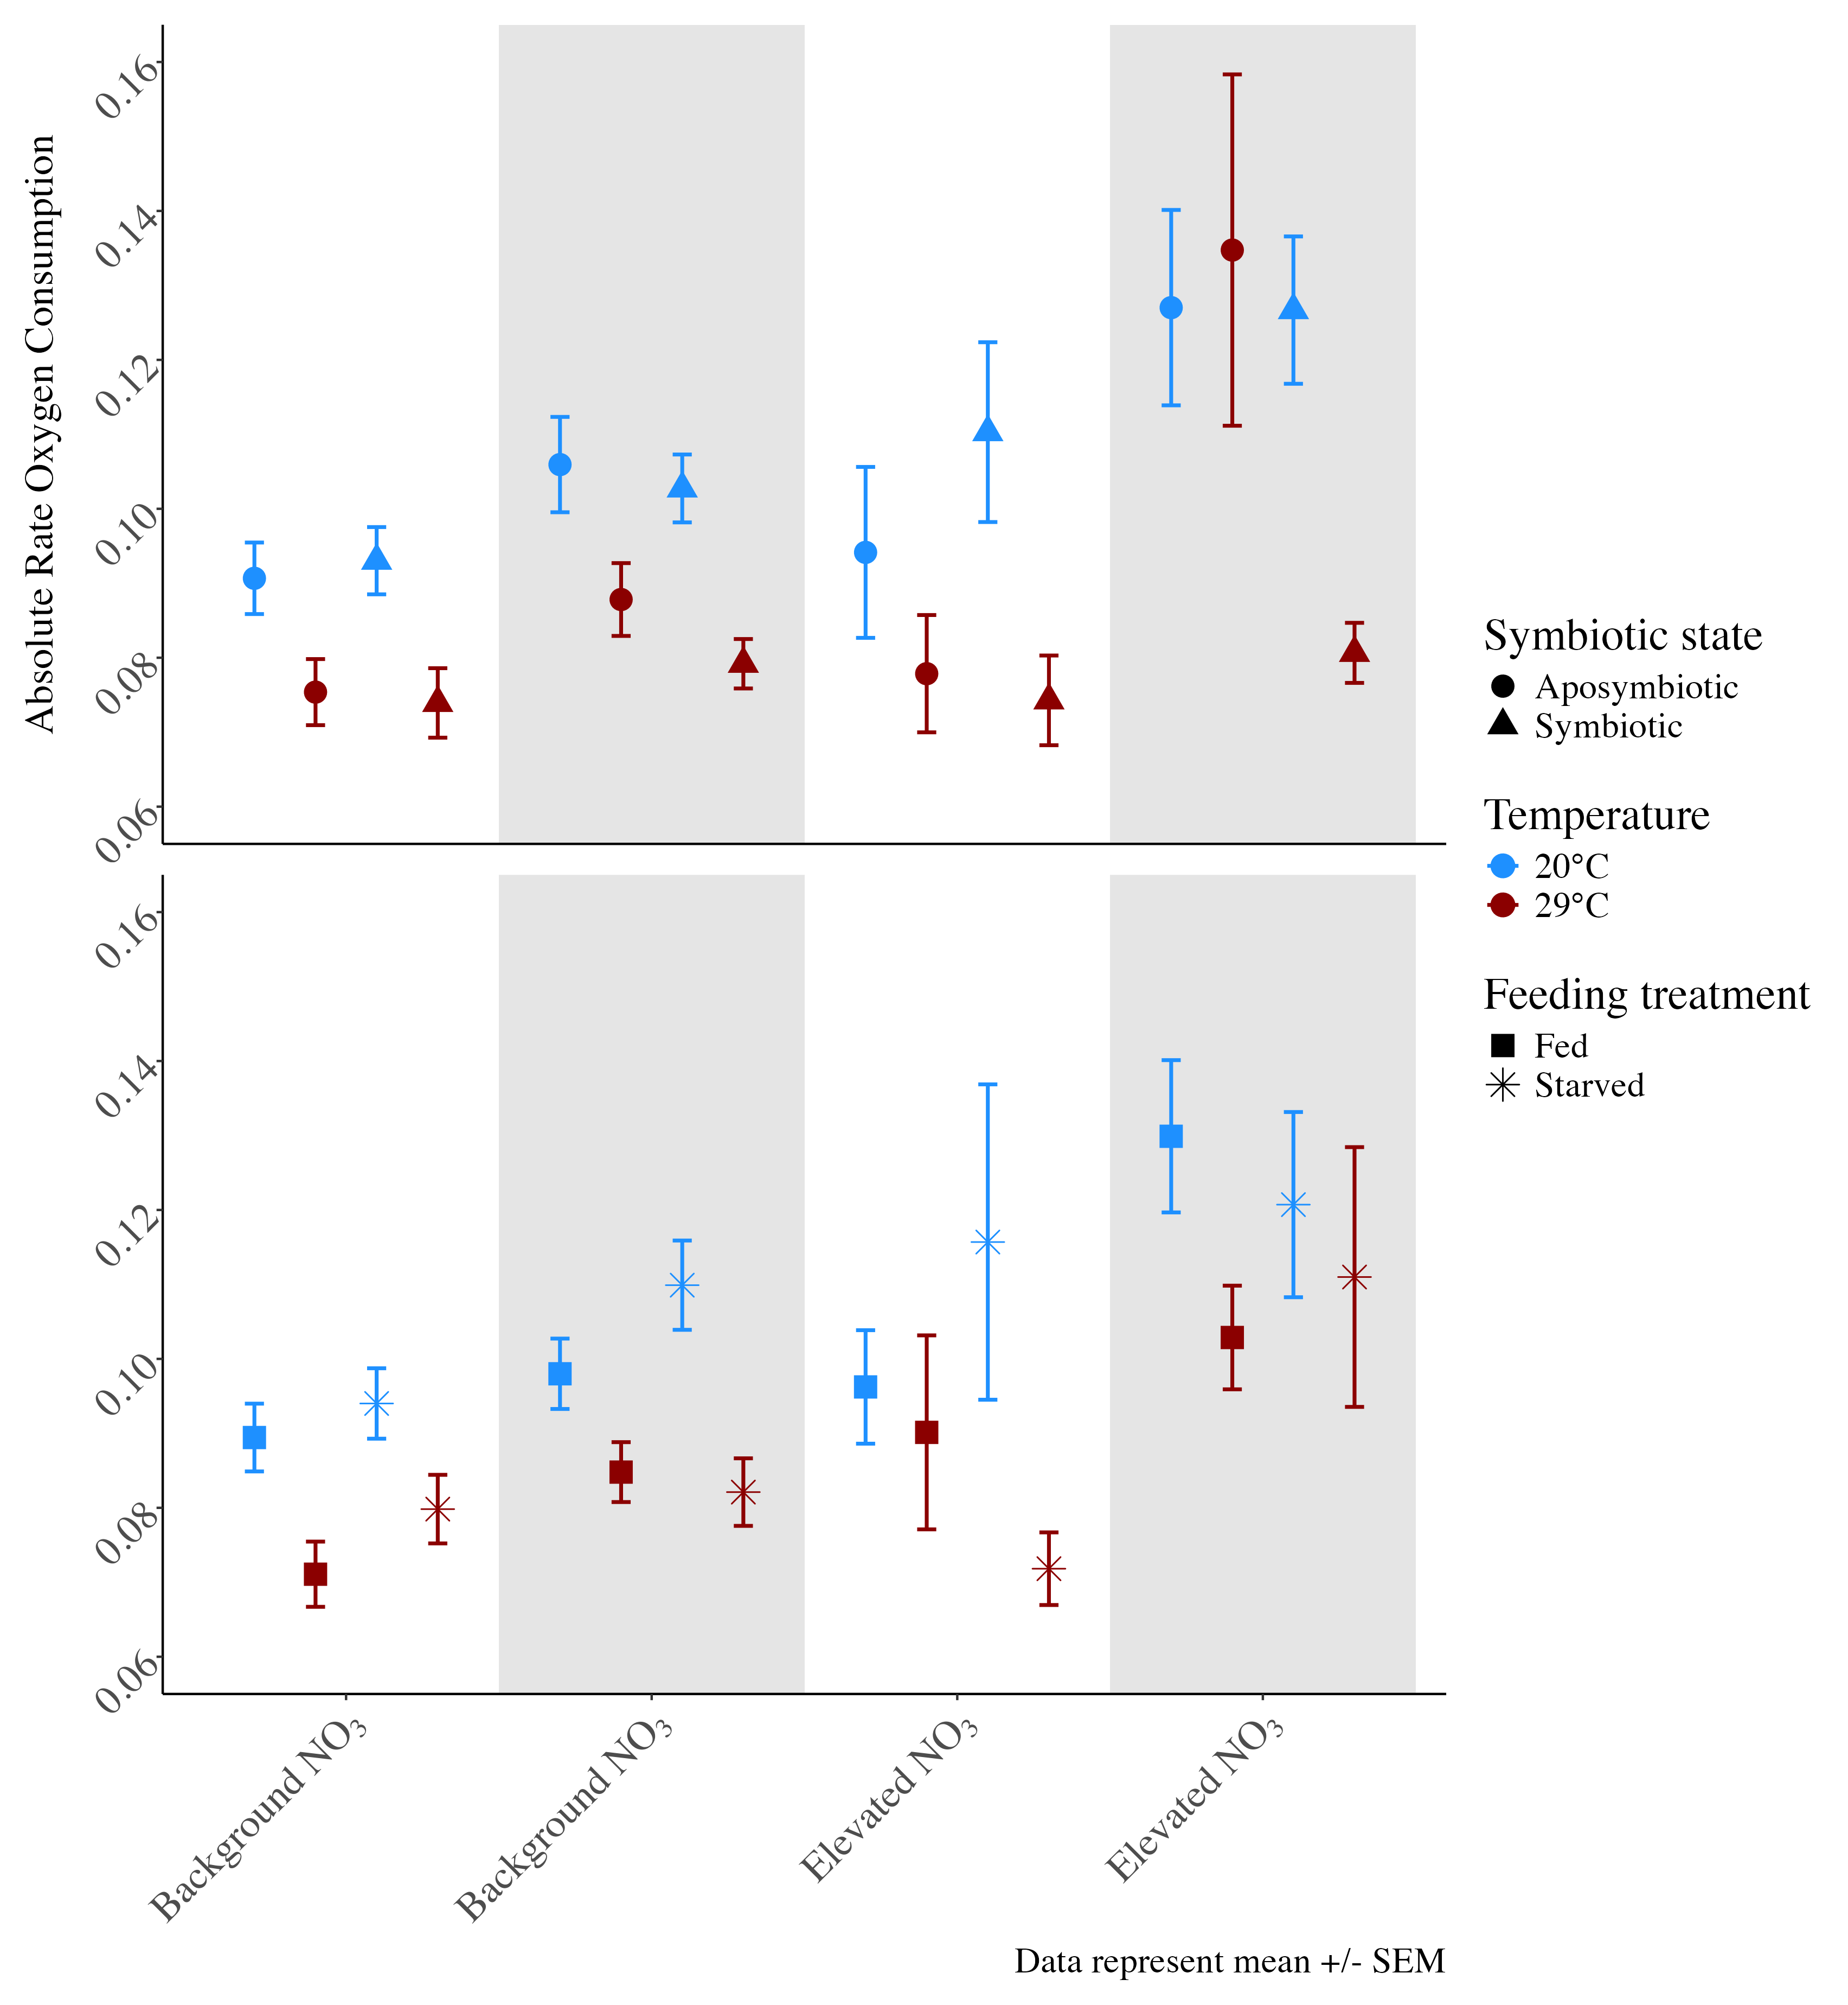
Symbiotic state: symbiotic vs. aposymbiotic
Absolute rate O₂ consumption (µmol/min/cm²)
B) Feeding treatment: fed versus starved
E. coli challenge
No E. coli
E. coli
Background NO₃
Elevated NO₃

Slide 2
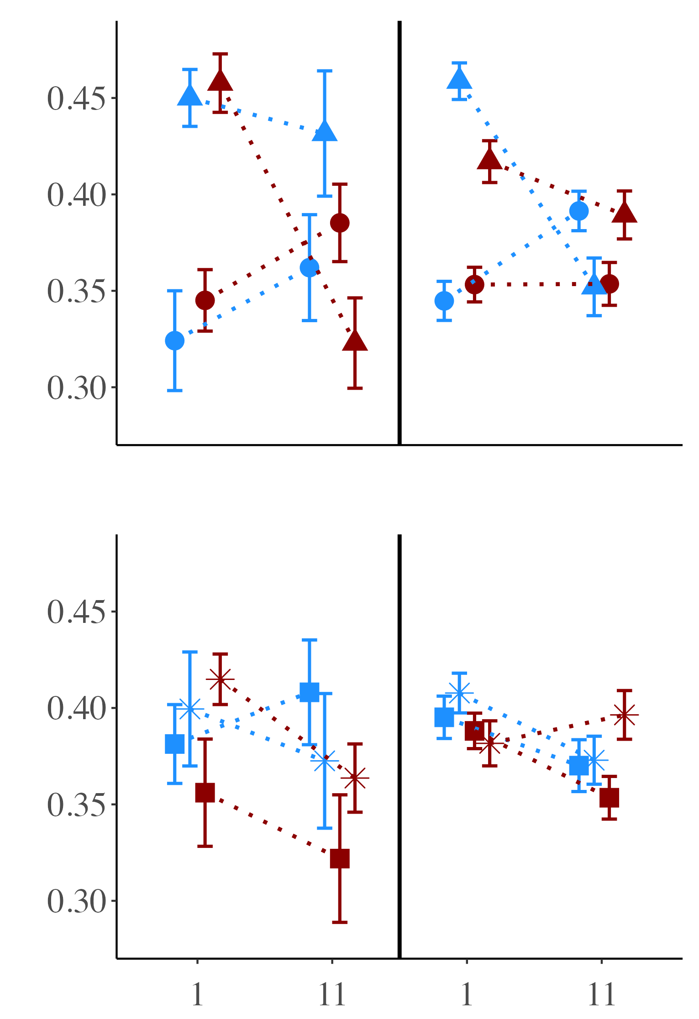
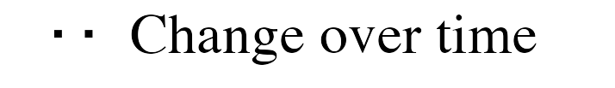
Symbiotic state
Photosynthetic efficiency (Fv/Fm)
B) Feeding treatment
Background NO₃
Elevated NO₃
Day of experiment

Slide 3
12-day experimental condition
4-hour acute challenge
NO₃
30°C
Starved
Symbiotic
E. coli
↑ Respiration rate
No effect
↓ Photo efficiency
↑ Photo efficiency
↓ Polyp extension
↑ Mortality
↓ Respiration rate
↓ Polyp extension
No effect

