Slide 1
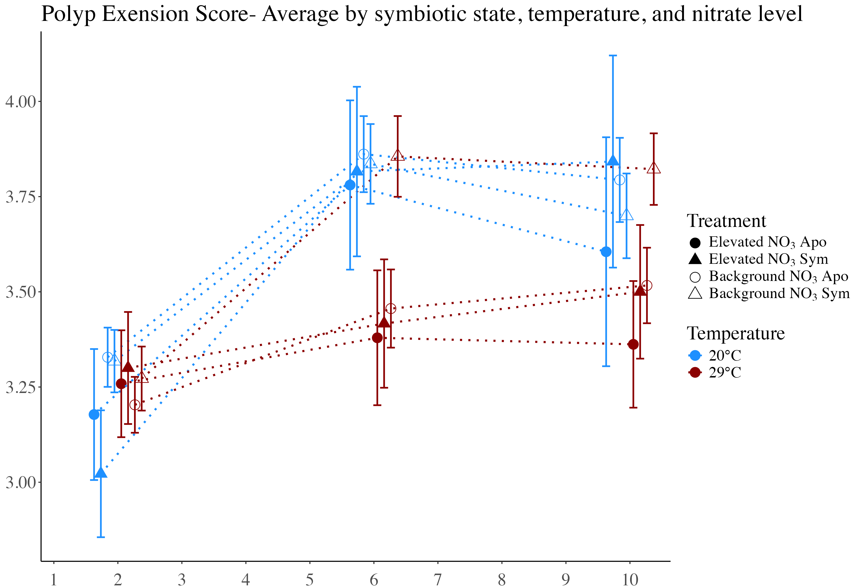
Average polyp extension score
Day of experiment

Slide 2
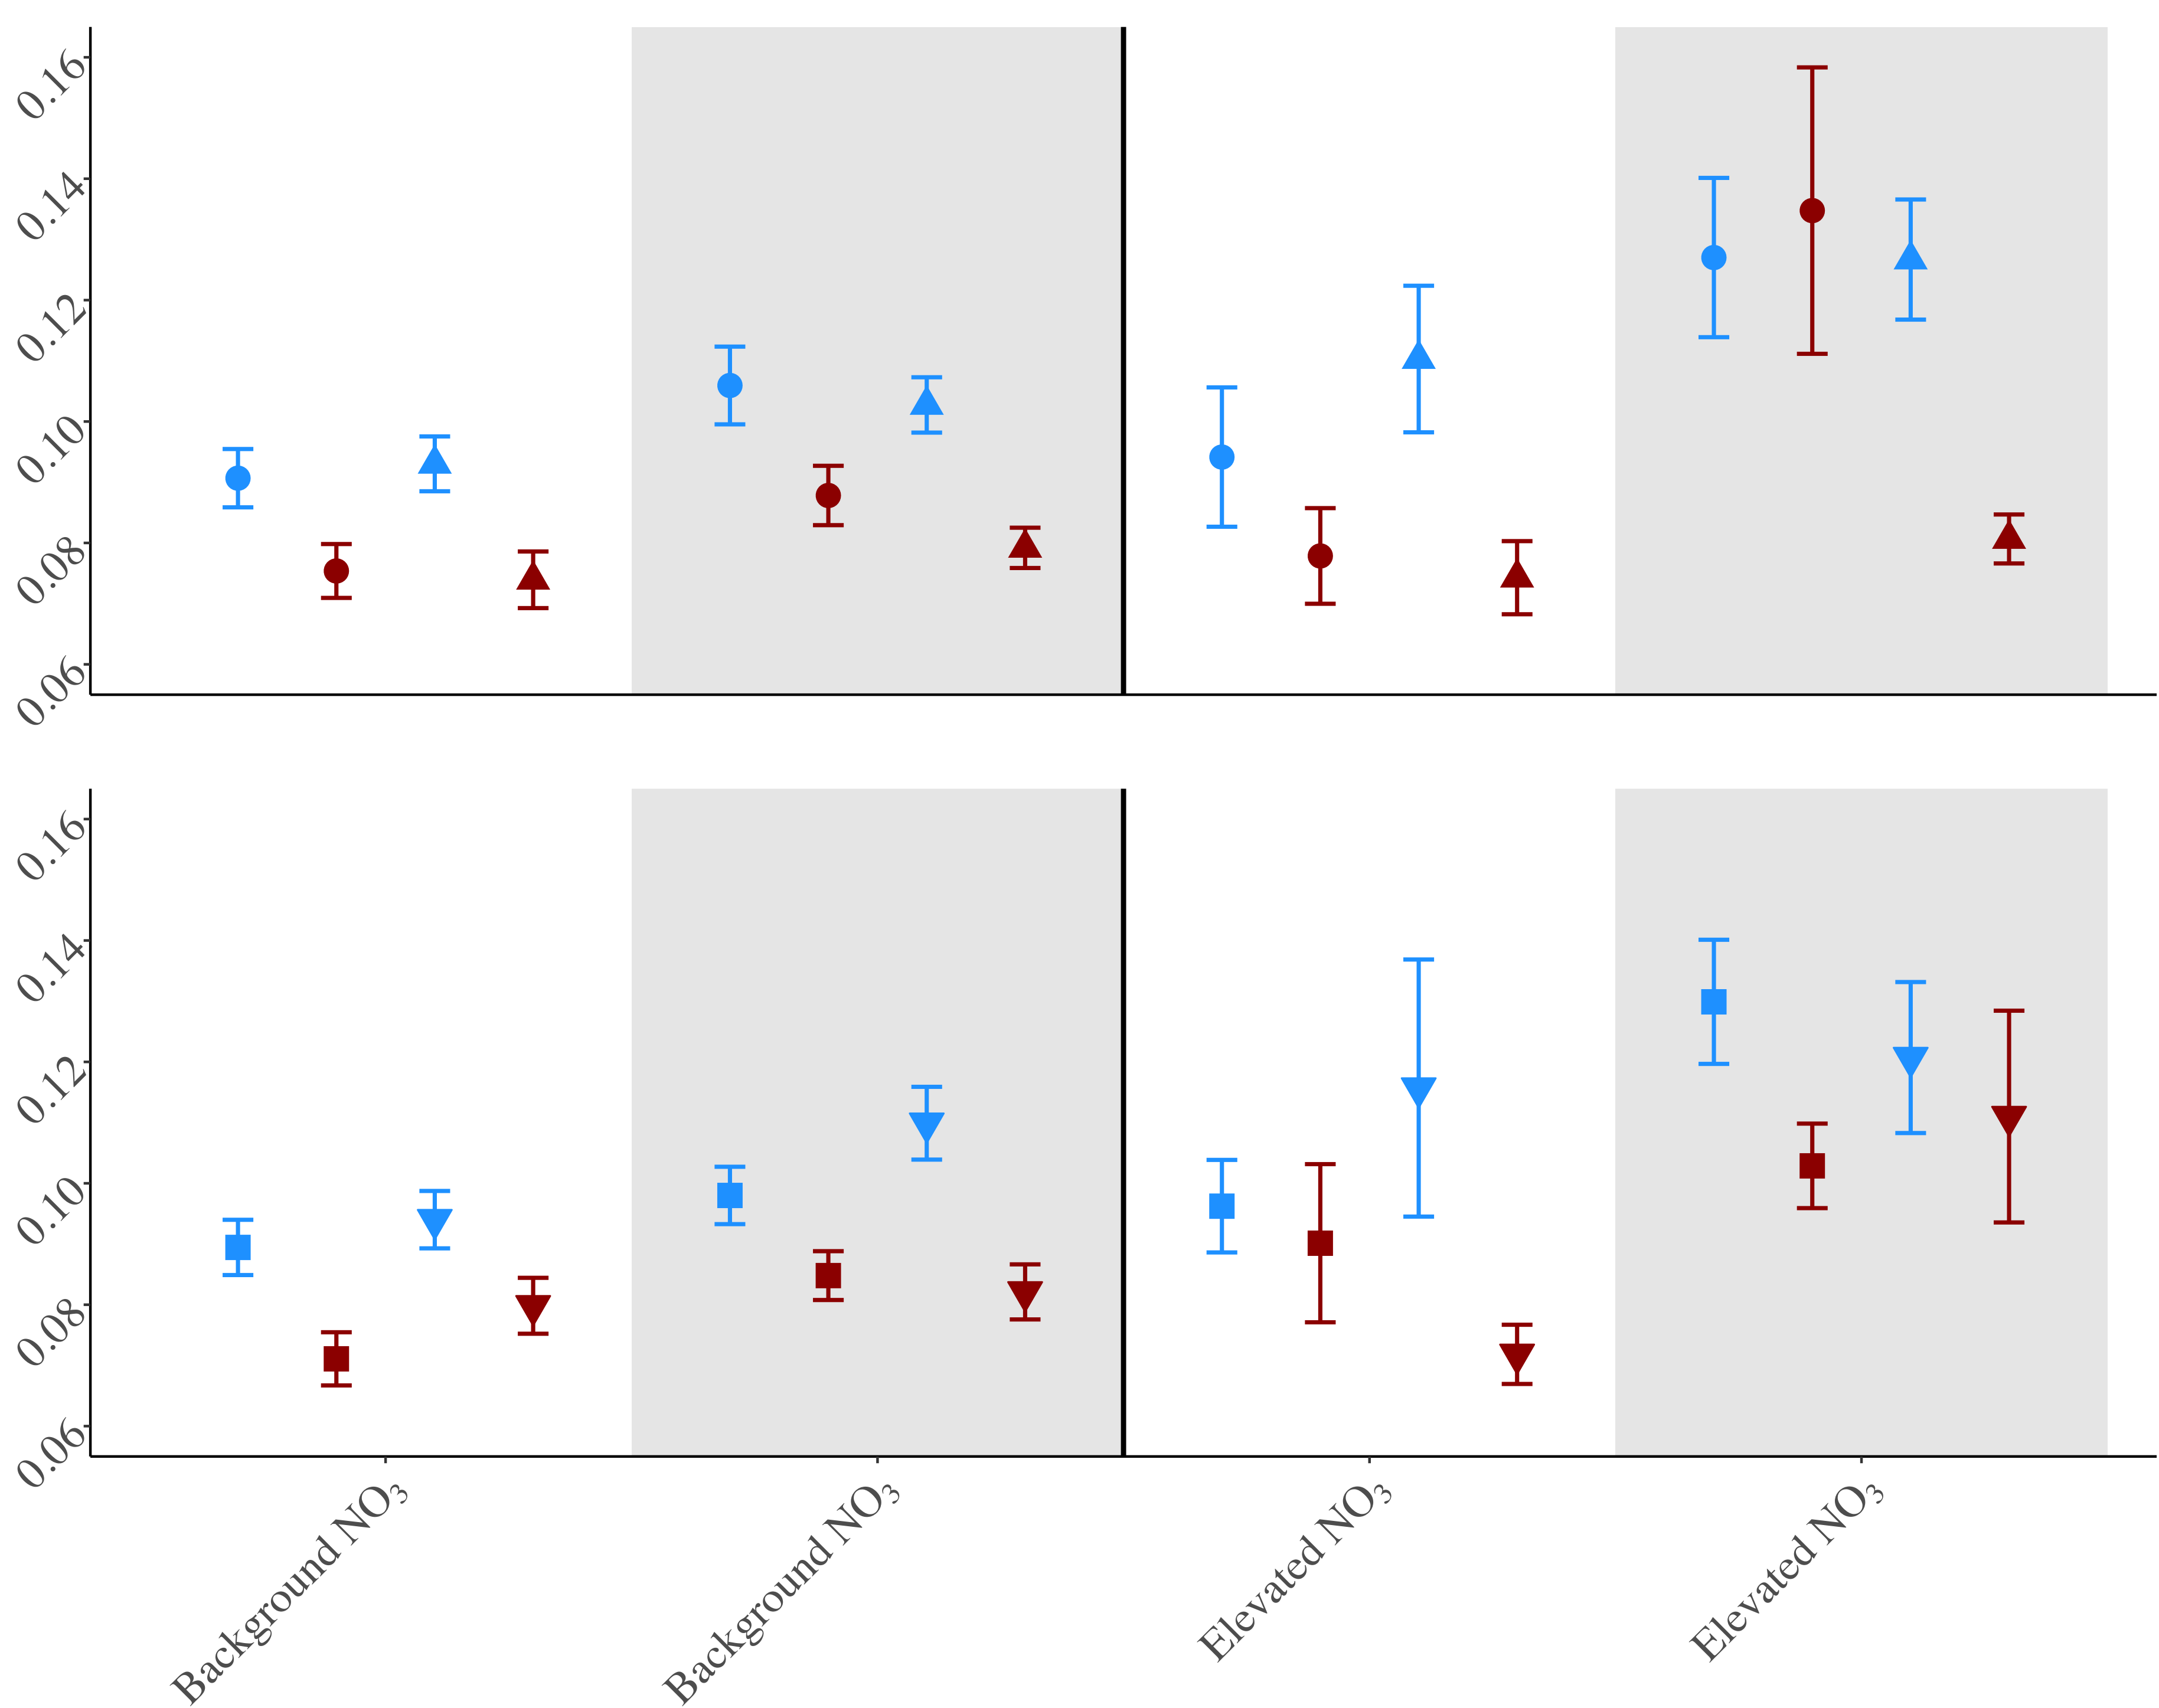
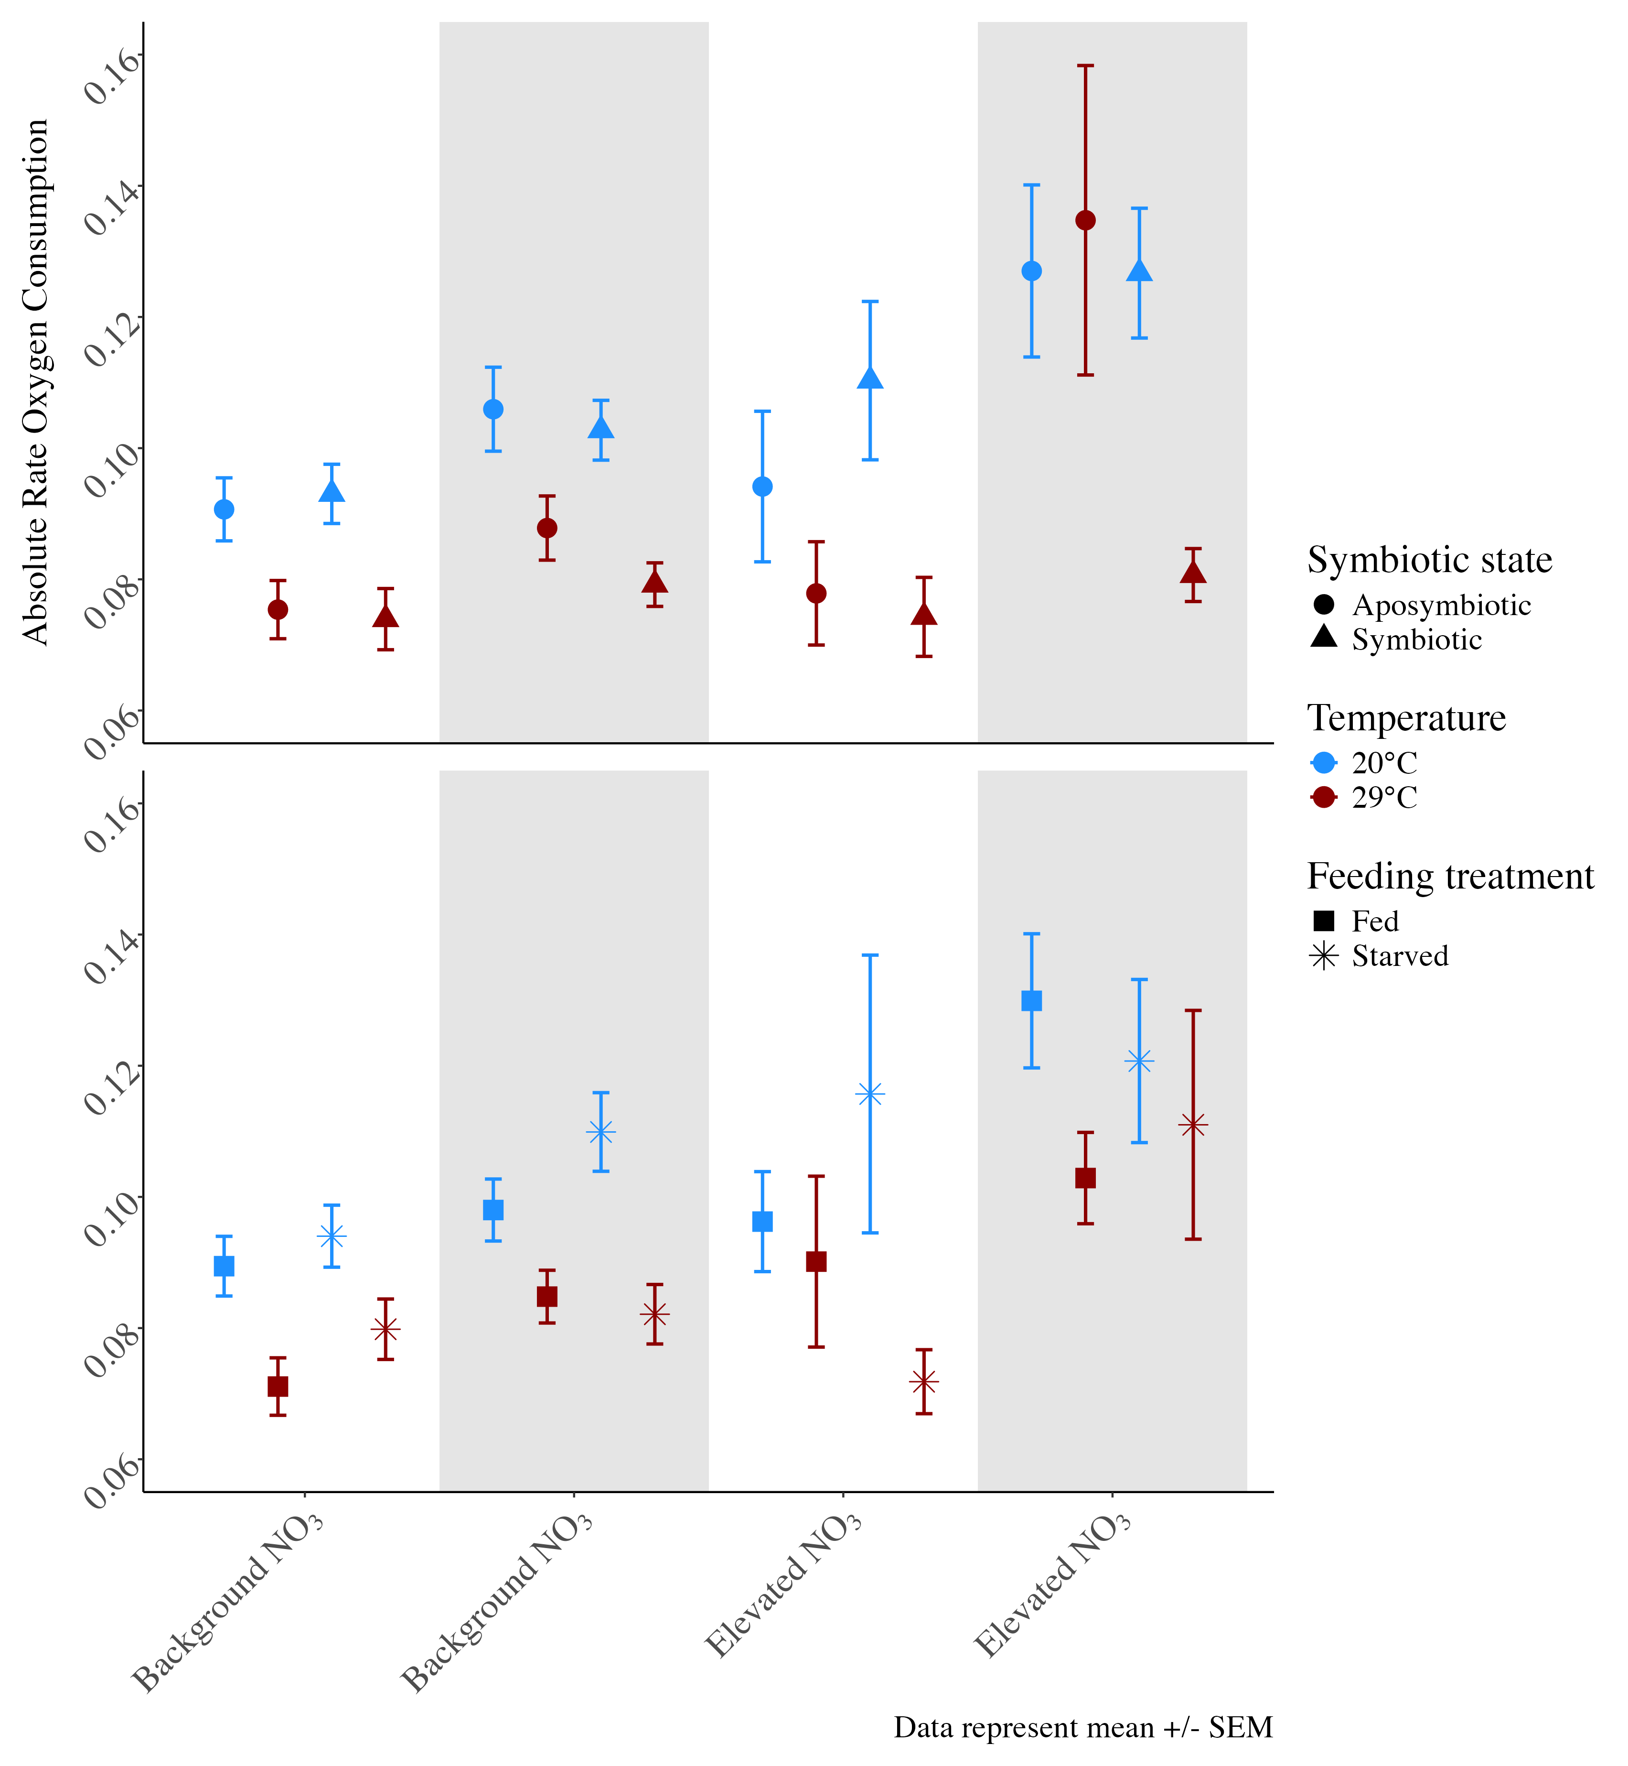
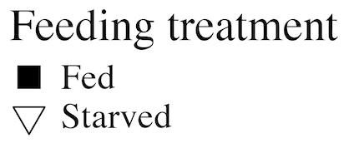
Symbiotic state: symbiotic vs. aposymbiotic
Absolute rate O₂ consumption (µmol/min/cm²)
B) Feeding treatment: fed versus starved
E. coli challenge
B) Feeding treatment: fed versus starved
No E. coli
E. coli
Background NO₃
Elevated NO₃

Slide 3
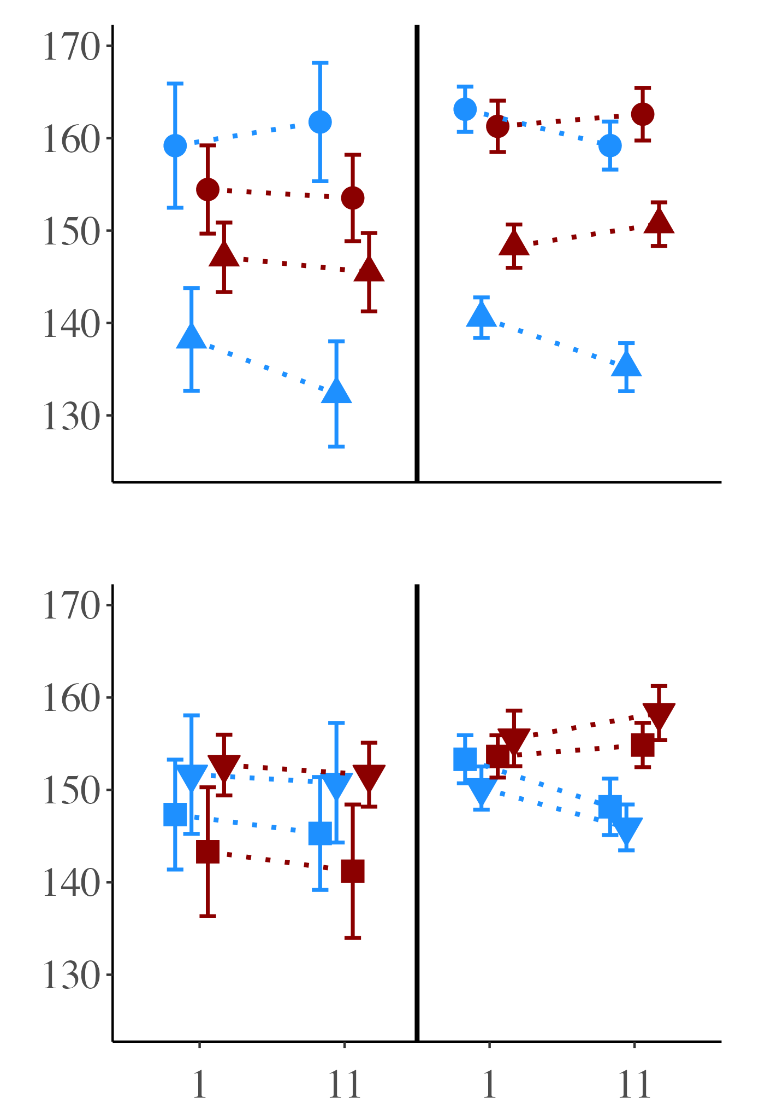
Symbiotic state: symbiotic vs. aposymbiotic
Red Channel Value
B) Feeding treatment: fed vs. starved
Background NO₃
Elevated NO₃
Notes:
25

Slide 4
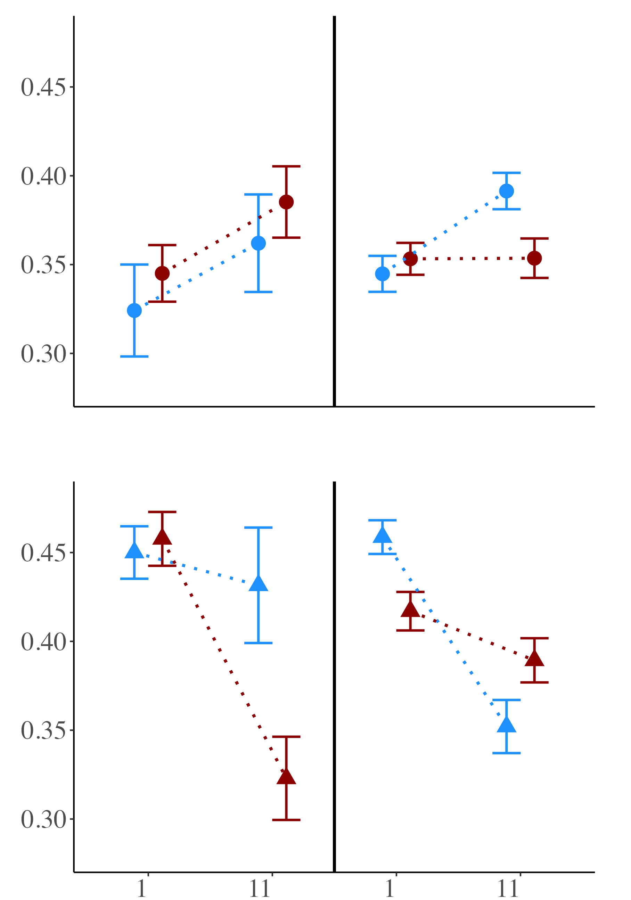
Aposymbiotic corals
B) Symbiotic corals
Photosynthetic efficiency (Fv/Fm)
Background NO₃
Elevated NO₃
Notes:
25

Slide 5
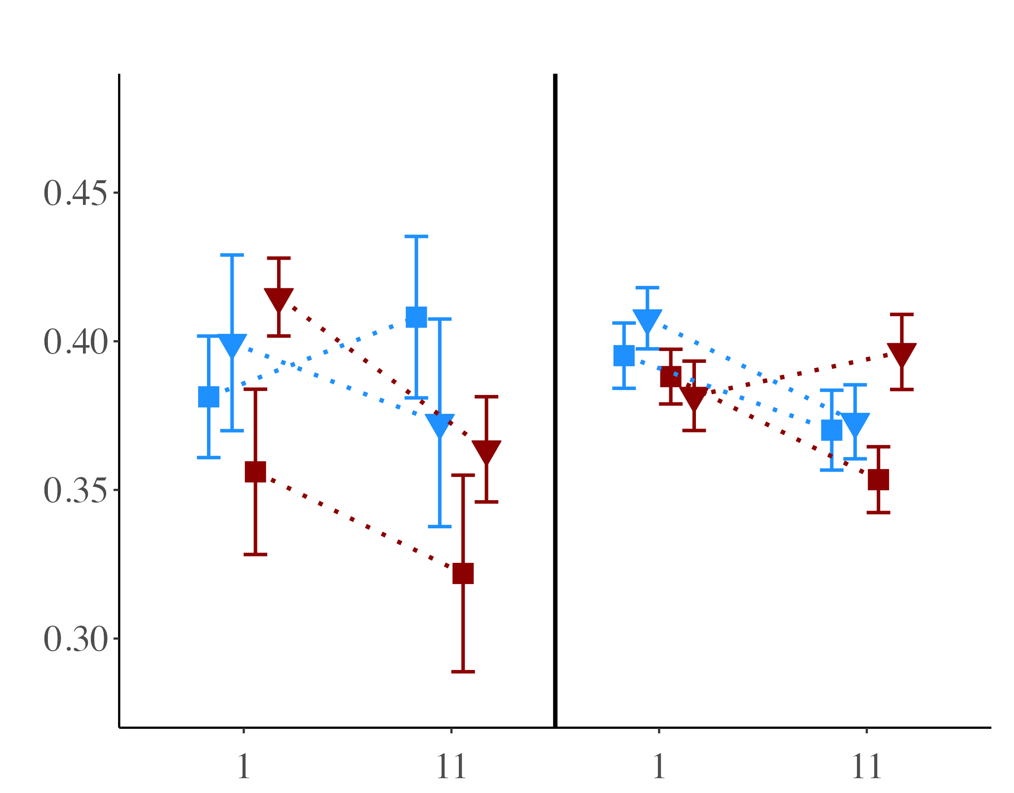
Photosynthetic efficiency (Fv/Fm)
Background NO₃
Elevated NO₃
Notes:
25

Slide 6
12-day experimental condition
4-hour acute challenge
Key
Single factor response
Dual factor response
Multi-factor response
NO₃
30°C
Starved
Symbiotic
E. coli
↑ Respiration rate
No effect
↓ Photo efficiency
↑ Photo efficiency
↓ Polyp extension
↑ Mortality
↓ Respiration rate
↓ Polyp extension
No effect

Slide 7
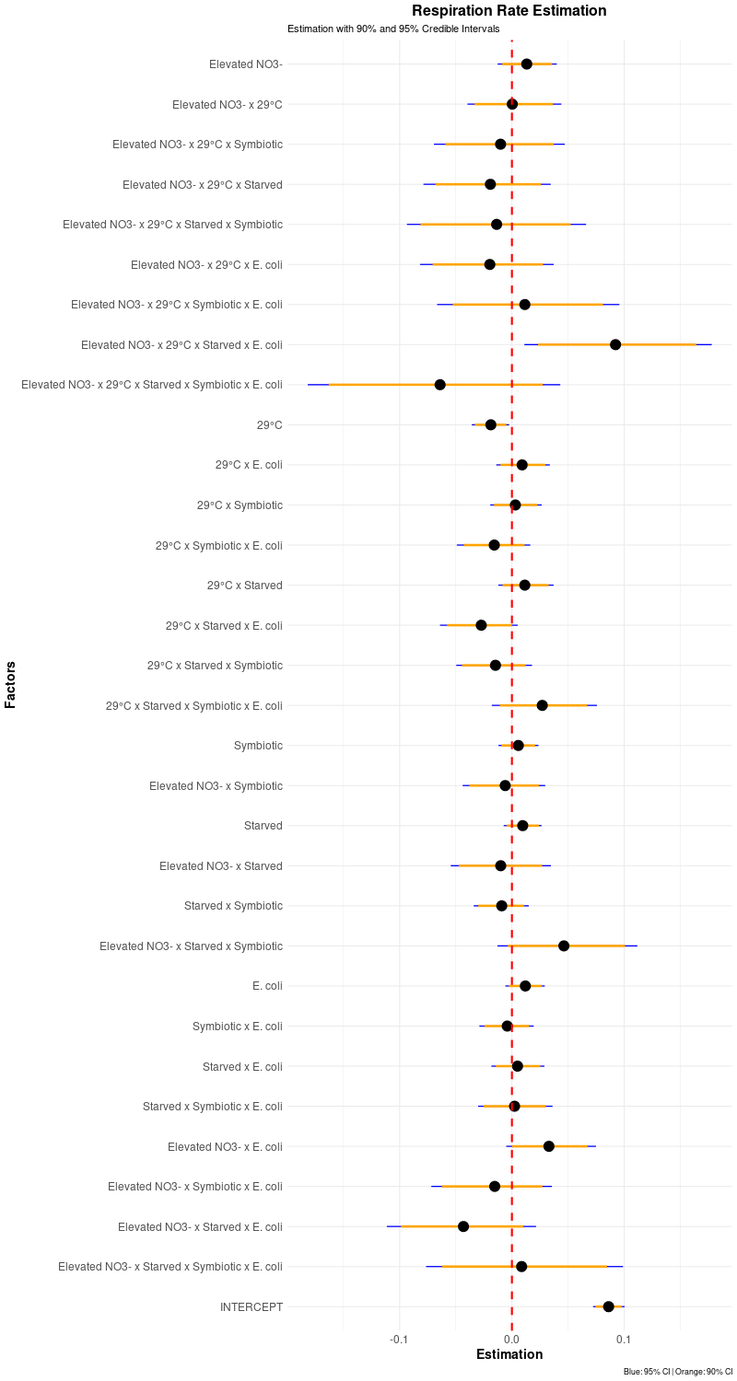
Covariates

Slide 8
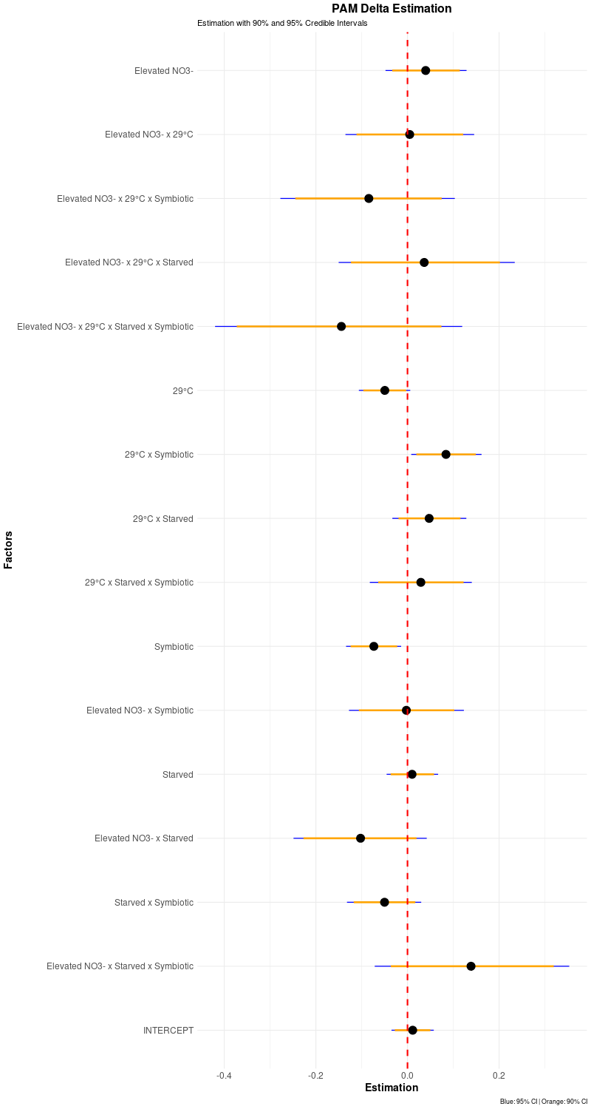
PAM delta
Covariates

Slide 9
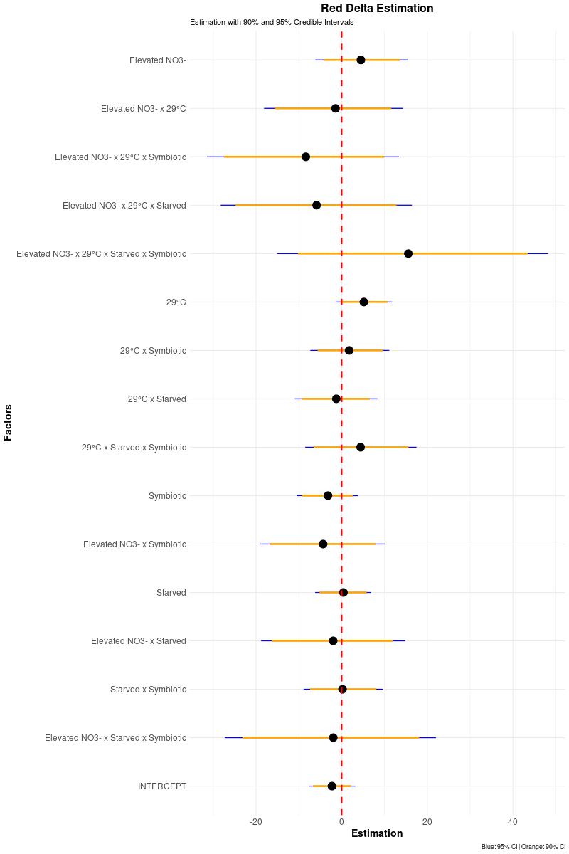
RGB delta
Covariates

