Slide 1
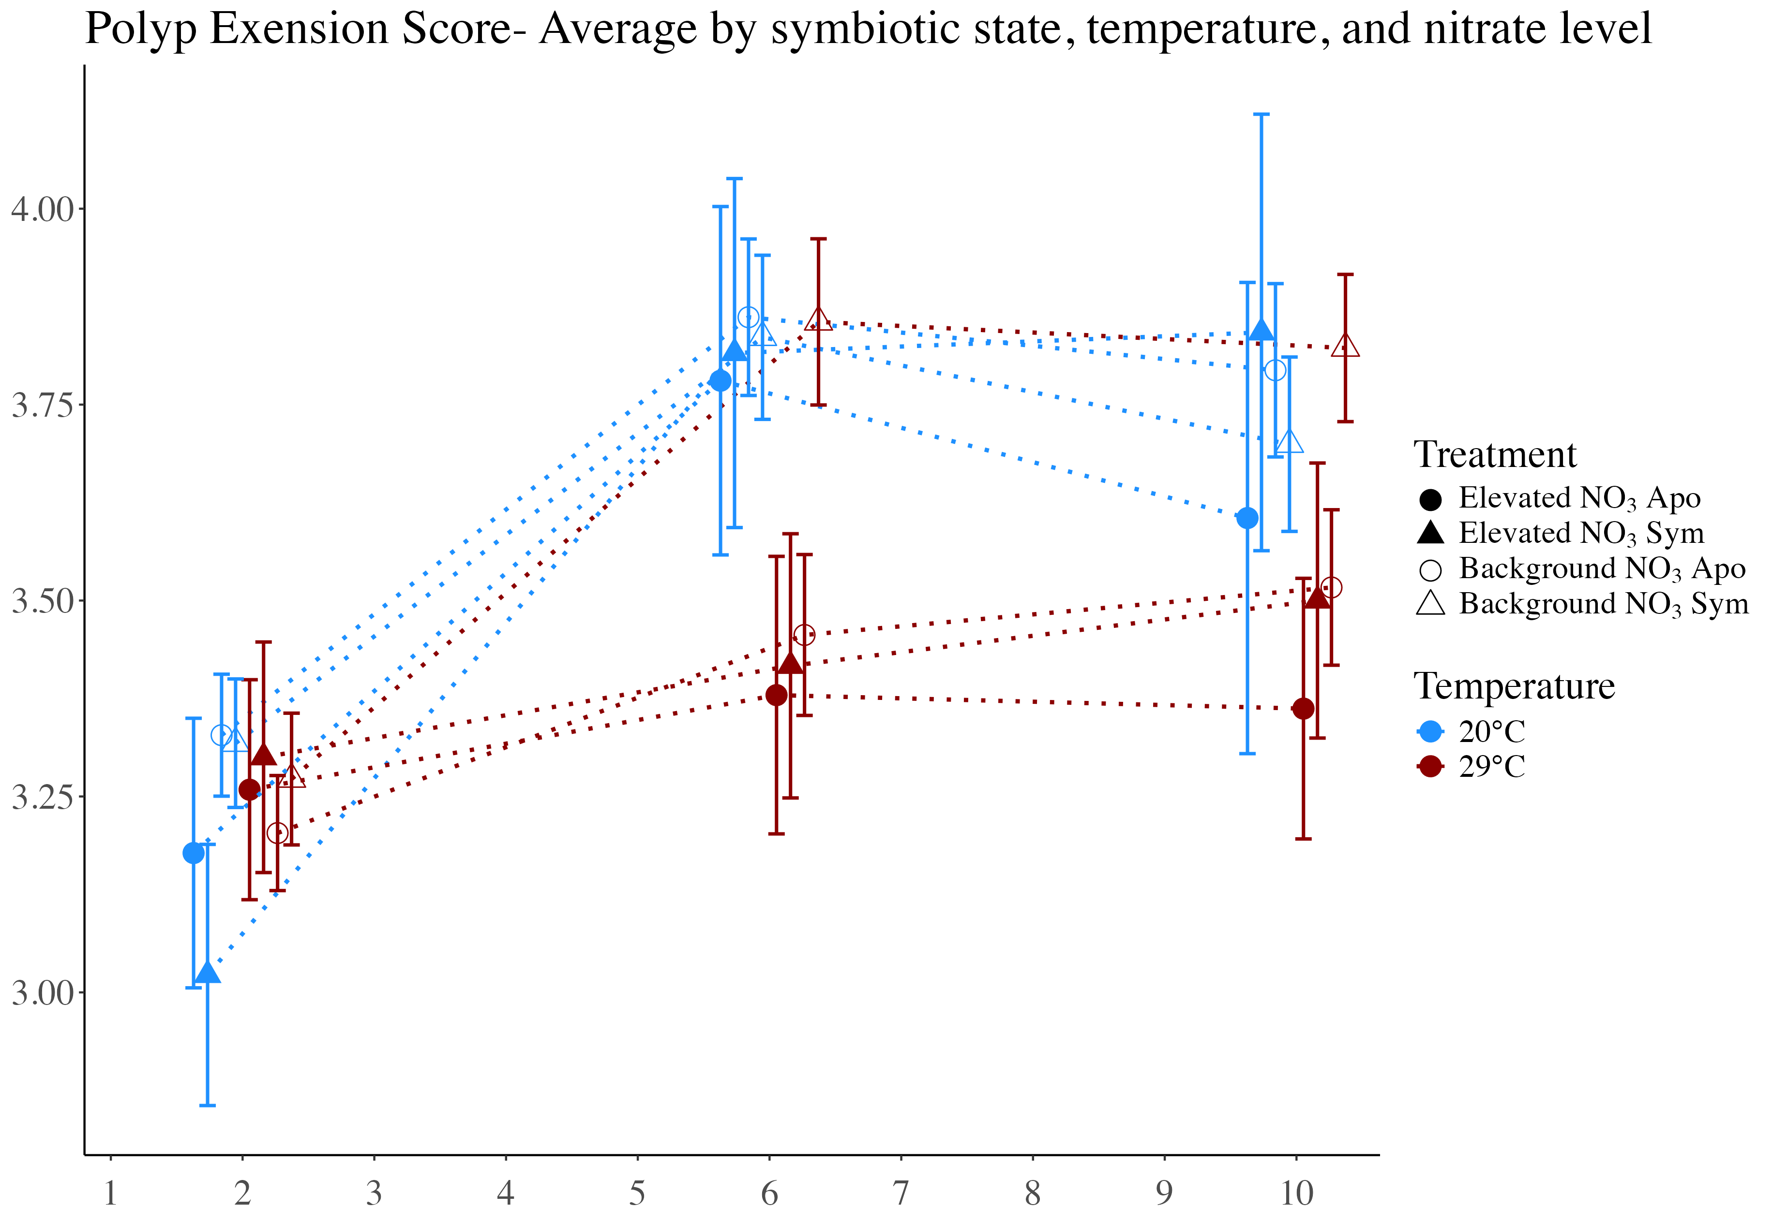
Average polyp extension score
Day of experiment

Slide 2
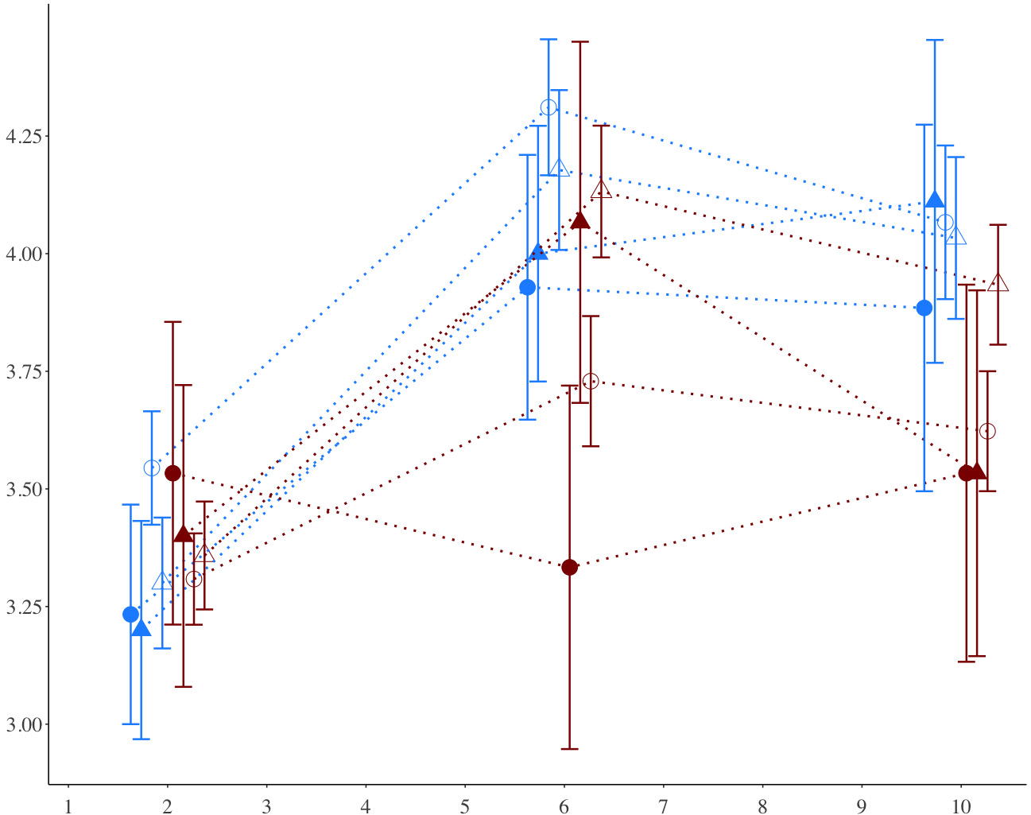
Average polyp extension score
Day of experiment

Slide 3
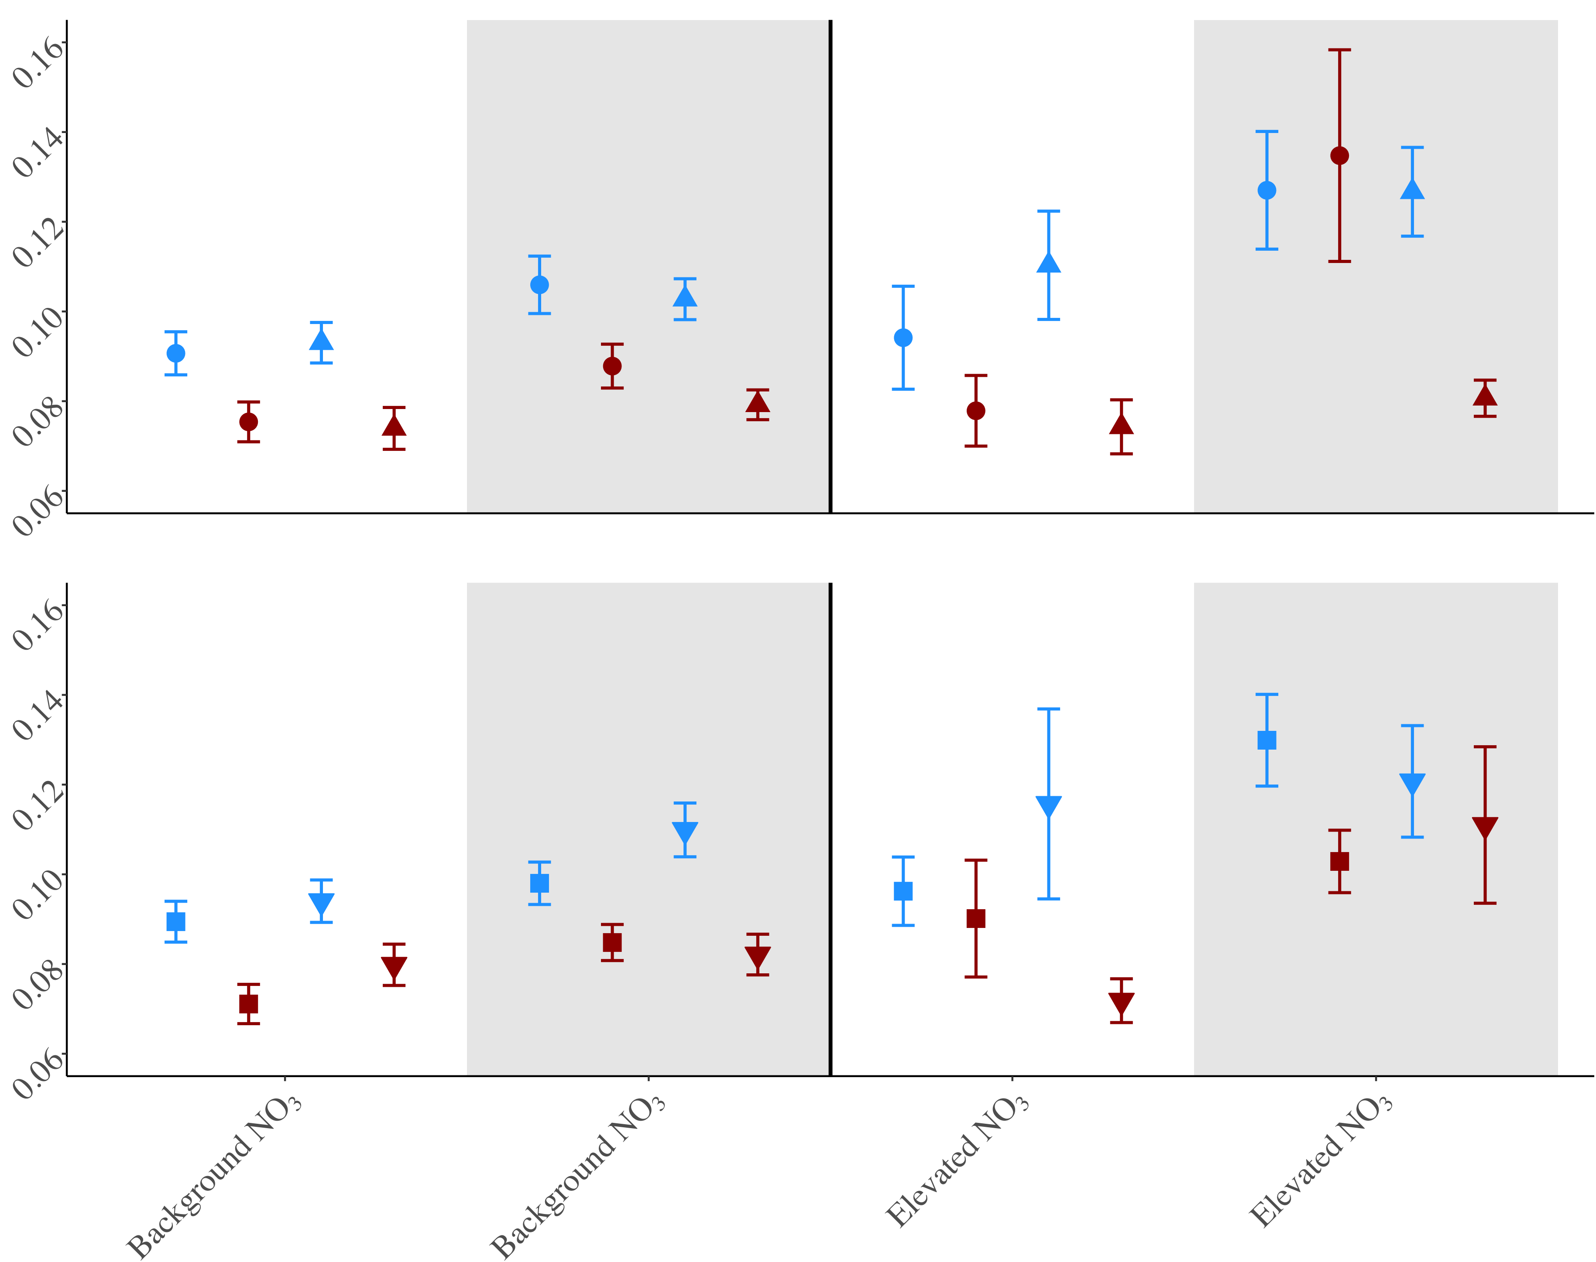
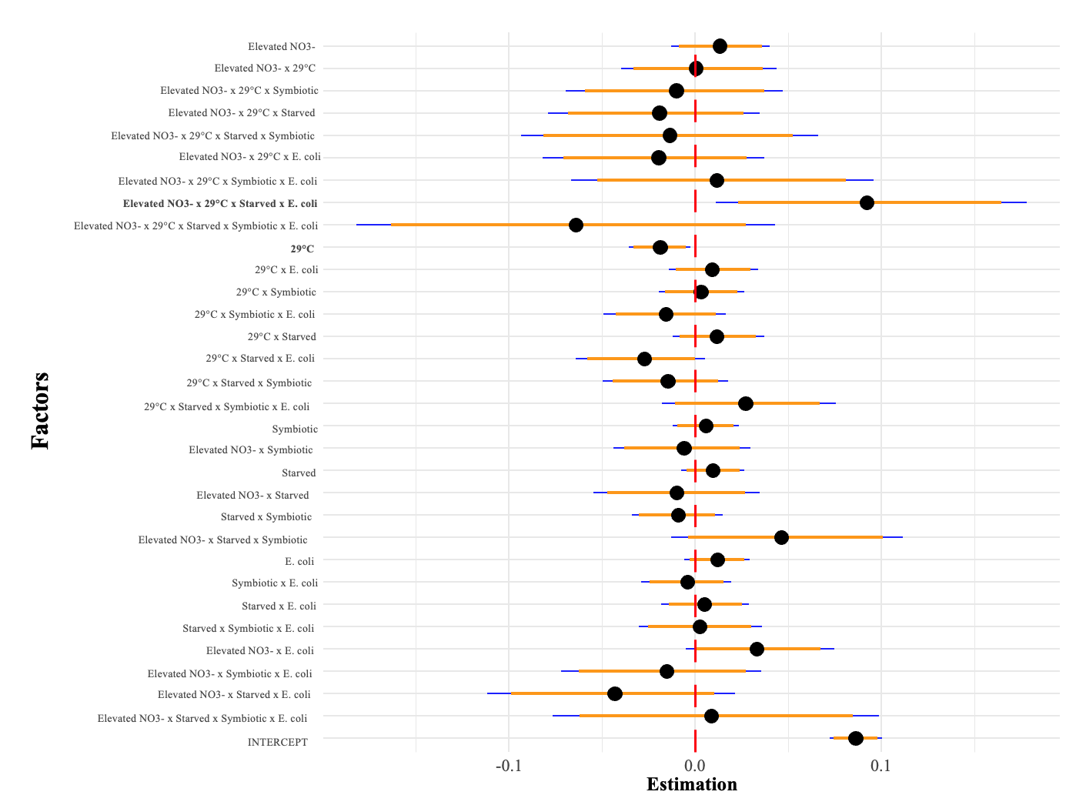
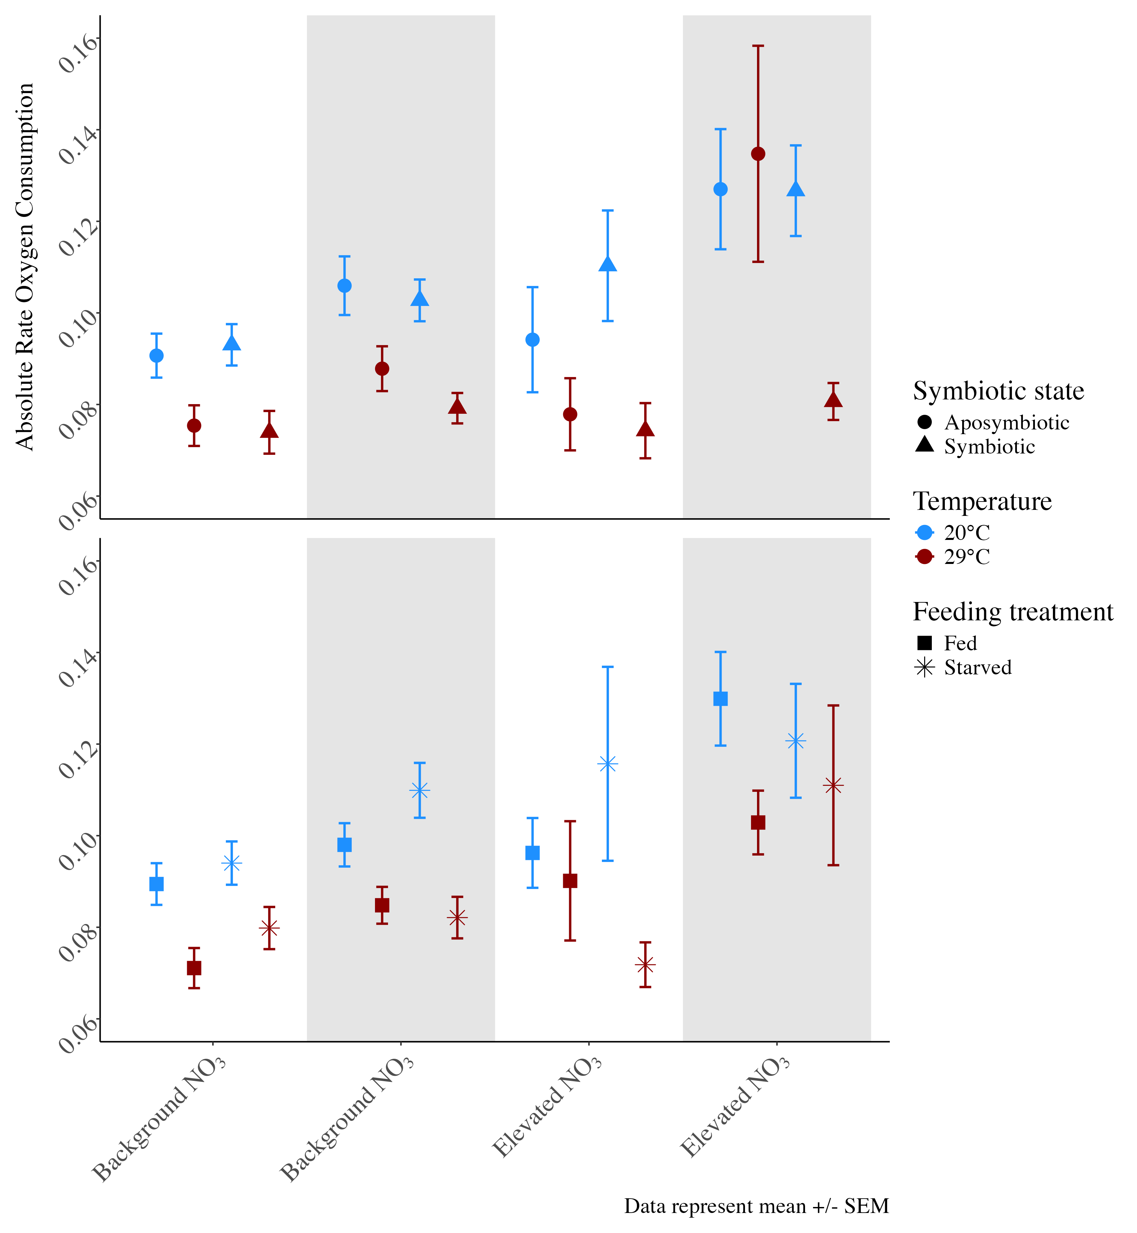
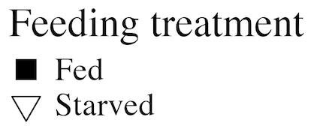
Symbiotic state: symbiotic vs. aposymbiotic
C) Bayesian Coefficients
Absolute rate O₂ consumption (µmol/min/cm²)
B) Feeding treatment: fed versus starved
B) Feeding treatment: fed versus starved
Background NO₃
Elevated NO₃
E. coli challenge
No E. coli
E. coli

Slide 4
Elevated NO3-
Elevated NO3- x 29°C
Elevated NO3- x 29°C x Symbiotic
Elevated NO3- x 29°C x Starved
Elevated NO3- x 29°C x Starved x Symbiotic
Elevated NO3- x 29°C x E. coli
Elevated NO3- x 29°C x Symbiotic x E. coli
Elevated NO3- x 29°C x Starved x E. coli
Elevated NO3- x 29°C x Starved x Symbiotic x E. coli
29°C
29°C x E. coli
29°C x Symbiotic
29°C x Symbiotic x E. coli
29°C x Starved
29°C x Starved x E. coli
29°C x Starved x Symbiotic
Factors
29°C x Starved x Symbiotic x E. coli
Symbiotic
Elevated NO3- x Symbiotic
Starved
Elevated NO3- x Starved
Starved x Symbiotic
Elevated NO3- x Starved x Symbiotic
E. coli
Symbiotic x E. coli
Starved x E. coli
Starved x Symbiotic x E. coli
Elevated NO3- x E. coli
Elevated NO3- x Symbiotic x E. coli
Elevated NO3- x Starved x E. coli
Elevated NO3- x Starved x Symbiotic x E. coli
INTERCEPT
-0.1
0.0
0.1
Estimation

Slide 5
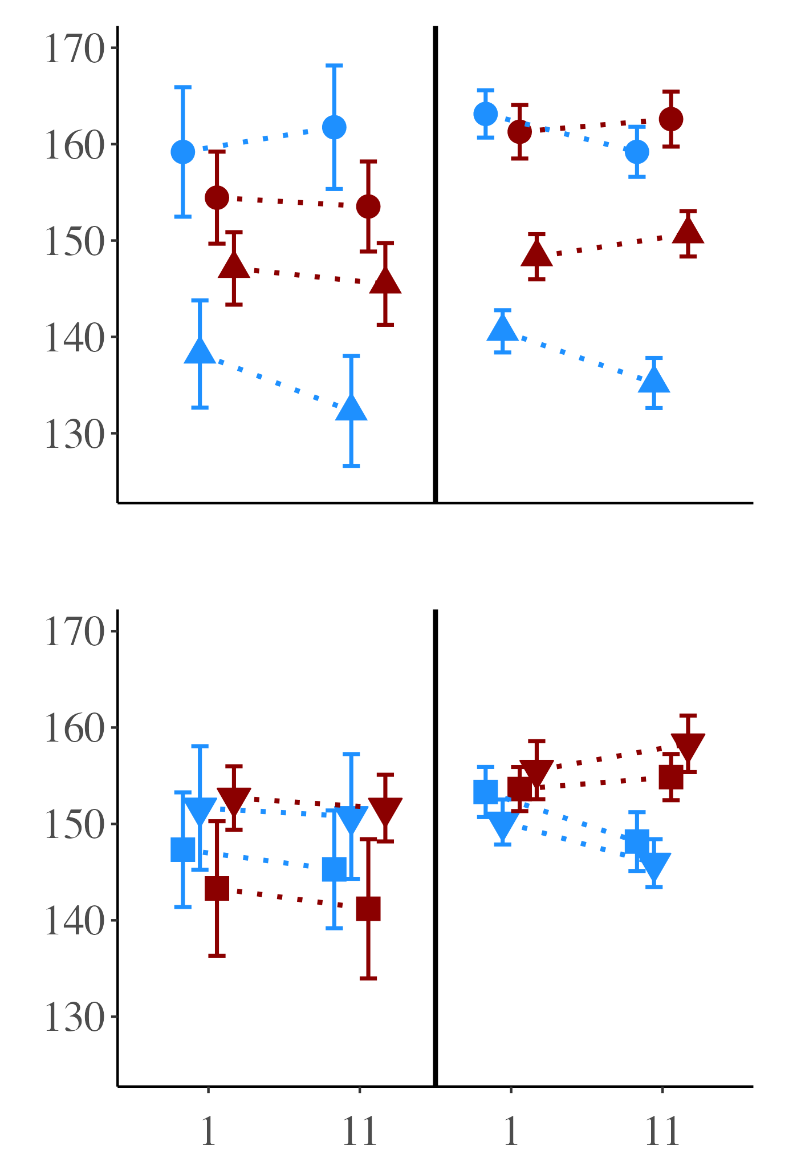
Symbiotic state: symbiotic vs. aposymbiotic
Red Channel Value
B) Feeding treatment: fed vs. starved
Background NO₃
Elevated NO₃
Notes:
25

Slide 6
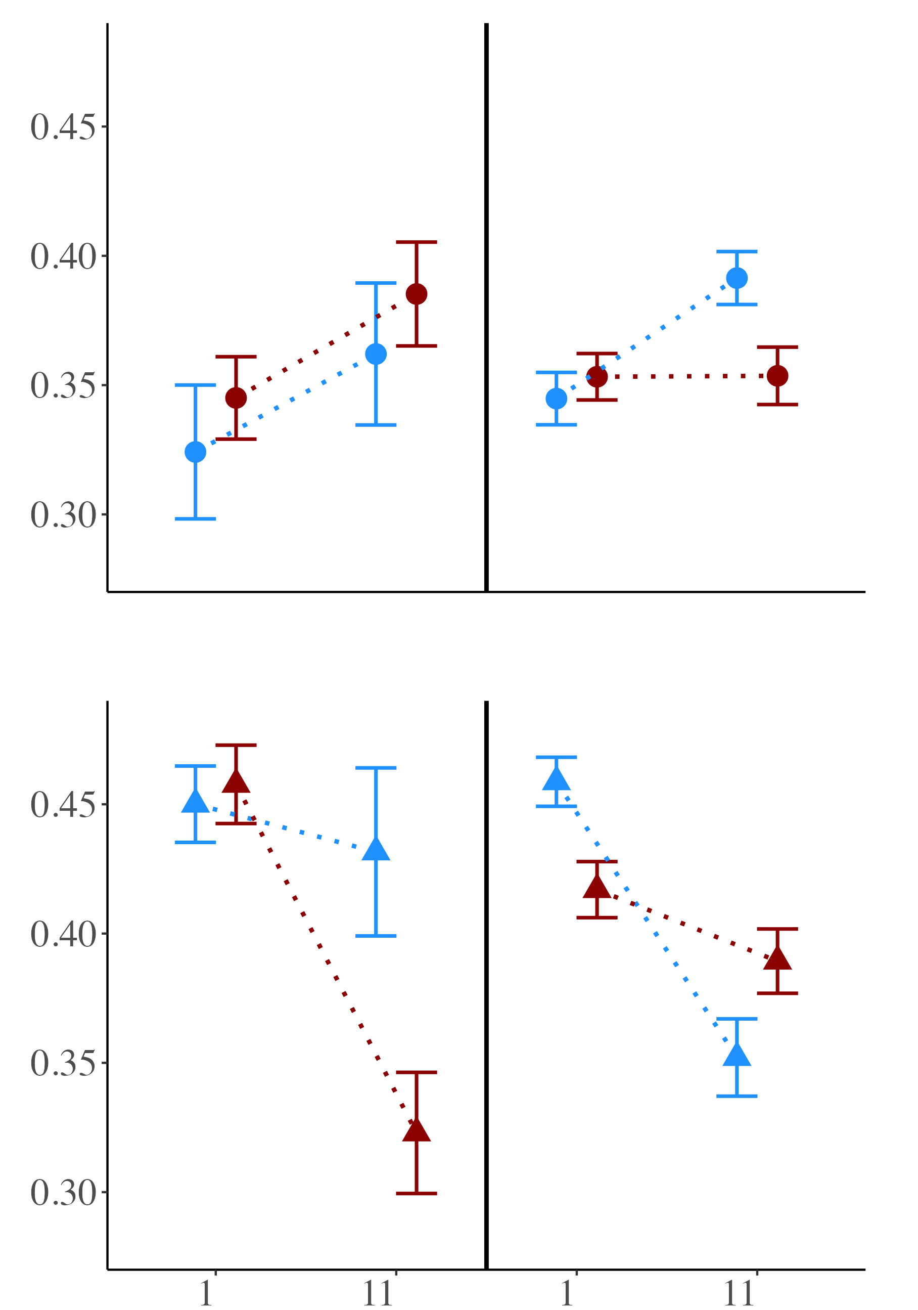
Aposymbiotic corals
B) Symbiotic corals
Photosynthetic efficiency (Fv/Fm)
Background NO₃
Elevated NO₃
Notes:
25

Slide 7
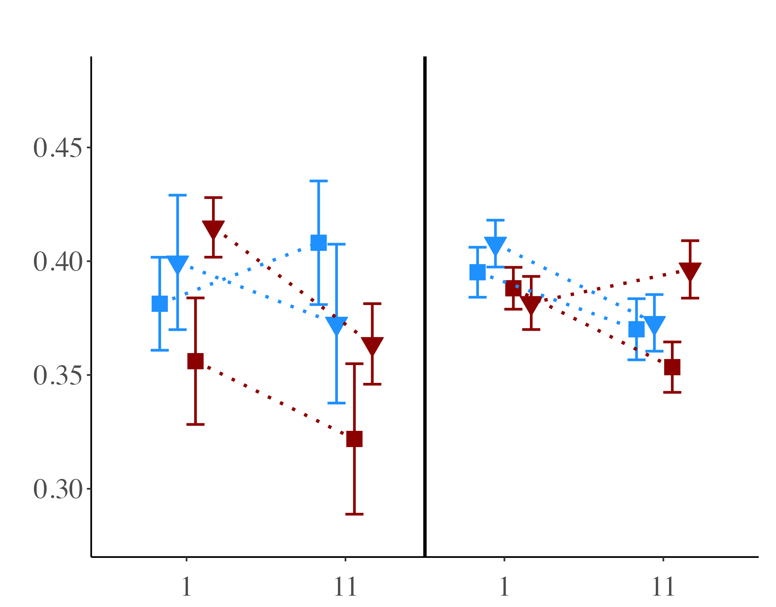
Photosynthetic efficiency (Fv/Fm)
Background NO₃
Elevated NO₃
Notes:
25

Slide 8
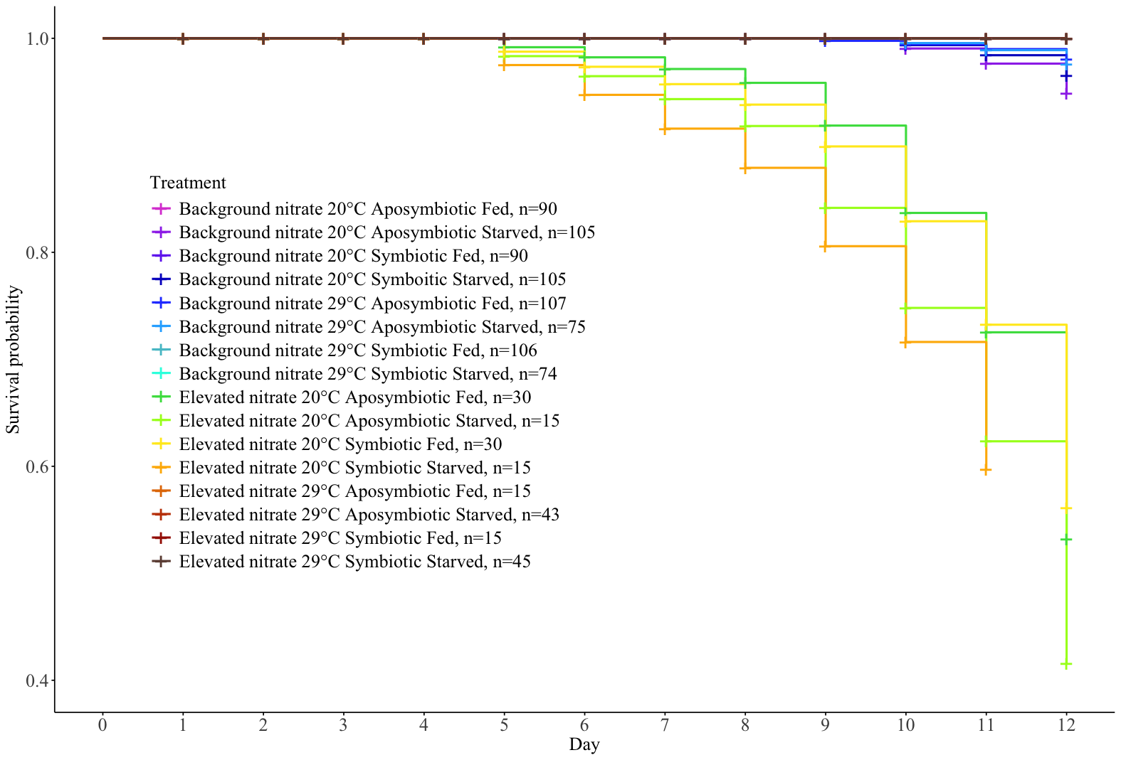

Slide 9
12-day experimental condition
4-hour acute challenge
Key
Single factor response
Dual factor response
Multi-factor response
NO₃
30°C
Starved
Symbiotic
E. coli
↑ Respiration rate
↑ Mortality
No effect
↓ Photo efficiency
No effect
↑ Photo efficiency
↓ Polyp extension
↓ Polyp Extension
↓ Respiration rate
↓ Photosynthetic efficiency

Slide 10
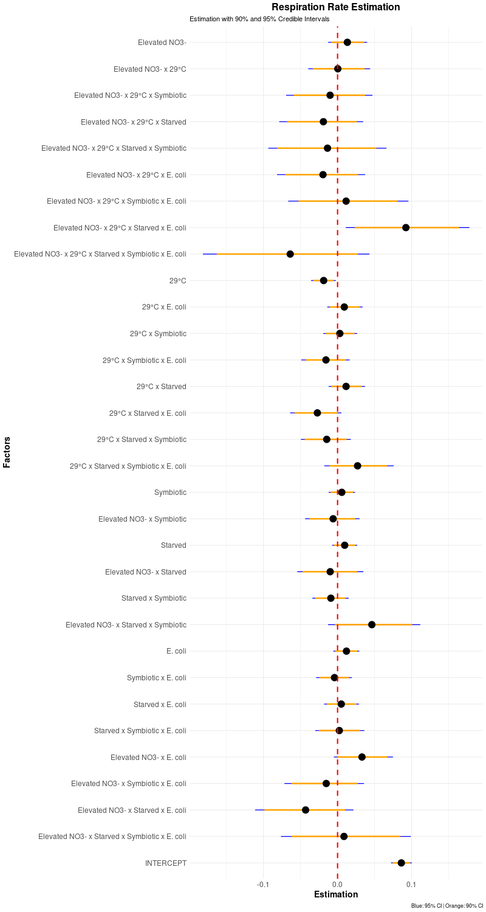
Covariates

Slide 11
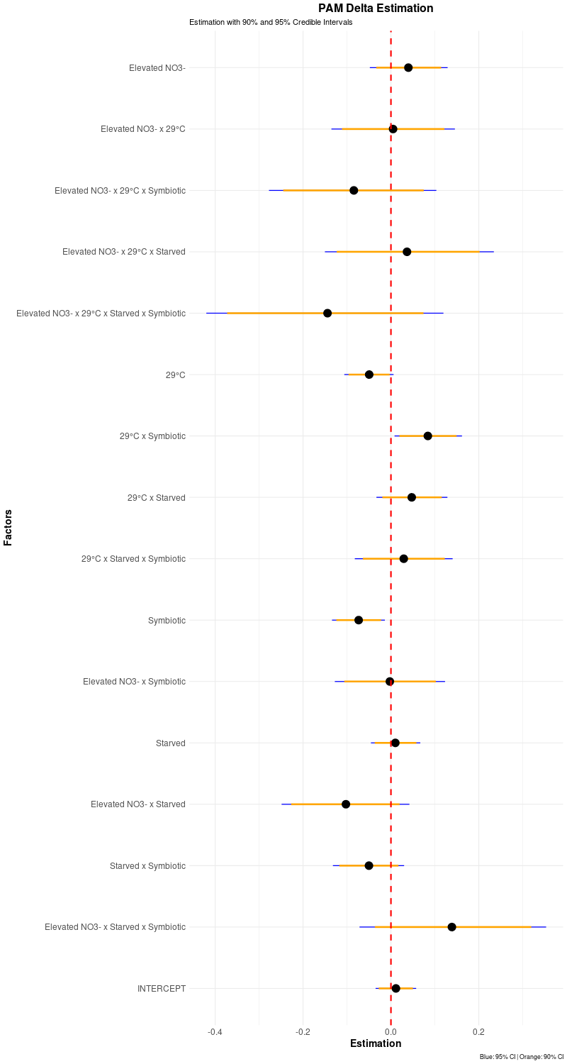
PAM delta
Covariates

Slide 12
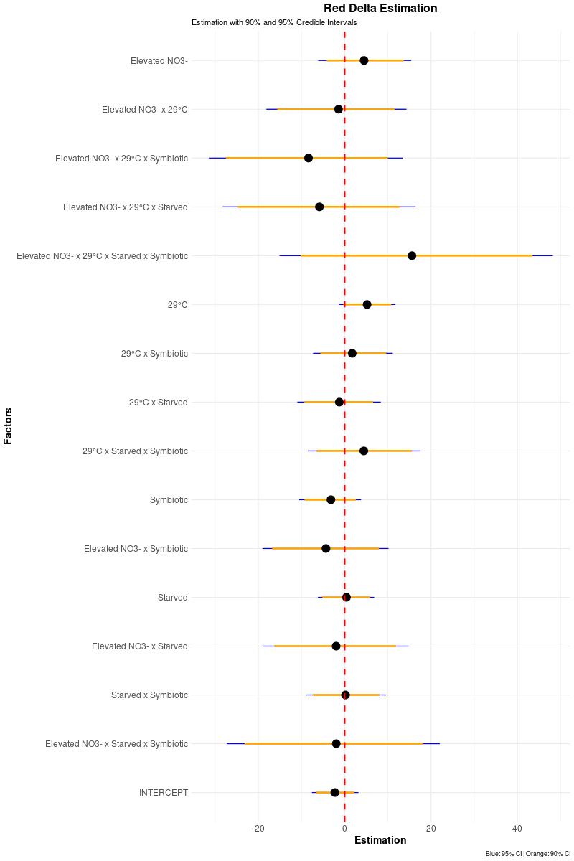
RGB delta
Covariates

Slide 13
Death table
Total mortality 32/960
 | 20°C | 29°C
Elevated | 8 - Fed Apo 5 - Starved Apo 7 - Fed Sym 5 - Starved Sym | 0 - Fed Apo 0 - Starved Apo 0 - Fed Sym 0 - Starved Sym
Low | 0 - Fed Apo 3 - Starved Apo 0 - Fed Sym 2 - Starved Sym | 1 - Fed Apo 1 - Starved Apo 0 - Fed Sym 0 - Starved Sym

Slide 14
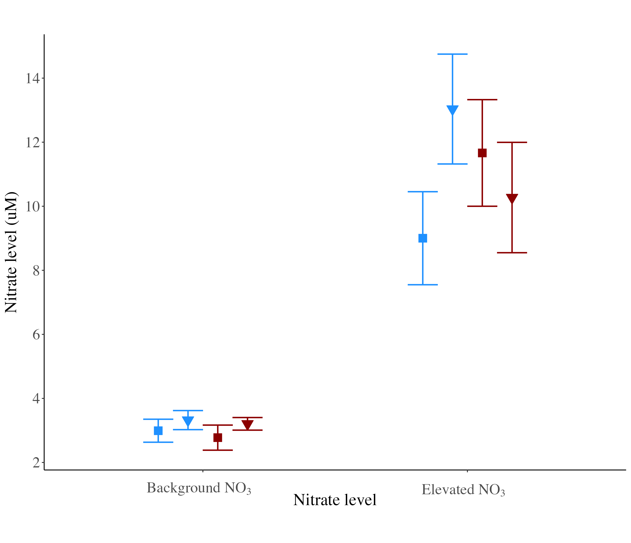

Slide 15
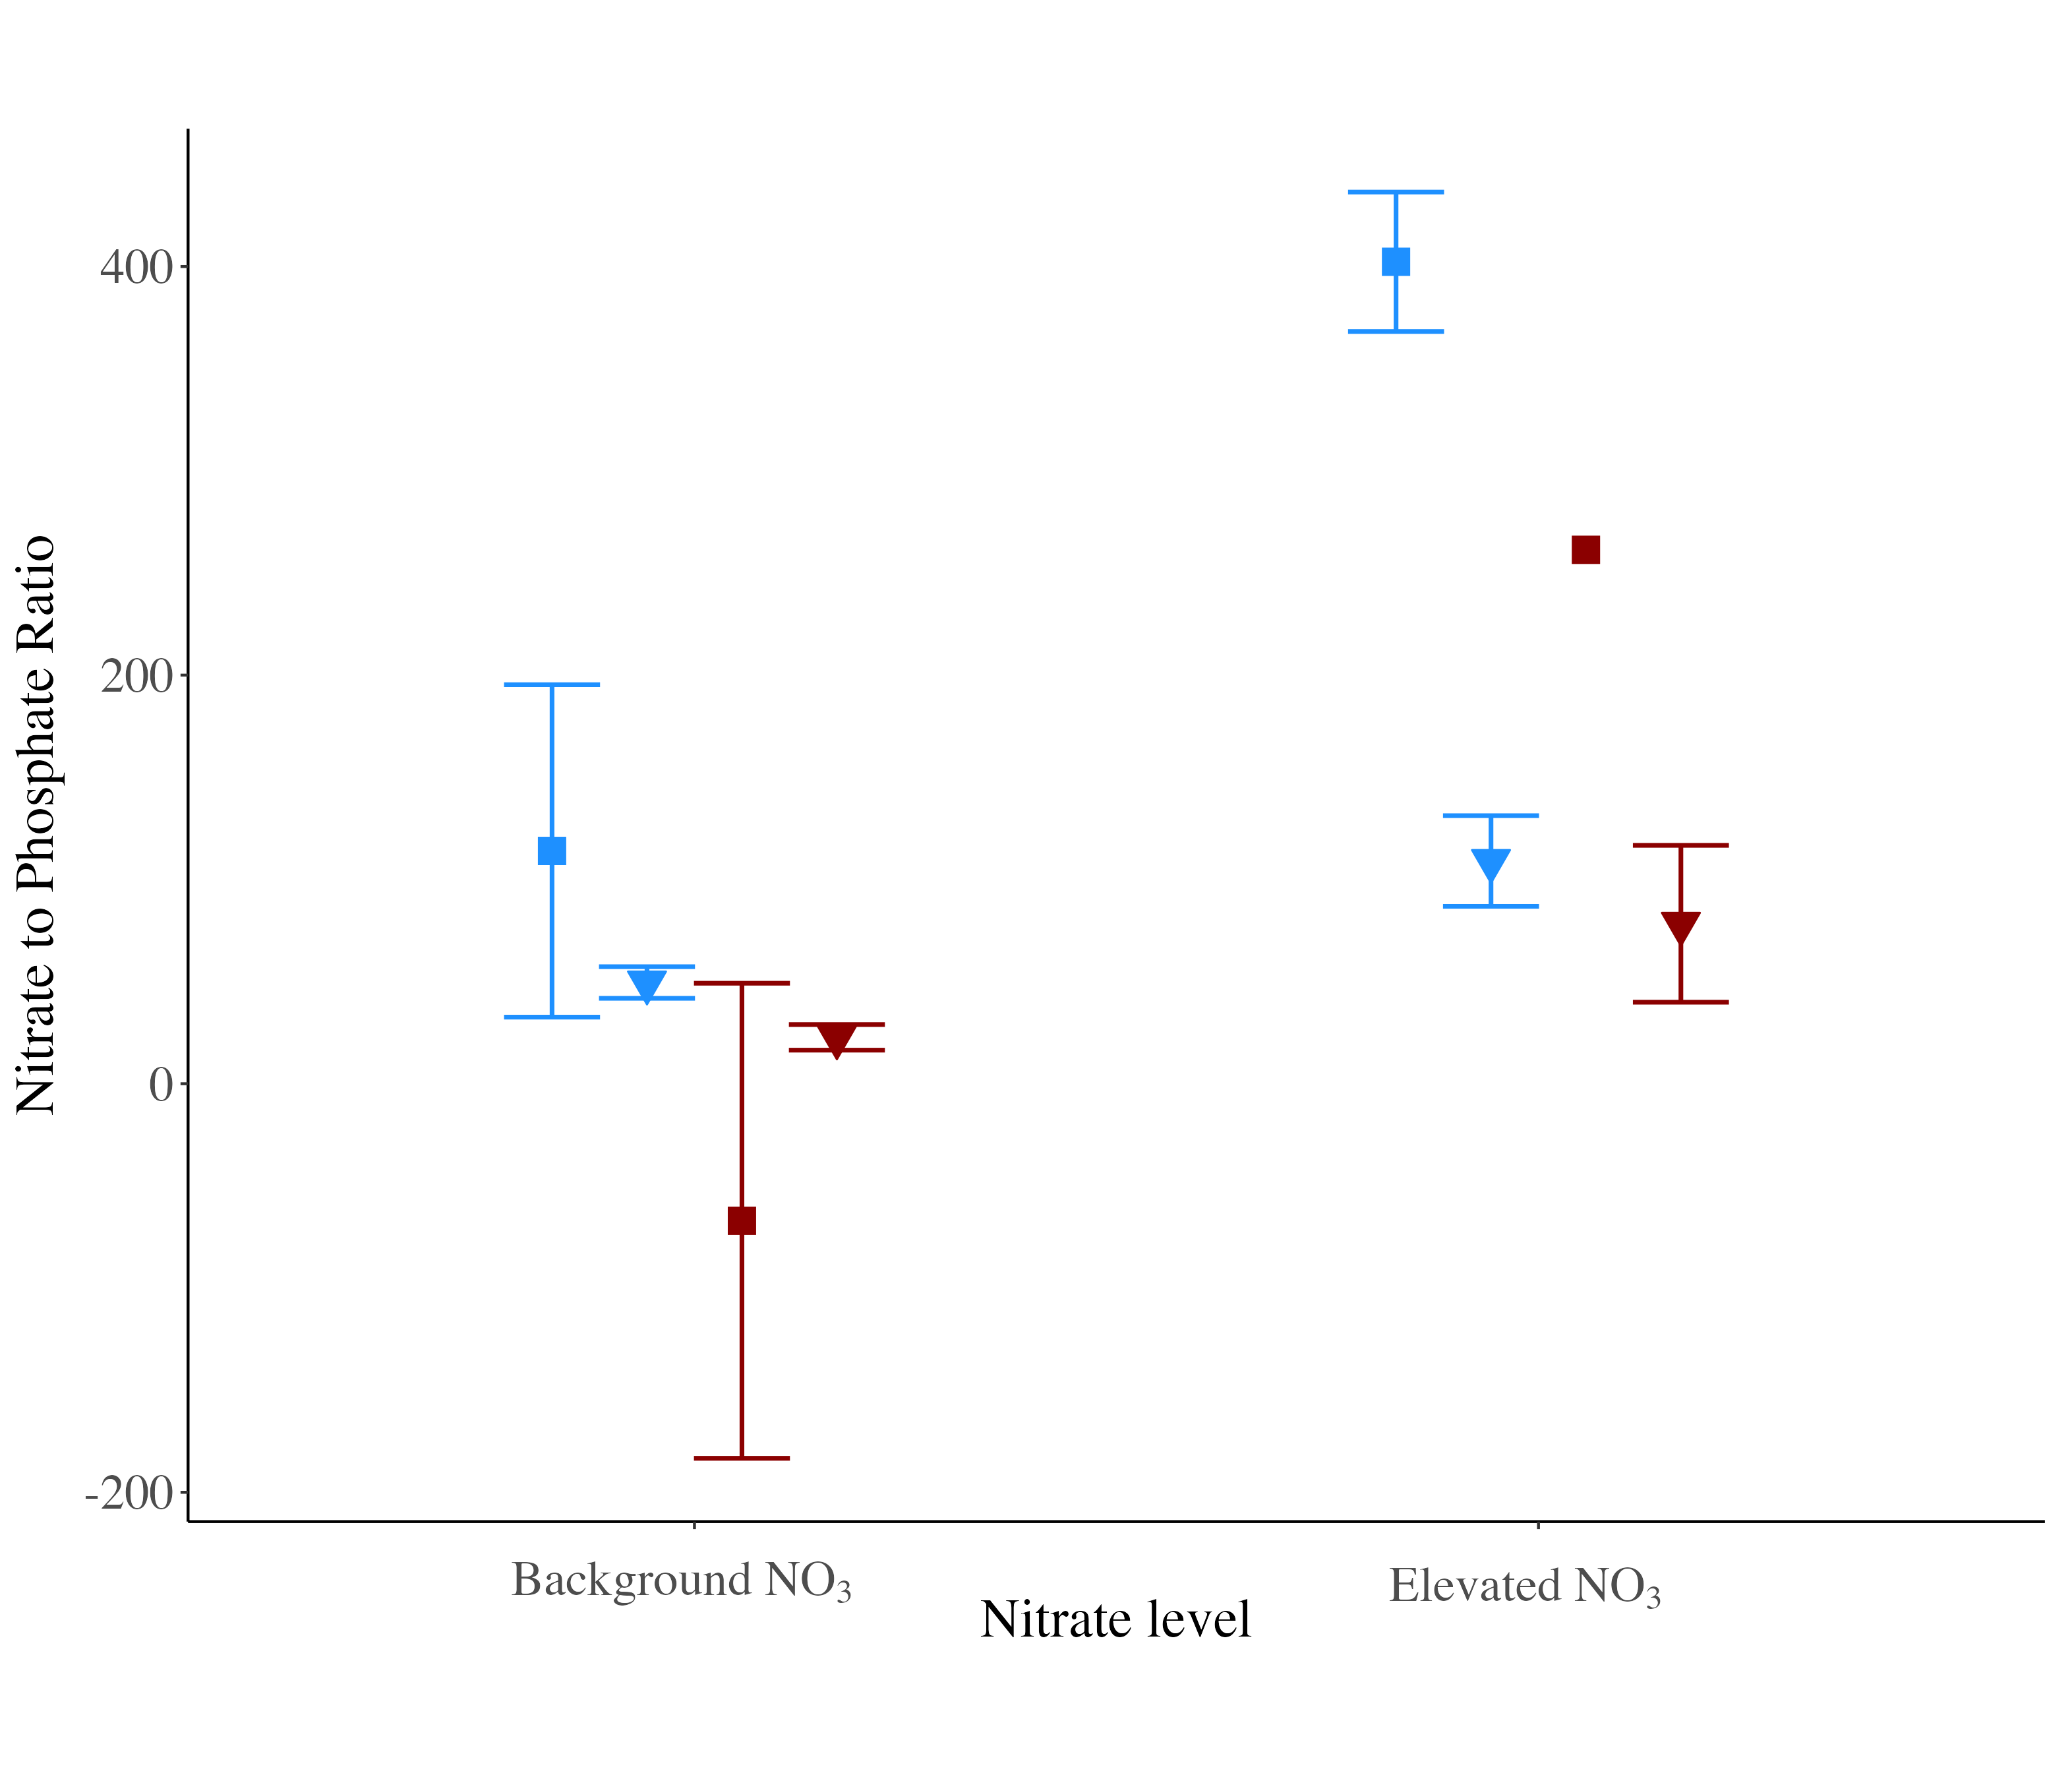

Slide 16
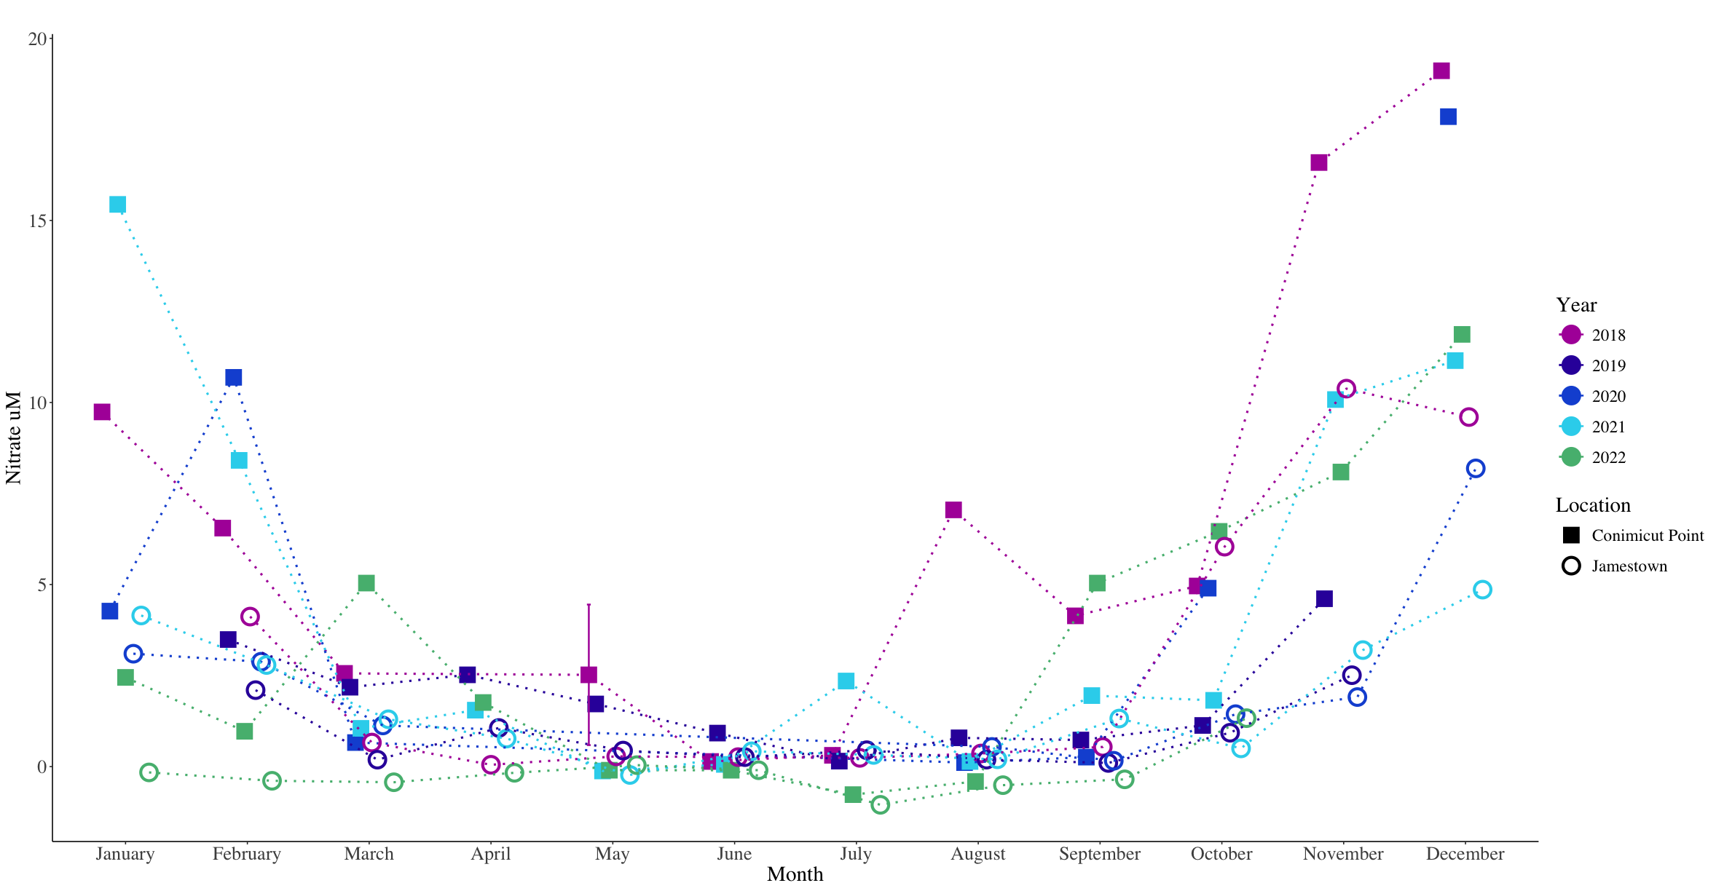

Slide 17
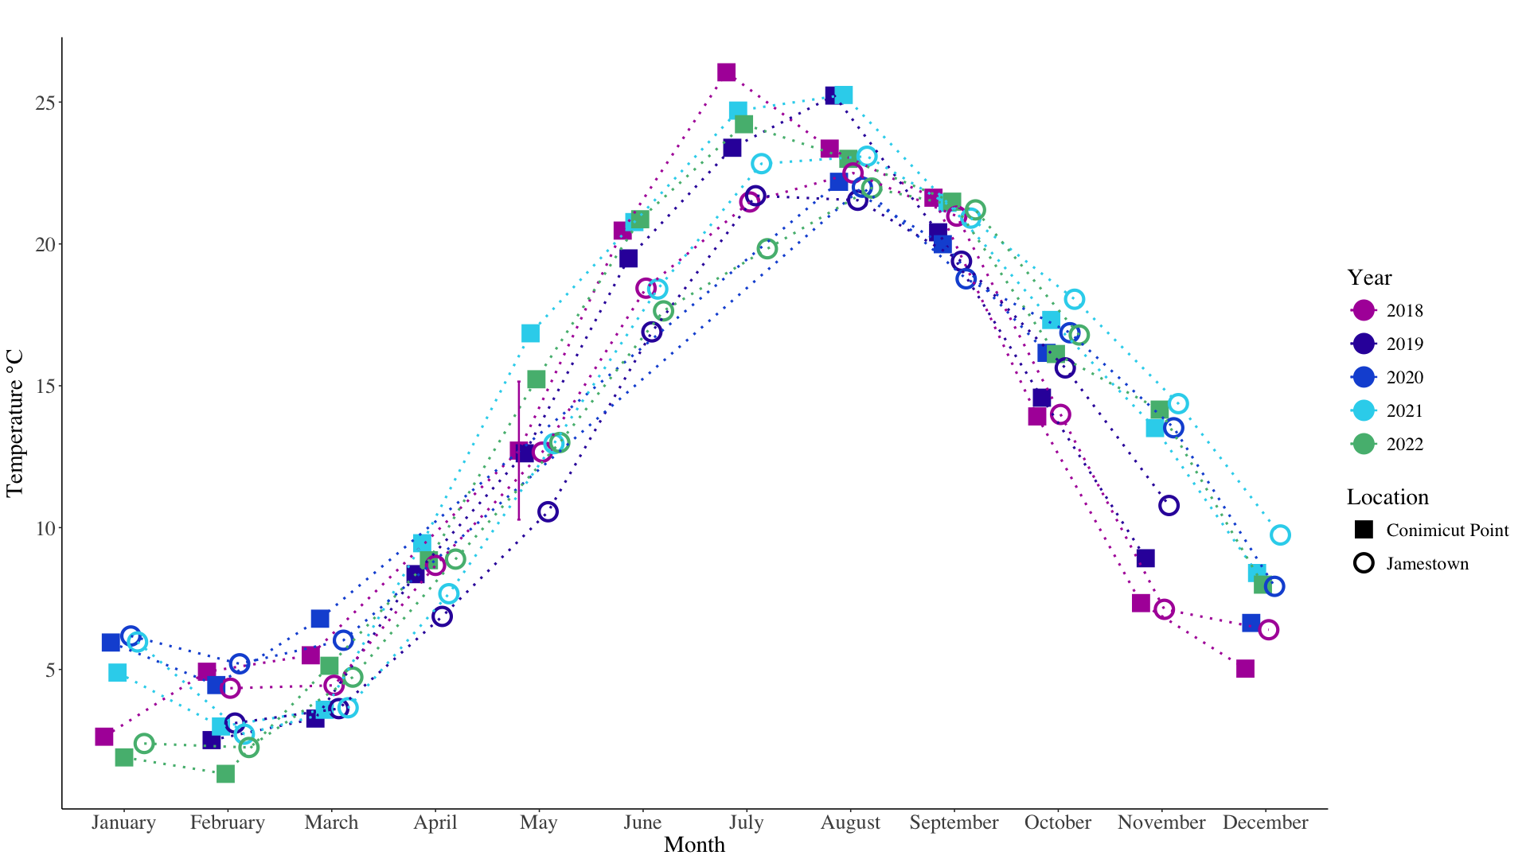

Slide 18
